Slide 1
SAMPLES: Self Adaptive Mining of Persistent LExical Snippets for Classifying Mobile Application Traffic
Gyan Ranjan
Principal Data Scientist,
Symantec Corporation, USA.

Slide 2



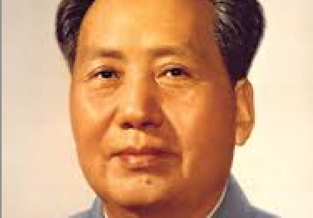
Partenaires dans le Crime
Hongyi Yao
University of Michigan,
Anne Arbor, MI, USA.
hyyao@umich.edu
Alok Tongaonkar
Symantec Corporation,
Mountain View, CA, USA.
alok_tongaonkar@symantec.com
Yong Liao
Symantec Corporation,
Mountain View, CA, USA.
yong_liao@symantec.com
Z. Morley Mao
University of Michigan,
Anne Arbor, MI, USA.
zmao@umich.edu

Slide 3
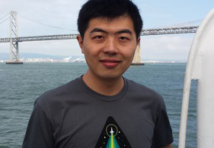
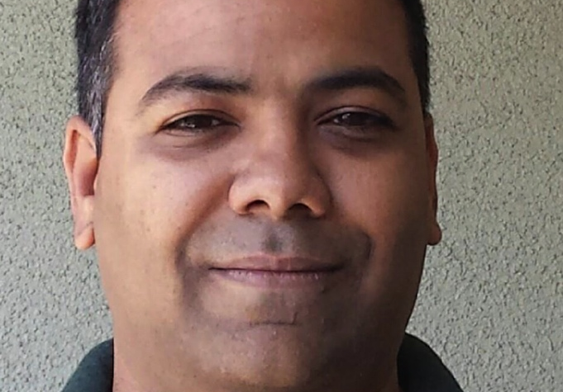

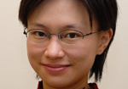
Partenaires dans le Crime
Hongyi Yao
University of Michigan,
Anne Arbor, MI, USA.
hyyao@umich.edu
Alok Tongaonkar
Symantec Corporation,
Mountain View, CA, USA.
alok_tongaonkar@symantec.com
Yong Liao
Symantec Corporation,
Mountain View, CA, USA.
yong_liao@symantec.com
Z. Morley Mao
University of Michigan,
Anne Arbor, MI, USA.
zmao@umich.edu

Slide 4
So, What Exactly are we Peddling here?
Identifying applications responsible for the observed traffic in a network
  At a vantage point IN THE NETWORK
  WITHOUT access to user devices
  Preferably at a PER-FLOW granularity
F₁
Analysis Engine
A(F₁)
F₂
A(F₂)
.
.
.
.
.
.
F_{m}
A(F_{m})

Slide 5
Who Gives a Hoot?
Network operators/managers require clear and detailed visibility into their traffic
  Network measurement tasks
    Usage statistics, application behaviour profiles …
  Network management tasks
    Bandwidth provisioning, application level firewalls, access control …
Also, GOOD PEOPLE in HIGH PLACES that shall remain unnamed
  But you already know that, don’t you!
  They are your friends too.

Slide 6
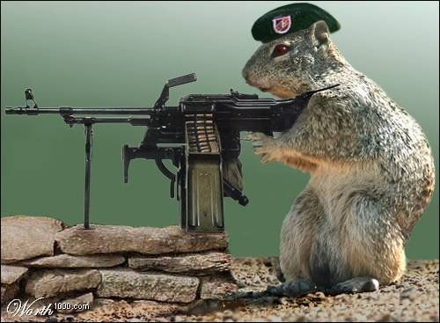
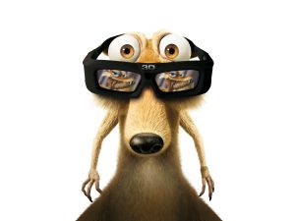
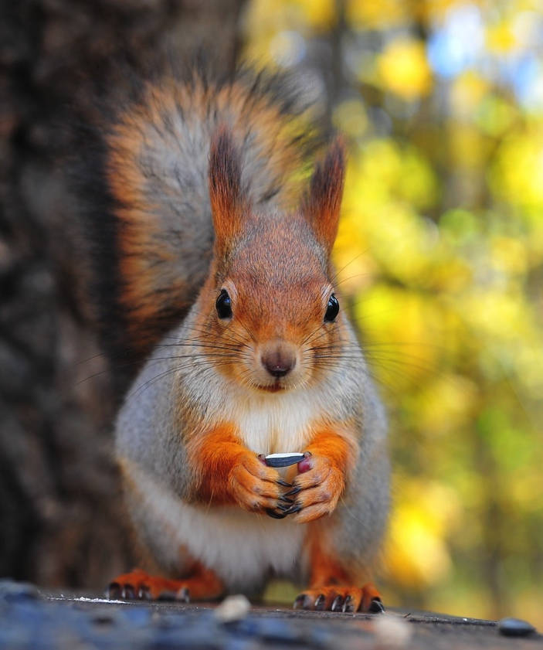
But what’s the Fuss About?
The mobile era
  Multiple platforms
    Android, BlackBerry, iOS, Nokia/Symbian, Windows Mobile.
  Millions of applications, wide ranging functionalities.
Bring-Your-Own-Device (BYOD) to work
  Practically no control over the devices.
And the future is already here
  Wearables are in vogue!

Slide 7
An Interesting Contradiction …
The BAD news is
  HTTP is the preferred protocol for communication
    Protocol/volumetric based solutions are rendered useless.
The GOOD news is
  HTTP is the preferred protocol for communication
    Standard format: Header + Payload.
    Lexical structure: Fields + plain text content.
HST: a.vserv.mobi
SIP: 10.0.2.15
MET: POST
TS: 4061433202
DIP: 54.214.39.142
TPL: ua=Nokia502%2F14.0.1%2Fjava_runtime_version=Nokia_Asha_1_2%20Profile%2FMIDP%2D2.1%20Configuration%2FCLDC%2D1.1&sw=240&sh=302&vr=j0.1.15&app=1&mn=1916%20Dogfight&vs3=1&sg=1&ts=1&ps=1&lc=en&im=18997660069511359566&smsc=123456&pd=30%2F6%2F2014&pt=11%3A44%3A31&av=1.0.0&showat=start&zoneid=18997
…
Notes:
One person’s flow, is another’s

Slide 8
An Interesting Contradiction …
The BAD news is
  HTTP is the preferred protocol for communication
    Protocol/volumetric based solutions are rendered useless.
The GOOD news is
  HTTP is the preferred protocol for communication
    Standard format: Header + Payload.
    Lexical structure: Fields + plain text content.
HST: a.vserv.mobi
SIP: 10.0.2.15
MET: POST
TS: 4061433202
DIP: 54.214.39.142
TPL: ua=Nokia502%2F14.0.1%2Fjava_runtime_version=Nokia_Asha_1_2%20Profile%2FMIDP%2D2.1%20Configuration%2FCLDC%2D1.1&sw=240&sh=302&vr=j0.1.15&app=1&mn=1916%20Dogfight&vs3=1&sg=1&ts=1&ps=1&lc=en&im=18997660069511359566&smsc=123456&pd=30%2F6%2F2014&pt=11%3A44%3A31&av=1.0.0&showat=start&zoneid=18997
…
Where some may see black and white, we see IDENTIFIERS!
Notes:
One person’s flow, is another’s

Slide 9

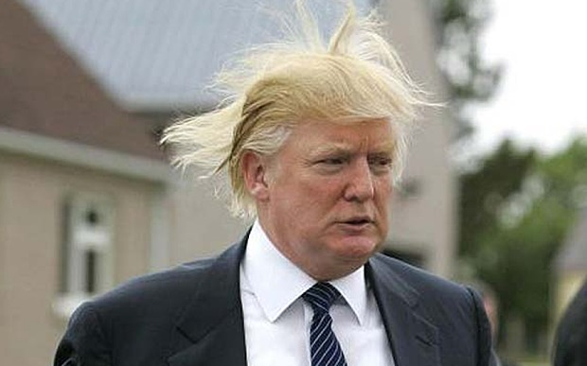
Behold! Angry Birds …
Identifier, what identifier!

Slide 10
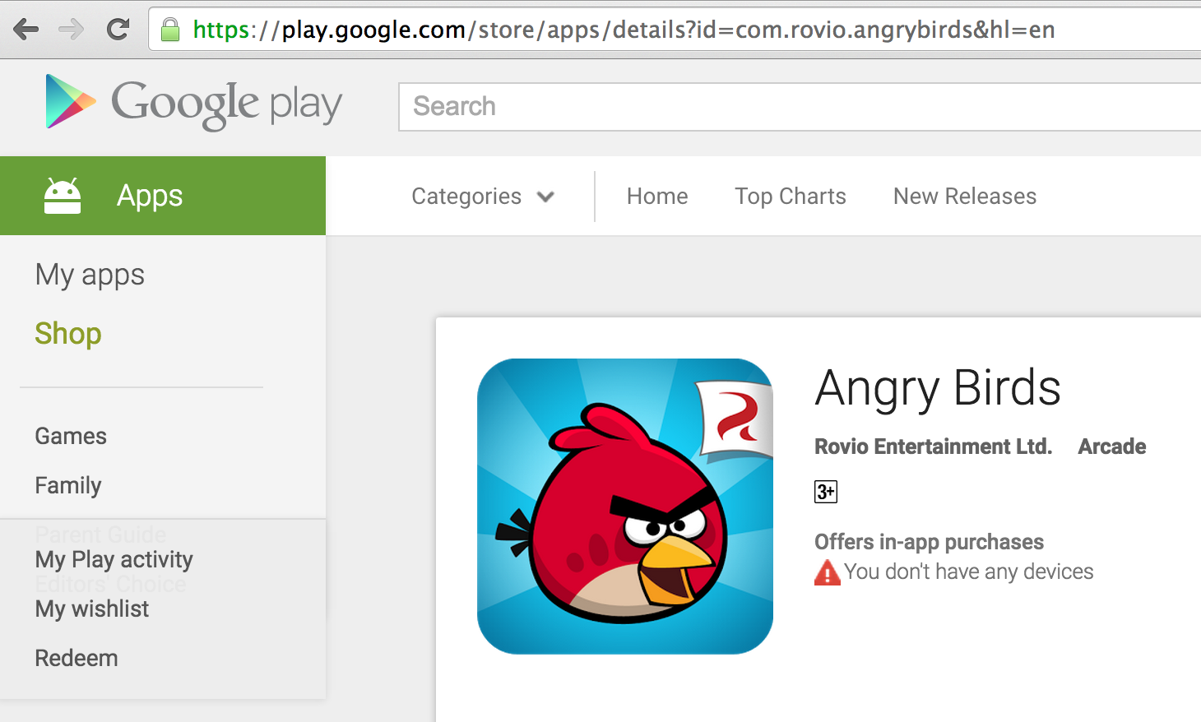
Identifiers? You Ask …
Marketplace Identifiers: AppId
Google Play | com.rovio.angrybirds
Apple iTunes | 409807569
Nokia OVI store | 23158
cfbundleidentifier | cfbundledisplayname | cfbundleexecutable | cfbundlename
com.rovio.angrybirdsfree | Angry Birds | AngryBirdsClassicLight | Angry Birds Free

Slide 11
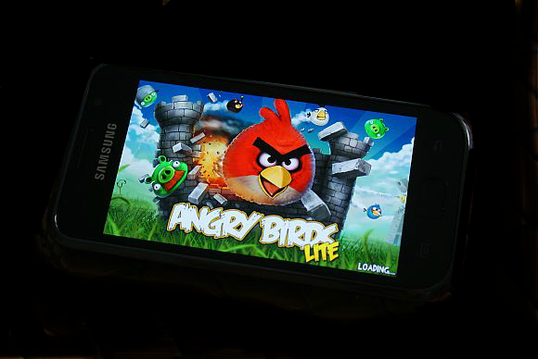
An HTTP GET Request on Android …
HTTP Header
200 OK
…
Client: 192.168.1.10 Scheme:http
GET
User-Agent: Mozilla/4.0 (Linux; U; Android
4.3; …)
Connection: Keep-Alive
.
? … &msid=com.rovio.angrybirds& …
The market place identifier!

Slide 12
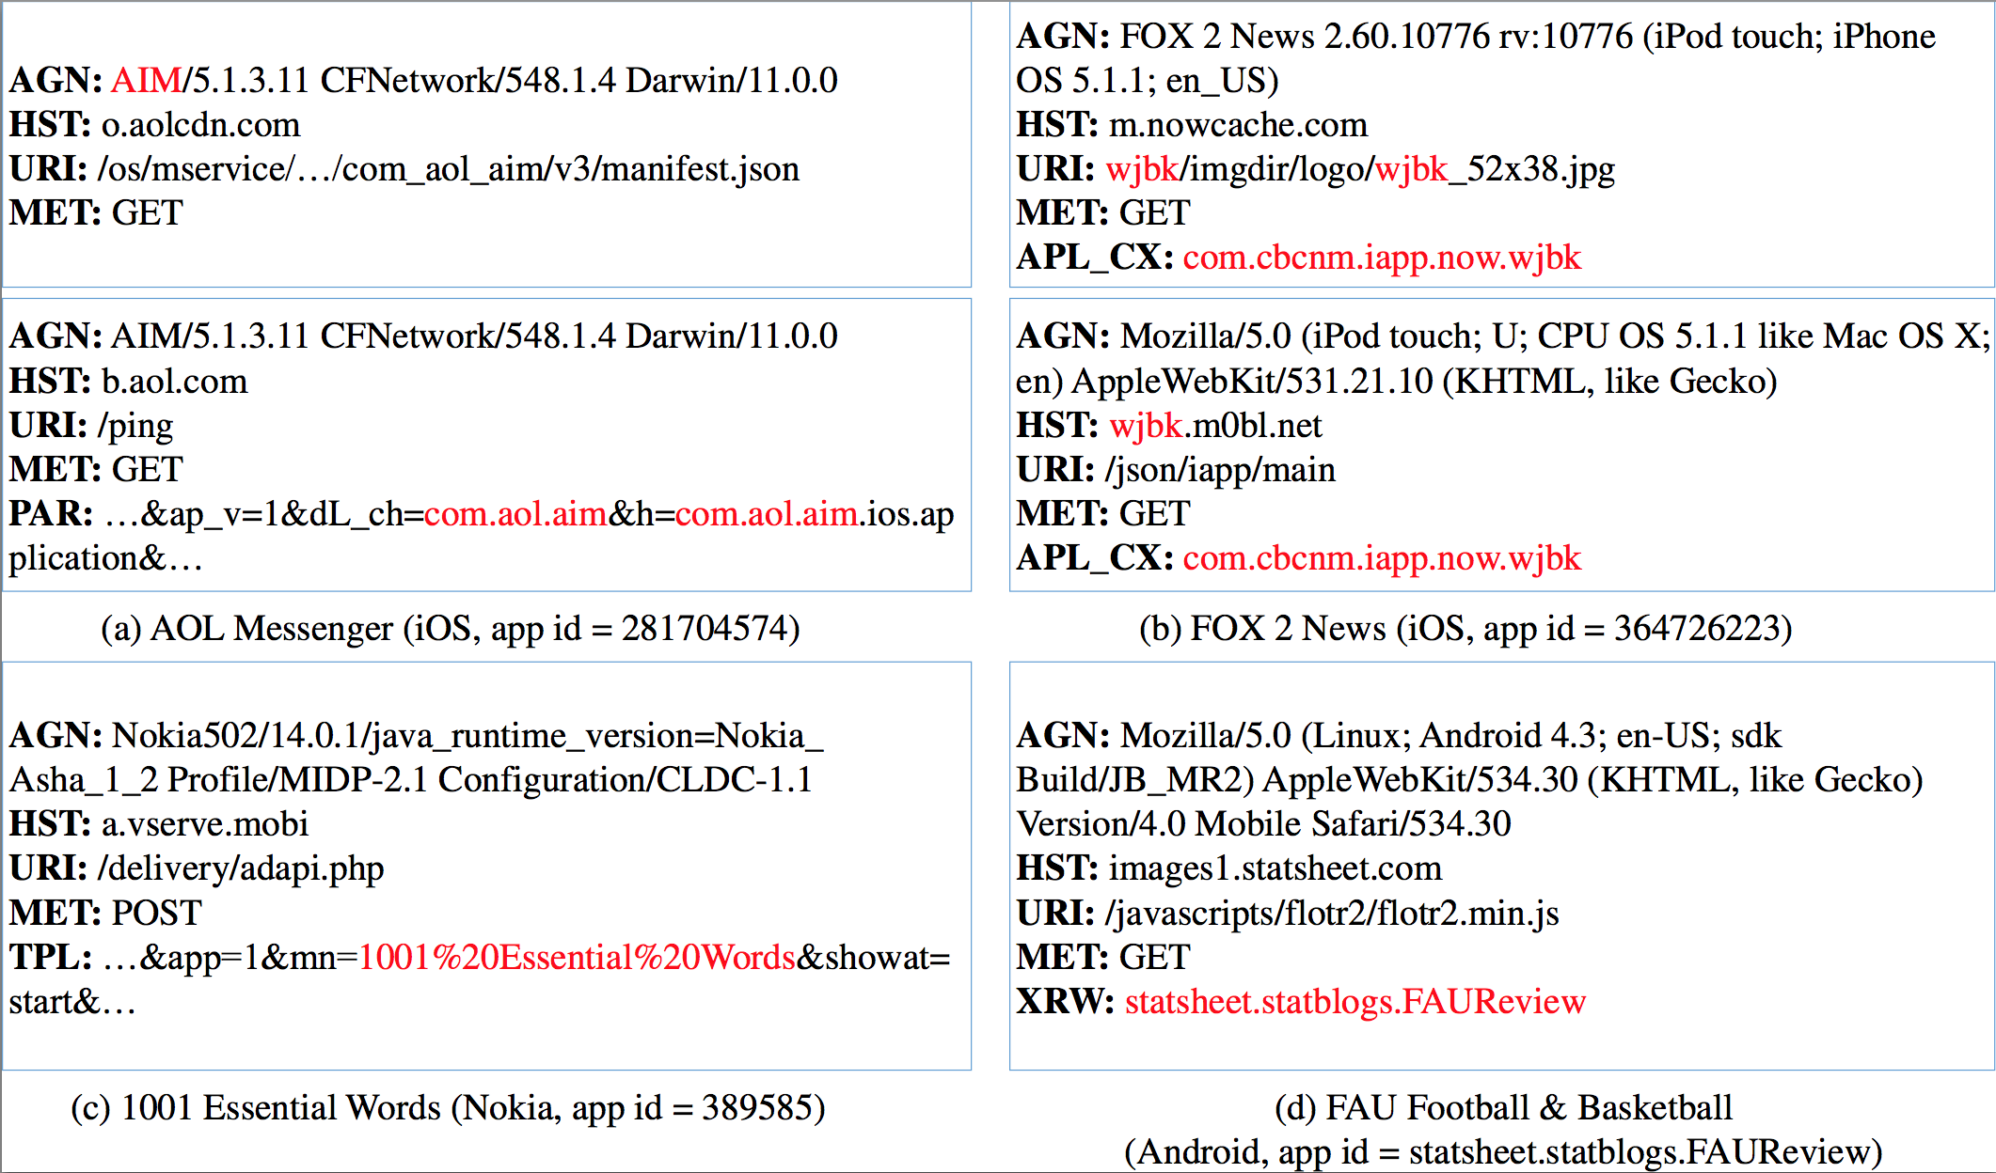
Identifiers and Lexical Snippets
Identifiers in HTTP Headers
Of various types
In different fields
For multiple applications
On all platforms
Lexical Snippet
A sub-string in the HTTP header (or payload)
that contains in it an application identifier.

Slide 13
Putting Things in Context …
TPL
App Name
For each observed lexical snippet, we ask:
  Which identifier type is it?
  Where in the header/payload does it occur?
  What surrounds its occurrence?
HST: a.vserv.mobi
SIP: 10.0.2.15
MET: POST
TS: 4061433202
DIP: 54.214.39.142
TPL: ua=Nokia502%2F14.0.1%2Fjava_runtime_version=Nokia_Asha_1_2%20Profile%2FMIDP%2D2.1%20Configuration%2FCLDC%2D1.1&sw=240&sh=302&vr=j0.1.15&app=1&mn=1916%20Dogfight&vs3=1&sg=1&ts=1&ps=1&lc=en&im=18997660069511359566&smsc=123456&pd=30%2F6%2F2014&pt=11%3A44%3A31&av=1.0.0&showat=start& …
…
Prefix: …&app=1&mn=
Suffix: &vs3=1&sg=1&…

Slide 14
App Identification: The Three Step Process
Extract FROM TPL,
Pattern \b mn=(.*?)& AND
LookUp IN {app name}
IF MET IN {GET, POST, HEAD } AND PLATFORM IN {NOKIA}.
Dictionary: app name
HST: a.vserv.mobi
SIP: 10.0.2.15
MET: POST
TS: 4061433202
DIP: 54.214.39.142
TPL: ua=Nokia502%2F14.0.1%2Fjava_runtime_version=Nokia_Asha_1_2%20Profile%2FMIDP%2D2.1%20Configuration%2FCLDC%2D1.1&sw=240&sh=302&vr=j0.1.15&app=1&mn=1916%20Dogfight&vs3=1&sg=1&ts=1&ps=1&lc=en&im=18997660069511359566&smsc=123456&pd=30%2F6%2F2014&pt=11%3A44%3A31&av=1.0.0&showat=start …
…
Extracted String appId
1916%20Dogfight 361323
1916+Dogfight 361323
…
A(F) = 36123

Slide 15
From Context to Conjunctive Rules
AppId | Identifier Type | Field Name: Snippet
281704574 | cfbundlename/displayname | AGN: AIM/5.1.3.11 CFNetwork/548.1.4 Darwin/11.0.0
281935788 | cfbundlename/executable | AGN: Essentials/1309241730 CFNetwork/609.1.4 …
282935706 | cfbundlename/displayname/executable | AGN: Bible/4.0.1 CFNetwork/548.0.4 Darwin/11.0.0
Lexical Context: |  | AGN: ˆ(.+)/[0-9].+ CFNetwork/[0-9].+ Darwin/[0-9].+
App-Ident-Rule:
Extract FROM AGN, Pattern:^(.+)/[0-9].+ CFNetwork/[0-9].+ Darwin/[0-9].+,
AND Lookup IN {cfbundleexecutable / cfbundlename / cfbundledisplayname}.

Slide 16
From Context to Conjunctive Rules
AppId | Identifier Type | Field Name: Snippet
286851614 | App Id | PAR: ... &msid=286851614& ...
288553125 | App Id | PAR: ... &msid=288553125& ...
291826753 | App Id | PAR: ... &msid=291826753& ...
Lexical Context: |  | PAR: \b msid=(\d{9}) \b
App-Ident-Rule:
Extract FROM PAR, Pattern:\b msid=(\d{9}) \b, AND Lookup IN {appid} IF HST: googleads.*.doubleclick.net.

Slide 17
Let there be SAMPLES …
Self Adaptive Mining of Persistent Lexical Snippets
  Self adaptively trains a rule generator using a small fraction of apps (fewer than 2% per platform).
  Small system memory footprint (fewer than 100 rules in all).
  High coverage and accuracy (13 M flows from 700 K mobile apps, lower than 1% false +ve rate).
  Achieves high goodput which bodes well for a real world deployment.
And the key to it all is to Identify the Identifiers!

Slide 18
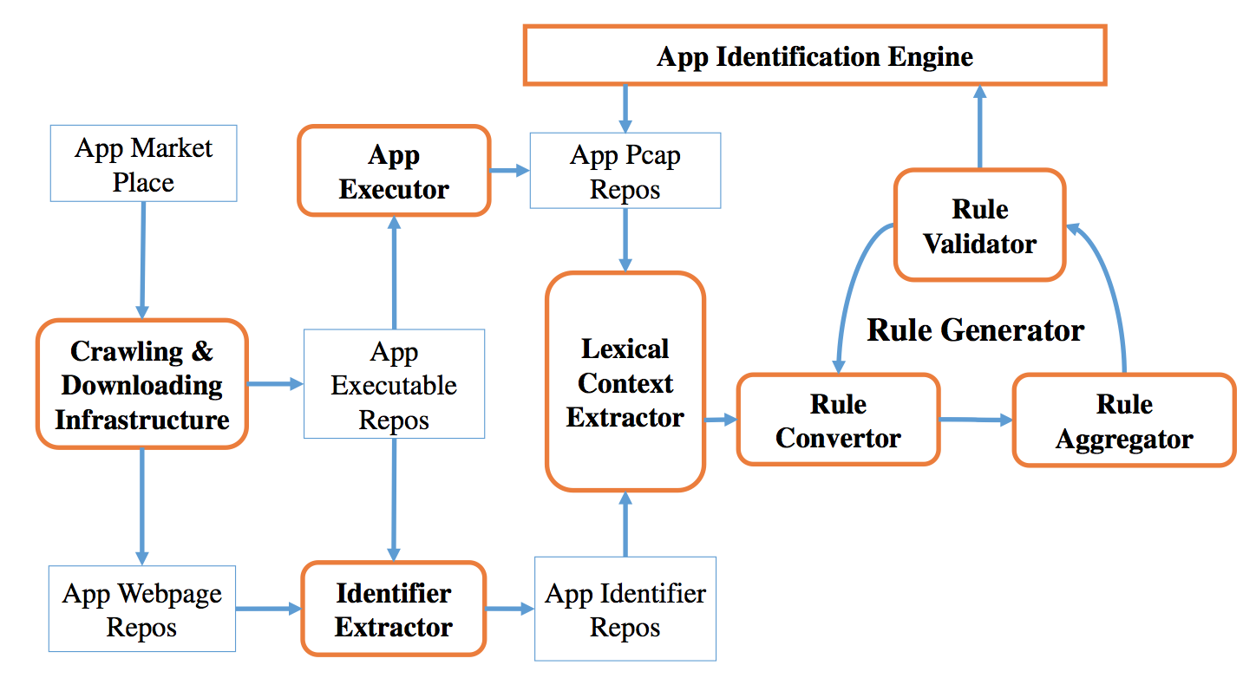
The SAMPLES WAR-MACHINE

Slide 19
The SAMPLES WAR-MACHINE
For a given app marketplace:
Crawl and download applications
Application webpage
Application executable (Free apps)
Operational result:
Application repository: web-pages and
app-executables.

Slide 20
The SAMPLES WAR-MACHINE
For an app in the repository:
Extract identifiers from
Application webpage
Application executable (Free apps)
Operational result:
Set of application identifiers grouped by type.

Slide 21
The SAMPLES WAR-MACHINE
For an app in the repository:
Execute the application in an emulator to
Produce HTTP flows for the app
Store flows in labeled pcap files.
Operational result:
Labeled application flow headers.
Ground truth!

Slide 22
The SAMPLES WAR-MACHINE
For a pcap in the training set:
Identify lexical snippets in flows by
Looking for occurrence of identifiers
Extracting the general lexical context
Operational result:
Labeled lexical context training set.

Slide 23
The SAMPLES WAR-MACHINE
For each lexical context:
Create conjunctive rules through
Aggregating general contexts
Validating over test data
Operational result:
Conjunctive Rules.

Slide 24

Wait, Something’s not right here!

Slide 25
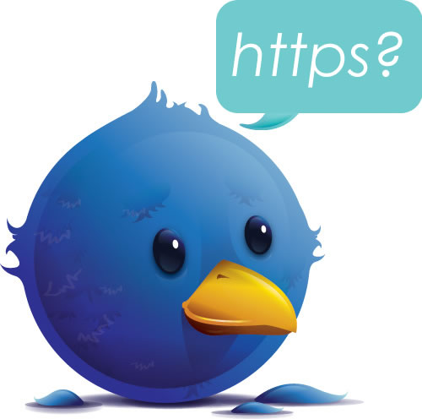
Not again …

Slide 26


I Know What You are Thinking, Governor …
Ya betcha!
TRAMPLES

Slide 27

Behold! A Woman-In-The-Middle …
Disclaimer:
Humour is injurious to prejudice. Some
Animals, somewhere, were harmed during
the preparation of these slides, but NOT by
the author.
Trademarks and images are property of the
original owners (presumably Vanity Fair).
They appear here only for instructional
purposes.

Slide 28
Behold! A Woman-In-The-Middle …
Useful References:
[21] MAPPER: a Mobile Application
Personal Policy Enforcement Router for
Enterprise Networks, ACM MobiArch, 2014.
[22] Per-User Policy Enforcement on Mobile
Apps through Network Functions
Virtualization, EWSDN, 2014.

Slide 29
HTTPS with Woman-In-The-Middle
200 OK
Content-Type: application/json;charset=utf-8
Content-Length: 139
X-Max-Sequence: 1
{ "@pendingMsg" : 0, "@syncStatus": 0, "responses" : [ { "disconnect" : { "sequence" : 1, "receiver" : “a*******”, "reason" : 4 } }
] }
Client: 192.168.1.10 Scheme: https
GET 216.115.100.103:443/pe/4d8c5d92/92bcb62d/3661ec2a/15957/config/prod/config.xml
Cache-Control: no-cache, no-transform
Accept-Encoding: gzip
Accept: */*
User-Agent: YahooMobileMessenger/1.0 (Android Messenger; 1.8.4) (grouper; asus; Nexus 7; 4.2.2/JDQ39B)
Host: s.yimg.com
Connection: Keep-Alive
Client: 192.168.1.11 Scheme: https
POST 31.13.75.1:443/login.php?login_attempt=1
Host: www.facebook.com
User-Agent: Mozilla/5.0 (X11; Ubuntu; Linux x86_64; rv:26.0) Gecko/20100101 Firefox/26.0
Accept: text/html,application/xhtml+xml,application/xml;q=0.9,*/*;q=0.8
Accept-Language: en-US,en;q=0.5
Accept-Encoding: gzip, deflate
Referer: https://www.facebook.com/
Cookie: datr=bJLQUo4rXIgvkkOEKRA6ikD7; reg_fb_gate=https%3A%2F%2Fwww.facebook.com%2F; reg_fb_ref=https%3A%2F%2Fwww.facebook.com%2F; wd=1440x692; act=1389400695566%2F0; …
Connection: keep-alive
Content-Type: application/x-www-form-urlencoded
Content-Length: 144
lsd=AVqqYCGq&email=a*******@mail.com&pass=testPass%402013&….

Slide 30
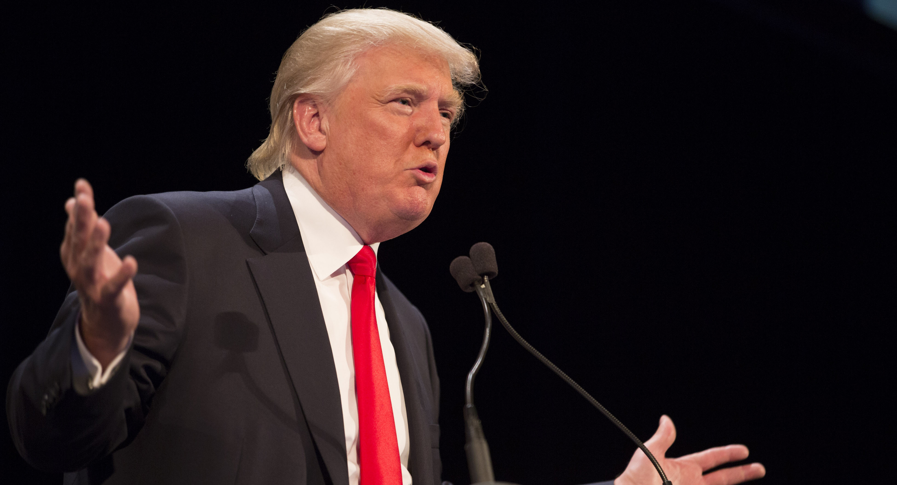
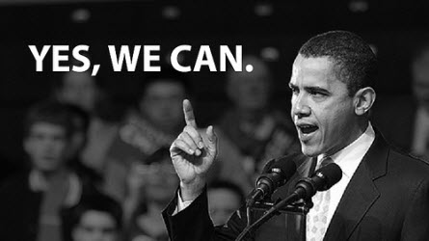
So …
Oh yeah! Where’s YOUR certificate?
200 OK
Content-Type: application/json;charset=utf-8
Content-Length: 139
X-Max-Sequence: 1
{ "@pendingMsg" : 0, "@syncStatus": 0, "responses" : [ { "disconnect" : { "sequence" : 1, "receiver" : “a*******”, "reason" : 4 } }
] }
Client: 192.168.1.10 Scheme: https
GET 216.115.100.103:443/pe/4d8c5d92/92bcb62d/3661ec2a/15957/config/prod/config.xml
Cache-Control: no-cache, no-transform
Accept-Encoding: gzip
Accept: */*
User-Agent: YahooMobileMessenger/1.0 (Android Messenger; 1.8.4) (grouper; asus; Nexus 7; 4.2.2/JDQ39B)
Host: s.yimg.com
Connection: Keep-Alive
Client: 192.168.1.11 Scheme: https
POST 31.13.75.1:443/login.php?login_attempt=1
Host: www.facebook.com
User-Agent: Mozilla/5.0 (X11; Ubuntu; Linux x86_64; rv:26.0) Gecko/20100101 Firefox/26.0
Accept: text/html,application/xhtml+xml,application/xml;q=0.9,*/*;q=0.8
Accept-Language: en-US,en;q=0.5
Accept-Encoding: gzip, deflate
Referer: https://www.facebook.com/
Cookie: datr=bJLQUo4rXIgvkkOEKRA6ikD7; reg_fb_gate=https%3A%2F%2Fwww.facebook.com%2F; reg_fb_ref=https%3A%2F%2Fwww.facebook.com%2F; wd=1440x692; act=1389400695566%2F0; …
Connection: keep-alive
Content-Type: application/x-www-form-urlencoded
Content-Length: 144
lsd=AVqqYCGq&email=a*******@mail.com&pass=testPass%402013&….

Slide 31
Summary of Results
Platform | # Applications | # Flows | # Training Applications | # Rules Produced | Application Coverage*
Android | 651, 000 | 13,000,000 | 22,000 | 51 | 96%
iOS | 68,000 | 478,000 | 32,000 | 64 | 92%
Nokia/Symbian | 10,000 | 39,000 | 5,000 | 12 | 99%
* Of the 76.8%, 67.4% and 63.2% (respectively) of applications that generate flow headers with at least one identifier in them.
Notes:
Google Play store, iTunes store, and Nokia OVI store and collected 651K Android apps, 68K iOS apps, and 10K Nokia apps, respectively. By executing each downloaded app in software emulators, we captured 13, 003K Android flows, 478K iOS flows and 39K Nokia flows. We use flows from 22K Android apps, 32K iOS apps, and 5K Nokia apps as the training set and the rest as the testing set.
Over 99% of the flows’ originating apps can be correctly identified. Furthermore, the rule set also covers most of identifiable apps in the network. We can identify 74%, 62% and 63% apps on Android, iOS and Nokia test set, respectively. As a comparison, there are only 76.8%, 67.4% and 63.2% apps among those three datasets that is identifiable, respectively. In other words, SAMPLES can identify over 90% of identifiable apps among three platforms.

Slide 32
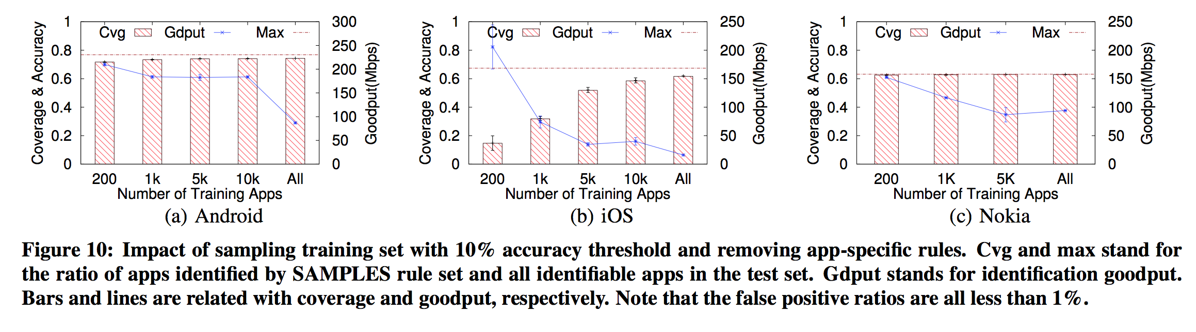
Robustness to Sampling Bias
Notes:
Google Play store, iTunes store, and Nokia OVI store and collected 651K Android apps, 68K iOS apps, and 10K Nokia apps, respectively. By executing each downloaded app in software emulators, we captured 13, 003K Android flows, 478K iOS flows and 39K Nokia flows. We use flows from 22K Android apps, 32K iOS apps, and 5K Nokia apps as the training set and the rest as the testing set.
Over 99% of the flows’ originating apps can be correctly identified. Furthermore, the rule set also covers most of identifiable apps in the network. We can identify 74%, 62% and 63% apps on Android, iOS and Nokia test set, respectively. As a comparison, there are only 76.8%, 67.4% and 63.2% apps among those three datasets that is identifiable, respectively. In an- other word, SAMPLES can identify over 90% of identifiable apps among three platforms.

Slide 33
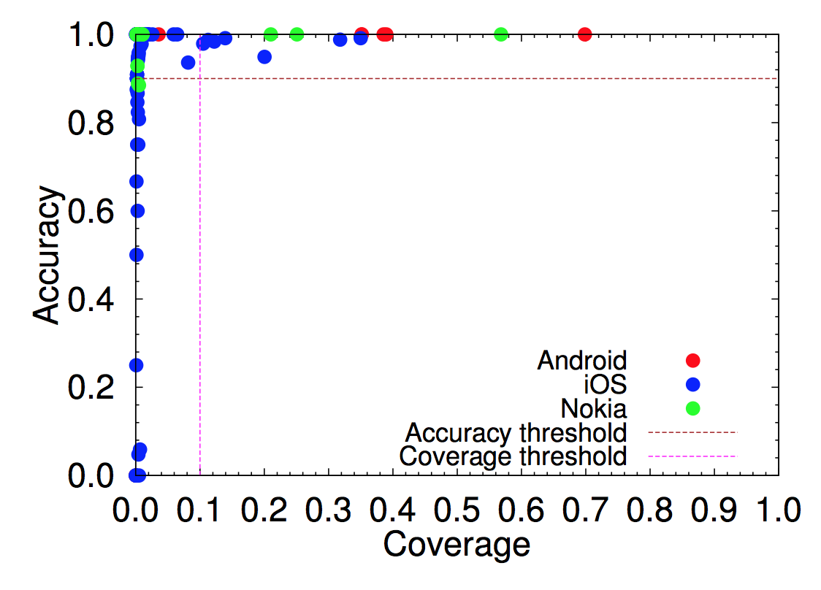
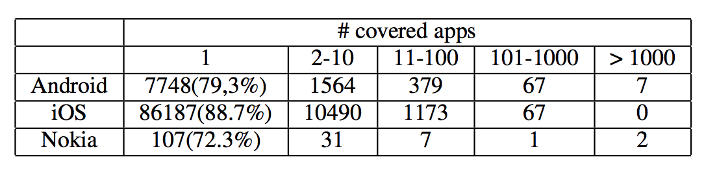
The Leader Effect
A small subset of rules account for a large fraction of applications with high accuracy for all platforms.

Slide 34
But Wait, hasn’t All this been done Before?
Identifying diverse usage behaviors of smartphone apps [IMC 2011].
  Identification based on User-Agent fields.
Understanding mobile app usage patterns using in-app advertisements [PAM 2013].
  Identification based on key-value pairs assigned by advertisement networks.
Networkprofiler: Towards automatic fingerprinting of android apps [Infocom, 2013].
  Identification based on exhaustive state-machine creation for each application.
Automatic generation of mobile app signatures from traffic observations [Infocom,2015].
  Identification based on signatures extracted from flow-groups.
Ad hoc, require manual inspection & expertise, or computationally too complex to be of practical use.
Most importantly, take an application centric view for training.

Slide 35
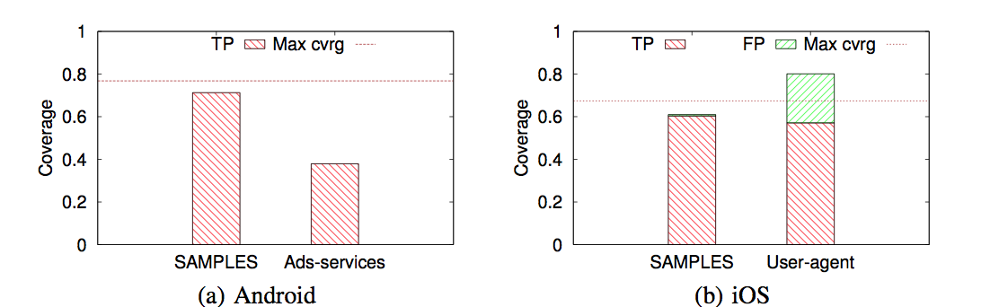
Comparatively Speaking …
Are you impressed? Or, is it really that surprising?

Slide 36
And Yes, we have our Limitations …
Non-HTTP traffic
  Of and beyond HTTPS-in-the-Wild type.
Requires constant background effort
  Updating identifier repositories.
Adversarial behaviour
  An application deliberately uses an identifier of another.
Measuring coverage and accuracy in live deployments
  No ground truth.

Slide 37
Conclusions
Please draw your own!
  After all it’s a free world.
We believe that SAMPLES can (and does) enable …
  Identification of mobile applications in network traffic at a per flow granularity.
  With high coverage and accuracy across multiple platforms.
  While maintaining a relatively small memory footprint.
We would like to hear from you. Test it out, write to us if you find things amiss and we will …

Slide 39
Gyan Ranjan
Gyan_Ranjan@Symantec.com

Slide 40
Backup Slides

Slide 41
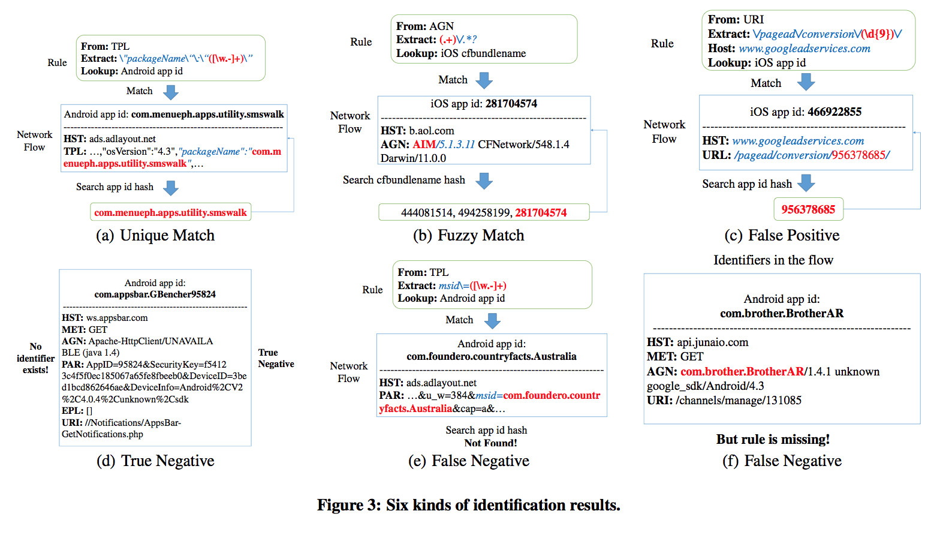
Possible Result Space …
Notes:
Google Play store, iTunes store, and Nokia OVI store and collected 651K Android apps, 68K iOS apps, and 10K Nokia apps, respectively. By executing each downloaded app in software emulators, we captured 13, 003K Android flows, 478K iOS flows and 39K Nokia flows. We use flows from 22K Android apps, 32K iOS apps, and 5K Nokia apps as the training set and the rest as the testing set.
Over 99% of the flows’ originating apps can be correctly identified. Furthermore, the rule set also covers most of identifiable apps in the network. We can identify 74%, 62% and 63% apps on Android, iOS and Nokia test set, respectively. As a comparison, there are only 76.8%, 67.4% and 63.2% apps among those three datasets that is identifiable, respectively. In an- other word, SAMPLES can identify over 90% of identifiable apps among three platforms.

Slide 42
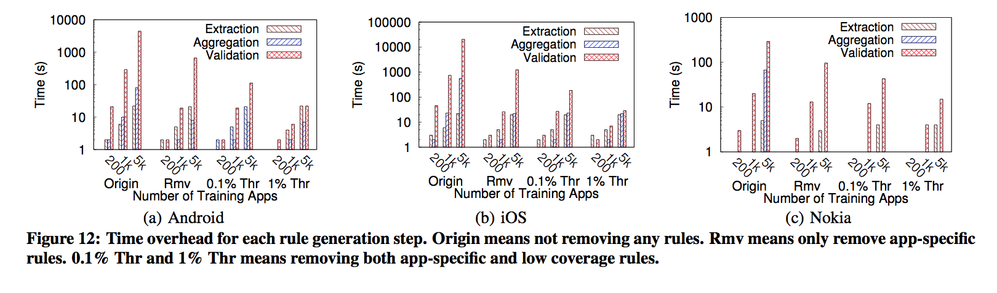
Robustness to Sampling Bias
Notes:
Google Play store, iTunes store, and Nokia OVI store and collected 651K Android apps, 68K iOS apps, and 10K Nokia apps, respectively. By executing each downloaded app in software emulators, we captured 13, 003K Android flows, 478K iOS flows and 39K Nokia flows. We use flows from 22K Android apps, 32K iOS apps, and 5K Nokia apps as the training set and the rest as the testing set.
Over 99% of the flows’ originating apps can be correctly identified. Furthermore, the rule set also covers most of identifiable apps in the network. We can identify 74%, 62% and 63% apps on Android, iOS and Nokia test set, respectively. As a comparison, there are only 76.8%, 67.4% and 63.2% apps among those three datasets that is identifiable, respectively. In an- other word, SAMPLES can identify over 90% of identifiable apps among three platforms.

