Slide 1

Global Monitoring of Inland Surface Water Dynamics using Remote Sensing Data
Anuj Karpatne
University of Minnesota
  Research funded by:
  National Science Foundation Awards 1029711 and 0905581
  NASA Award NNX12AP37G

Slide 2
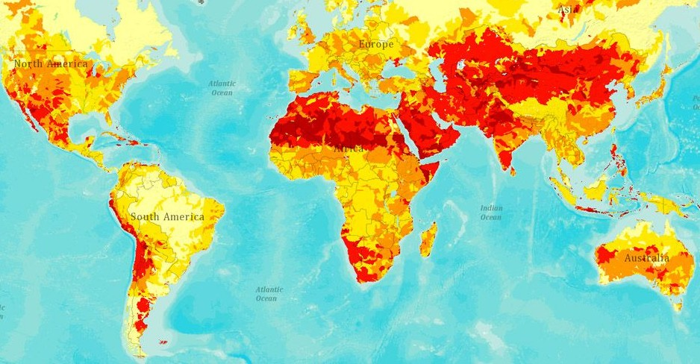
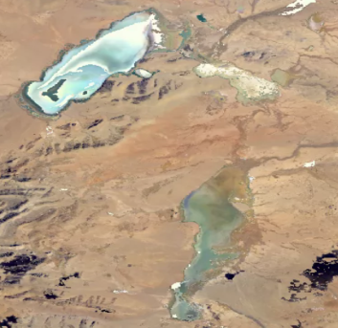
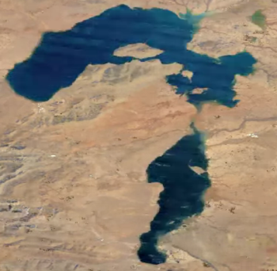
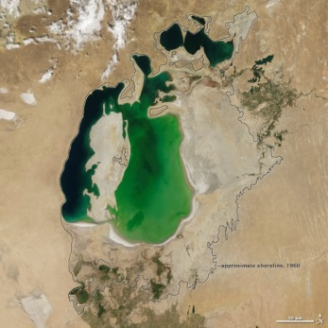
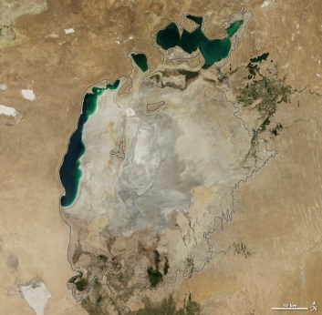
Importance of Monitoring Water Dynamics
Cedo Caka Lake
in Tibet, 2011
Cedo Caka Lake
in Tibet, 1984
Global projections of water risks (red)
Understanding interplay with
climate change
Managing water resources
Remote Sensing Data
Multi-spectral data
  MODIS (at 500m, from 2000)
  Landsat (at 30m, from 1970s)
Can be used to classify every location at a given time as water or land (binary classes)
Ground truth on specific dates available from various sources: SRTM, GLWD
Aral Sea in 2000
Aral Sea in 2014
Aral Sea in 2000
Aral Sea in 2014
Assessing the impact of human actions

Slide 3

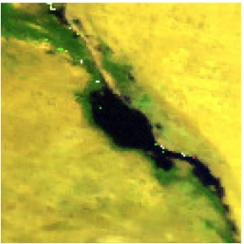
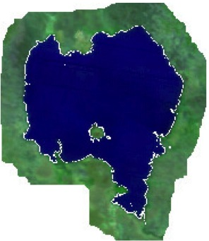
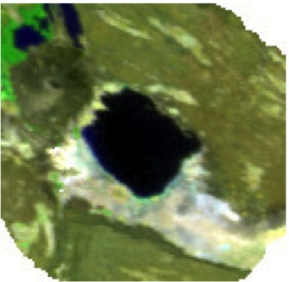
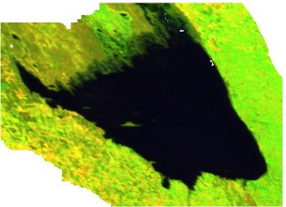
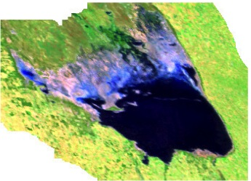
Challenges for Supervised Learning Methods
Challenge 1: Heterogeneity in space and time
  Water and land bodies look different in different regions of the world
  Same water body can look different at different time-instances
Challenge 2: Data Quality
  Noise: clouds, shadows, atmospheric disturbances
  Missing data
Great Bitter Lake, Egypt
Lake Tana, Ethiopia
Lake Abbe, Africa
Poyang Lake, China
Mar Chiquita Lake, Argentina in 2000 (left) and 2012 (right)
(Pink color shows missing data)

Slide 4
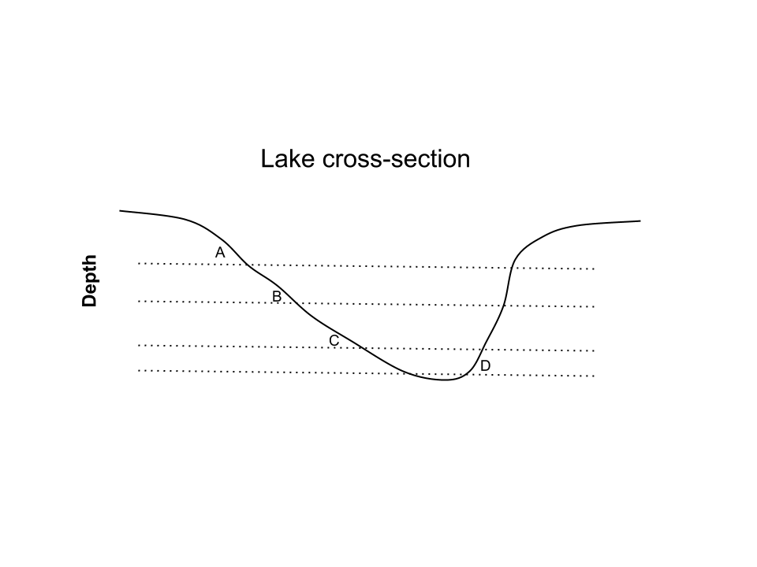
Method Innovations for Monitoring Water
Ensemble Learning Methods for Handling Heterogeneity in Data ^{1,2}
Using Physics Guided Labeling to Handle Poor Data Quality^{3,4}
Learn an ensemble of classifiers to distinguish b/w different pairs of positive and negative modes
Use elevation information to constrain physically-consistent labels
Positive Modes
(Water)
Negative Modes
(Land)
P₁
N₁
P₂
N₂
P₃
N₃
Elevation A > B > C > D
¹ Karpatne et al. SDM 2015
² Karpatne et al. ICDM 2015
³ Khandelwal et al. ICDM 2015
⁴ Mithal et al. (PhD Dissertation)

Slide 5
A Global Water Monitoring System http://z.umn.edu/monitoringwater
Summary of Capabilities:
  Maps the dynamics of all major water bodies (surface area > 2.5 km²) in the last 15 years across the world
    Identifies on-going droughts in Brazil and California
  Finds changes in river morphology (river meandering, delta erosion)
  Detects the construction of new dams and reservoirs

Slide 6
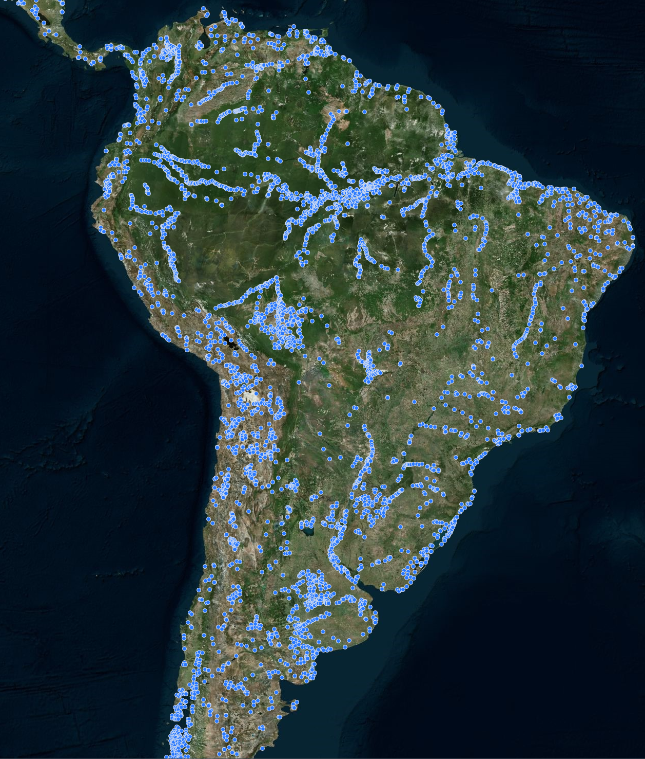
Global Maps of Water Bodies
Every blue dot is a water body, present in the last 15 years,
with size greater than 2.5 km²

Slide 7
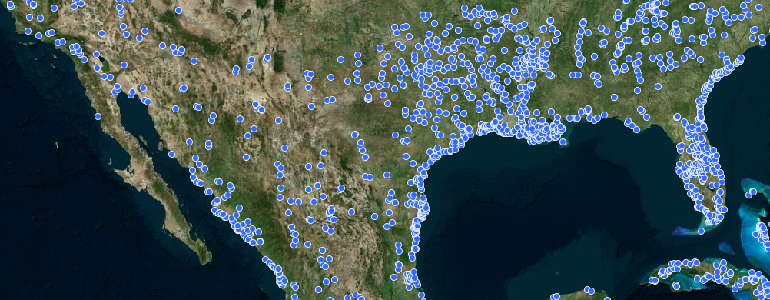
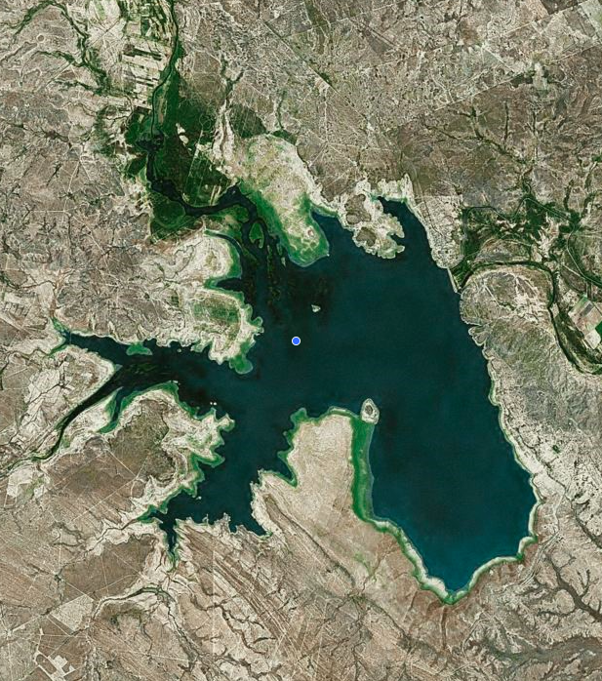
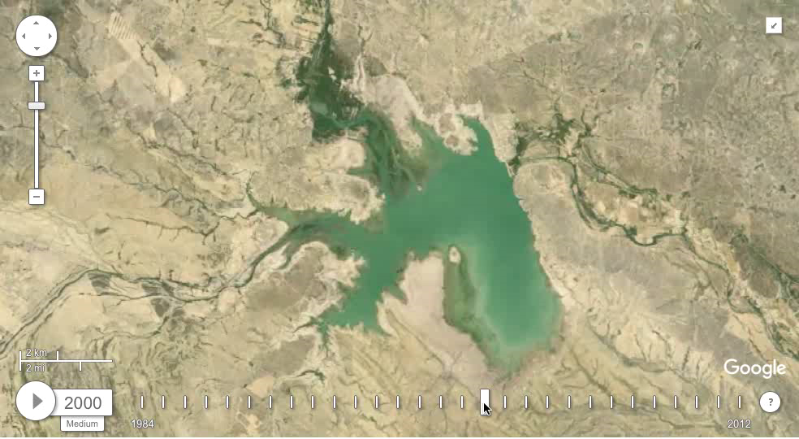
Showing Surface Water Dynamics
Annual Landsat Time-lapse of this region
(Courtesy: Google Earth Engine)
Don Martin Dam, Mexico
Surface area of water around Don Martin Dam across time

Slide 8
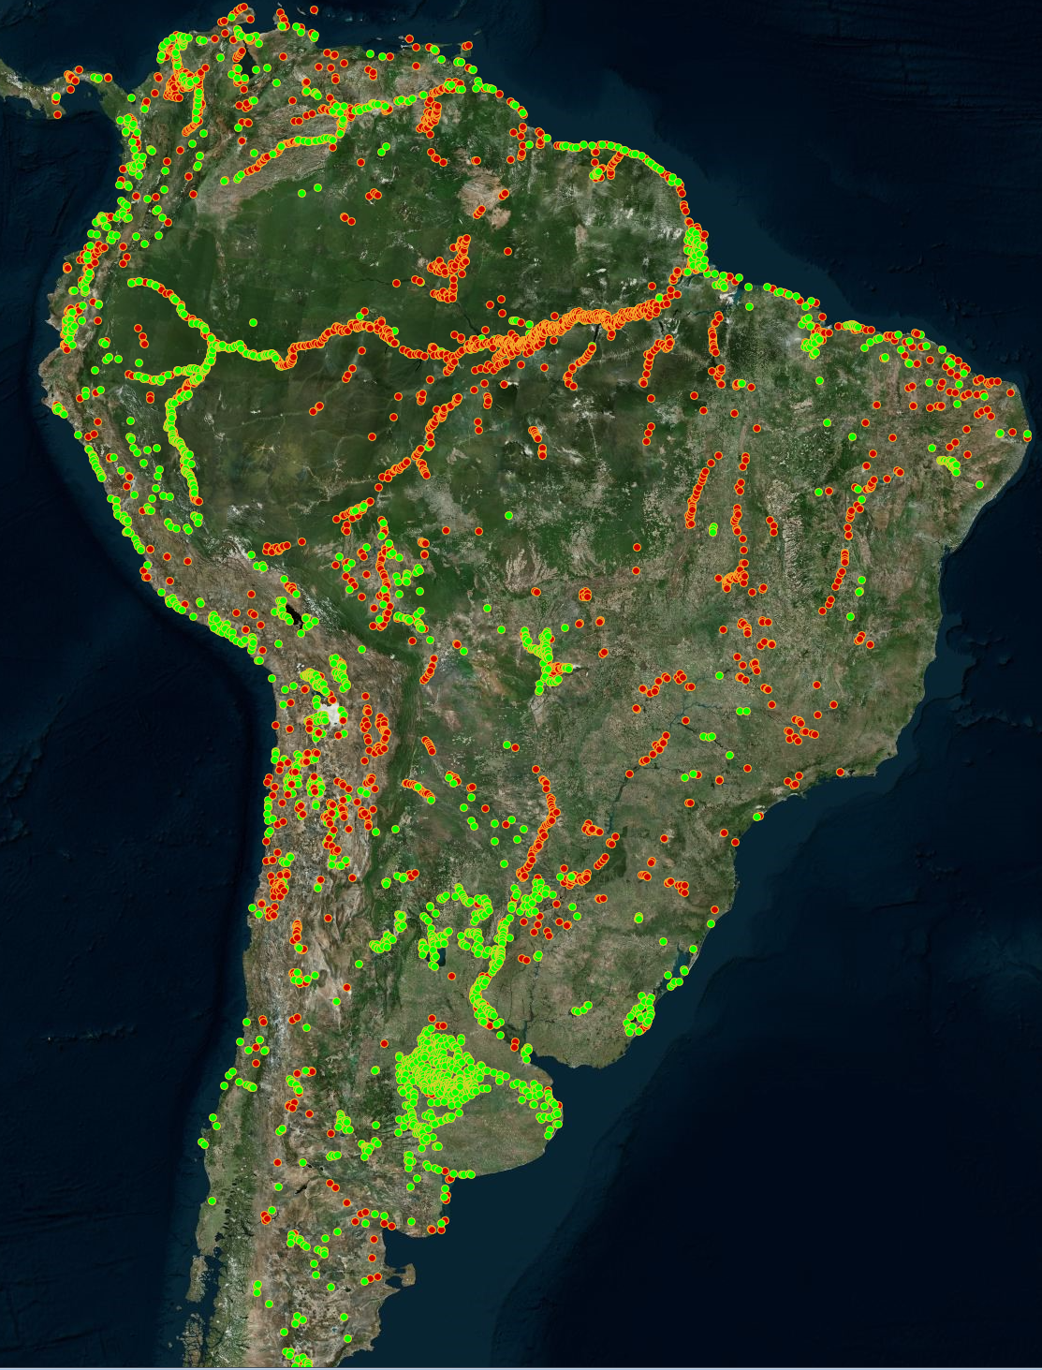
Regions of Change in South America
Red Dots (Water Gain):
Region of size > 2.5 km² that have changed from land to water in the last 15 years
Example time series of a Water Gain region
Green Dots (Water Loss):
Region of size > 2.5 km² that have changed from water to land in the last 15 years
Example time series of a Water Loss region

Slide 9
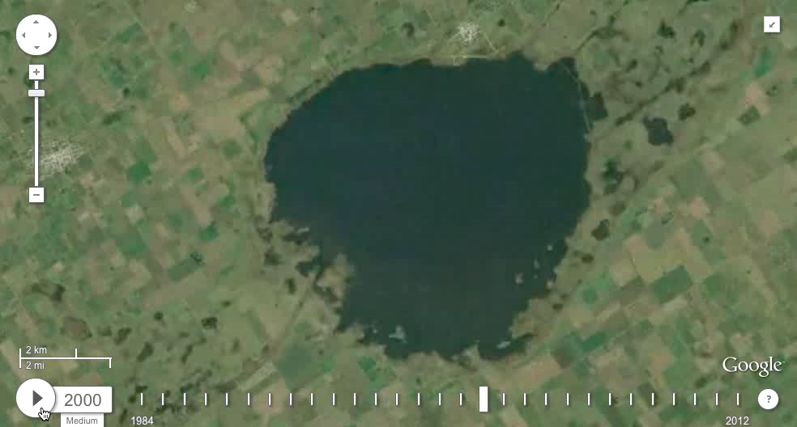
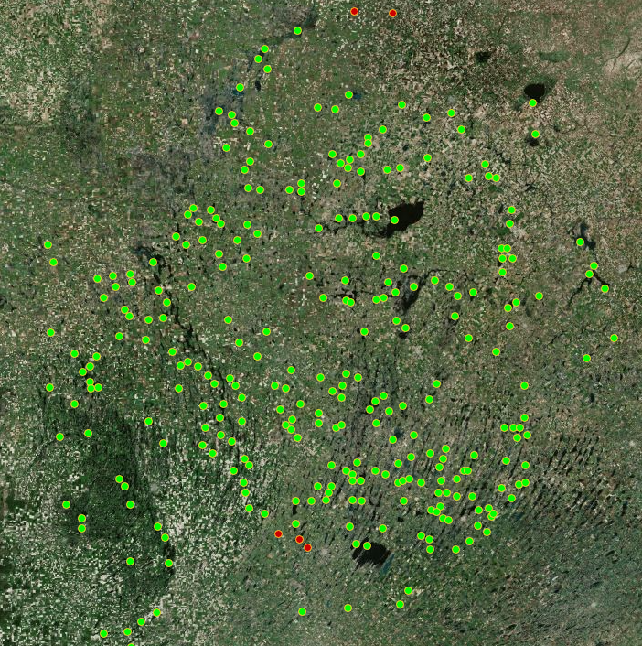
Examples of Change: Shrinking Water Bodies
(Green dots show regions changing from water to land in last 15 years)
Annual Time-lapse of an example green dot
Aggregate dynamics of all green dots shown on left

Slide 10
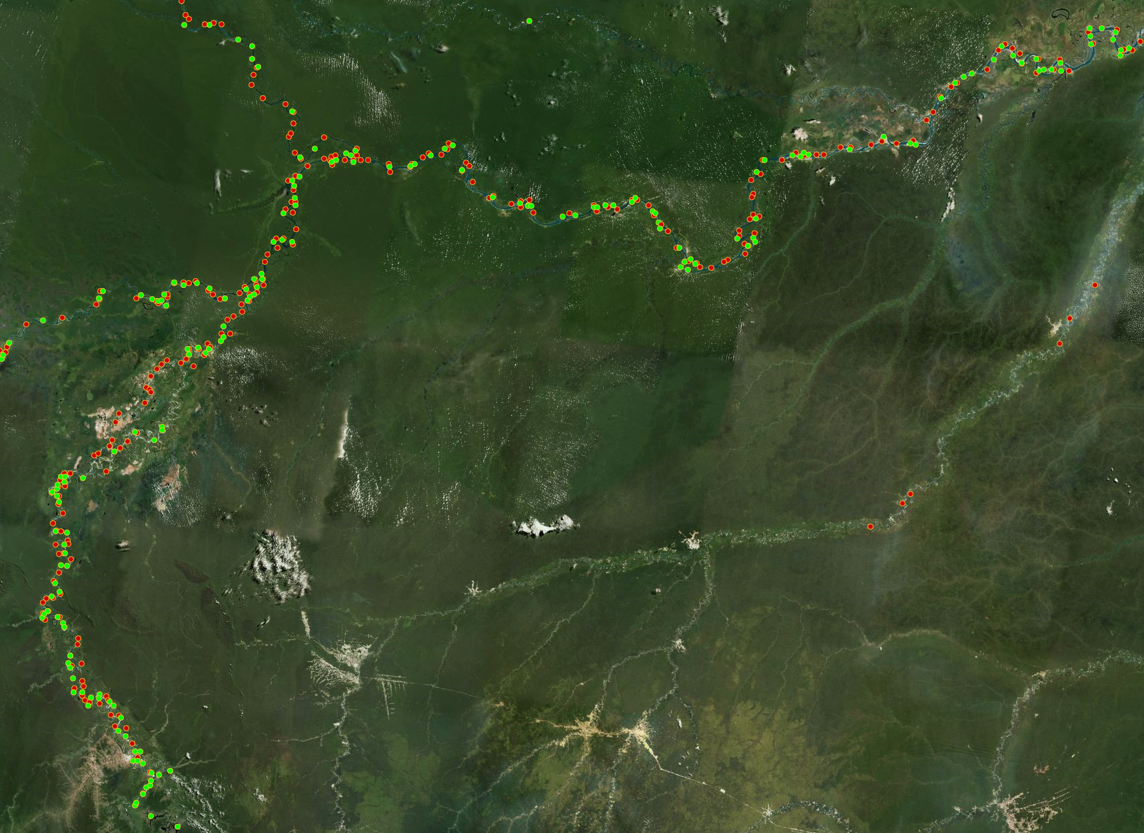
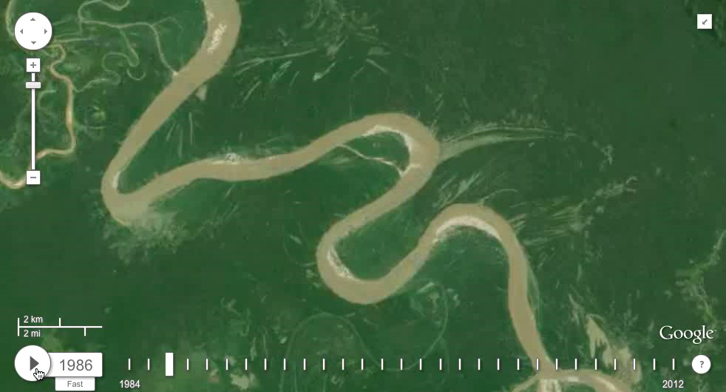
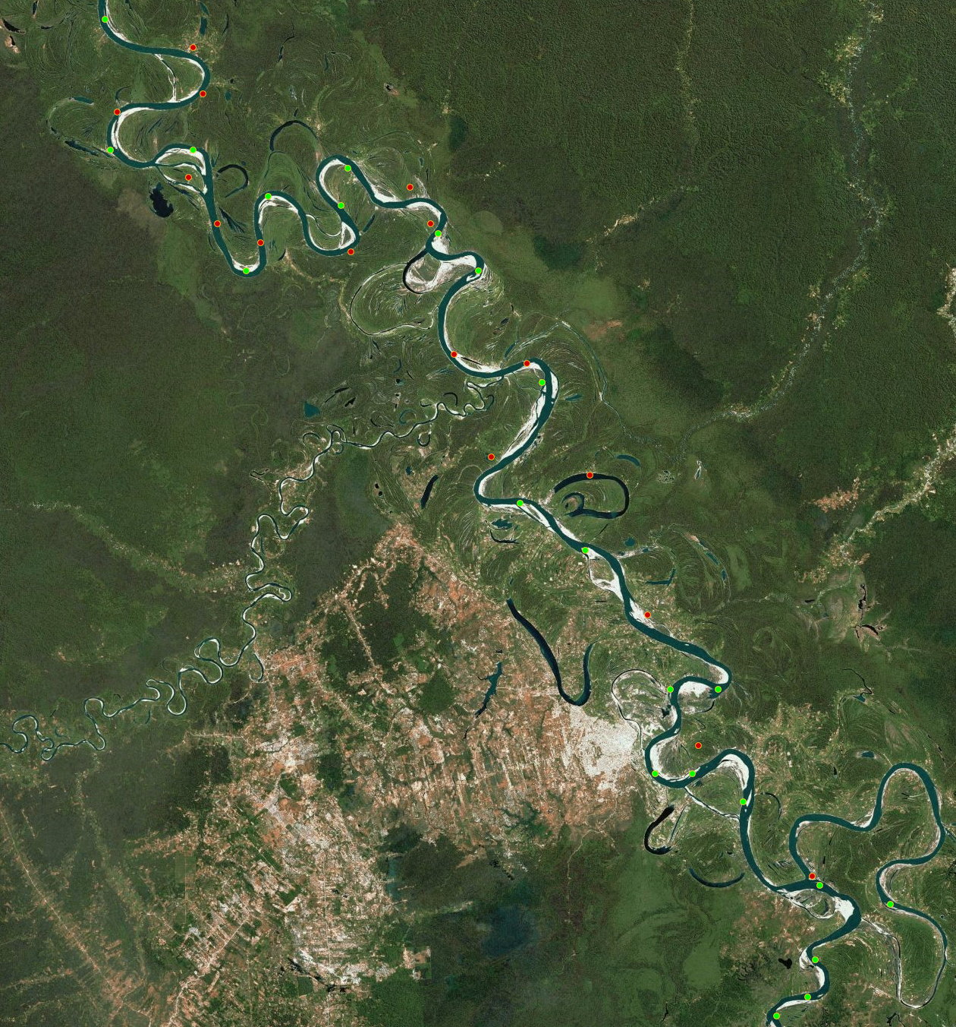
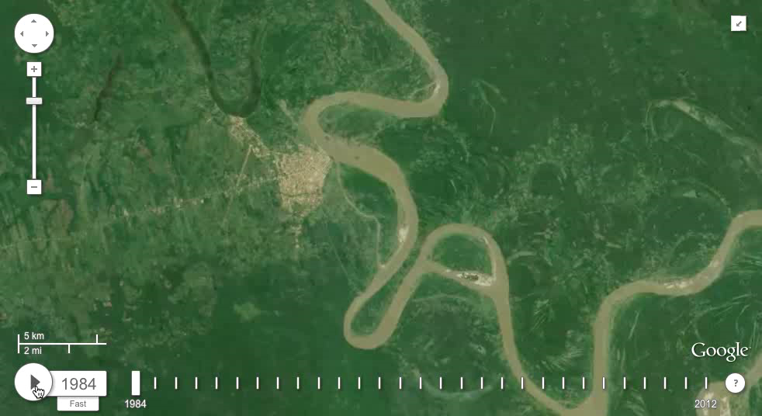
Examples of Change: River Meandering
(Adjacent occurrence of Water Gain (red) and Water Loss (green) regions all along the river indicate the displacement of water from the green dots to the red dots)
Time-lapse of 2
Zoomed-in View
2
Time-lapse of 1
Example time series of a Water Loss region
1
Example time series of a Water Gain region

Slide 11
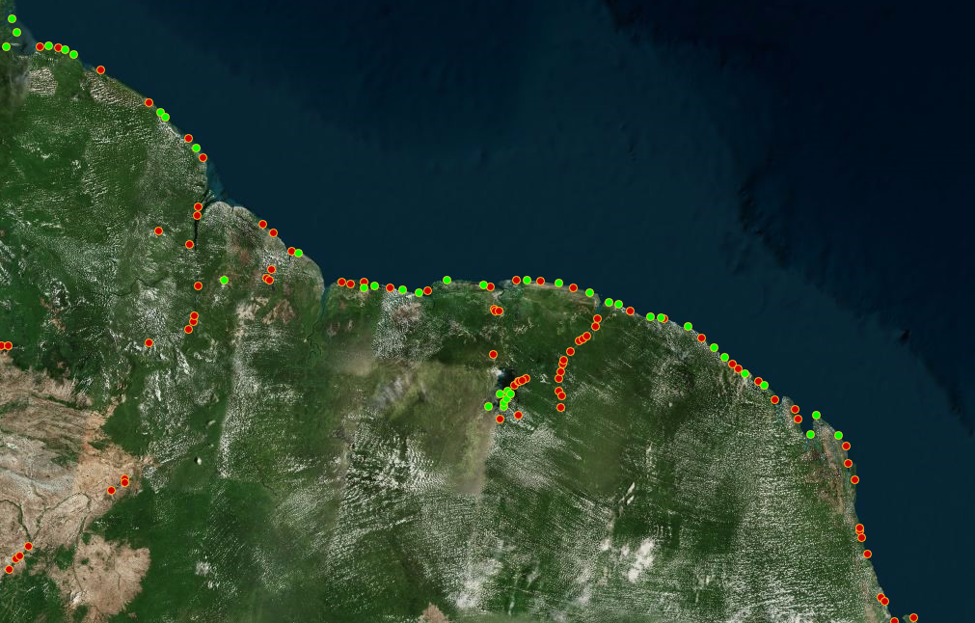
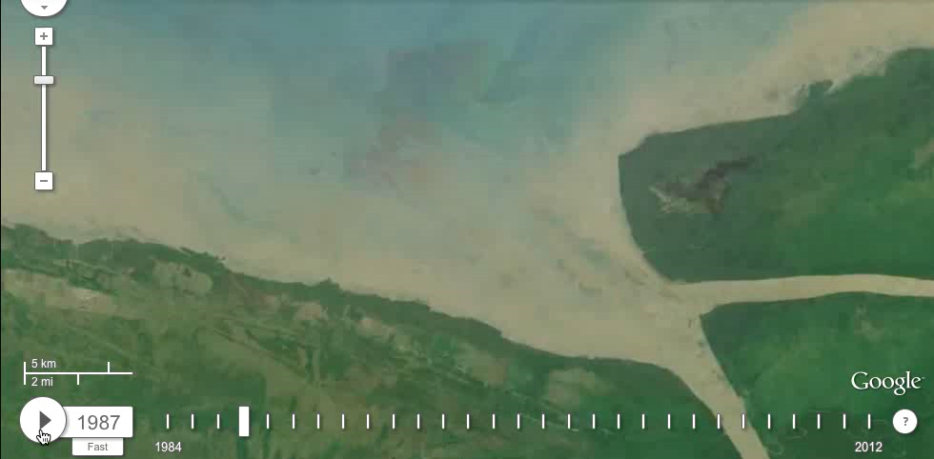
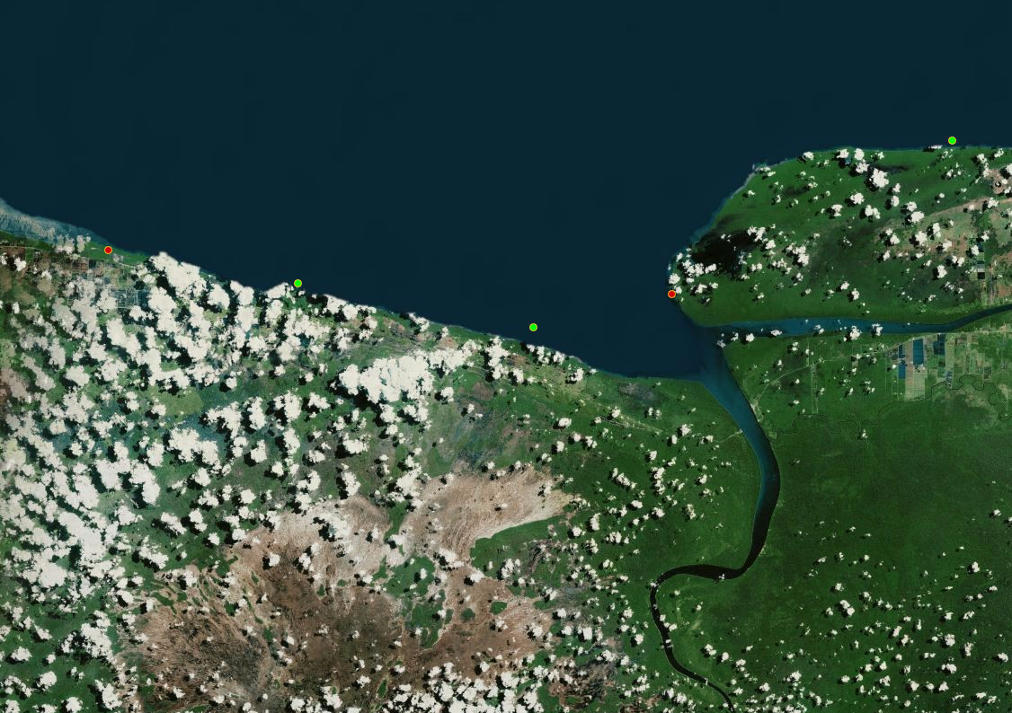
Examples of Change: Delta Erosion
(Water Gain and Water Loss regions appear on the coastline, due to displacement of sediments around river deltas)
Annual time-lapse of region shown on right
Zoomed-in View
Example time series of a Water Loss region
Example time series of a Water Gain region

Slide 12
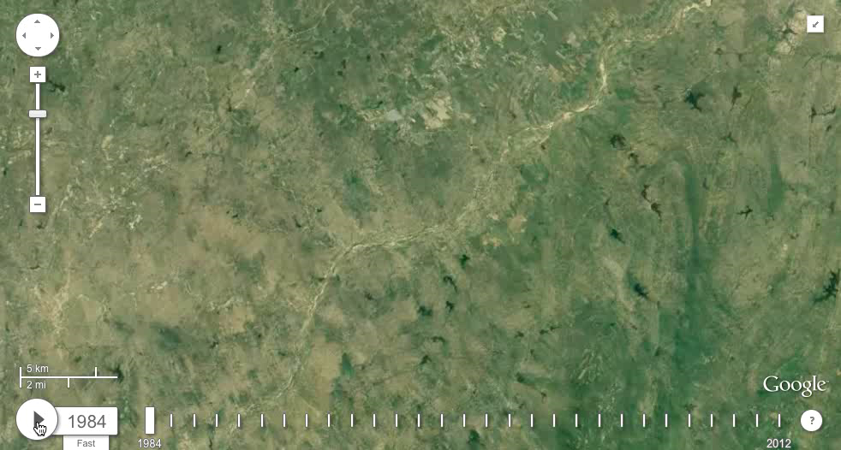
Examples of Change: Dam Constructions
Construction of a dam often results in the creation of a reservoir
Characterized by a sudden and persistent increase in surface area
Define a Sudden Increase Score to distinguish dam construction events from other natural events (gradual increases)

Slide 13
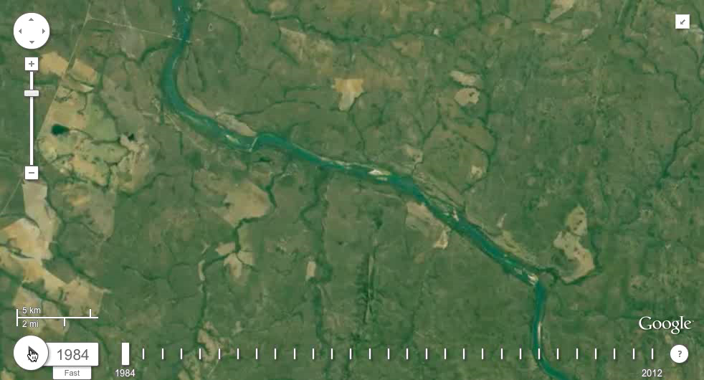
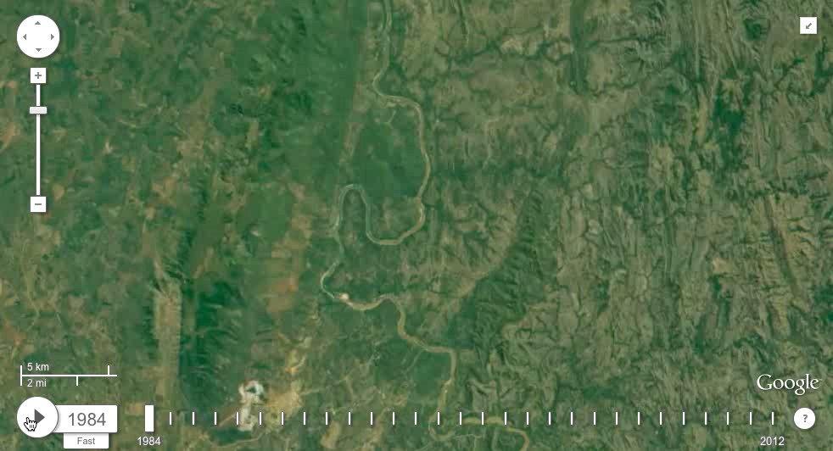
Detecting Dam Constructions using Sudden Increase Score
1
Sudden Increase Score of Water Gain regions in a selected area
1
2
Dam construction at Region 1 showing a high score
3
2
3
Gradual increase at Region 3 showing low score
Dam construction at Region 2 showing a high score

Slide 14
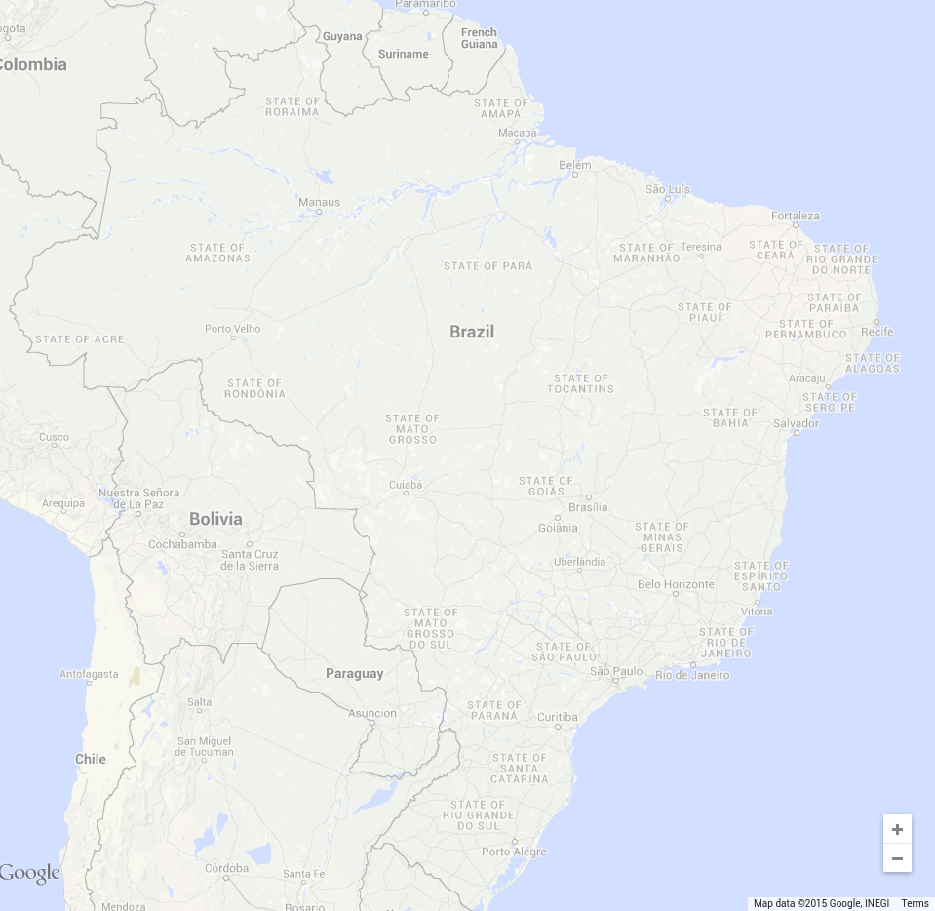
Validating Dam Constructions
Global Reservoir and Dam (GRanD) Database:
An initiative by Global Water System Project (GWSP)
Reports 65 dams globally constructed after 2000
12 new dams in Brazil
UMN Approach:
Finds 134 dam constructions after 2000 in Brazil¹
¹Prepared in collaboration with Juan Carlos, Planetary Skin Institute

Slide 15
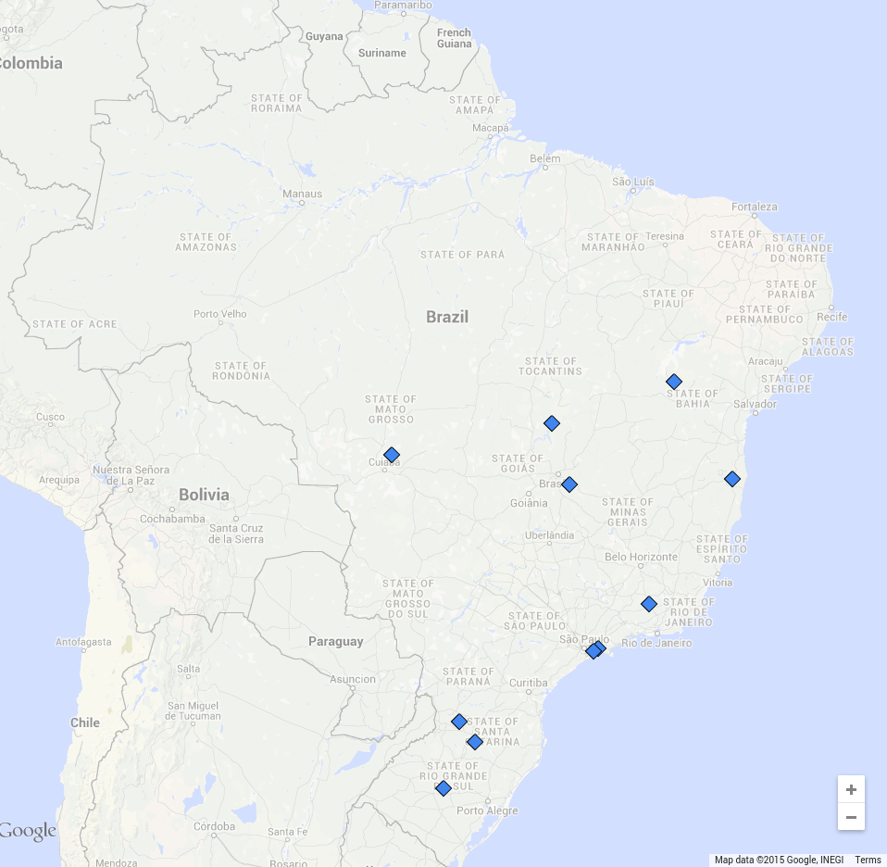
Validating Dam Constructions
Global Reservoir and Dam (GRanD) Database:
An initiative by Global Water System Project (GWSP)
Reports 65 dams globally constructed after 2000
12 new dams in Brazil
UMN Approach:
Finds 134 dam constructions after 2000 in Brazil¹
GRanD (12)
¹Prepared in collaboration with Juan Carlos, Planetary Skin Institute

Slide 16
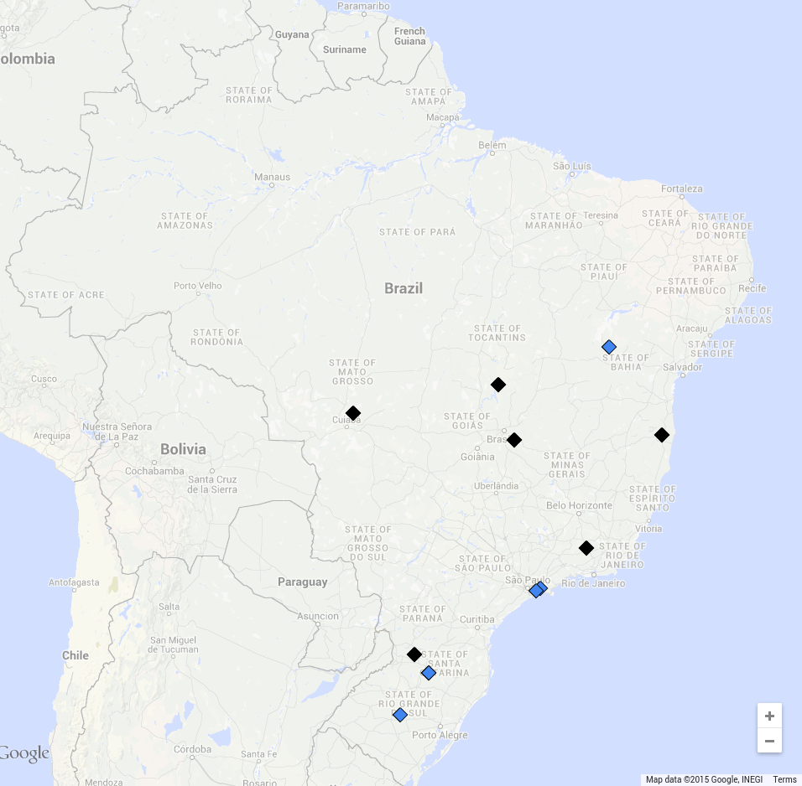
Validating Dam Constructions
Global Reservoir and Dam (GRanD) Database:
An initiative by Global Water System Project (GWSP)
Reports 65 dams globally constructed after 2000
12 new dams in Brazil
UMN Approach:
Finds 134 dam constructions after 2000 in Brazil¹
Only GRanD (5)
GRanD & UMN
(7)
Missing run-of-the-river dams with small water storage ( < 2.5 km²)
¹Prepared in collaboration with Juan Carlos, Planetary Skin Institute

Slide 17
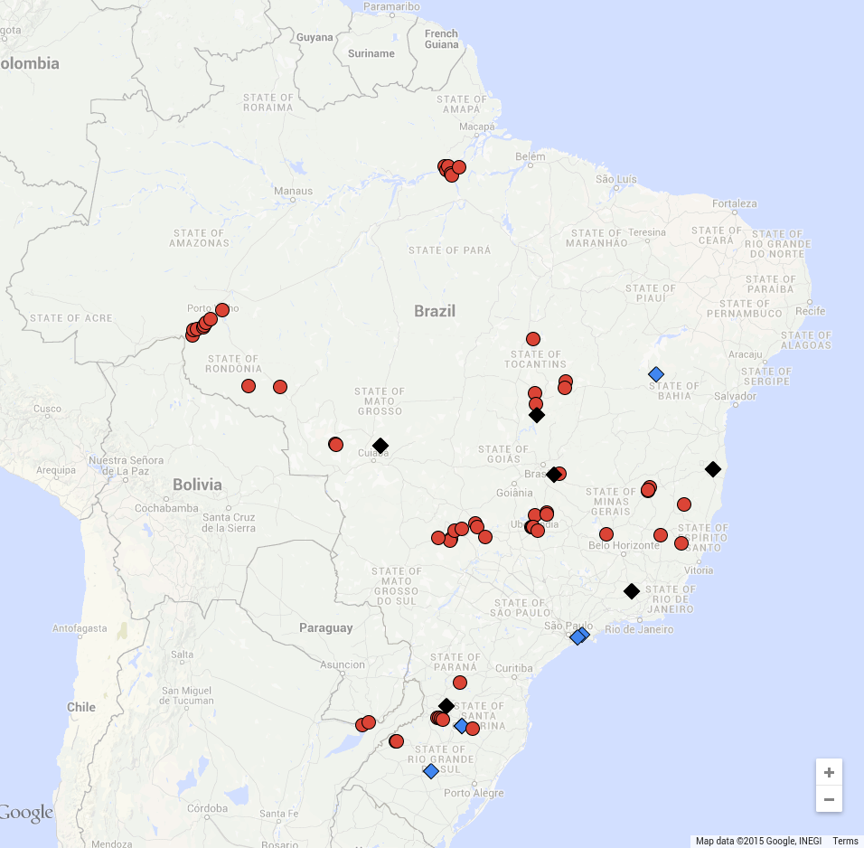
Validating Dam Constructions
Global Reservoir and Dam (GRanD) Database:
An initiative by Global Water System Project (GWSP)
Reports 65 dams globally constructed after 2000
12 new dams in Brazil
UMN Approach:
Finds 134 dam constructions after 2000 in Brazil¹
Only GRanD (5)
GRanD & UMN
(7)
Reported by CBDB
(44)
¹Prepared in collaboration with Juan Carlos, Planetary Skin Institute

Slide 18
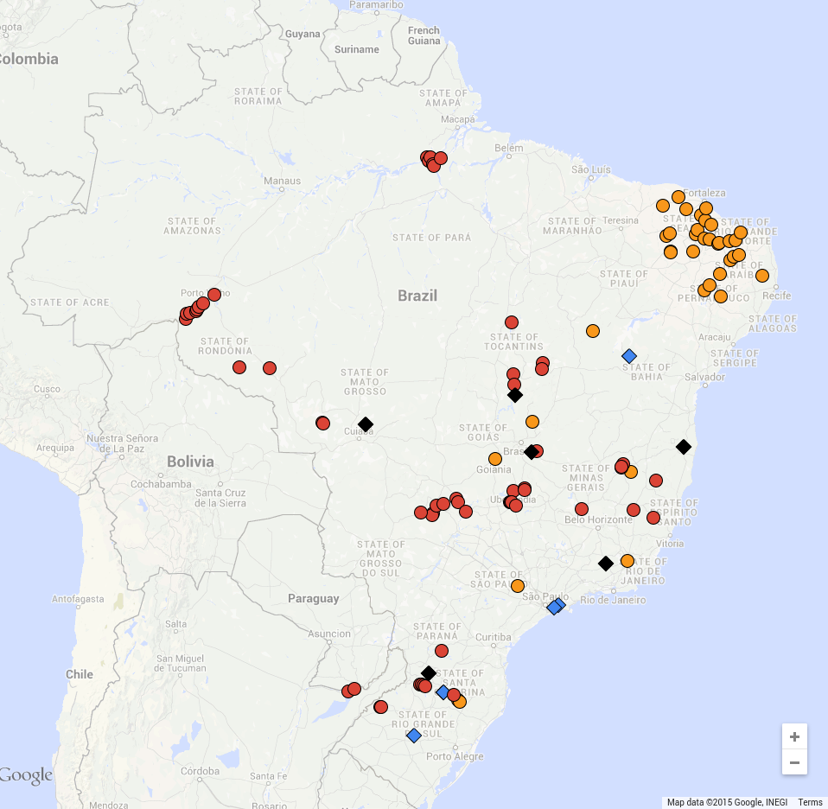
Validating Dam Constructions
Global Reservoir and Dam (GRanD) Database:
An initiative by Global Water System Project (GWSP)
Reports 65 dams globally constructed after 2000
12 new dams in Brazil
UMN Approach:
Finds 134 dam constructions after 2000 in Brazil¹
Only GRanD (5)
GRanD & UMN
(7)
Reported by CBDB
(44)
Agriculture Dams (32)
¹Prepared in collaboration with Juan Carlos, Planetary Skin Institute

Slide 19
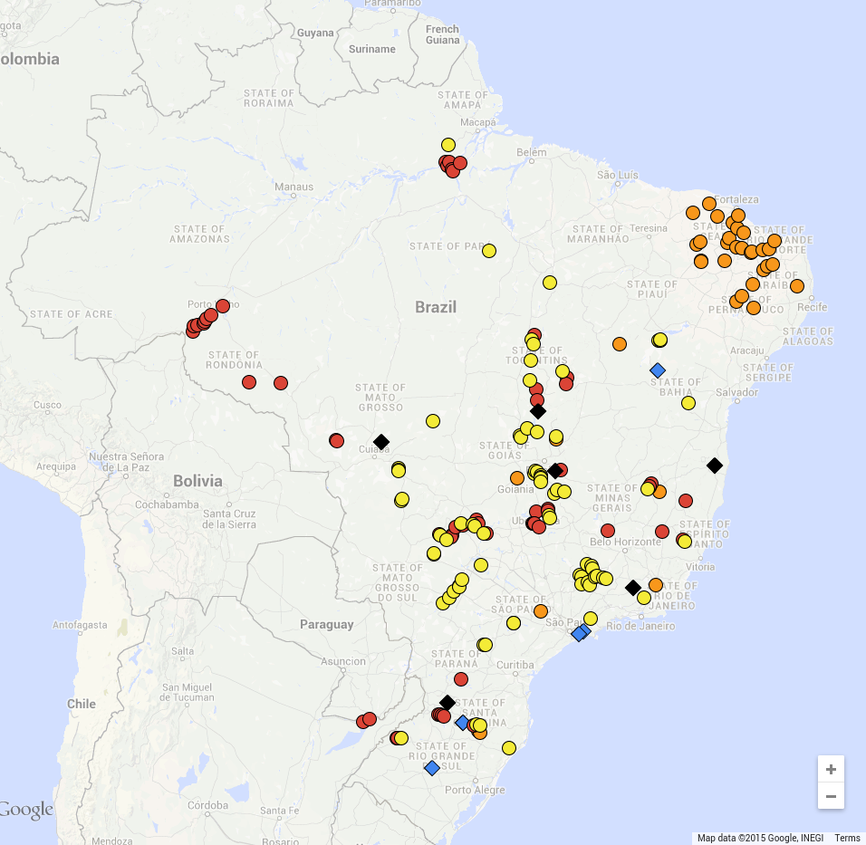
Validating Dam Constructions
Global Reservoir and Dam (GRanD) Database:
An initiative by Global Water System Project (GWSP)
Reports 65 dams globally constructed after 2000
12 new dams in Brazil
UMN Approach:
Finds 134 dam constructions after 2000 in Brazil¹
Only GRanD (5)
GRanD & UMN
(7)
Reported by CBDB
(44)
Hydro
Dams (41)
Agriculture Dams (32)
¹Prepared in collaboration with Juan Carlos, Planetary Skin Institute

Slide 20
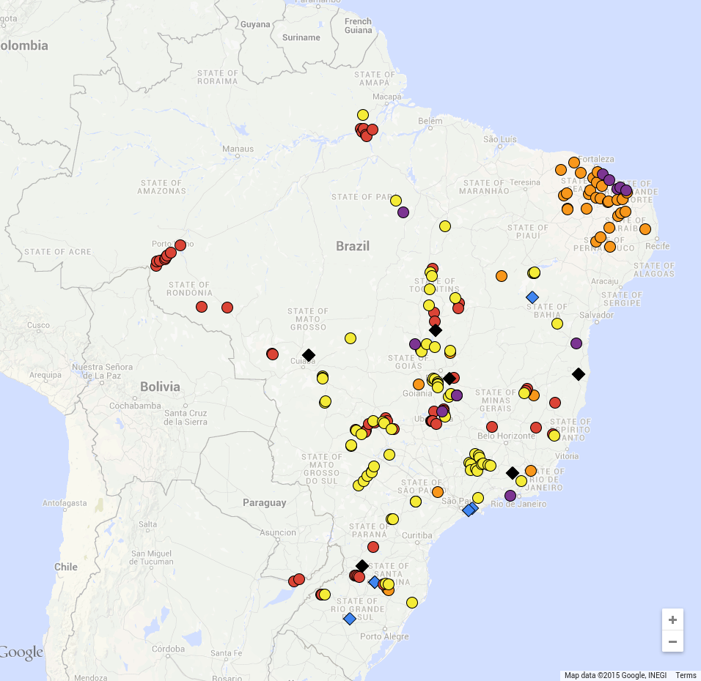
Validating Dam Constructions
Global Reservoir and Dam (GRanD) Database:
An initiative by Global Water System Project (GWSP)
Reports 65 dams globally constructed after 2001
12 new dams in Brazil
UMN Approach:
Finds 134 dam constructions after 2001 in Brazil¹
Only GRanD (5)
GRanD & UMN
(7)
Mining
(10)
Reported by CBDB
(44)
Hydro
Dams (41)
Agriculture Dams (32)
¹Prepared in collaboration with Juan Carlos, Planetary Skin Institute

Slide 21
A Global Water Monitoring System:
Current Scope and Next Steps
Current Scope:
  Maps the dynamics of water bodies using coarse-scale MODIS data (at 500m resolution, every 8 days, starting from 2000)
  Covers all water bodies below ~50°N that are not covered by snow at any time of the year
Next Steps:
  Global coverage of all water bodies using fine-scale Landsat data (at 30m resolution, every 16 days, starting from 1970s)
  Including the dynamics of snow-covered water bodies by only considering observations during their summer season

Slide 22
Potential Use Cases of a Water Monitoring System
Quantifying available water stocks and their dynamics over time
Mapping the dynamics of rivers and estimating their discharge at a global scale using fine-resolution Landsat data
Detecting a variety of changes occurring in water bodies and studying their interactions with natural phenomena and human actions
Including information about surface water dynamics in currently available hydrological models at regional to global scales

Slide 23
Publications
A. Karpatne, A. Khaldelwal, X. Chen, V. Mithal, J.H. Faghmous, and V. Kumar, Global monitoring of inland water dynamics: State-of-the-art, challenges, and opportunities, In K. Morik, J. Lässig, and K. Kersting, Eds. Computational Sustainability, Springer. 2015 (to appear)
A. Karpatne and V. Kumar, Adaptive heterogeneous ensemble learning using the context of test instances, International Conference on Data Mining (ICDM), 2015
A. Khandelwal, V. Mithal, and V. Kumar. Post-classification label refinement using implicit ordering constraints among data instances. International Conference on Data Mining (ICDM), 2015.
X. Chen, J. Faghmous, A. Khandelwal, and V. Kumar, Clustering dynamic spatio-temporal patterns in the presence of noise and missing data, International Joint Conference on Artificial Intelligence (IJCAI), 2015.
A. Karpatne, A. Khaldelwal, and V. Kumar, Ensemble learning methods for binary classification with multi-modality within the classes, SIAM International Conference on Data Mining (SDM), 2015
For further information, please visit the Expeditions Project website:
http://climatechange.cs.umn.edu

Slide 24
Acknowledgments
Team UMN:
  Ankush Khandelwal, Xi Chen, Varun Mithal
  Robert Leuenberger, Eric Mccaleb, Yizheng Ding, Reid Anderson, Kshitij Aranke, Amolak Singh, Stryker Thompson, Karl Holub
  Vipin Kumar
Collaborators:
  Institute on Environment, UMN: Kate Brauman
  Planetary Skin Institute: Juan Carlos Castilla-Rubio, Fabio Faria
Funding:
  National Science Foundation Awards 1029711 and 0905581
  NASA Award NNX12AP37G
  Doctoral Dissertation Fellowship and UMII Informatics Fellowship

