Slide 1










Understanding Global Change from Data
Vipin Kumar
University of Minnesota
kumar@cs.umn.edu
www.cs.umn.edu/~kumar

Slide 2
Global Change:
A Defining Issue of our Era
What is Global Change?

Slide 3
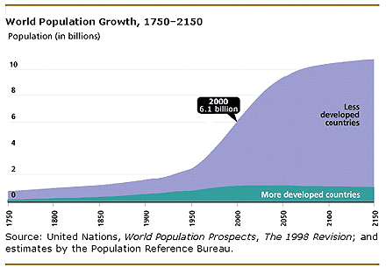
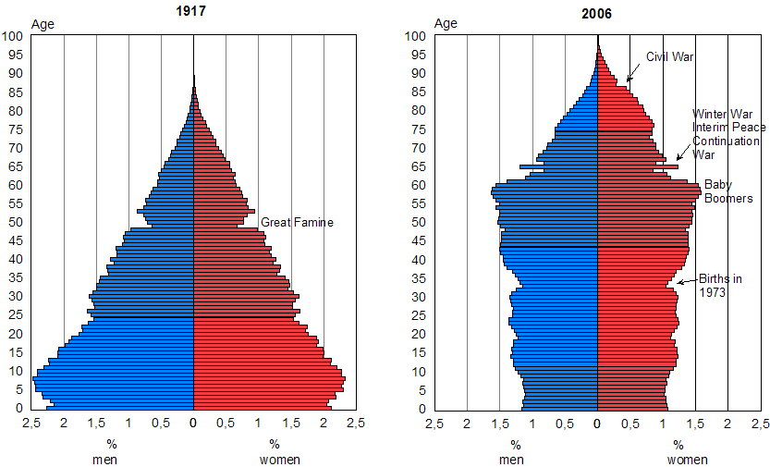
Global Change:
A Defining Issue of our Era
Population Growth & Demographic Shifts

Slide 4
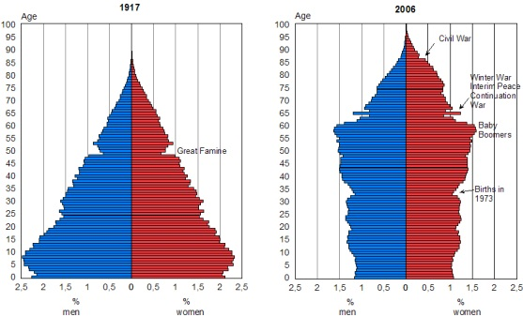
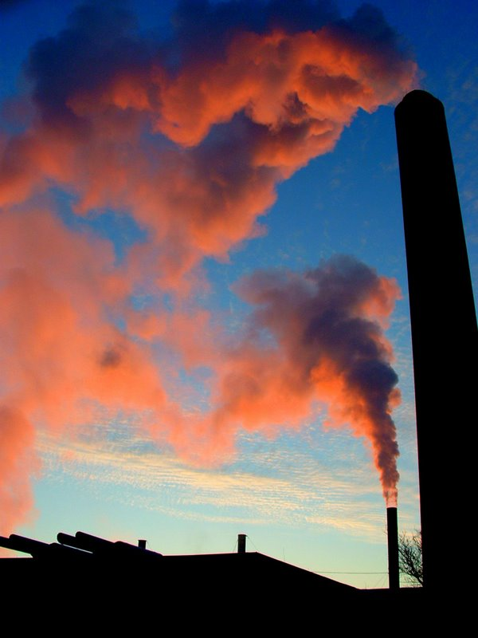


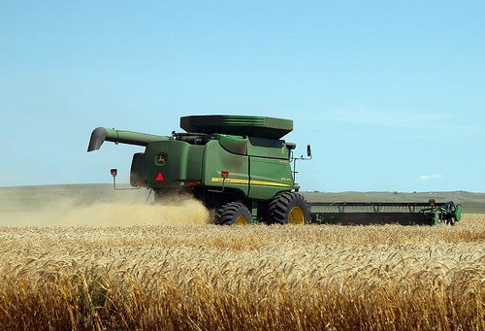
Global Change:
A Defining Issue of our Era
Population Growth & Demographic Shifts
Industrialization & Modernization

Slide 5




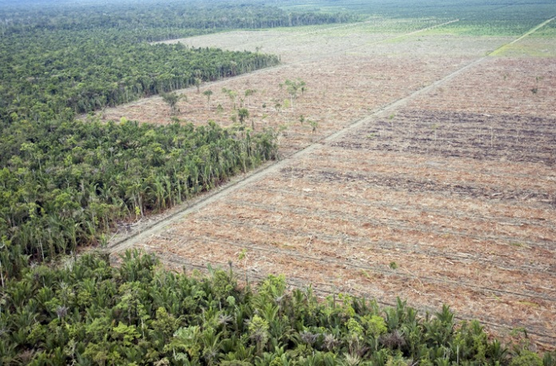
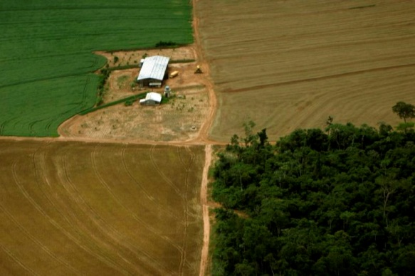
Global Change:
A Defining Issue of our Era
Industrialization & Modernization
Population Growth & Demographic Shifts
Land Use
Change
Urbanization
Deforestation
Land Conversion

Slide 6



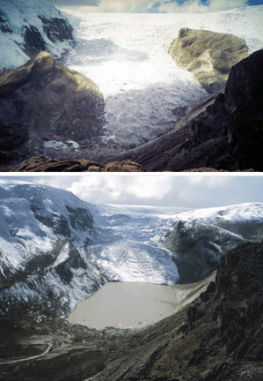
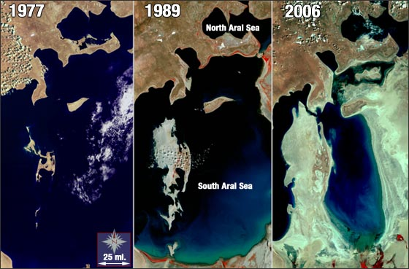
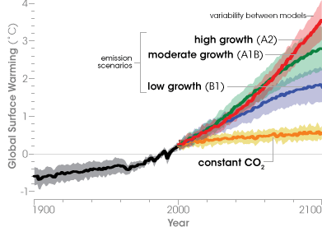
Global Change:
A Defining Issue of our Era
Land Use Change
Industrialization & Modernization
Population Growth & Demographic Shifts
Climate Change

Slide 7

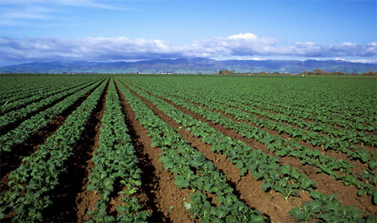



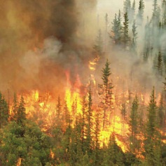
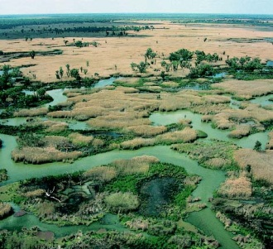
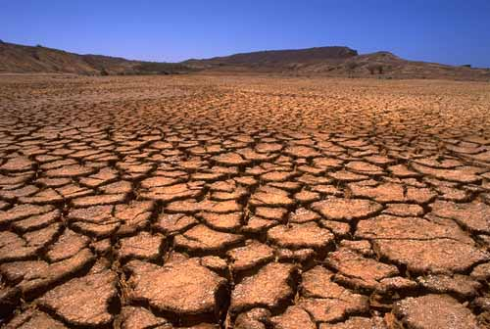
Global Change:
A Defining Issue of our Era
Land Use Change
Industrialization & Modernization
Population Growth & Demographic Shifts
Biodiversity Loss & Natural Disasters
Cyclones
Climate
Change
Monoculture
Ocean
Acidification
Fires
Destruction
of Wetlands
Drought

Slide 8



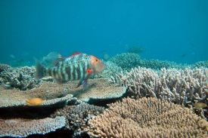
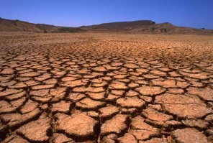
Global Change:
A Defining Issue of our Era
Land Use Change
Industrialization & Modernization
Population Growth & Demographic Shifts
THIS IS GLOBAL CHANGE
Climate
Change
Biodiversity
Loss
Natural
Disasters

Slide 9
Responding to Societal Needs
Where is population growth putting pressure on urban infrastructure and natural resources?
What is the interplay between the global climate system, local ecosystems and natural disasters?
How does increased biofuel production impact crop
patterns and food availability?
How do changing oceans affect the atmosphere and
land climate?
What are the major feedback mechanisms among
eco-climatic processes?

Slide 10
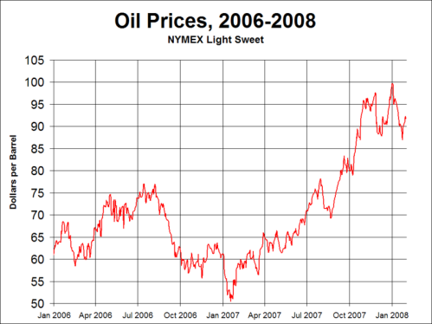
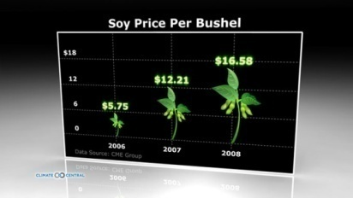

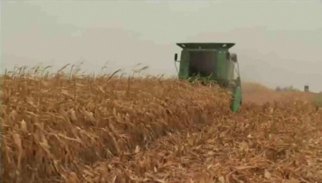
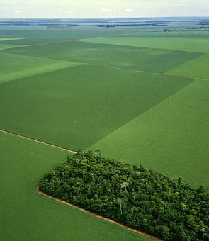

What is the relationship between oil prices, deforestation, and green house gas emissions ?
Increased
Corn Production
Biofuel
A tiny sliver of transitional rainforest is surrounded by hectares of soybean fields in Mato Grosso, Brazil
Source: Time, Climate Central

Slide 11
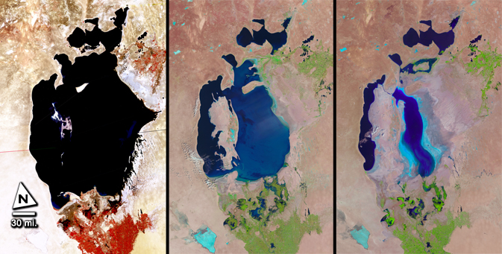
What is the impact of agriculture on water resources and regional climate?
1977
1998
2010
Source: NASA Landsat Data Continuity Mission
Shrinking of the Aral Sea
Water from rivers feeding Aral Sea increasingly used to irrigate cotton fields
Population has increased 3-fold since 1960 while size of the Aral Sea decreased by 75%
Regional climate has changed to being more continental with shorter, warmer, drier summers and longer, colder, snowless winters

Slide 12
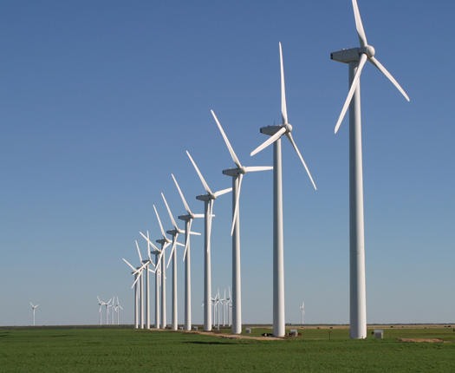
How can climate and geography be used to predict power generation from wind farms?
High-dimensional regression problem involving a combination of heterogeneous covariates, e.g., climatic, geographic, etc.
Large-scale climate phenomena
affect regional weather patterns
Local topography and surface
characteristics modulate air flow
Interaction between individual
turbines affects aggregate
output of the wind farm

Slide 13
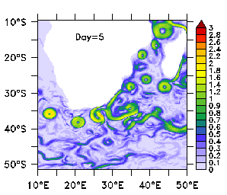
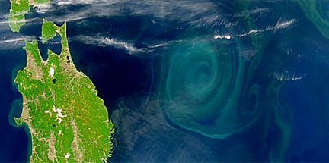
How do ocean eddies impact marine ecosystems and the atmosphere?
Eddies (“the storms of the sea”) dominate the ocean’s kinetic energy
Play a significant role in the transport of water, salt, heat
and nutrients
Enhance phytoplankton bloom,
affect uptake of carbon dioxide
Relationship with tropical storm tracks under investigation
Eddies near Madagascar. Source: GFDL
Large spiral eddy off the coast of Japan. Source: NASA

Slide 14
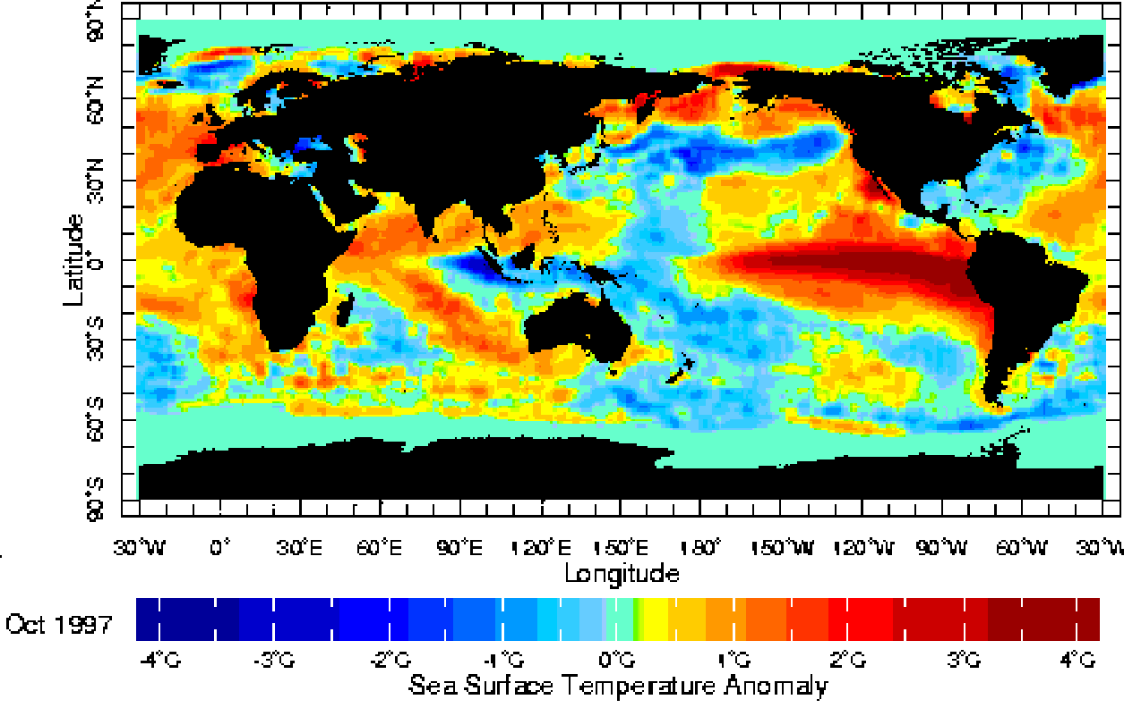
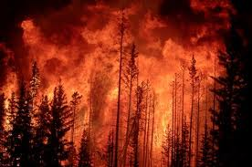
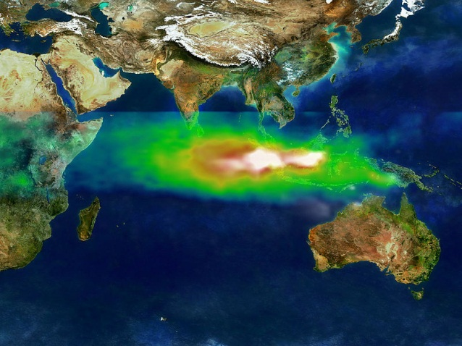
What is the interplay between global climate system, local ecosystems and natural disasters?
Increased sea surface temperatures lead to less precipitation during the wet season and thus less saturation of soils in Indonesian forests.
Months later in the dry season this leaves vegetation more flammable, vulnerable to fires.
1997 October SST anomalies. Source: U. Bergen
A large aerosol and ozone plume extends from Indonesia on October 22, 1997. Source: NASA

Slide 15
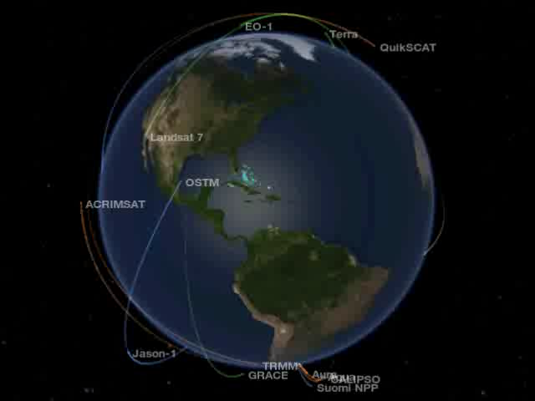
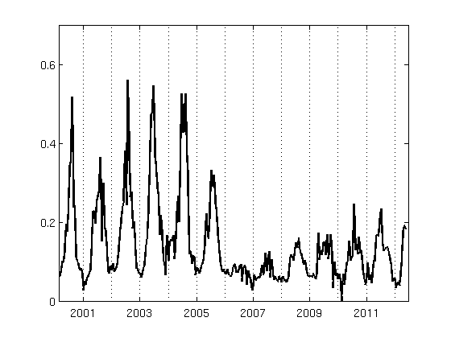
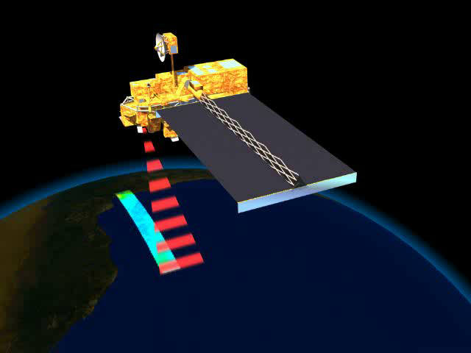
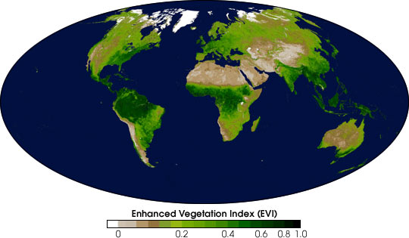
Transformation: Data-Poor to Data-Rich
Climate Models
Reanalysis Data
River Discharge
Agricultural Statistics
Population Data
Air Quality
…
Satellite Data
  Spectral Reflectance
  Elevation Models
  Nighttime Lights
  Aerosols
Oceanographic Data
  Temperature
  Salinity
  Circulation
This vegetation time series captures temporal dynamics around the site of the China National Convention Center
MODIS instrument on
NASA Aqua/Terra Satellites
A vegetation index measures the surface “greenness” – proxy for total biomass

Slide 16




Global Change is a Big Data Problem
Scale and nature of the data offer numerous challenges and opportunities for research in the computational analysis of large datasets.
Data-driven discovery methods hold great promise for advancing our understanding
of the climate and ecosystem processes contributing to global change.
“The future of science depends […] on cleverness being applied to data for their own sake, complementing scientific hypotheses as a basis for exploring today’s information cornucopia.” (Nature, September 2008)
  "data-intensive science [is] so different that
  it is worth distinguishing [it] … as a new,
  fourth paradigm for scientific exploration.” – Jim Gray

Slide 17
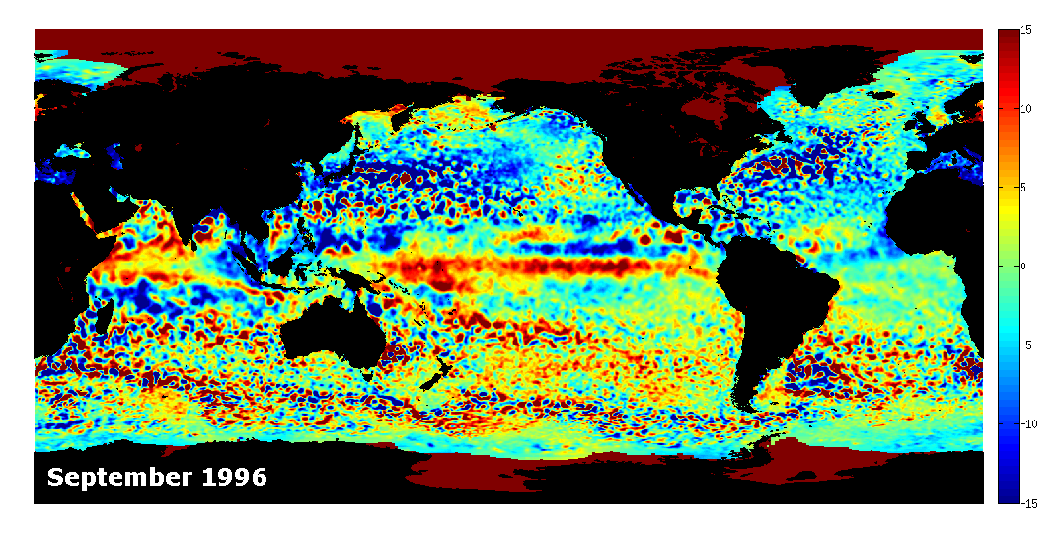
Data & Computational Challenges
Illustrative Example: Identifying Eddy Dynamics from Sea Surface Height (SSH)
High natural variability
Dynamic nature of the phenomenon
  Different eddies have different properties, e.g., shape and size
  An eddy can change over time
Heterogeneity of eddy activity in space and time
Lack of ground truth (unsupervised)

Slide 18
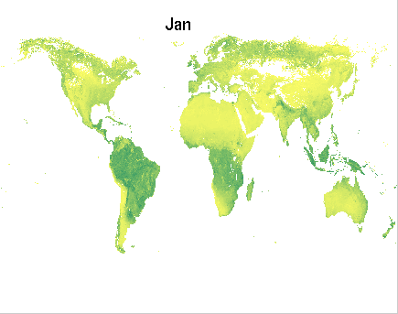
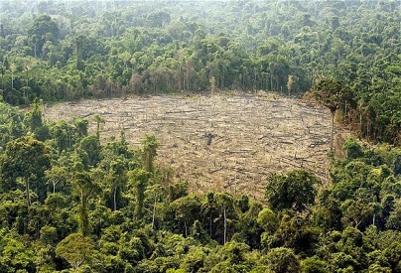
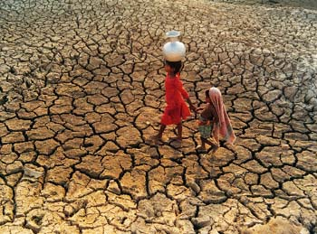
Data & Computational Challenges
Illustrative Example: Land Surface Monitoring
High natural variability
Heterogeneity in space and time
Changes are rare events
Nature of change not explicitly defined
Characterization of changes necessary
Multivariate analysis required
Lack of ground truth (unsupervised)
Enhanced Vegetation Index (EVI)

Slide 19
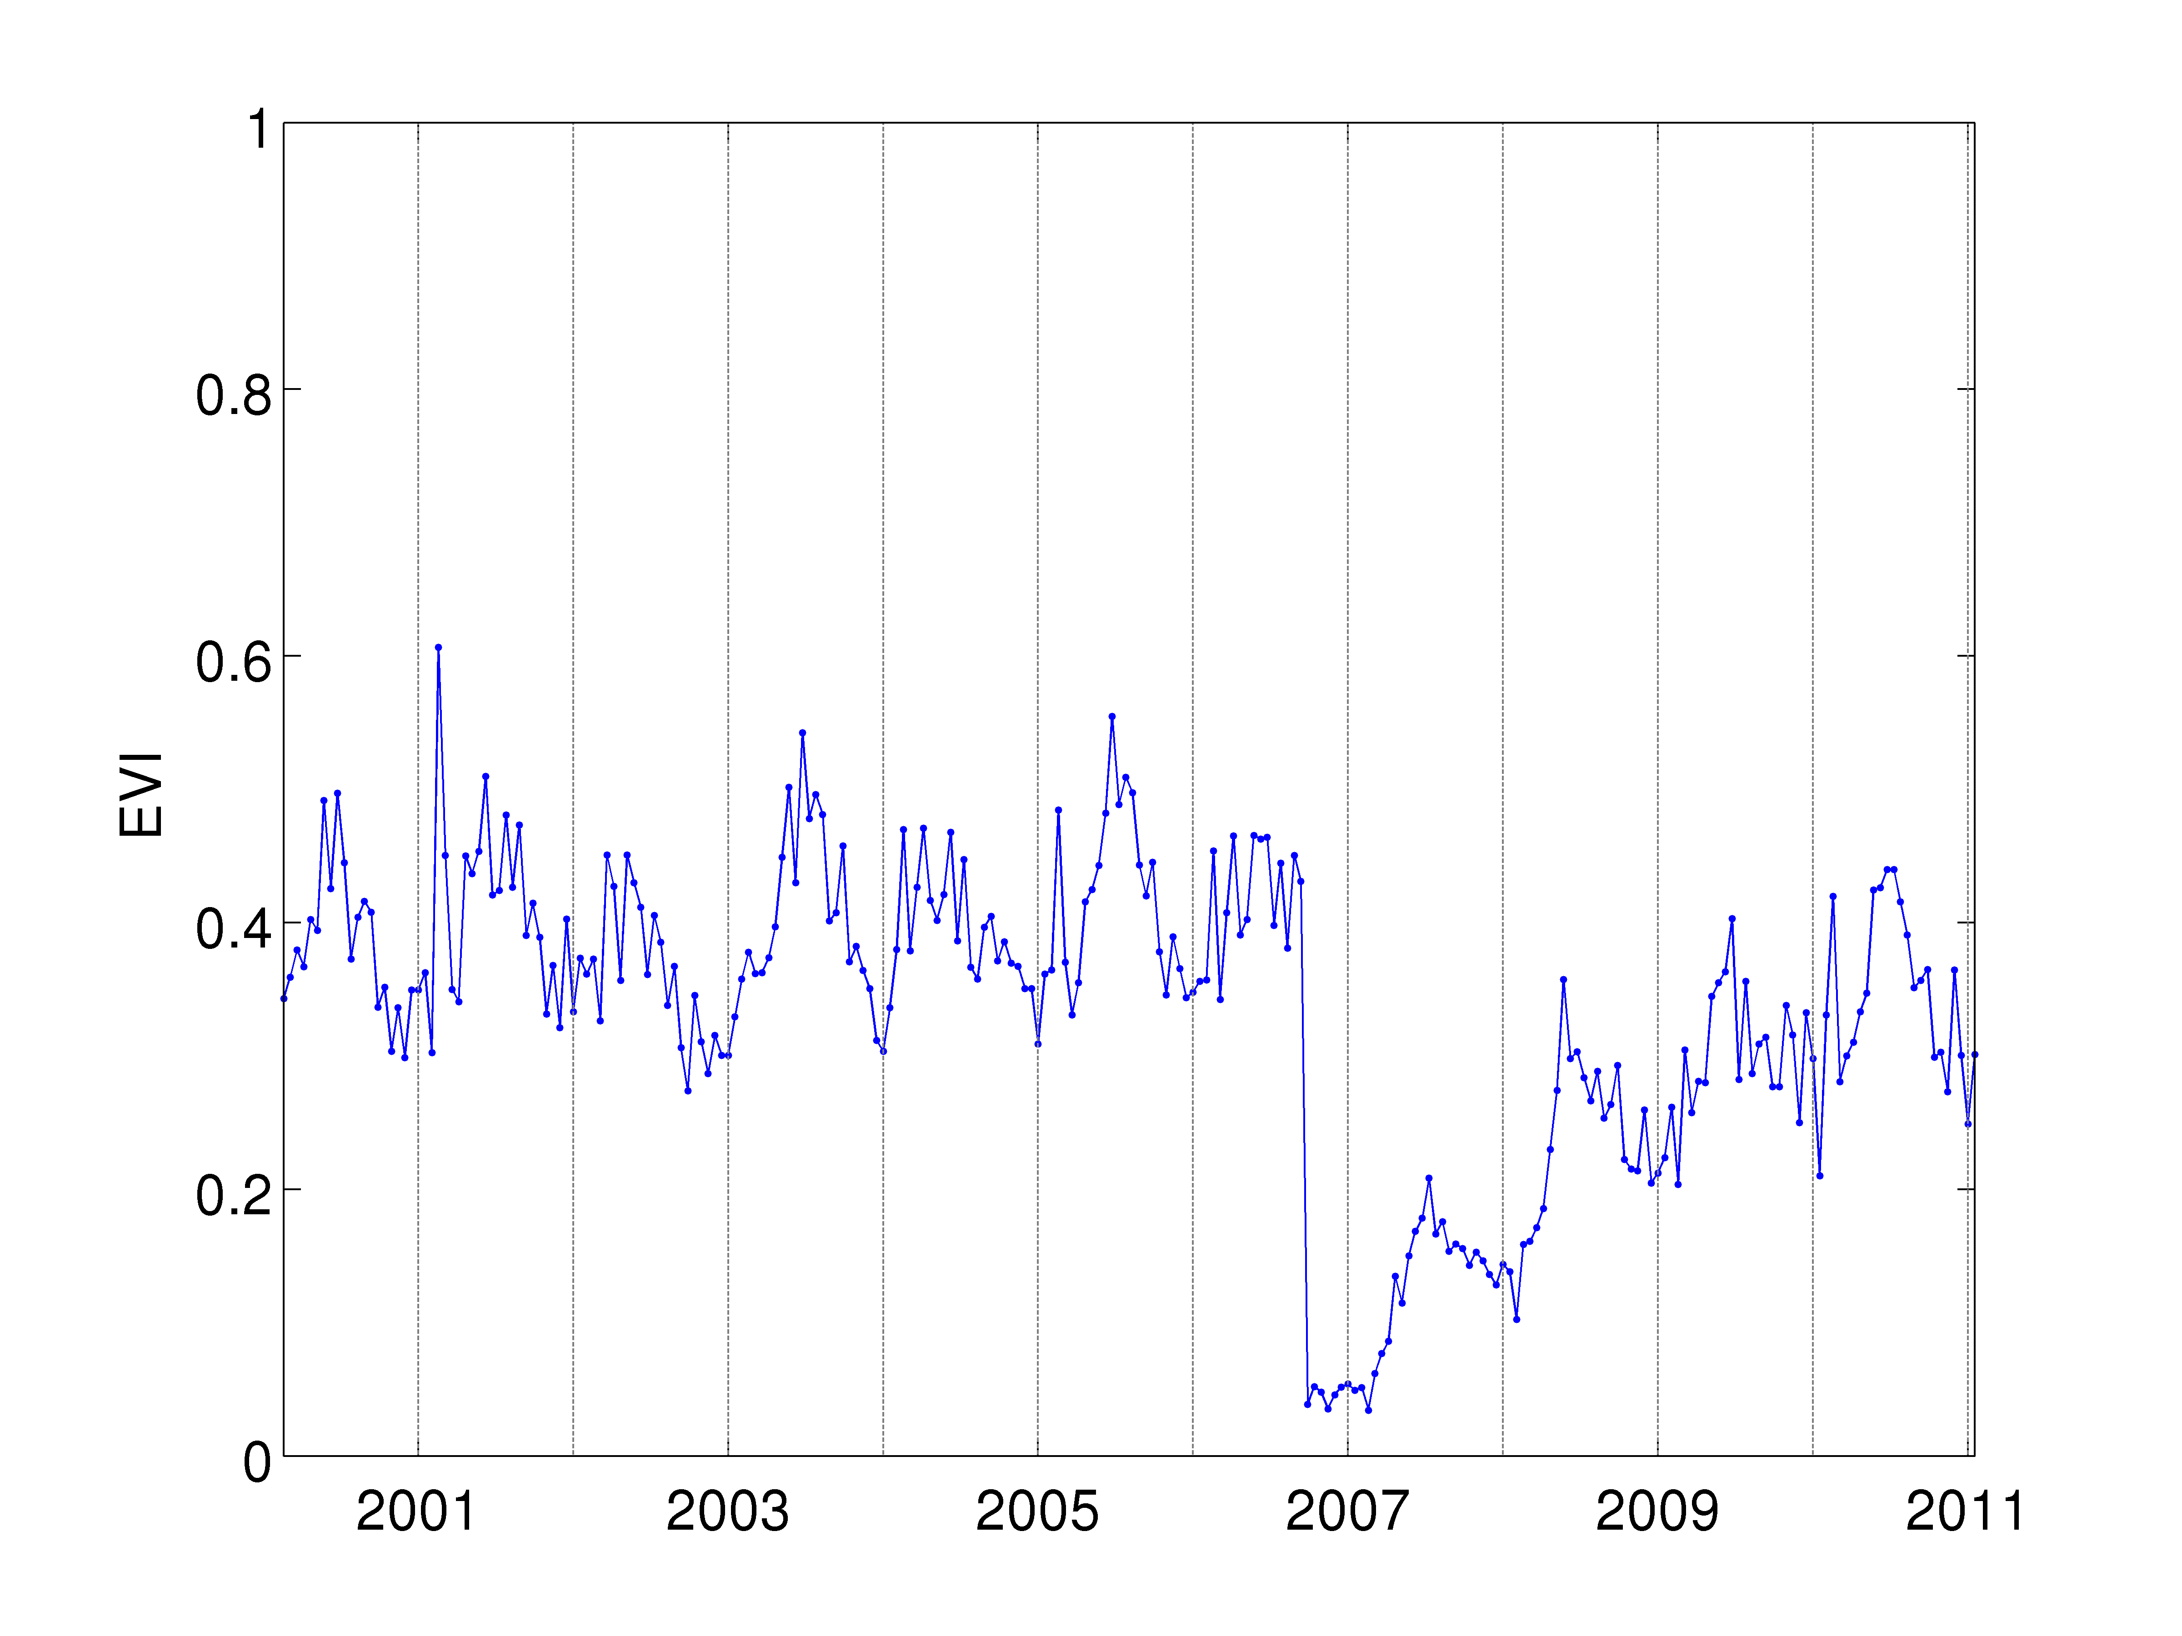
Data & Computational Challenges
Illustrative Example: Land Surface Monitoring
This may look easy…

Slide 20
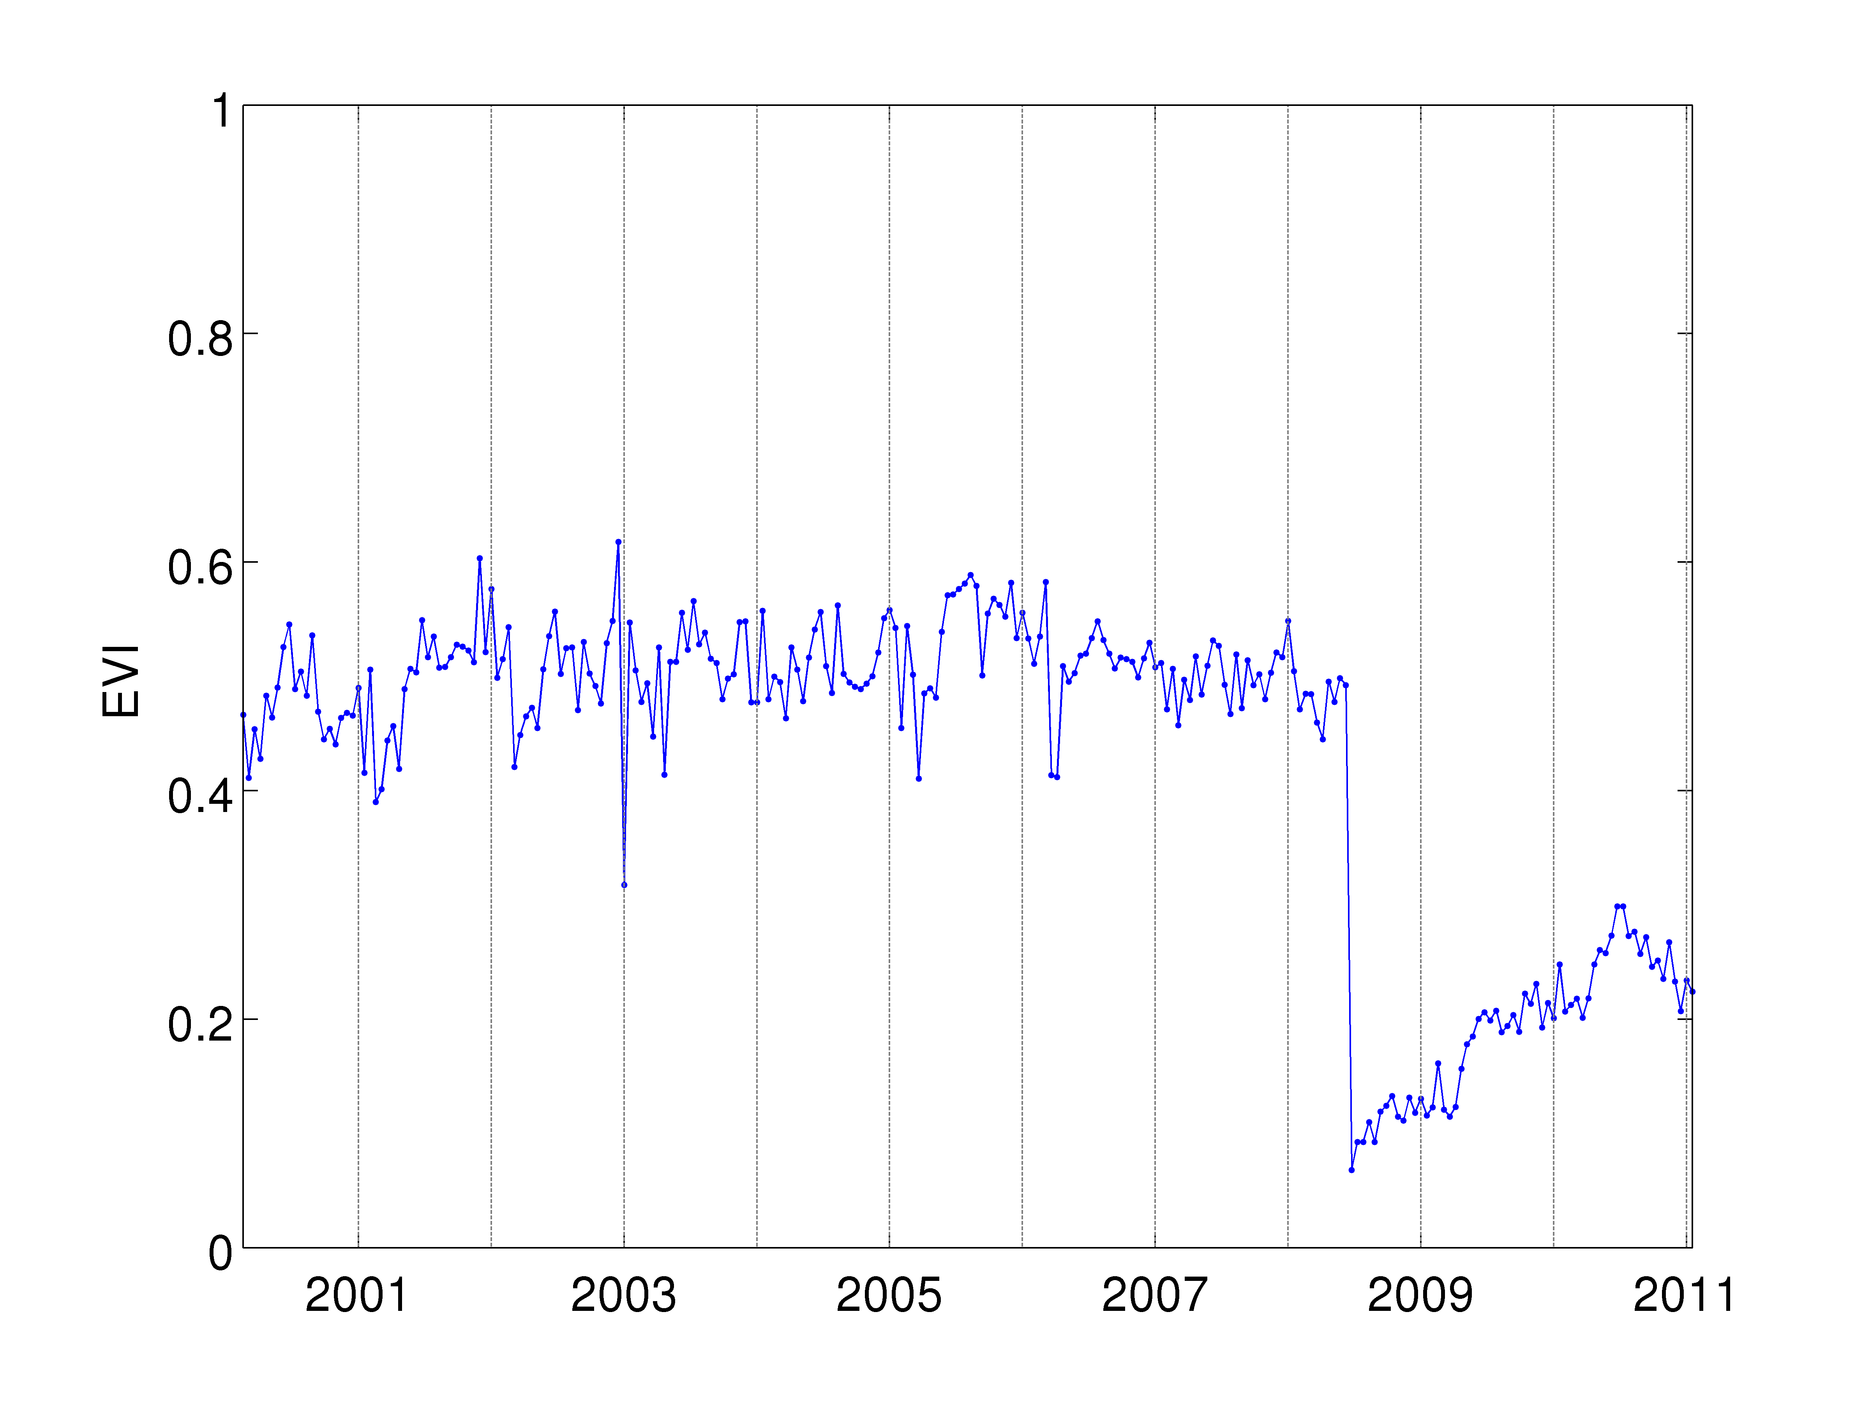
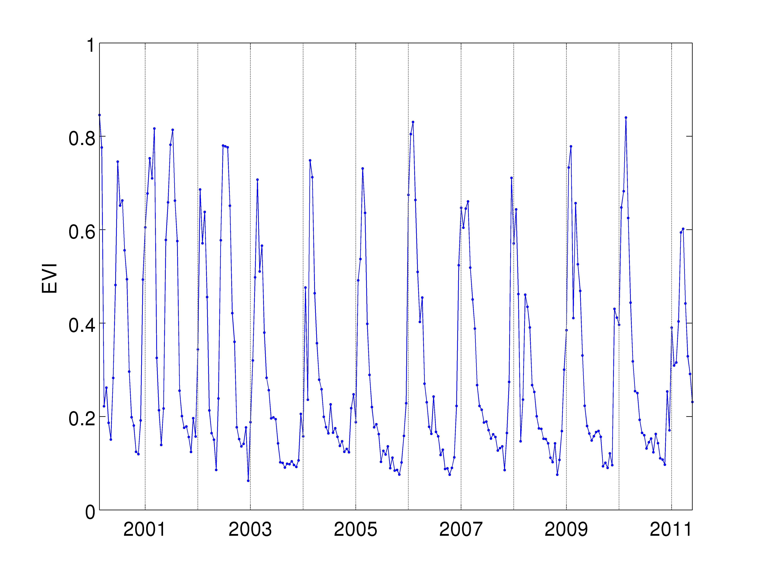
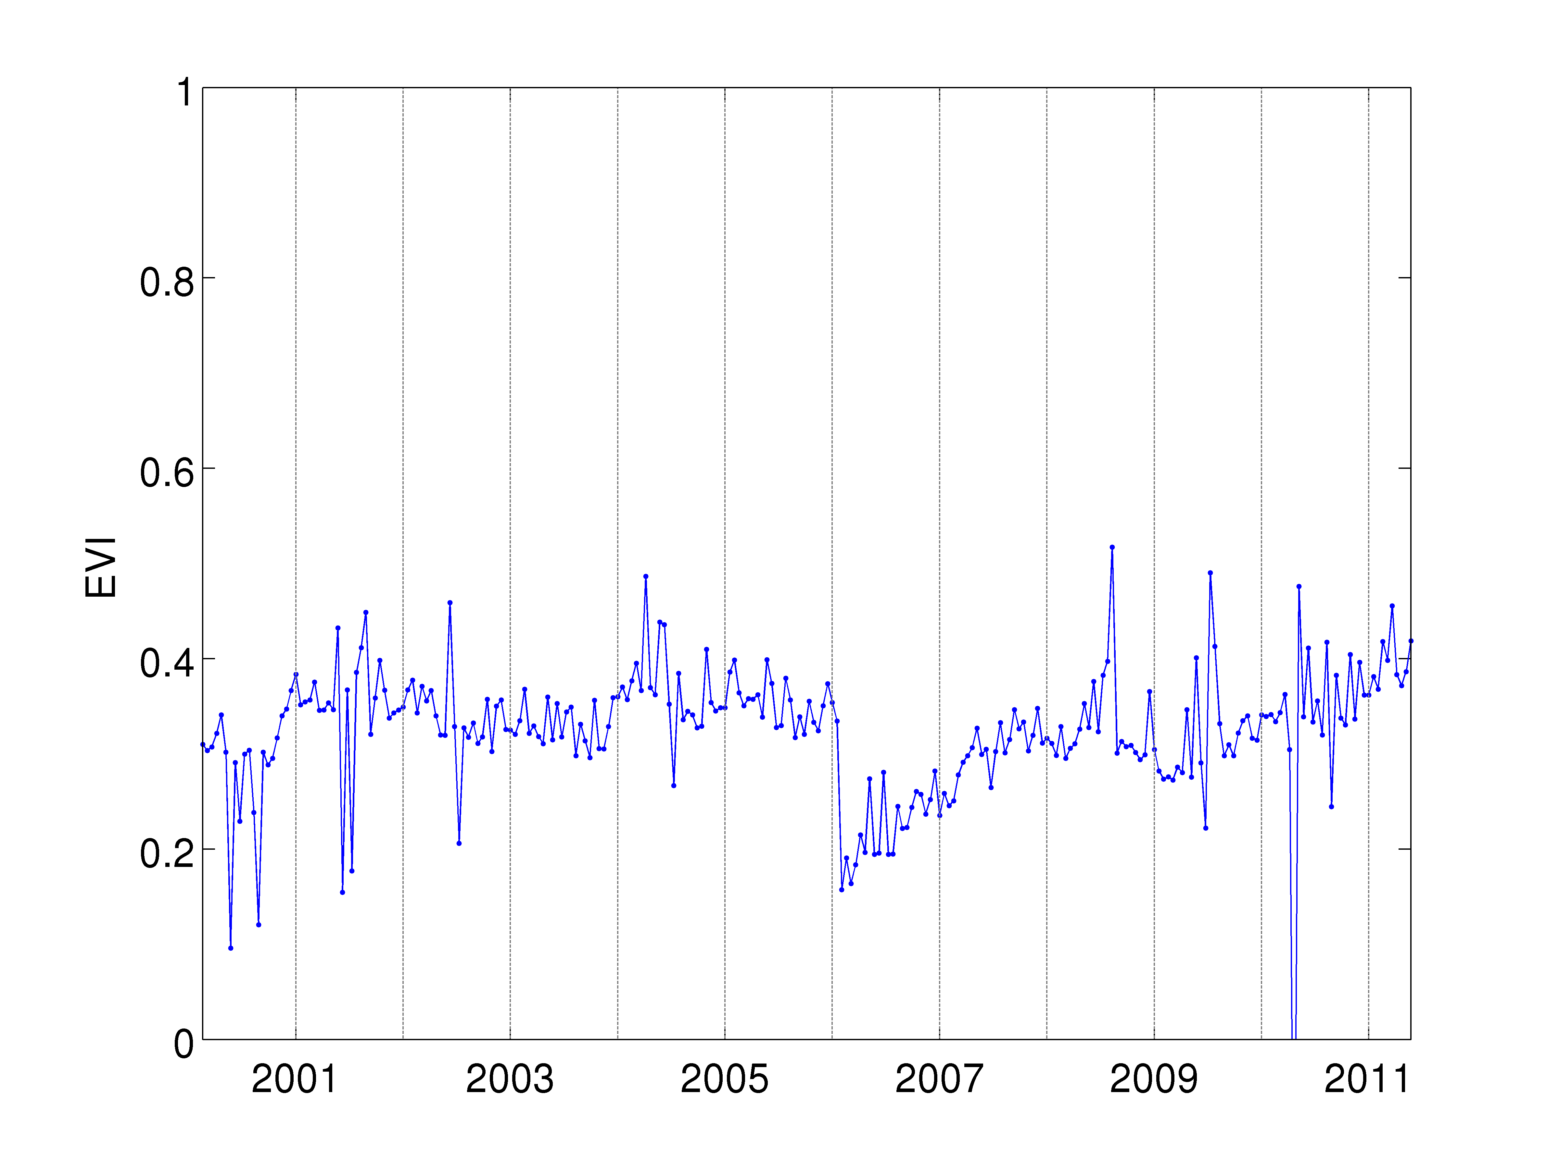
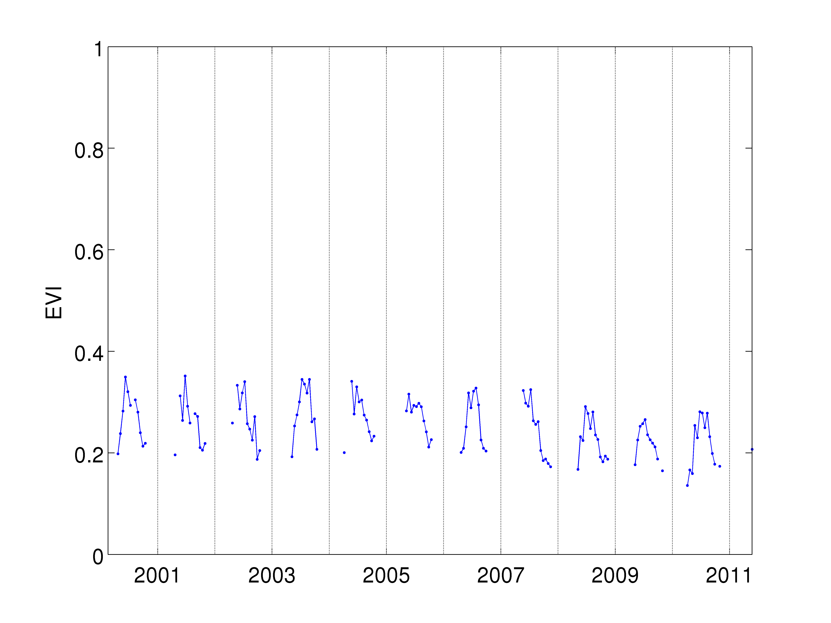
Data & Computational Challenges
Illustrative Example: Land Surface Monitoring
…but there are two billion time series…

Slide 21

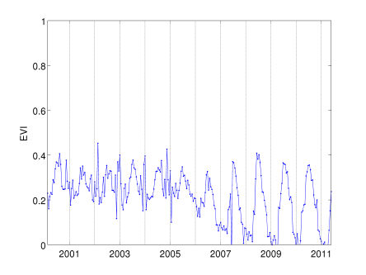
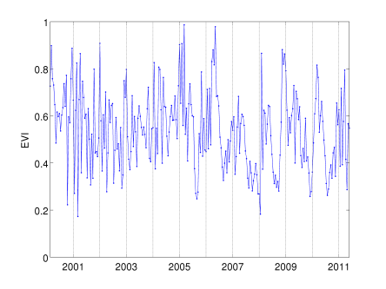
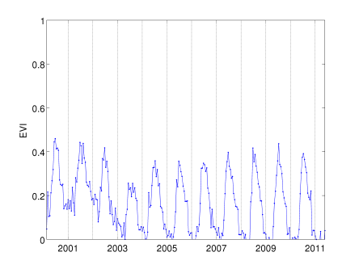
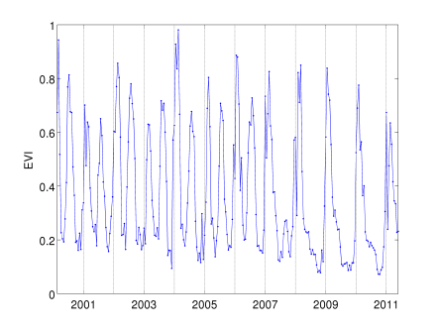
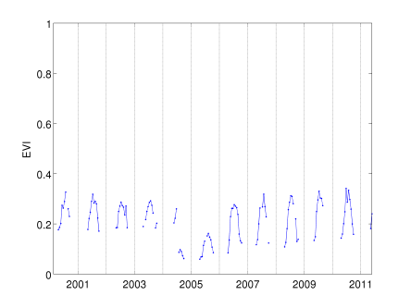
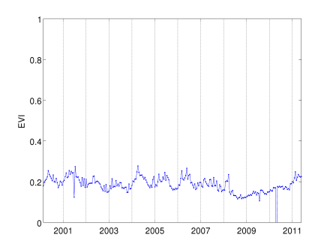
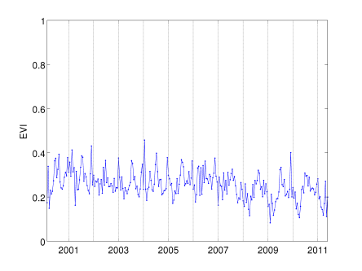
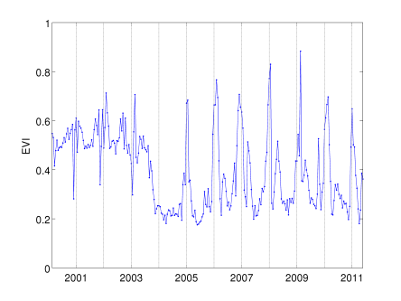
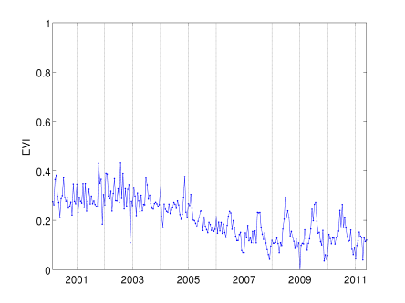

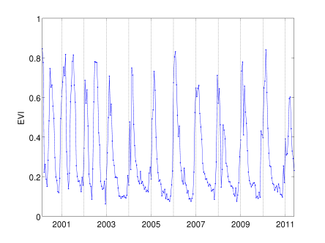




Data & Computational Challenges
Illustrative Example: Land Surface Monitoring
…and every one is different!

Slide 22


Data & Computational Challenges
Illustrative Example: Dependencies & Teleconnections
Massive search space and multiple hypothesis,
requires significance testing
Potential presence of time lags
Non-linear relationships
Relationships often exist
only in subspaces of
the data, i.e., some
geographic regions
and time intervals
Nino 1+2 Index

Slide 23


Data & Computational Challenges
Illustrative Example: Spatio-Temporal Classification & Regression
Spatial and temporal autocorrelation
  Non-i.i.d. data
  Requires suitable evaluation metrics
Non-stationarity, heteroskedasticity
Dependent variables may be extreme events
High dimensionality and multivariate
  Feature selection
  Dimensionality reduction
  Sparse methods
Heterogeneity in space and time
Sparse regression of temperature in Brazil using multiple input variables
Classification of wetlands using spatial decision trees

Slide 24

Active Research Projects
GOPHER: Global Observatory for Planetary Health and Resources
  Project Aim: Monitoring of global ecosystem for
  changes in land cover, land use, etc.
NSF Expeditions: Understanding Climate Change – A Data Driven Approach
Project Aim: Develop novel data analysis
methods to help improve understanding
and prediction of climate change
NSF Expeditions in Computing

Slide 25


ALERTS: Automated Land change Evaluation, Reporting and Tracking System
Planetary Information System
for interactive investigation of ecosystem disturbances discovered by GOPHER
  Forest Fires
  Deforestation
  Droughts
  Urbanization
  …
Helps quantify carbon impact
of changes, understand the relationship between climate variability and human activity
Provides ubiquitous web-
based access to changes occurring across the globe, creating public awareness

Slide 26


Novel Change Detection Techniques
Current methods are not adequate to address these challenges. We focus on developing algorithms that are:
Robust to missing data, noise and outliers
Able to automatically characterize different types of changes
Capable of incremental update and (near) real-time detection
Aware of spatial context
Segmentation Approaches: Divide time series into pieces and determine if a change occurred
Before After
Prediction-Based Methods:
Build model of the “normal” behavior and predict, measure deviation
Model + Predict

Slide 27
Global Change Points

Slide 28

Northern Hemisphere Changes

Slide 29









Illustrative Examples
Large forest fires in Canada have converted the forests from a sink into source of carbon in the atmosphere.
Logging is legal in some parts of Canada, further reducing carbon sequestration
Brazil Accounts for almost 50% of all humid tropical forest clearing, nearly 4 times that of the next highest country.
Lake Chad (Nigeria) shrunk by as much as 90% over the past two decades.

Slide 30





Illustrative Examples
Examples of afforestation can be seen in several areas around the world, including this region near Beijing (China) where new trees have been planted to prevent dust storms and erosion.
Hurricane Katrina caused significant damage and vegetation loss along the US Gulf Coast.
One winter the Ob River caused massive flooding due to freezing of the Bay of Ob / Kara Sea.
Political conflict and the ensuing “land reform” resulted in wide-spread farm abandonment and loss of productivity in Zimbabwe between 2004 and 2008.

Slide 31

Impact on REDD+
“The [Peru] government needs to spend more than $100m a year on high-resolution satellite pictures of its billions of trees.
But … a computing facility developed by the Planetary Skin Institute (PSI) … might help cut that budget.”
“ALERTS, which was launched at Cancún, uses … data-mining algorithms developed at the University of Minnesota and a lot of computing power … to spot places where land use changed.”
(The Economist 12/16/2010)

Slide 32




Understanding Climate Change:
A Data Driven Approach
5-year / $10M NSF Expeditions in Computing
Team led by UMN, consists of 15 senior personnel and ~50 students and post-docs
Developing state of the art computational methods to address research questions in climate sciences

Slide 33

















Expeditions Team
Vipin Kumar, UM Auroop Ganguly, NEU Nagiza Samatova, NCSU Arindam Banerjee, UM Fred Semazzi, NCSU
Joe Knight, UM Shashi Shekhar, UM Peter Snyder, UM Jon Foley, UM Alok Choudhary, NW Ankit Agrawal, NW
Abdollah Homiafar Michael Steinbach Singdhansu Chatterjee Karsten Steinhaeuser Stefan Liess Shyam Boriah
NCA&T UM UM UM UM UM

Slide 34



Climate Change: Defining Issue of our Era
The planet is warming
  Multiple lines of evidence
  Credible link to human GHG
  (green house gas) emissions
Consequences can be dire
  Extreme weather events
  Regional climate and ecosystem shifts
  Abrupt climate change
  Stress on key resources and
  critical infrastructures
There is an urgency to act
  Adaptation: “Manage the unavoidable”
  Mitigation: “Avoid the unmanageable”
The societal cost of both action and
inaction is large
Key outstanding science challenge:
Actionable predictive insights to credibly inform policy

Slide 35



Understanding Climate Change
Physics Based Approach
General Circulation Models: Mathematical models with physical equations based on fluid dynamics
Cell
Parameterization and non-linearity
of differential equations are sources for uncertainty!
Clouds
Land
Ocean
Figure Courtesy: ORNL
A2: “divided world” with local fuels
A1B: “integrated world” with balance of fuels
B1: “integrated world”, environmentally conscious
IPCC (2007)
Projection of temperature increase under different Special Report on Emissions Scenarios (SRES) by 24 different GCM configurations from 16 research centers used in the Intergovernmental Panel on Climate Change (IPCC) 4th Assessment Report.

Slide 36

Understanding Climate Change
Physics Based Approach
General Circulation Models: Mathematical models with physical equations based on fluid dynamics
Cell
Parameterization and non-linearity
of differential equations are sources for uncertainty!
Clouds
Land
Ocean
Figure Courtesy: ORNL
Disagreement between IPCC models
Physics based models are essential but not adequate
  Relatively reliable predictions at global scale for ancillary variables such as temperature
  Least reliable predictions for variables that are crucial for impact assessment such as regional precipitation
“The sad truth of climate science is that the most crucial information is the least reliable” (Nature, 2010)
Regional hydrology exhibits large variations among major IPCC model projections

Slide 37







Expeditions Project Highlights
Hurricane Intensity Prediction
and Land-Fall Modeling
Climate Extremes and Uncertainty
Teleconnections & Sparse Predictive Modeling
High-Performance Data Analytics
El Nino Events
Nino 1+2 Index

Slide 38
Illustrative Example: Dipole Discovery
Are there any dominant dipole patterns in the climate system beyond the well-known oscillations (e.g., ENSO, NAO, AAO)?
How to identify centers of action that are negatively correlated with each other at significant levels over long periods of time?
Novel algorithm for dipole discovery
  Graph-based approach
  Has advantages over traditional techniques (e.g., EOF analysis)
  Methodology to test statistical significance
Discovered known dipoles, and potentially new phenomena
Can be used for model evaluation

Slide 39


Data-Driven Discovery of Dipoles
Dipoles represent a class of teleconnections characterized by anomalies of opposite polarity at two locations at the same time.

Slide 40




Importance of Dipoles
Crucial for understanding the climate system and are known to cause temperature and precipitation anomalies throughout the globe.
NAO influences sea level pressure (SLP) and temperature over the Northern Hemisphere.
SOI strongly influences global climate variability.
Correlation of land temperature anomalies with NAO
Correlation of land temperature anomalies with SOI

Slide 41


List of Major Climate Oscillations
Discovered primarily by human observation or by EOF analysis.
AO: EOF Analysis of 20N-90N Latitude
van Loon & Rogers, 1978
Wallace & Gutzler, 1981
von Storch & Zwiers, 2002
AAO: EOF Analysis of 20S-90S Latitude

Slide 42



Graph-Based Approach for Dipole Discovery
Climate Network
Nodes in the Graph correspond to grid points on the globe.
Edge weight corresponds to correlation between the two anomaly time series
Steinbach et al., 2003
Tsonis et al., 2004, 2006
Donges et al., 2009a,b
Kawale et al., 2011
Discovered Dipoles

Slide 43

Benefits of Automatic Dipole Discovery
Detection of Global Dipole Structure
  Most known dipoles discovered
  New dipoles may represent previously unknown phenomenon.
  Enables analysis of relationships between different dipoles
Location based definition possible for some known indices that are defined using EOF analysis.
Dynamic versions are often better than static
Dipole structure provides an alternate method to analyze GCM performance
CIDU’11: Best Student Paper Award
SC’11: Explorations in Science through Computation Award
Grace Hopper’12: Best Poster Award (Winner of the ACM Student Research Competition)
Kawale et al., 2011a,b, 2012

Slide 44



Location Based definition of AO
Mean Correlation between static and dynamic index: 0.84
Impact on land temperature anomalies comparatively same using static and dynamic index
Static AO: EOF Analysis of 20N-90N Latitude
Impact on Land temperature Anomalies using Static and Dynamic AO

Slide 45



Location Based definition of AAO
Mean Correlation between Static and Dynamic index = 0.88
Impact on land temperature anomalies comparatively same using static and dynamic index
Static AAO: EOF Analysis of 20S-90S Latitude
Impact on Land temperature Anomalies using Static and Dynamic AAO

Slide 46


Static vs Dynamic NAO Index - Impact on land temperature
Static Index
Dynamic Index
The dynamic index generates a stronger impact on land temperature anomalies as compared to the static index.
Figure to the right shows the aggregate area weighted correlation for networks computed for different 20 year periods during 1948-2008.

Slide 47


Static vs Dynamic SO Index - Impact on land temperature
Static Index
Dynamic Index
The dynamic index generates a stronger impact on land temperature anomalies as compared to the static index.
Figure to the right shows the aggregate area weighted correlation for networks computed for different 20 year periods during 1948-2008.

Slide 48




A New Dipole near Australia?
Comparison of dipoles by looking at land temperature impact.
Significant difference between the AAO impact and that due to dipoles 1,2,3 which are similar
It is possible that this may be a new phenomenon but this is still under speculation.
AAO
AAO
1
2
1
3
3

Slide 49






Composites of ASO dipole from Hadley center SLP data on Hadley center SLP at 95% confidence
ASO
AAO
SOI
WHOLE YEAR
SOUTHERN WINTER (JJA)

Slide 50






Composites of ASO dipole from Hadley center SLP data on MERRA TAS data at 95% confidence
ASO
AAO
SOI
WHOLE YEAR
SOUTHERN WINTER (JJA)

Slide 51






Composites of ASO dipole from Hadley center SLP data on
GPCP precipitation data at 95% confidence
ASO
AAO
SOI
WHOLE YEAR
SOUTHERN WINTER (JJA)

Slide 52




Model Evaluation and Comparison:
Dipole Structure in CCSM and GFDL models for CMIP3 and CMIP5 versions
GFDL (CMIP3)
GFDL (CMIP5)
SOI present
SOI present
CCSM(CMIP3)
CCSM (CMIP5)
SOI absent
SOI present

Slide 53
Concluding Remarks
Global change is a defining societal challenge of our generation
Data-guided discovery methods can play a major role in answering some of the key questions
Significant advances in spatio-temporal data mining methodologies are needed to harness these opportunities

Slide 54
Thank You! Questions?
UMN Team Members
Vipin Kumar, Arindam Banerjee, Shyam Boriah, Snigdhansu Chatterjee, Jonathan Foley, Joseph Knight, Stefan Liess, Shashi Shekhar, Peter Snyder, Michael Steinbach, Karsten Steinhaeuser
UMN Students
Graduate: Ivan Brugere, Yashu Chamber, Xi Chen, James Faghmous, Jaya Kawale, Arjun Kumar, Michael Lau, Varun Mithal; Undergraduate: Kelly Cutler, Ryan Haasken, Zachary O’Connor, Dominick Ormsby
PSI Collaborators NSF Expeditions Collaborators
NASA Ames: Christopher Potter NCSU: Nagiza Samatova, Fredrick Semazzi
Cal State Monterey Bay: Stephen Klooster Northeastern: Auroop Ganguly
Michigan State: Pang-Ning Tan Northwestern: Alok Choudhary, Wei-keng Liao
PSI: Juan Carlos Castilla-Rubio North Carolina A&T: Abdollah Homaifar
website: gopher.cs.umn.edu website: climatechange.cs.umn.edu
Acknowledgements Contributors
Grant IIS-1029711

