Slide 1
Urbanization in Greater Noida
Event 7

Slide 2
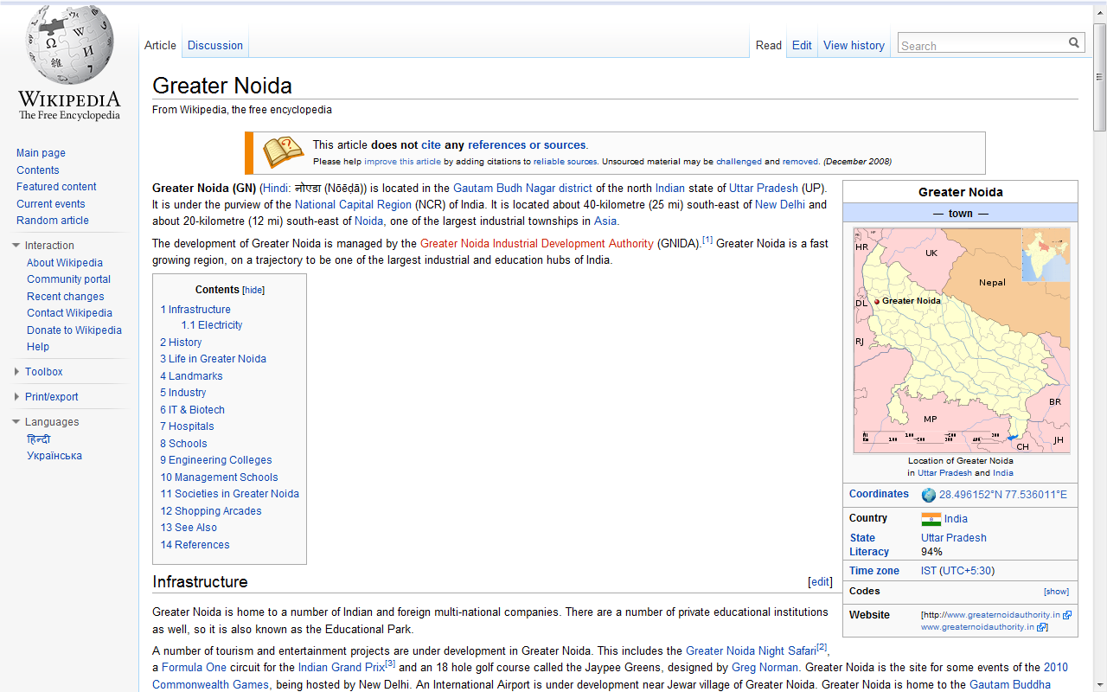
http://en.wikipedia.org/wiki/Greater_Noida

Slide 3
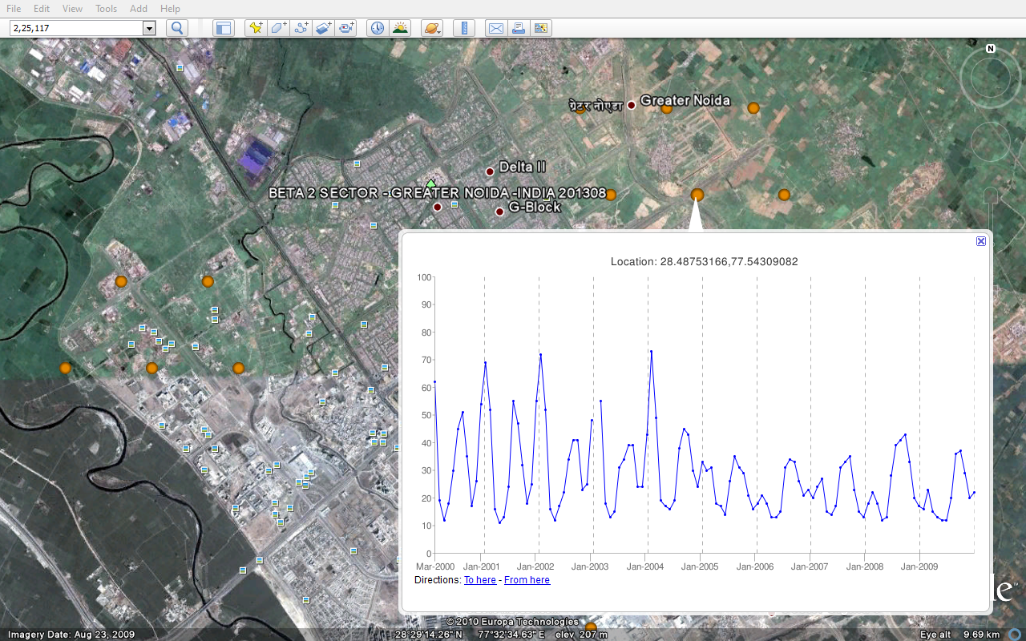

Slide 4
