Slide 1
Submerging of surrounding areas by the reservoir : Banasura Sagar Dam, Kerala
Event 8

Slide 2
Banasura Sagar Dam, Kerala
Among the other interesting events detected by our algorithm, one of them is the creation of islands in the Kabini River which feeds the Banasura Sagar Dam. These were formed when the reservoir submerged the surrounding areas. The islands with the Banasura hills in the background provide a spectacular view.
The Banasura Sagar Dam is located 21 km from Kalpetta, in Wayanad District of Kerala in the Western Ghats. It is the largest earthen dam in India and the second largest in Asia and an ideal starting point for hikes into the surrounding scenic mountains.^{[2]} It is an important tourist attraction.

Slide 3
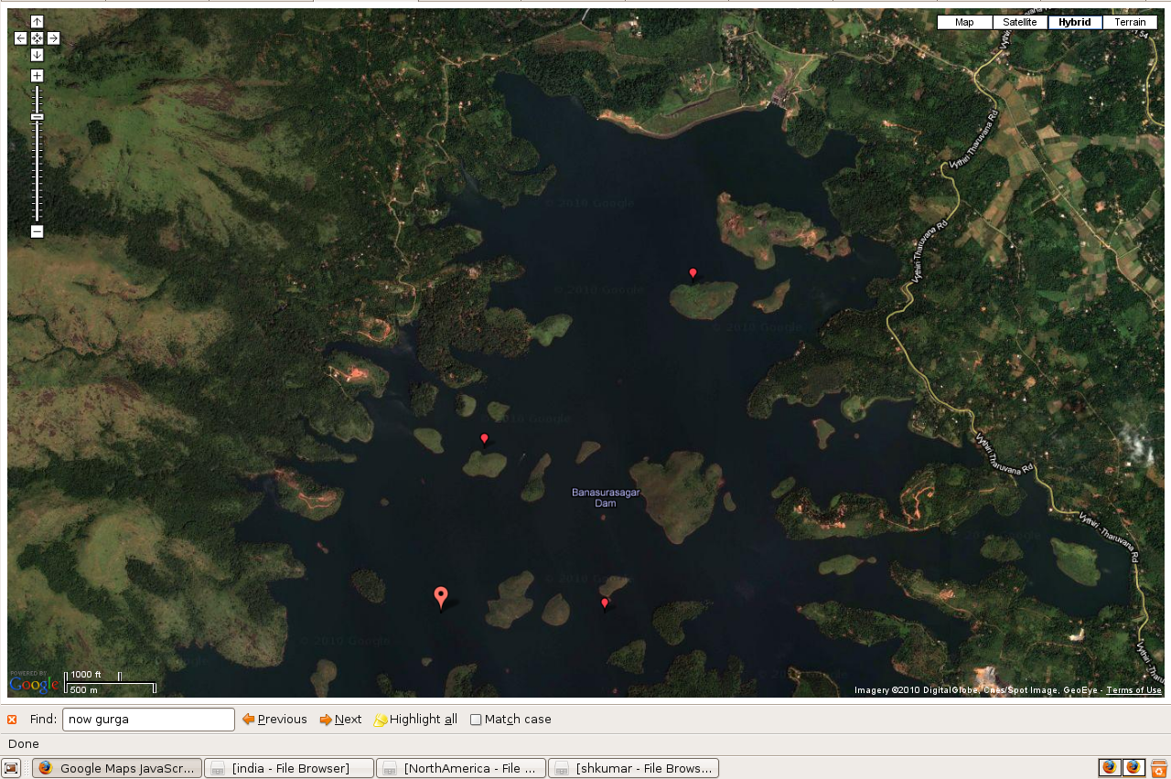

Slide 4
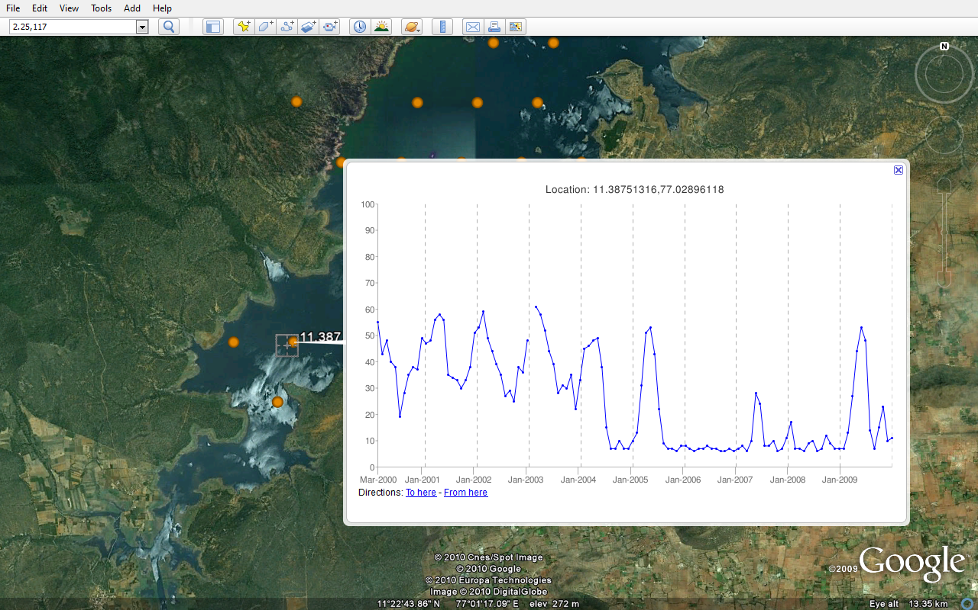

Slide 5
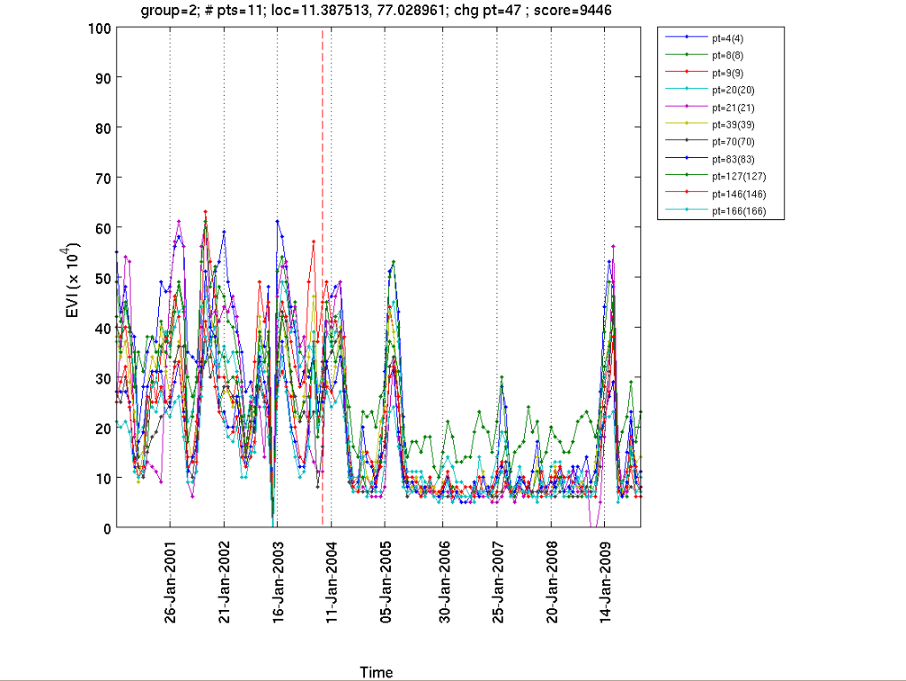

Slide 6
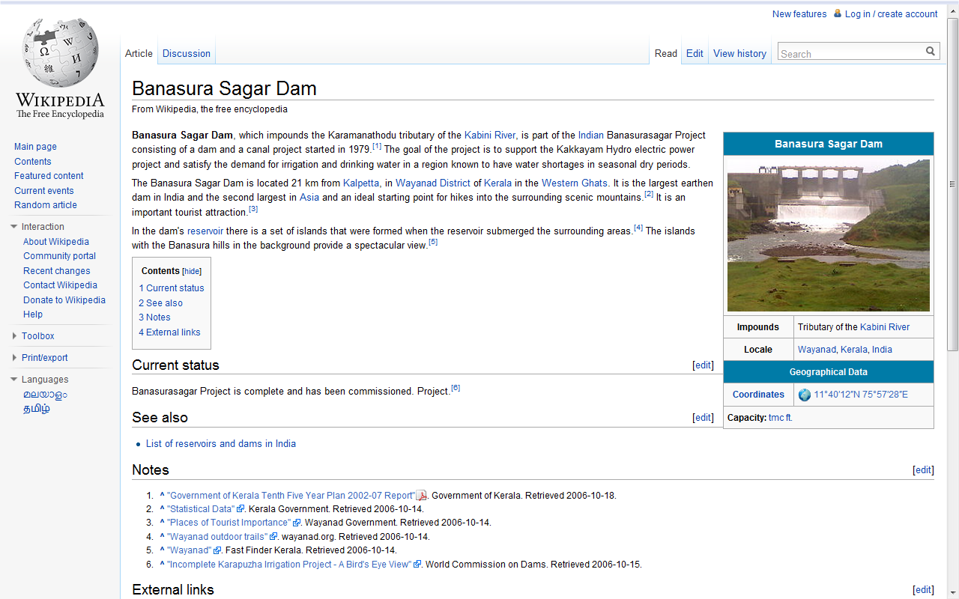
“the dam's reservoir there is a set of islands that were formed when the reservoir submerged the surrounding areas.^{[4]} The islands with the Banasura hills in the background provide a spectacular view.”
Source: http://en.wikipedia.org/wiki/Banasura_Sagar_Dam

Slide 7
Source : http://www.indianetzone.com/33/banasura_sagar_dam_kerala.htm

