Slide 1



Towards a food-energy-water-nexus data and data science community:
Big Data Analytics for Monitoring Global Surface Water Dynamics
Vipin Kumar
University of Minnesota
kumar@cs.umn.edu
www.cs.umn.edu/~kumar

Slide 2
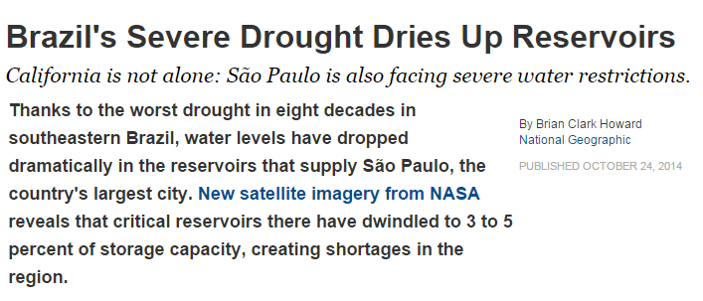
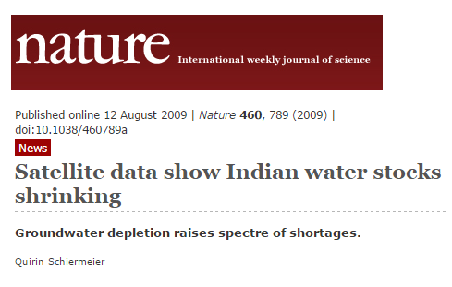

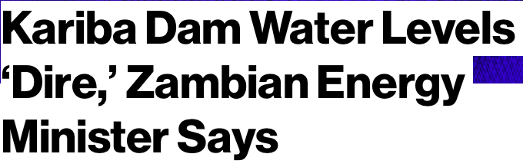
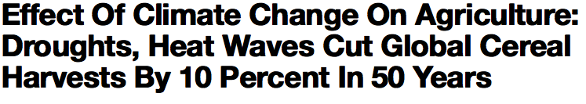
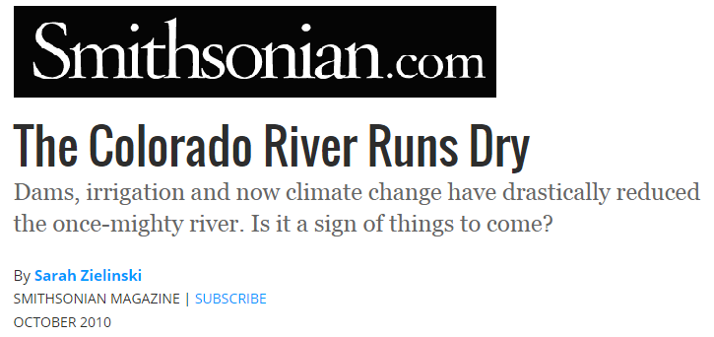

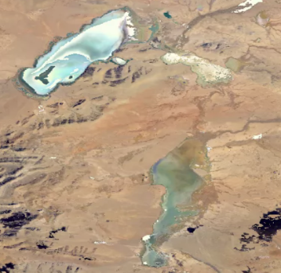
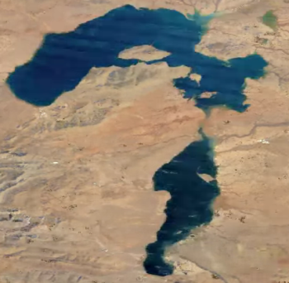
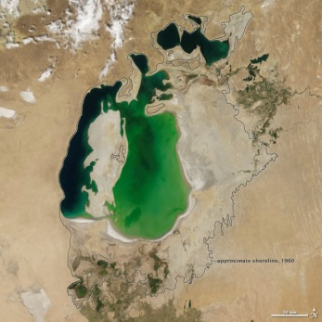
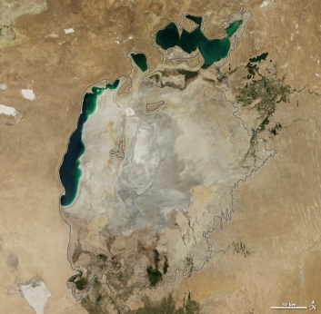
Importance of Monitoring Surface Water Dynamics in the Context of Food-energy-water Nexus
Cedo Caka Lake
in Tibet, 2011
Cedo Caka Lake
in Tibet, 1984
Aral Sea in 2000
Aral Sea in 2014
Melting of glacial lakes in Tibet
Shrinking of Aral Sea since 1960s

Slide 3
Importance of Monitoring Surface Water Dynamics in the Context of Food-energy-water Nexus
Opportunity in using Remote Sensing Data
Multi-spectral data
  MODIS (at 500m, from 2000)
  Landsat (at 30m, from 1970s)
Can be used to classify every location at a given time as water or land (binary classes)
Ground truth on specific dates available from various sources: SRTM, GLWD
Cedo Caka Lake
in Tibet, 2011
Cedo Caka Lake
in Tibet, 1984
Aral Sea in 2000
Aral Sea in 2014
Melting of glacial lakes in Tibet
Shrinking of Aral Sea since 1960s

Slide 4

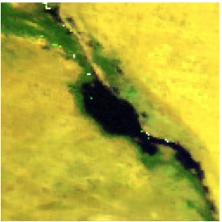
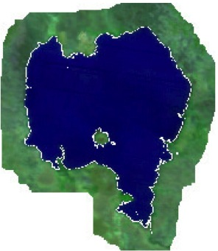
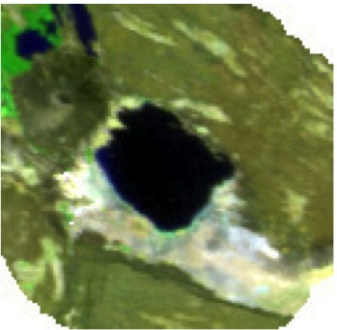
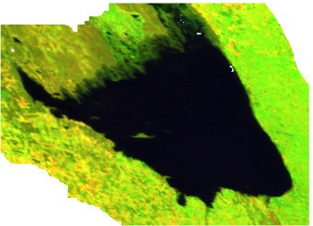
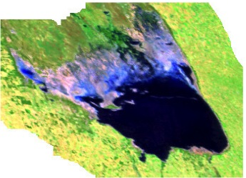
Challenges for Traditional Big Data Methods in Monitoring Water
Challenge 1: Heterogeneity in space and time
  Water and land bodies look different in different regions of the world
  Same water body can look different at different time-instances
Challenge 2: Data Quality
  Noise: clouds, shadows, atmospheric disturbances
  Missing data
Great Bitter Lake, Egypt
Lake Tana, Ethiopia
Lake Abbe, Africa
Poyang Lake, China
Mar Chiquita Lake, Argentina in 2000 (left) and 2012 (right)
(Pink color shows missing data)

Slide 5
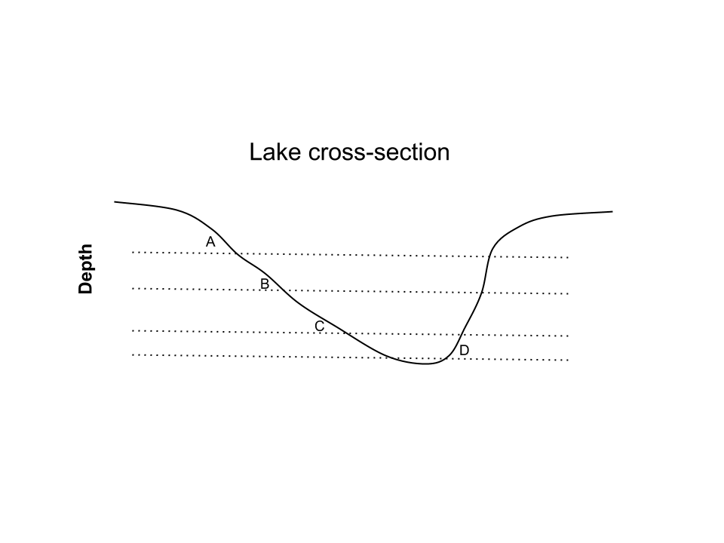
Method Innovations for Monitoring Water
Ensemble Learning Methods for Handling Heterogeneity in Data ^{1,2}
Using Physics Guided Labeling to Handle Poor Data Quality^{3,4}
Learn an ensemble of classifiers to distinguish b/w different pairs of positive and negative modes
Use elevation information to constrain physically-consistent labels
Positive Modes
(Water)
Negative Modes
(Land)
P₁
N₁
P₂
N₂
P₃
N₃
Elevation A > B > C > D
¹ Karpatne et al. SDM 2015
² Karpatne et al. ICDM 2015
³ Khandelwal et al. ICDM 2015
⁴ Mithal et al. (PhD Dissertation)

Slide 6
A Global Water Monitoring System http://z.umn.edu/monitoringwater
Summary of Capabilities:
  Maps the dynamics of all major water bodies (surface area > 2.5 km²) in the last 15 years across the world
    Identifies on-going droughts in Brazil and California
  Finds changes in river morphology (river meandering, delta erosion)
  Detects the construction of new dams and reservoirs
  Demonstrates strong relationships b/w surface water and ground water detected by GRACE

Slide 7
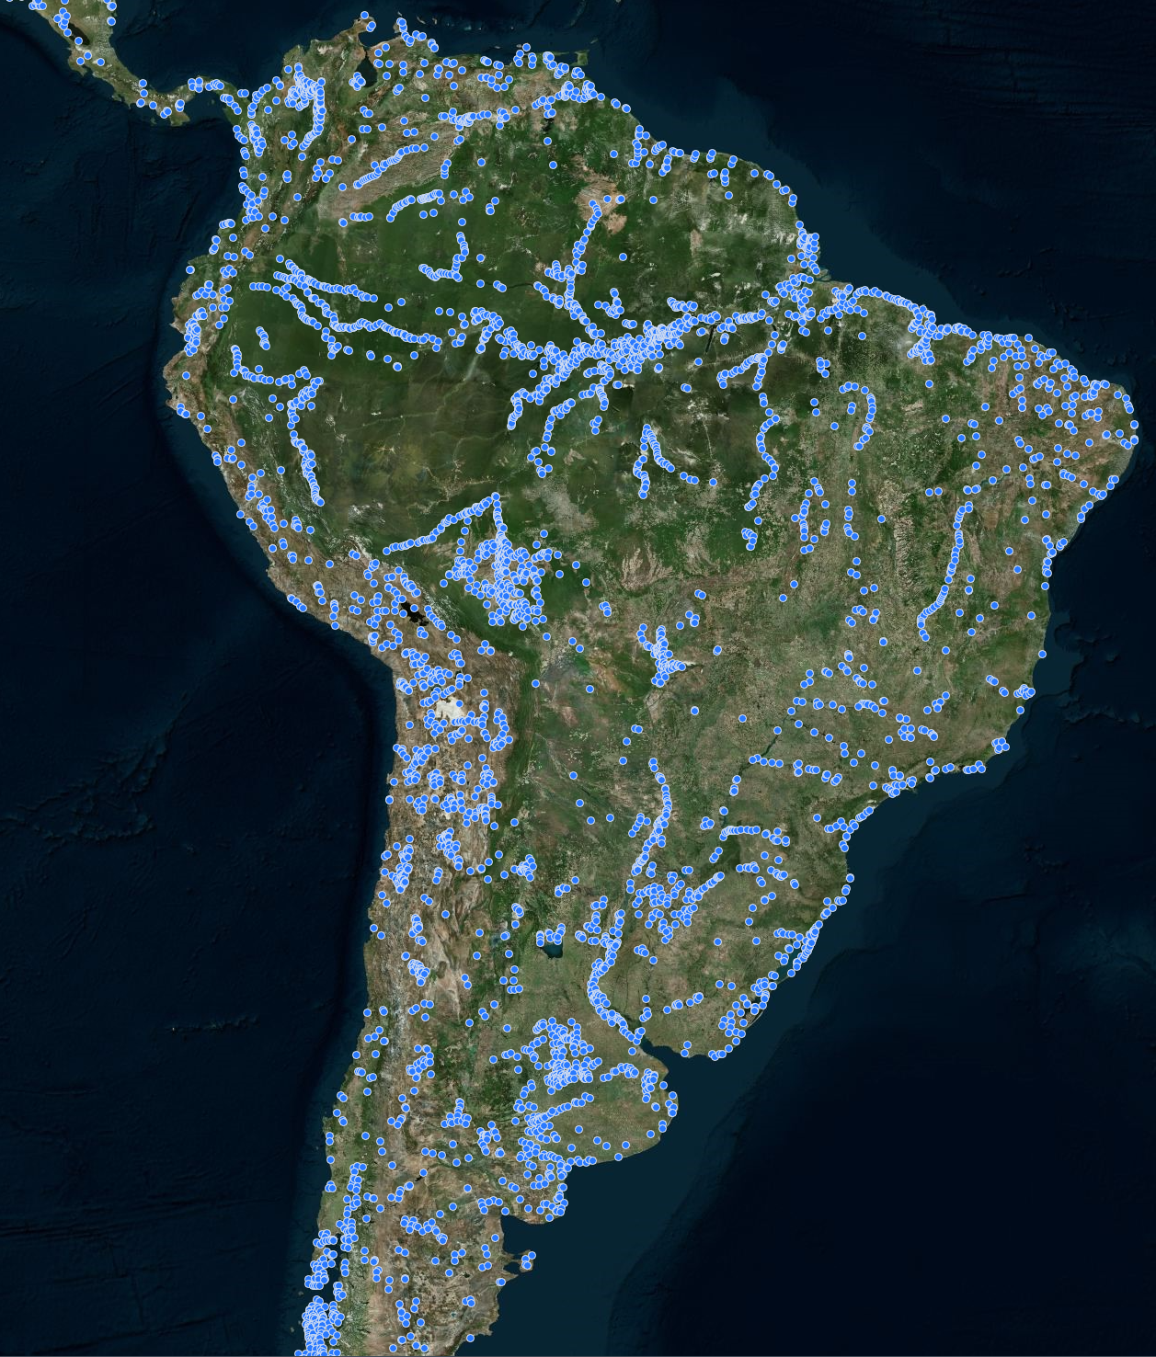
Global Maps of Water Bodies
Every blue dot is a water body, present in the last 15 years,
with size greater than 2.5 km²

Slide 8
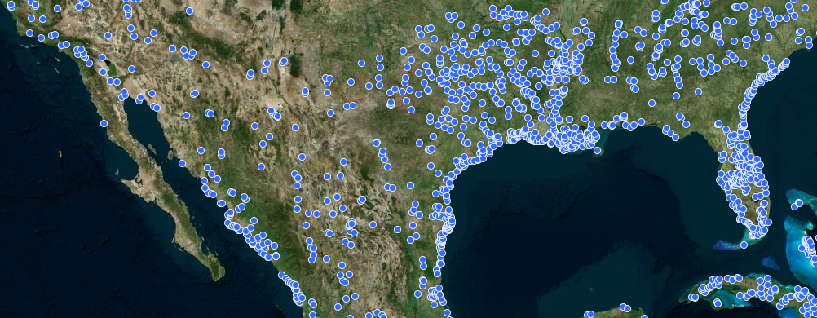
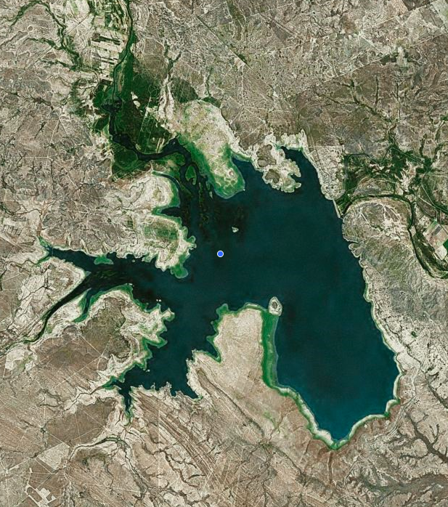
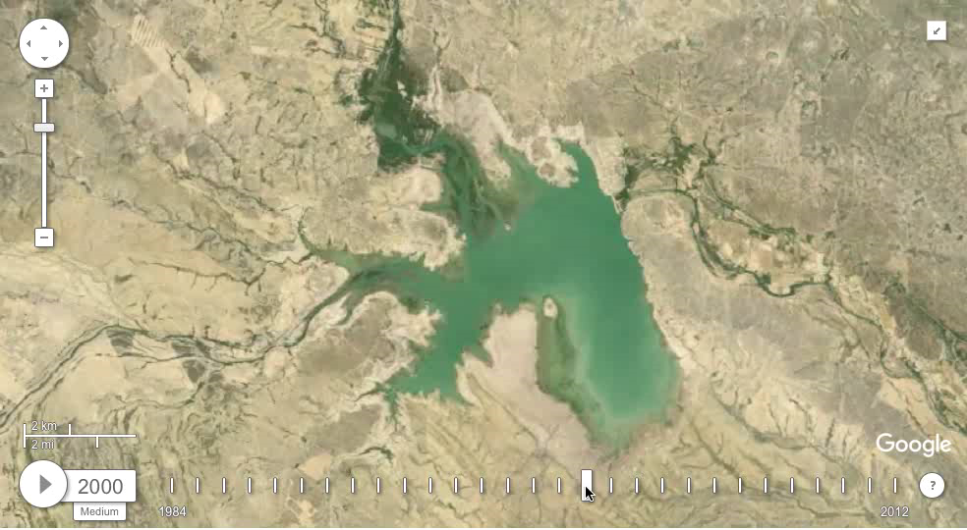
Showing Surface Water Dynamics
Annual Landsat Time-lapse of this region
(Courtesy: Google Earth Engine)
Don Martin Dam, Mexico
Surface area of water around Don Martin Dam across time

Slide 9
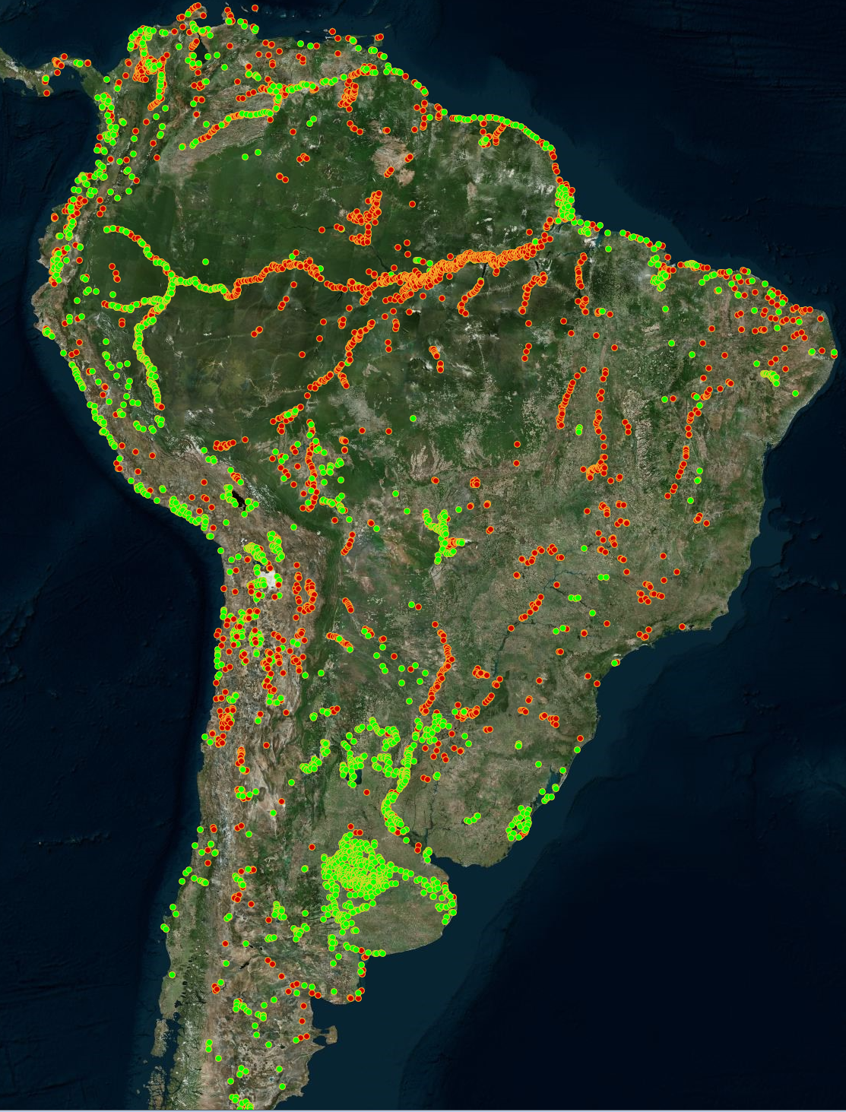
Regions of Change in South America
Red Dots (Water Gain):
Region of size > 2.5 km² that have changed from land to water in the last 15 years
Example time series of a Water Gain region
Green Dots (Water Loss):
Region of size > 2.5 km² that have changed from water to land in the last 15 years
Example time series of a Water Loss region

Slide 10
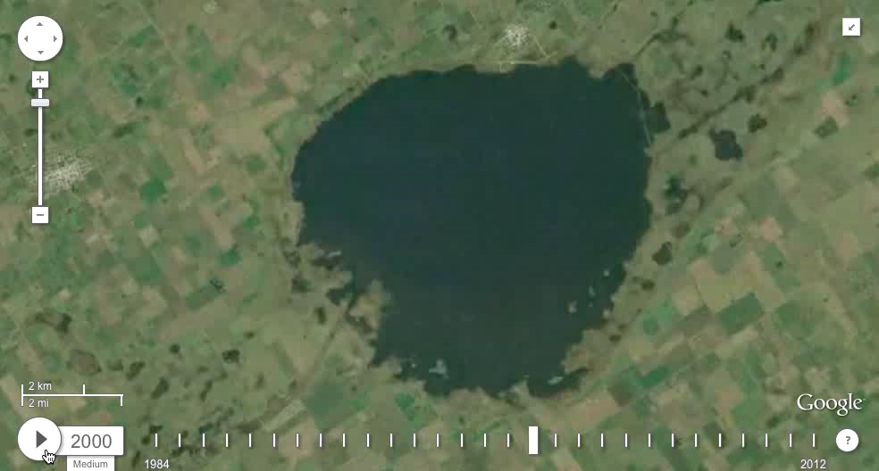
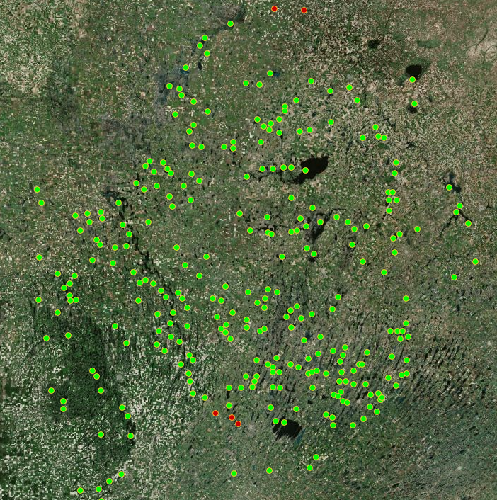
Examples of Change: Shrinking Water Bodies
(Green dots show regions changing from water to land in last 15 years)
Annual Time-lapse of an example green dot
Aggregate dynamics of all green dots shown on left

Slide 11
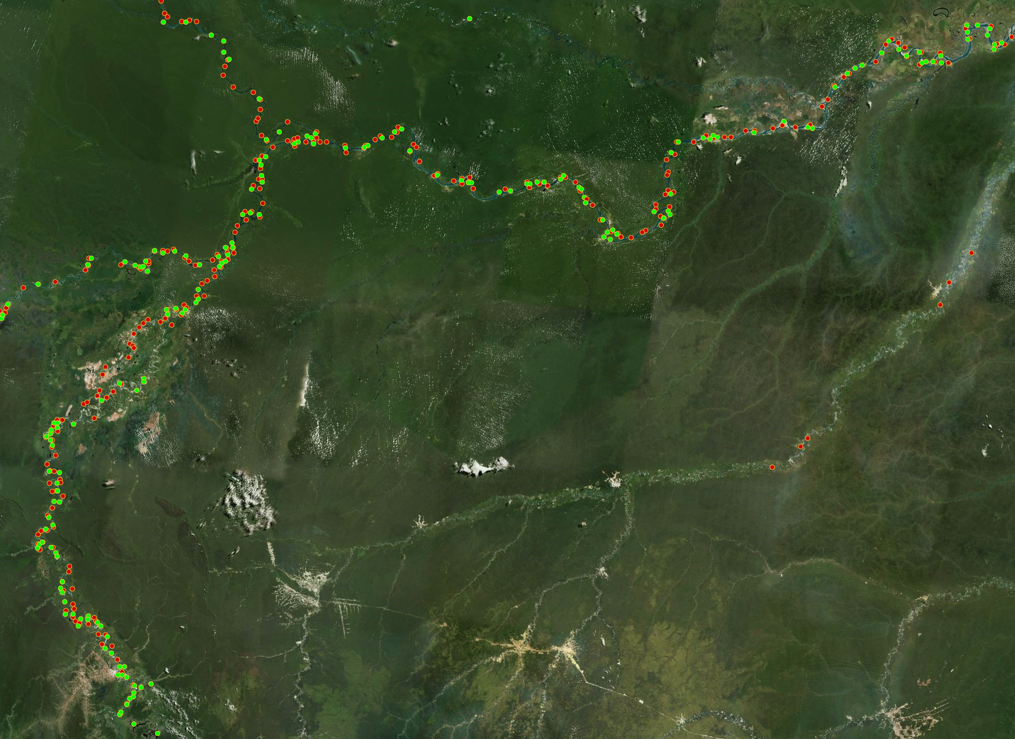
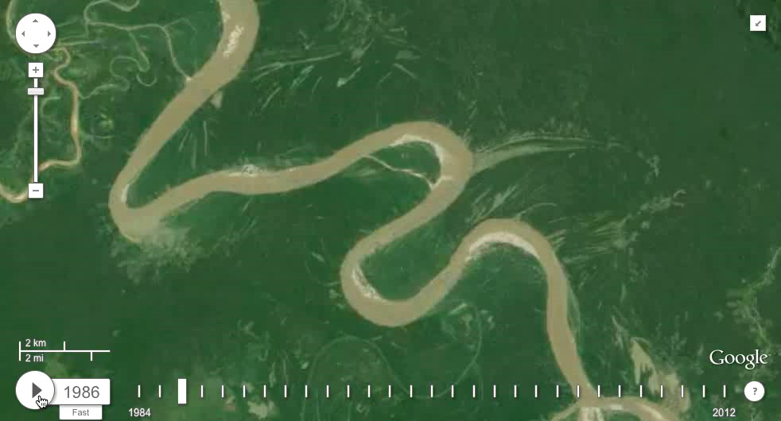
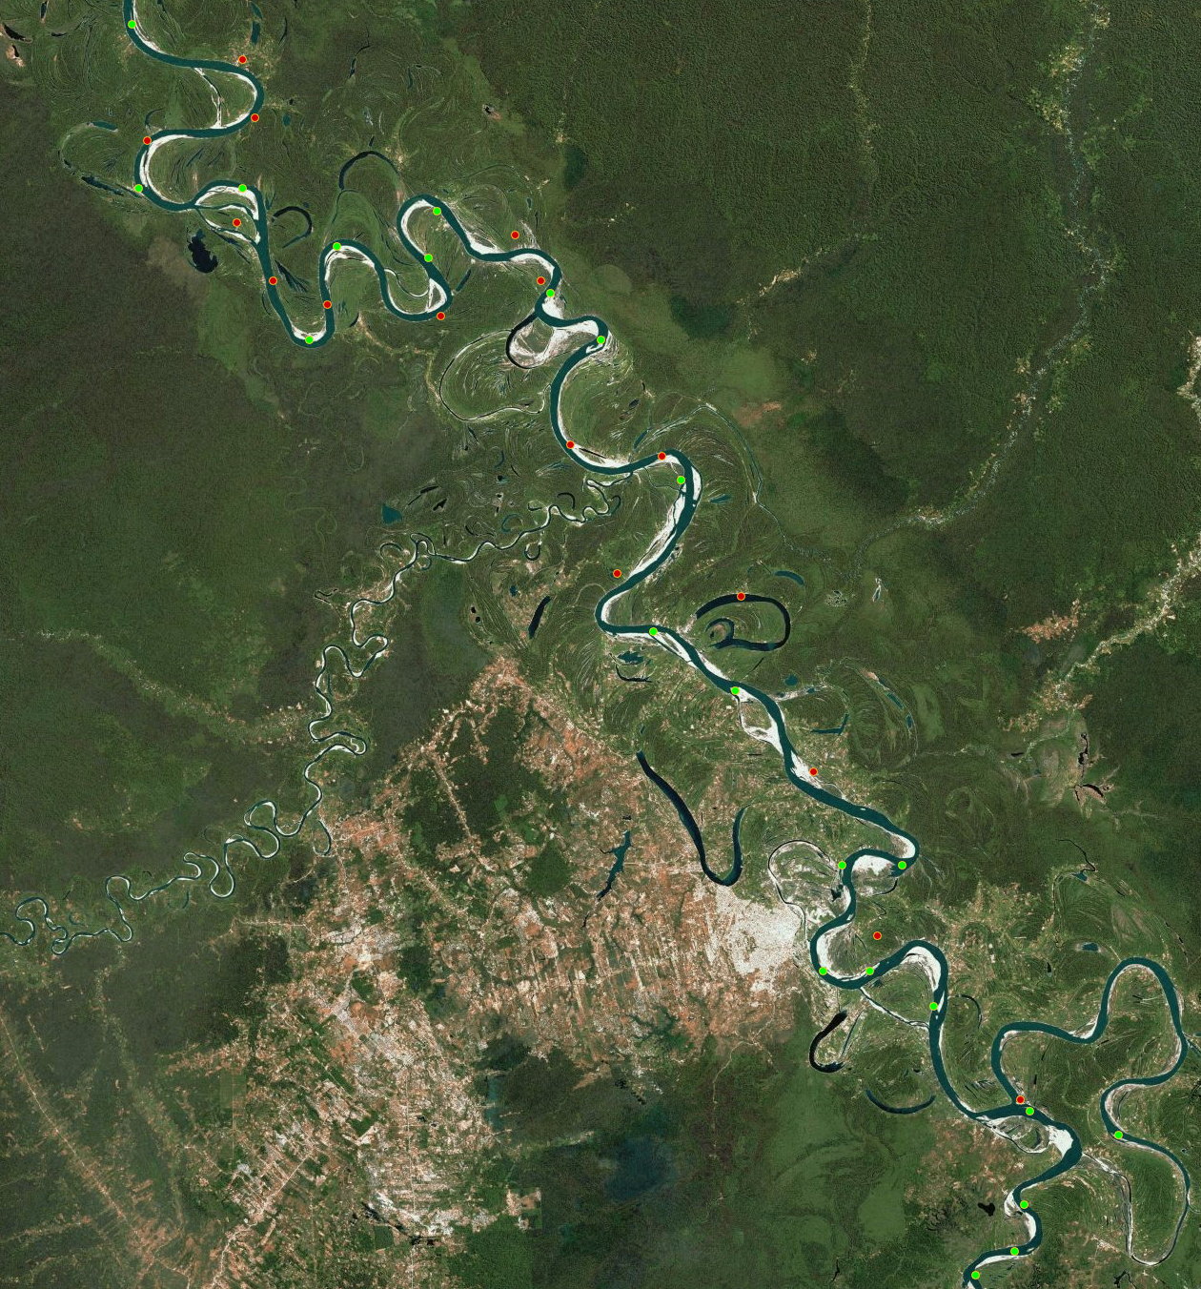
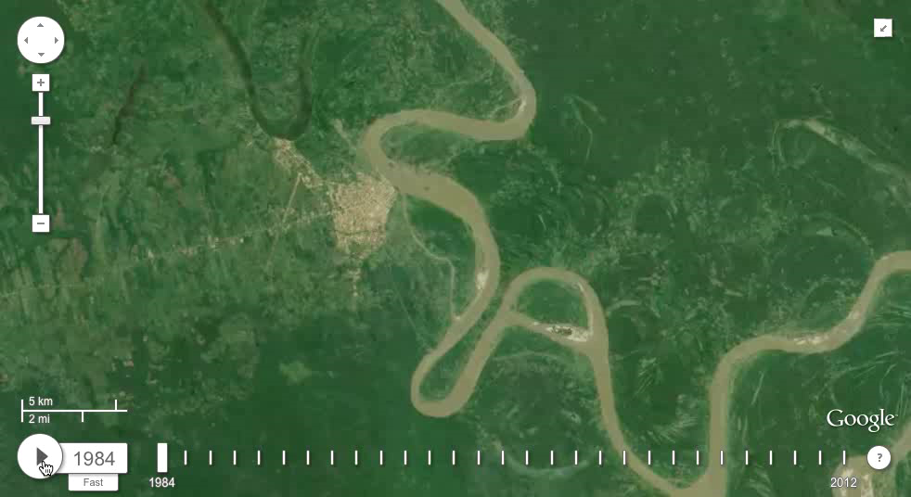
Examples of Change: River Meandering
(Adjacent occurrence of Water Gain (red) and Water Loss (green) regions all along the river indicate the displacement of water from the green dots to the red dots)
Time-lapse of 2
Zoomed-in View
2
Time-lapse of 1
Example time series of a Water Loss region
1
Example time series of a Water Gain region

Slide 12
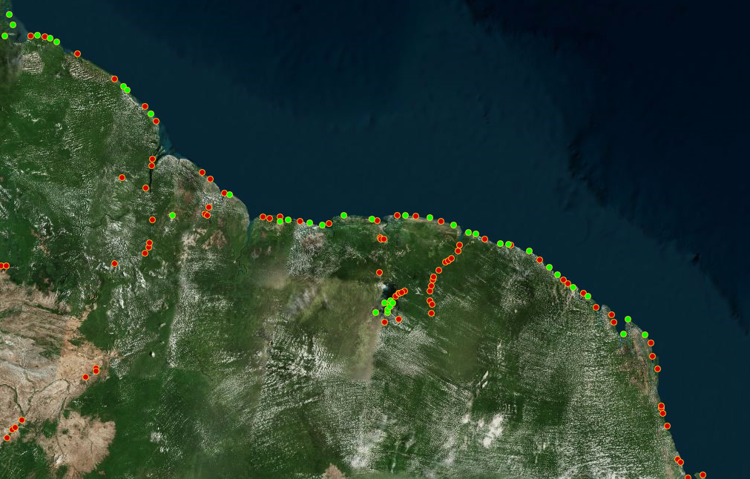
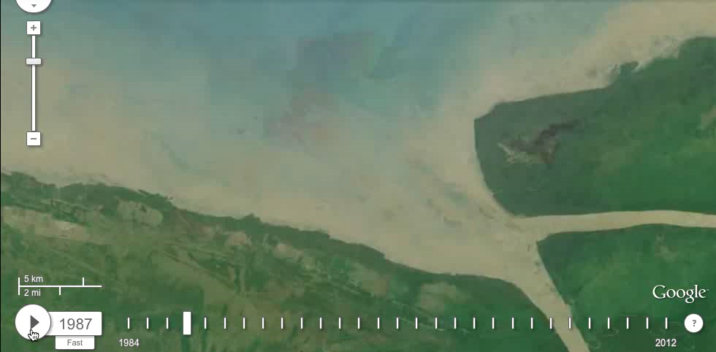
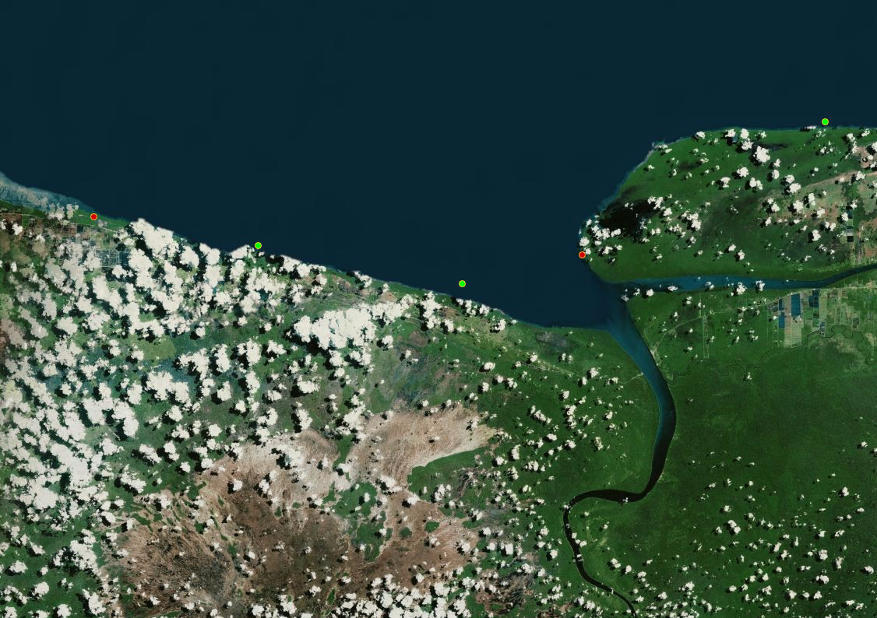
Examples of Change: Delta Erosion
(Water Gain and Water Loss regions appear on the coastline, due to displacement of sediments around river deltas)
Annual time-lapse of region shown on right
Zoomed-in View
Example time series of a Water Loss region
Example time series of a Water Gain region

Slide 13
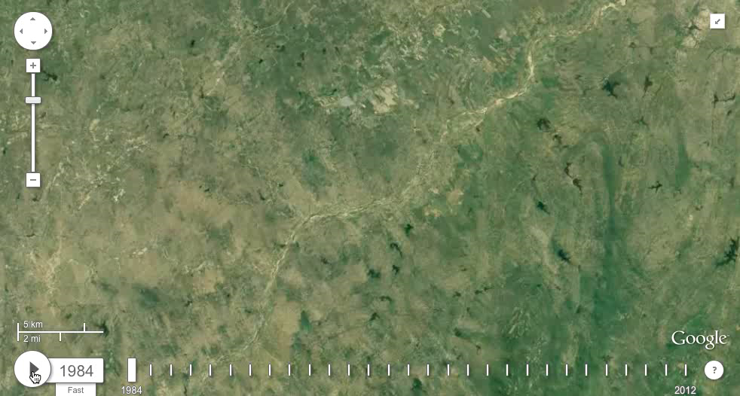
Examples of Change: Dam Constructions
Global Reservoir and Dam (GRanD) Database:
A data curation initiative by Global Water System Project (GWSP)
Finds dams constructed after 2001:
  (65 globally; 12 in Brazil)
UMN Approach:
Finds (458 globally; 134 in Brazil¹)
Construction of a dam characterized by a sudden and persistent increase in surface area
¹Prepared in collaboration with Juan Carlos, Planetary Skin Institute

Slide 14
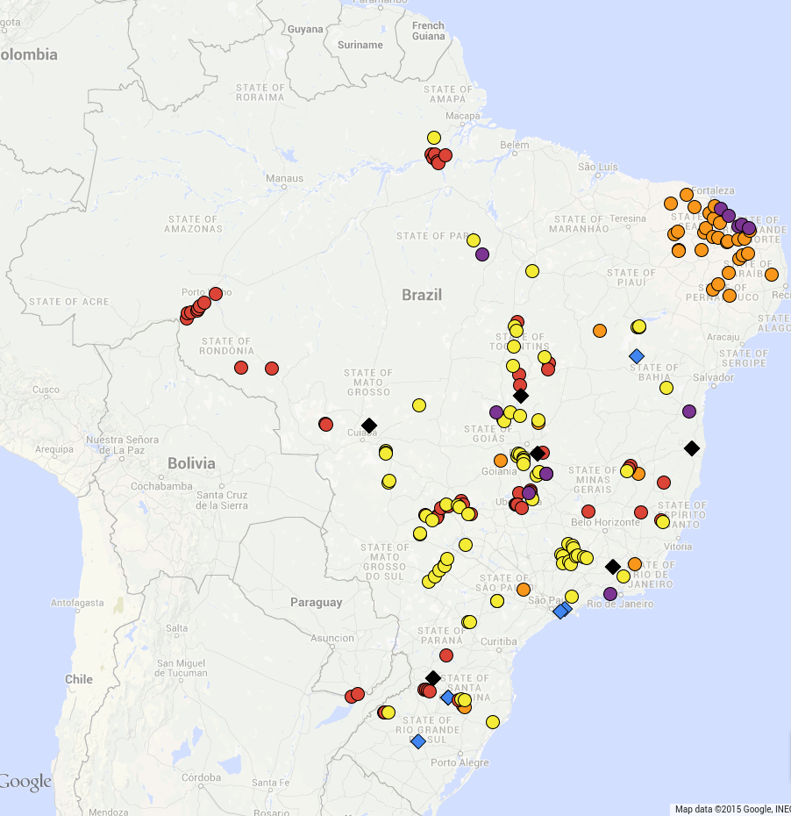
Examples of Change: Dam Constructions
Global Reservoir and Dam (GRanD) Database:
A data curation initiative by Global Water System Project (GWSP)
Finds dams constructed after 2001:
  (65 globally; 12 in Brazil)
UMN Approach:
Finds (458 globally; 134 in Brazil¹)
Only GRanD (5)
GRanD & UMN
(7)
Mining
(10)
Reported by CBDB
(44)
Hydro
Dams (41)
Agriculture Dams (32)
¹Prepared in collaboration with Juan Carlos, Planetary Skin Institute

Slide 15
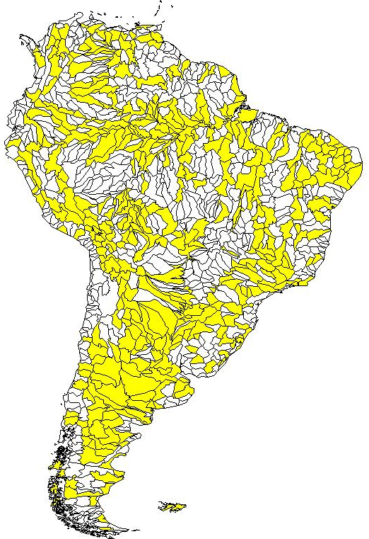
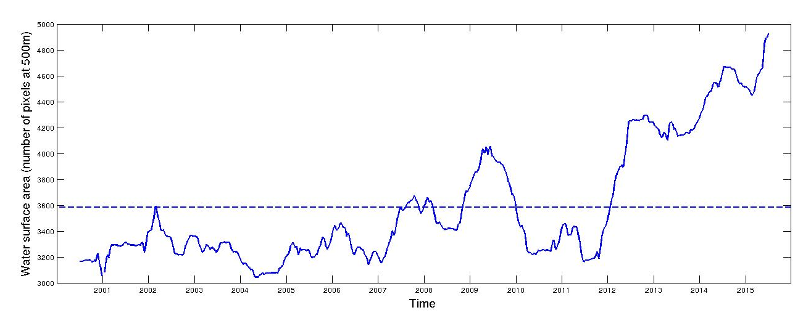
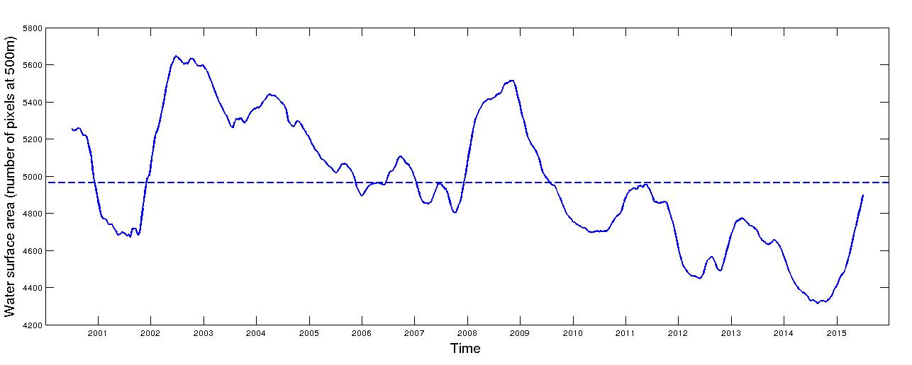
Aggregate Trends in Surface Water Dynamics
Surface Water Dynamics in Amazon
Surface Water Dynamics in NE Brazil

Slide 16
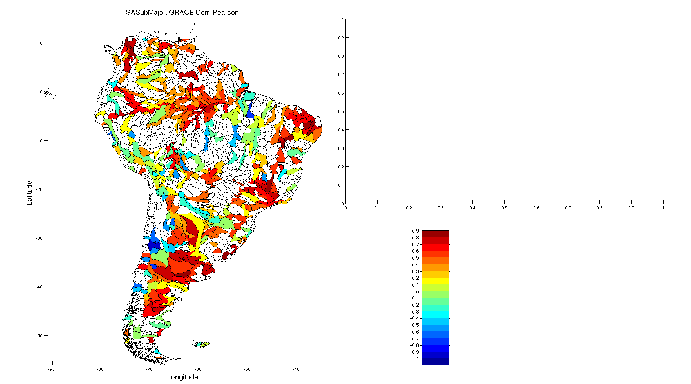
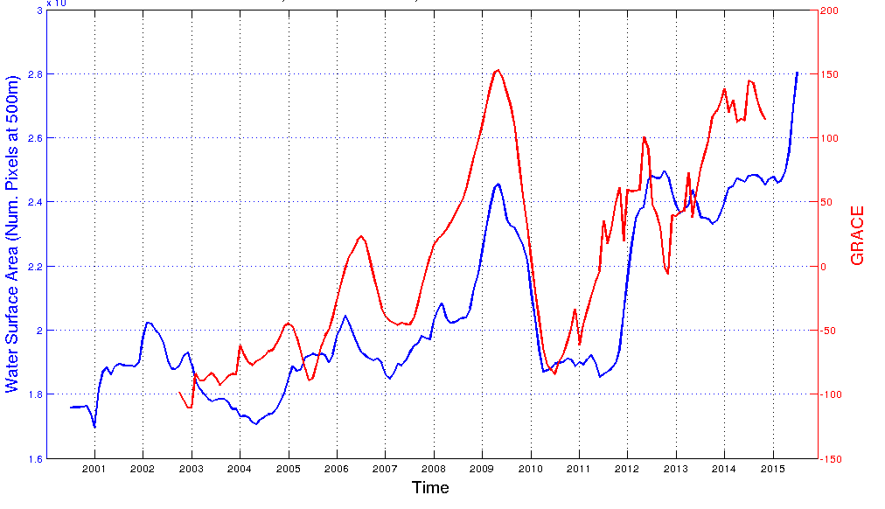
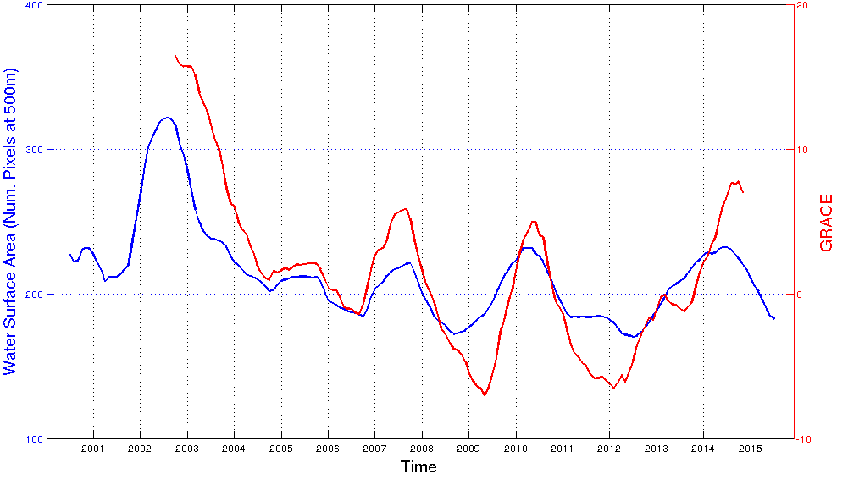
Correlations with GRACE
GRACE: Gravimetry Recovery and Climate Experiment
Measures changes in total water mass (surface + groundwater) at ~100 km
Correlations b/w surface water dynamics and GRACE measurements

Slide 17
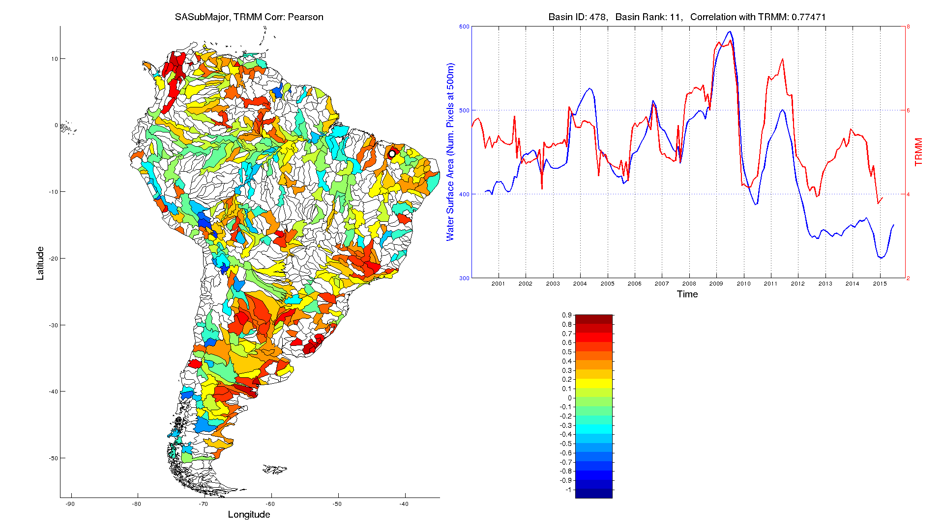
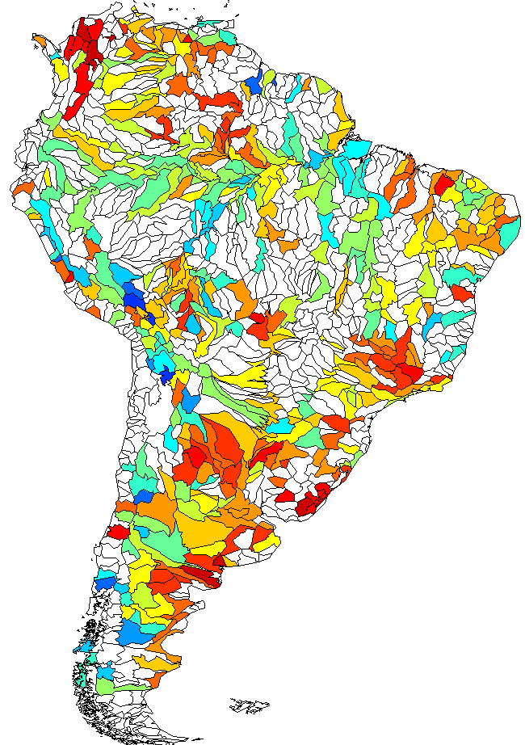
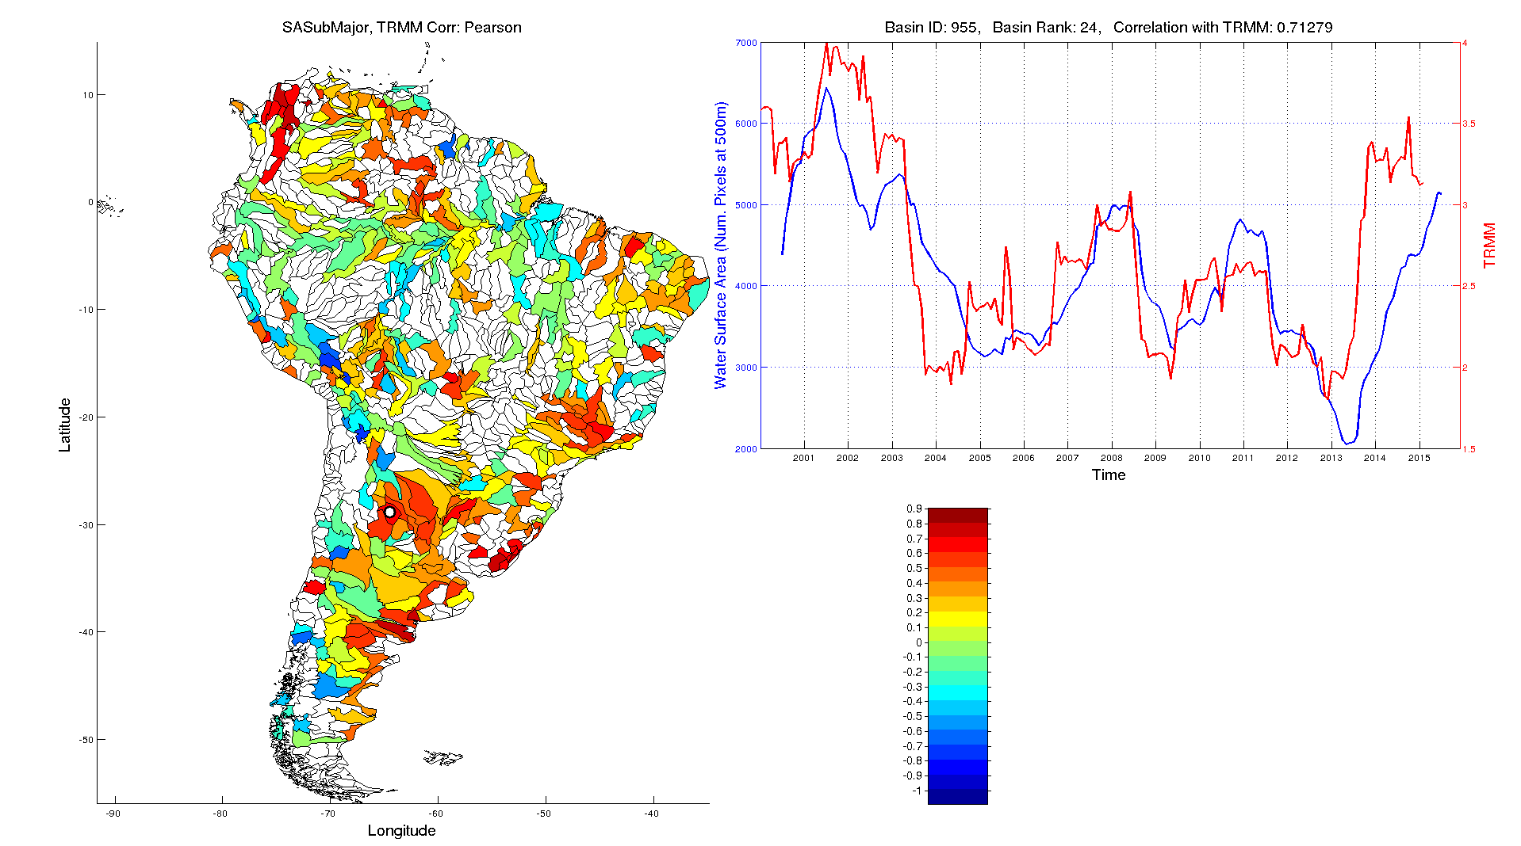
Correlations with Precipitation
TRMM: Tropical Rainfall Measuring Mission (available at ~25 km)
Correlations b/w surface water dynamics and TRMM measurements

Slide 18
Potential Use Cases of a Water Monitoring System
Quantifying available water stocks and their dynamics over time
Mapping the dynamics of rivers and estimating their discharge at a global scale using fine-resolution Landsat data
Detecting a variety of changes occurring in water bodies and studying their interactions with natural phenomena and human actions, especially in the context of food-energy-water systems
Including information about surface water dynamics in currently available hydrological models at regional to global scales

Slide 19







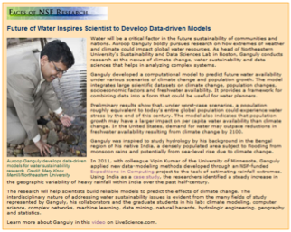

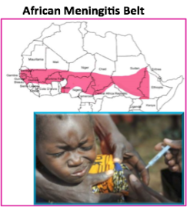


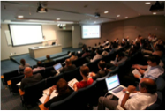


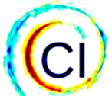





Five Year, $ 10m NSF Expeditions in Computing Project
Understanding Climate Change: A Data-driven Approach
Sample of Education and Outreach Activities
Education
Undergraduate and graduate courses/programs at the intersection of climate and data sciences
  Graph Mining and Real-Time Data Stream Analytics
  Climate Statistics
  Coursera MOOC, “From GPS and Google Maps to Spatial Computing”, reached 21,844 across
  182 countries
Cross disciplinary training environment
Engagement with UNEP, IPCC and World Economic Forum and wider climate science and impact community
Application to Climate:
Meningitis Problem over West Africa
Professional Science Master’s degree program in Climate Change & Society
Nurturing a “Climate Informatics” Community
Special Issues
Nonlinear Processes in Geophysics
Physics Driven Data Mining
IEEE Computing in Science & Engineering Magazine
Computing in Climate: Challenges and Opportunities
“Climate change research is now ‘big science,’ comparable in its magnitude, complexity, and societal importance to human genomics and bioinformatics.” (Nature Climate Change, Oct 2012)
Workshops and sessions in climate & computer science venues
Annual Workshop
Attended by 70-100 researchers from multiple disciplines

Slide 20
Publications
A. Karpatne, A. Khaldelwal, X. Chen, V. Mithal, J.H. Faghmous, and V. Kumar, Global monitoring of inland water dynamics: State-of-the-art, challenges, and opportunities, In K. Morik, J. Lässig, and K. Kersting, Eds. Computational Sustainability, Springer. 2015 (to appear)
A. Karpatne and V. Kumar, Adaptive heterogeneous ensemble learning using the context of test instances, International Conference on Data Mining (ICDM), 2015
A. Khandelwal, V. Mithal, and V. Kumar. Post-classification label refinement using implicit ordering constraints among data instances. International Conference on Data Mining (ICDM), 2015.
X. Chen, J. Faghmous, A. Khandelwal, and V. Kumar, Clustering dynamic spatio-temporal patterns in the presence of noise and missing data, International Joint Conference on Artificial Intelligence (IJCAI), 2015.
A. Karpatne, A. Khaldelwal, and V. Kumar, Ensemble learning methods for binary classification with multi-modality within the classes, SIAM International Conference on Data Mining (SDM), 2015
For further information, please visit the Expeditions Project website:
http://climatechange.cs.umn.edu

Slide 21
Acknowledgments
Team UMN:
  Ankush Khandelwal, Xi Chen, Varun Mithal
  Robert Leuenberger, Eric Mccaleb, Yizheng Ding, Reid Anderson, Kshitij Aranke, Amolak Singh, Stryker Thompson, Karl Holub
  Vipin Kumar
Collaborators:
  Institute on Environment, UMN: Kate Brauman
  Planetary Skin Institute: Juan Carlos Castilla-Rubio, Fabio Faria
Funding:
  National Science Foundation Awards 1029711 and 0905581
  NASA Award NNX12AP37G
  Doctoral Dissertation Fellowship and UMII Informatics Fellowship

