Slide 1






Understanding Climate Change:
A Data Driven Approach
Vipin Kumar
University of Minnesota
kumar@cs.umn.edu

Slide 2




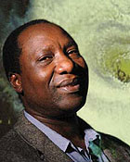












Expeditions Team
Vipin Kumar, UM Auroop Ganguly, NEU Nagiza Samatova, NCSU Arindam Banerjee, UM Fred Semazzi, NCSU
Joe Knight, UM Shashi Shekhar, UM Peter Snyder, UM Jon Foley, UM Alok Choudhary, NW Ankit Agrawal, NW
Abdollah Homiafar Michael Steinbach Singdhansu Chatterjee Karsten Steinhaeuser Stefan Liess Shyam Boriah
NCA&T UM UM UM UM UM

Slide 3
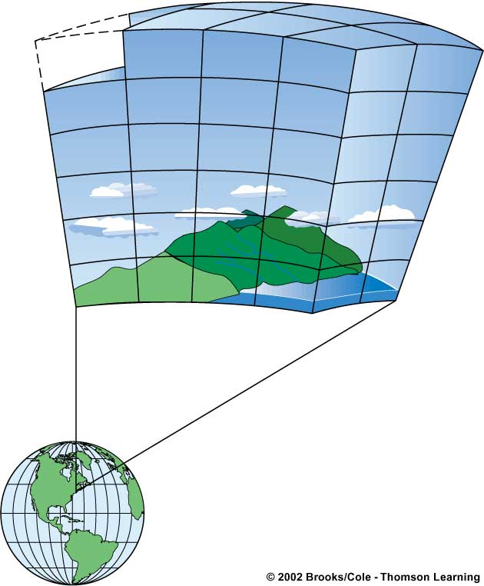
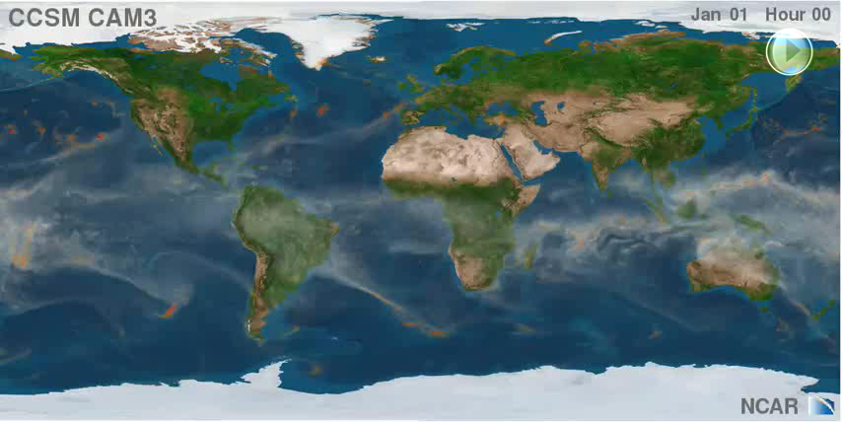
Understanding Climate Change - Physics Based Approach
General Circulation Models: Mathematical models with physical equations based on fluid dynamics
Cell
Parameterization and non-linearity
of differential equations are sources for uncertainty!
Clouds
Land
Ocean
Figure Courtesy: ORNL
Notes:
Obama in SOU address

Slide 4

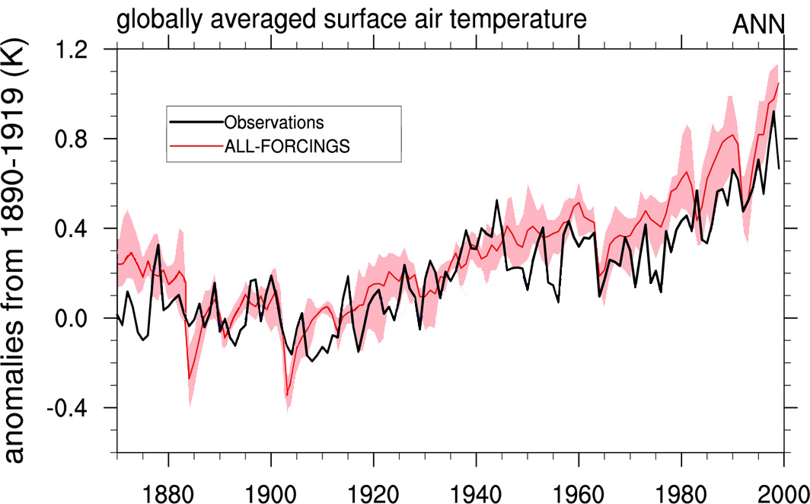
Understanding Climate Change - Physics Based Approach
General Circulation Models: Mathematical models with physical equations based on fluid dynamics
Cell
Clouds
Land
Ocean
Figure Courtesy: ORNL
Ensemble average with observed greenhouse gas concentrations

Slide 5
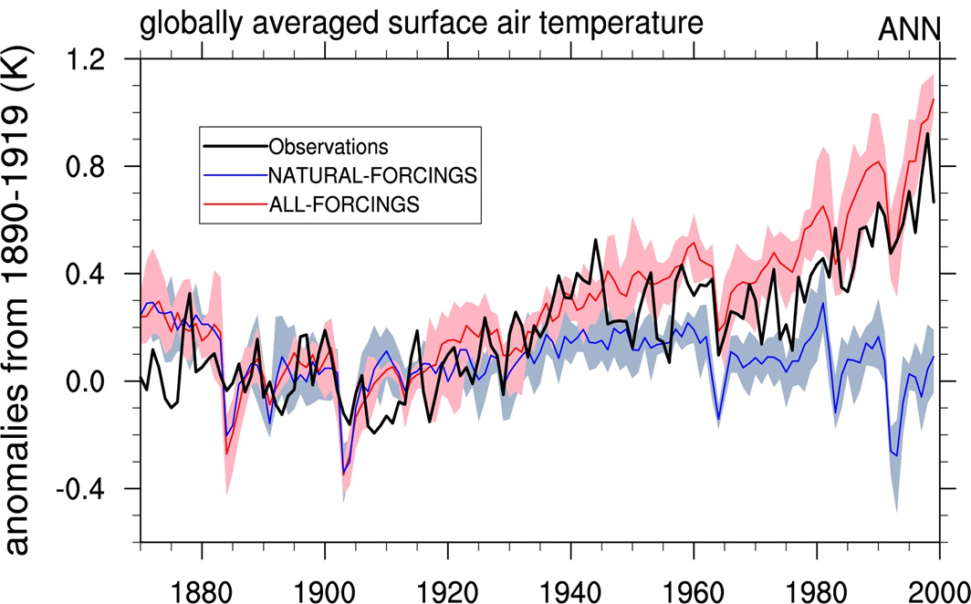
Understanding Climate Change - Physics Based Approach
General Circulation Models: Mathematical models with physical equations based on fluid dynamics
Cell
Clouds
Land
Ocean
Figure Courtesy: ORNL
Ensemble average with observed greenhouse gas concentrations
Ensemble average with pre-industrial greenhouse gas concentrations

Slide 6
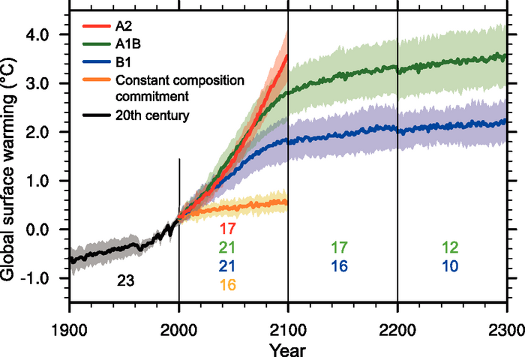
Understanding Climate Change - Physics Based Approach
Ensemble average with observed greenhouse gas concentrations
Ensemble average with pre-industrial greenhouse gas concentrations
Figure Courtesy: ORNL
A2: “divided world” with local fuels
A1B: “integrated world” with balance of fuels
B1: “integrated world”, environmentally conscious
IPCC (2007)
Projection of temperature increase under different Special Report on Emissions Scenarios (SRES) by 24 different GCM configurations from 16 research centers used in the Intergovernmental Panel on Climate Change (IPCC) 4th Assessment Report.
Notes:
There is an urgency to act
Adaptation: “Manage the unavoidable”
Mitigation: “Avoid the unmanageable”

Slide 7
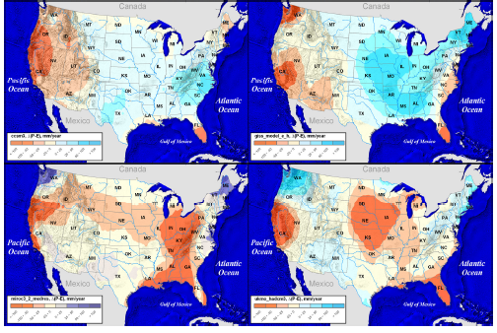
Physics based models are essential but insufficient
  Relatively reliable predictions at global scale for ancillary variables such as temperature
  Least reliable predictions for variables that are crucial for impact assessment such as regional precipitation
Disagreement between IPCC models
“The sad truth of climate science is that the most crucial information is the least reliable” (Nature, 2010)
Regional hydrology exhibits large variations among major IPCC model projections
Physics based models
Low uncertainty | High uncertainty | Out of scope
Temperature | Hurricanes | Fires
Pressure | Extremes | Malaria outbreaks
Large-scale wind | Precipitation | Landslides
Notes:
Computationally prohibitive
Sensitive to parameterization and initial conditions
Difficult to model regional climate (downscaling, boundary conditions, spectral nudging, etc.)
Climate occurs at global scale. Many climate processes however occur on a local scale
Additional resolution adds more errors and we don’t know the exact error function (additive, multiplicative, etc.)
The societal cost of both action and inaction is large
Key scientific goal is to reduce uncertainty
Things that are highly uncertain are the ones society cares about

Slide 8
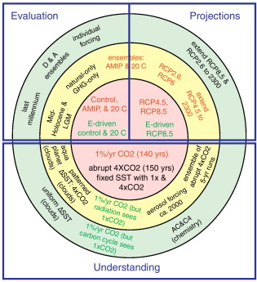
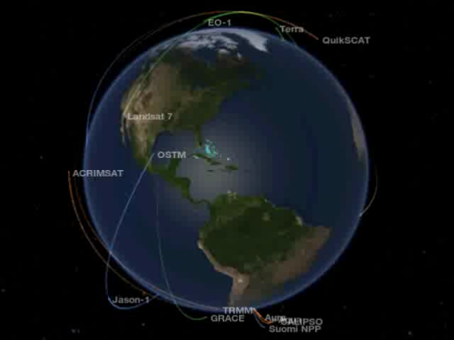
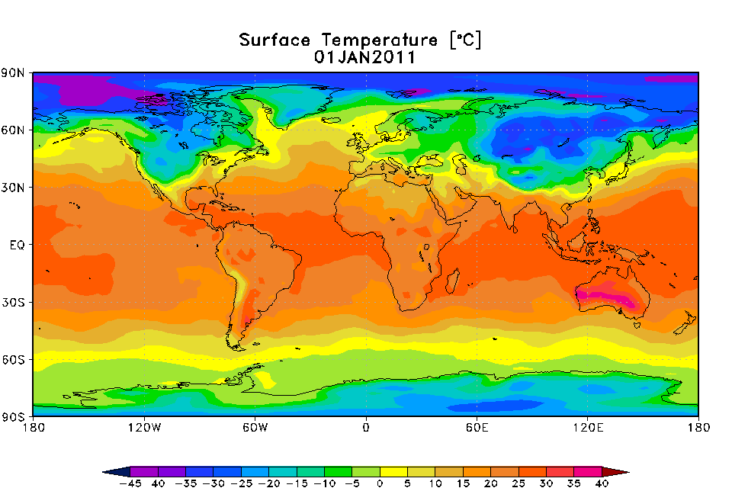
Data-Driven Knowledge Discovery in Climate Science
Transformation from Data-Poor to Data-Rich
  Sensor Observations
  Reanalysis Data
  Model Simulations
Project Aim
A new and transformative data-driven approach that makes use of physics-based models and observations to advance understanding of climate science and improve prediction of the potential impacts of climate change.
“Climate change research is now ‘big science,’ comparable in its magnitude, complexity, and societal importance to human genomics and bioinformatics.”
(Nature Climate Change, Oct 2012)

Slide 9
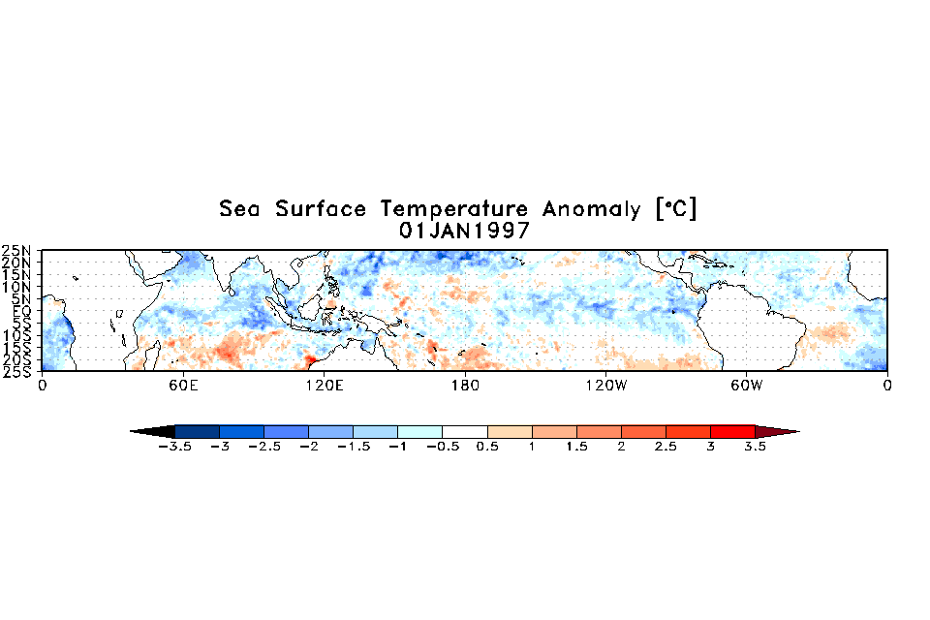

Need for data driven analysis
Low uncertainty | High uncertainty | Out of scope
Temperature | Global hurricanes | Global fires
Pressure | Extremes | Malaria outbreaks
Large-scale wind | Precipitation | Landslides
Global sea surface temperatures
Atlantic hurricanes
Global fires
Notes:
Observational data provide a “block-box” abstraction to the complicated dynamical systems
Project poorly modeled phenomena using well modeled ones
Reduce uncertainty
Study phenomena that occur at sub-grid space and time scales

Slide 10
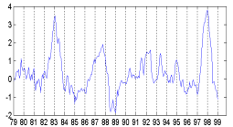
Need for data driven analysis
Low uncertainty | High uncertainty | Out of scope
Temperature | Global hurricanes | Global fires
Pressure | Extremes | Malaria outbreaks
Large-scale wind | Precipitation | Landslides
Global sea surface temperatures
Atlantic hurricanes
Global fires
SST Anomaly Time Series in the ENSO region
Correlation with fires in Amazon
Chen et al., Science, 2011
Notes:
Models are not capable of capturing certain processes because of:
1- Computation costs + resolution
2- Imperfect model (our understanding of physics and dynamics, etc.)
3- large-scale long-range non-linear relationships that are difficult to maintain (reductionist approach)
4- It is hard to integrate models together (i.e. coupling)
5- Error growth as we go to finer resolution

Slide 11
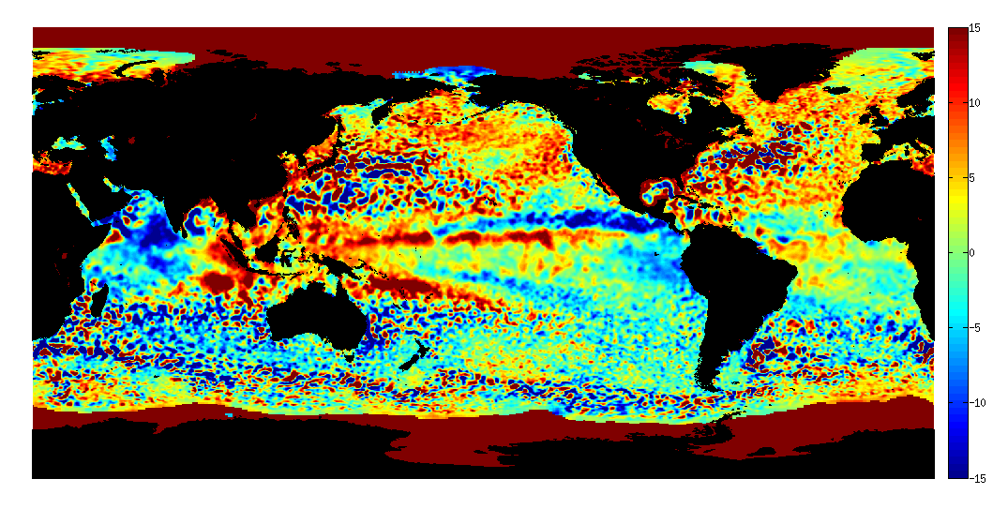
Challenges in data driven analysis
Spatio-temporal auto- and cross-correlation
Noisy, heterogeneous, and uncertain
Evolutionary processes
Multiple spatio-temporal scales
Unknown, non-linear, and long-range dependency structure
Variability
Class imbalance
Multi-variate non-stationary
Large unlabeled datasets
Significance testing

Slide 12
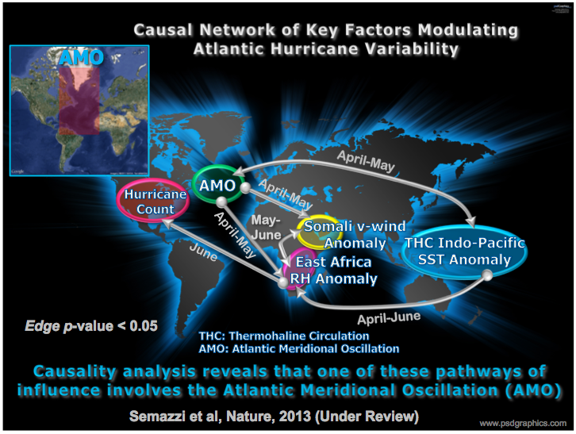
Guiding Theme
Discovery and characterization of patterns and dependencies
Provide an empirical understanding of physical processes
Ilustrative Example
Notes:
Build causal relationship models not currently resolved

Slide 13
Guiding Theme (Alternate Slide)
The discovery and characterization of patterns and dependencies have emerged as the primary research tasks because they…
Are often the first step to understanding of physical processes
- finding pressure dipole between Tahiti and Darwin led to the understanding of modulation of the Walker Circulation
Allow for prediction of unknown quantities
- where observations are sparse
- for statistical downscaling
- where physical models are inadequate (e.g., predicting the number of hurricanes using a large number of covariates)
Enable long-range projection of highly stochastic processes
- deriving climate extremes from low-resolution global model simulations

Slide 14
Project vision and scope
Transformative Computer Science Research
Advancing Climate Change Science
Process Understanding | Extreme Events Heat Waves Rainfall Extremes Droughts Hurricanes Model Evaluation Downscaling Statistical Dynamical Ocean-Atm.-Land Interactions | Change Detection Abrupt vs. Gradual Point vs. Regions/Intervals Change in Extremes Spatio-Temporal Classification Sparse/High-Dim. Methods Causal Relationships Networks/Graphs HPC | Computational Innovations
Understanding Climate Change

Slide 15
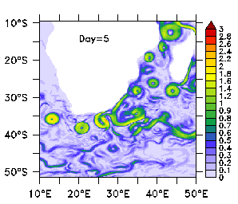
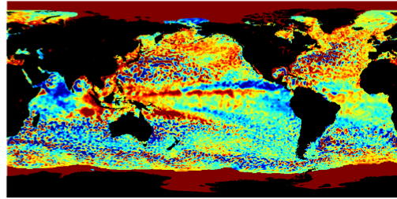
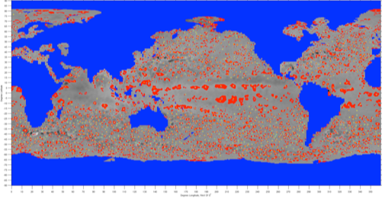
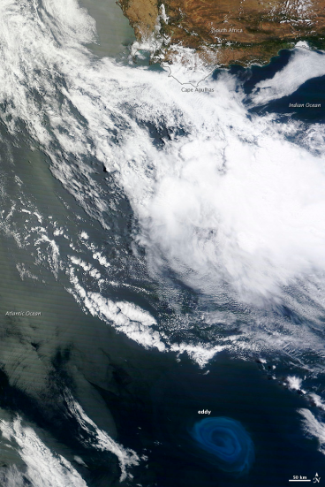
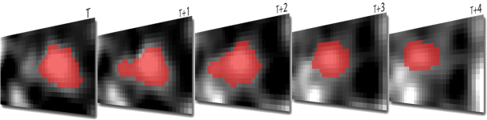
Pattern Mining: Ocean Eddies Monitoring
Rotating coherent structures that are sources of intense physical and biological activity
Identifying ocean eddies in satellite products is an active subject of research
Used spatio-temporal context of the data to extract statistically significant features
Open source data base of 20+ years of eddies and eddy tracks available for scientific applications
Faghmous et al. AAAI (2012a)
Faghmous et al. CIDU (2012b) Best student paper award
Faghmous et al. AAAI (2013)
NSF Nordic Research Opportunity Grant to conduct research at the Bjerknes Centre for Climate Research in Norway

Slide 16
Network analysis: Climate teleconnections
Large-scale long-range relationships play a crucial role in the atmosphere
Discovering such relationships is laborious and imprecise
Developed an automated procedure to discover teleconnections in large climate data sets
Technique discovered more robust relationships, new undiscovered relationships, and is a tool to evaluate climate models
Kawale et al. SDM(2011a)
Kawaleet al. CIDU (2011b) Best student paper award
Kawale et al. ACM SIGKDD (2012)
SC’11: Exploration in Science through Computation Award
Grace Hopper ‘12: Best Poster Award (Winner of the ACM Student Research Competition)

Slide 17
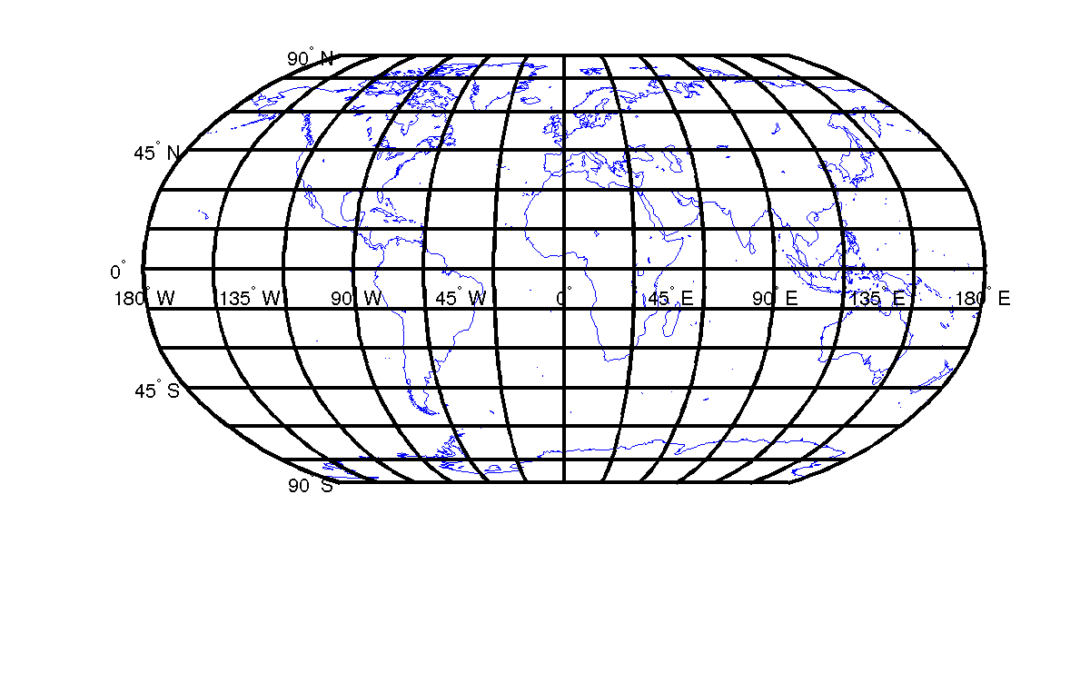
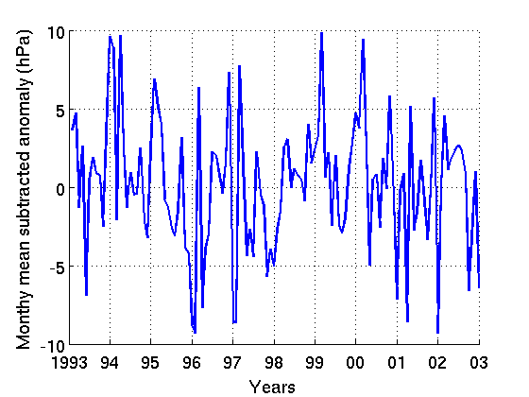
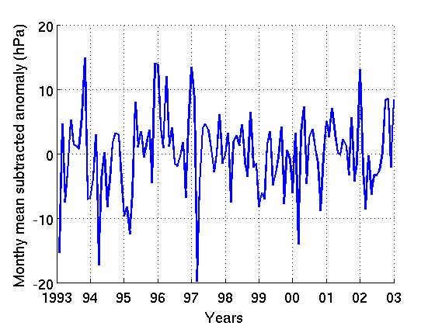
Graph-Based Approach for Dipole Discovery (Alternate)
Climate Network
Nodes in the Graph correspond to grid points on the globe.
Edge weight corresponds to correlation between the two anomaly time series
  Most known dipoles discovered
  New dipoles may represent new phenomena
  Enables analysis of relationships between different dipoles
  Dynamic versions are often better than static
  Dipole structure provides a method to analyze GCMs
Discovered Dipoles

Slide 18
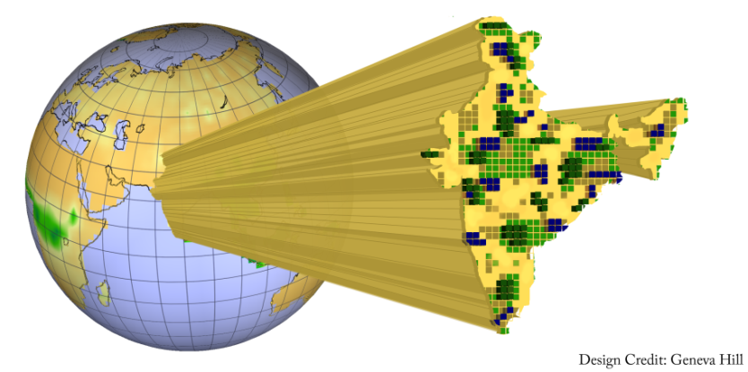
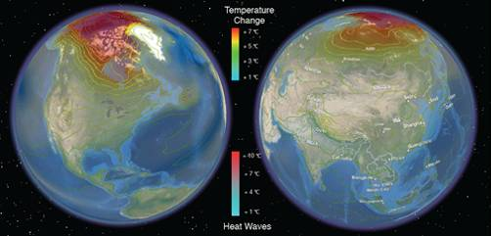
Extremes and uncertainty: Heat waves, heavy rainfall, …
Climate change has been called “global weirding” owing to possible exacerbation of hydro-meteorological extremes and changes in regional weather patterns
Understanding relevant dominant processes and discovering space-time dependence requires physics-guided data mining and uncertainty quantification
Computational data and geospatial sciences can help translate insights from models and observations to metrics relevant for adaptation and policy
Suite of methods developed new insights on climate extremes with uncertainty, and consequences for critical infrastructures and key resources
Ghosh et al. Nature Climate Change (2012)
Parish et al. Computers & Geosciences (2012)
Kodra et al. Environmental Research Letters (2012)
Ganguly et al. Climate Extremes & UQ: Book Chapter (2013)
Kodra et al. in revision at journal (2013)
Kumar et al. in review at journal (2013)

Slide 19
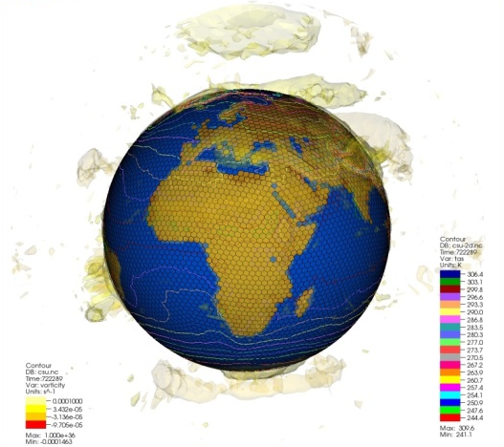
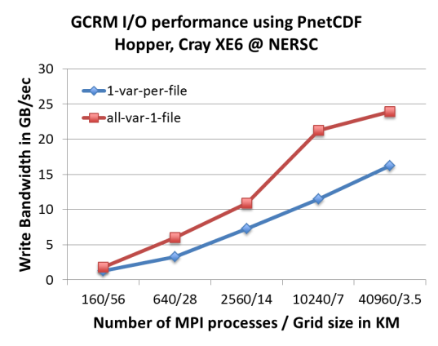
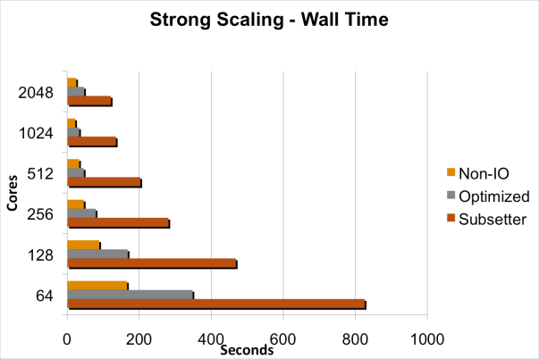
Scaling I/O and analytics: Global cloud resolving model
  Global Cloud Resolving Model (GCRM): simulates circulation associated with large convective clouds
  I/O was previously a major bottleneck for GCRM: 1.4 PB data per simulation and 1.5 TB per checkpoint
Improved I/O throughput Using Parallel NetCDF I/O library optimizations, massive scalability
Optimized memory utilization and process communication
Jin et al. EuroMPI (2011)
Patwary et al. SC (2012)
Hentrix et al. HPC (2012)
Kumar et al. IPDPS (2011)
Rangel et al. in review at journal (2013)
Jin et al. in review at journal (2013)

Slide 20
Machine Learning for Climate Data
Regression for downscaling and predictions
  Regional climate from GCMs, heat waves, monsoons
  High dimensions, low sample setting
  Statistical consistency using sparse hierarchical regularization
  Examples: Sparse group lasso, Gaussian Markov random fields
Multi-task learning with spatial smoothing
  Combining outputs of multiple GCMs
  Local regression with spatial smoothing
  Special case: Sylvester equations AX + XB = C
  More accurate than local or global regression
Inference using discrete graphical models (MRFs)
  Mega-drought detection, trends over past 100-1000 years
  LP relaxation to max-cut type problems, 10 million node graph
  Fast parallel algorithm: 10 mins on 20 cores, 30 secs on 500 cores
  Detects all major droughts, model evaluation in progress
SDM 2012, Best Student paper award
NIPS 2012
SDM 2013, Best Application paper award
ICML 2012
SDM 2012
UAI 2013
RMSE
Prediction RMSE from spatially smoothened Multi-model ensemble

