Slide 1
Data Guided Discovery of Dynamic Dipoles

Slide 2
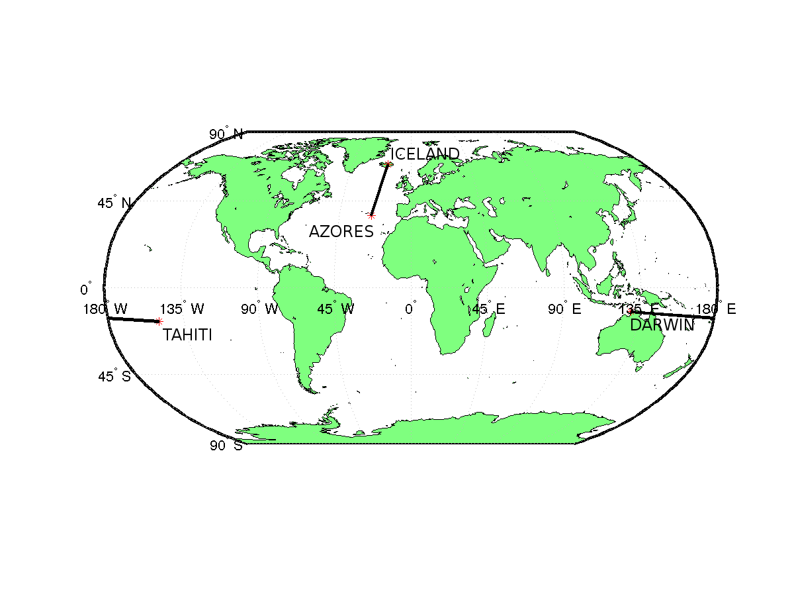
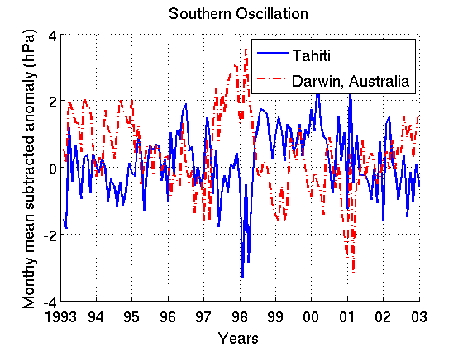
Dipoles
Dipoles represent a class of teleconnections characterized by anomalies of opposite polarity at two locations at the same time.

Slide 3
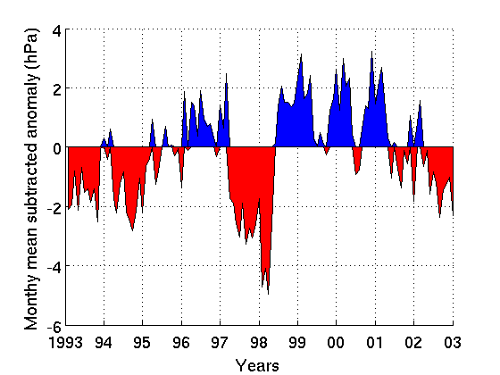
Dipoles
Dipoles represent a class of teleconnections characterized by anomalies of opposite polarity at two locations at the same time.

Slide 4
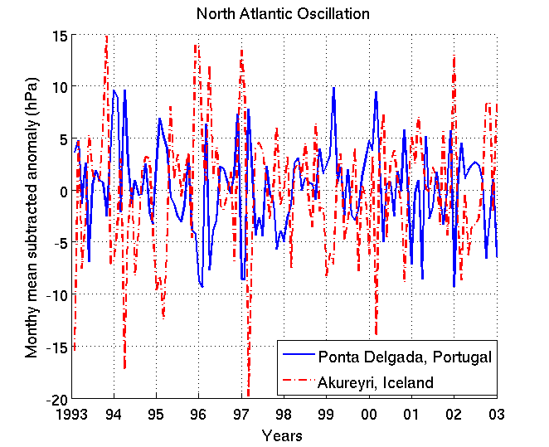
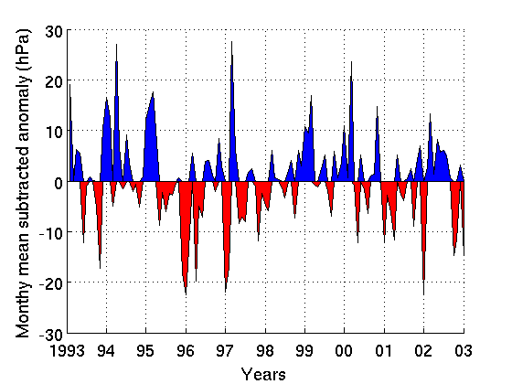
Dipoles
Dipoles represent a class of teleconnections characterized by anomalies of opposite polarity at two locations at the same time.
North Atlantic Oscillation: Iceland and Azores
Southern Oscillation: Tahiti and Darwin
North Atlantic Oscillation: Iceland and Azores

Slide 5
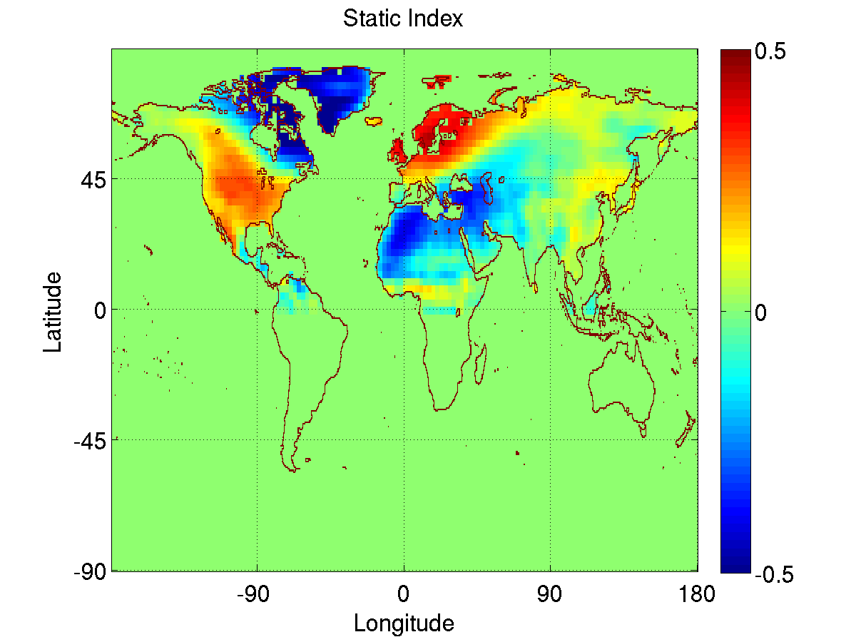
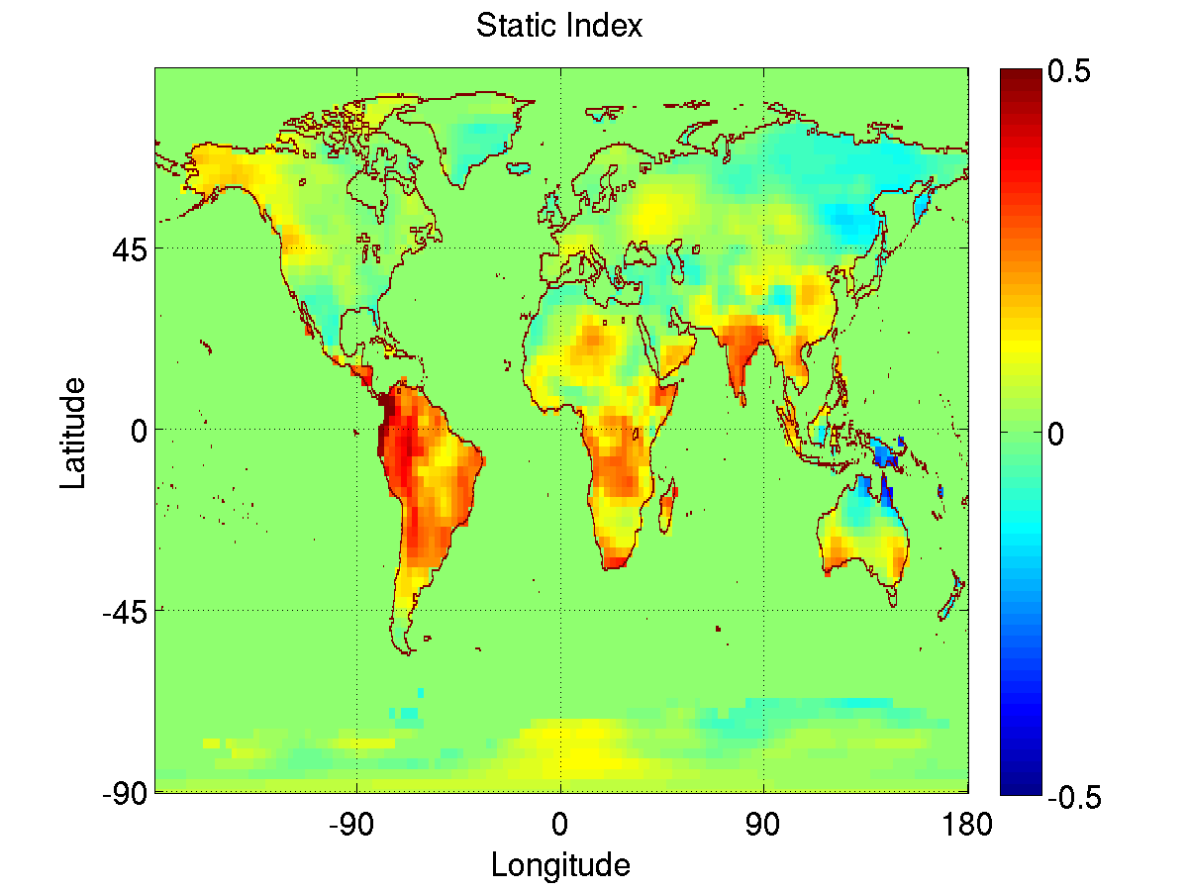
Importance of Dipoles
Crucial for understanding the climate system, especially for weather and climate forecast simulations within the context of global climate change.
NAO influences sea level pressure (SLP) over most of the Northern Hemisphere. Strong positive NAO phase (strong Islandic Low and strong Azores High) are associated with above-average temperatures in the eastern US.
SOI dominates tropical climate with floodings over East Asia and Australia, and droughts over America. Also has influence on global climate.
Correlation of Land temperature anomalies with NAO
Correlation of Land temperature anomalies with SOI

Slide 6
List of Major Dipole Oscillations

Slide 7
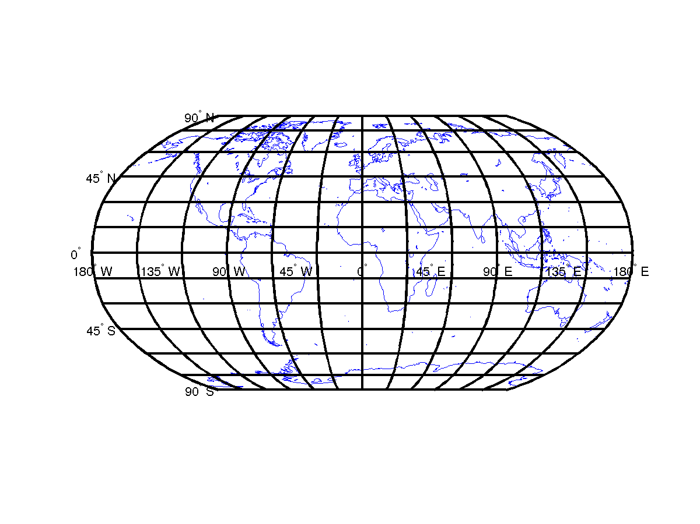
Related Work to find Dipoles
Discovered earlier by human observation.
  NAO observed in 1770-1778¹
  SOI observed by Sir Gilbert Walker as a sea-saw like oscillation of sea level pressure in the Pacific Ocean in 1924²
EOF analysis used to identify individual dipoles for the Arctic Oscillation (AO) and Antarctic Oscillation (AAO)³
  Similar to PCA, decomposes the time series into orthogonal basis functions.
AO: EOF Analysis of 20N-90N Latitude
AAO: EOF Analysis of 20S-90S Latitude
H. van Loon and J. C. Rogers. The seesaw in winter temperatures between greenland and northern europe. Part i: General description. Monthly Weather Review, 106(3):296{310, 1978}
G. Walker. Correlation in seasonal variations of weather, viii. a preliminary study of world weather. Memoirs of the India Meteorological Department, 24(4):75{131, 1923}
H. Von Storch and F. Zwiers. Statistical analysis in climate research. Cambridge Univ Pr, 2002
Portis, D. H., Walsh, J. E., El Hamly, Mostafa and Lamb, Peter J., Seasonality of the North Atlantic Oscillation, Journal of Climate, vol. 14, pg. 2069- 2078, 2001

Slide 8
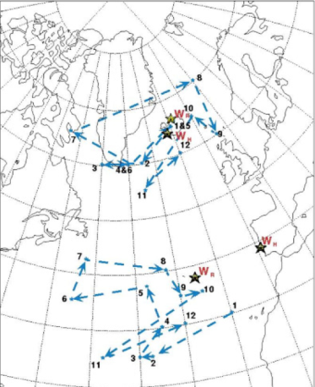
Motivation for Automatic Discovery of Dipoles
The known dipoles are defined by static locations but the underlying phenomenon is dynamic
Manual discovery can miss many dipoles
EOF and other types of eigenvector analysis finds the strongest signals and the physical interpretation of those can be difficult.
Enables analysis of the various GCMs
Dynamic behavior of the high and low pressure fields corresponding to NOA climate index (Portis et al, 2001)
AO: EOF Analysis of 20N-90N Latitude
AAO: EOF Analysis of 20S-90S Latitude

Slide 9
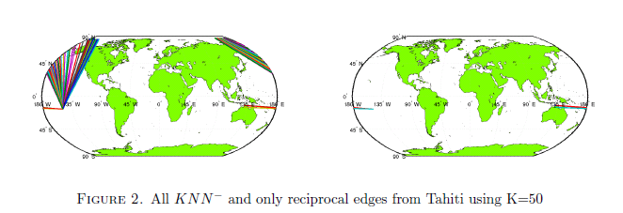
Shared Reciprocal Nearest Neighbors
Reciprocity: Two nodes A and B are reciprocal if they lie on each other’s nearest neighbor list.
Helps in noise reduction. (asymptotic reduction is θ(N/K).
Removes noise such as weakly correlated regions and anomalous connections.
A
C
B
E
D
B
A
F
E
D

Slide 10
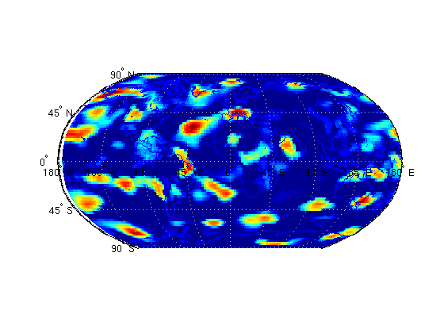
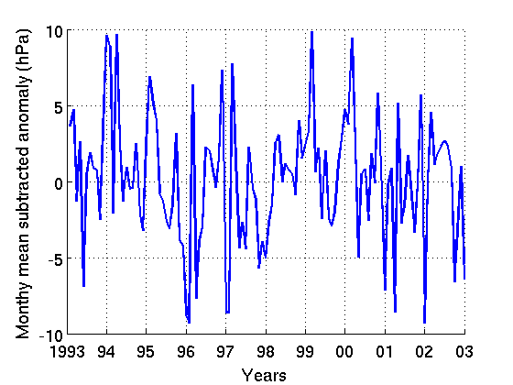
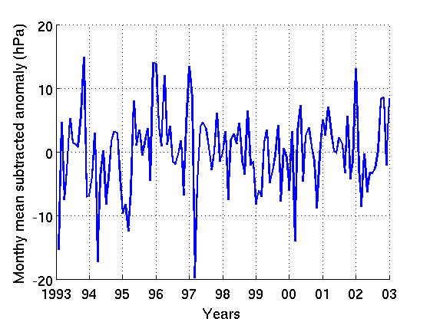
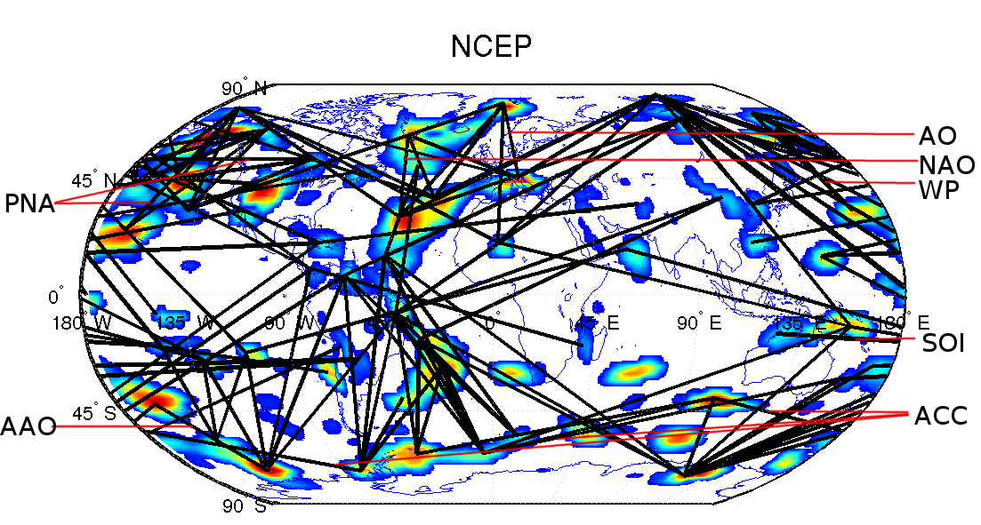
Overall Algorithm: Discovering Climate Teleconnections using SRNN
Shared Reciprocal Nearest Neighbors (SRNN) Density
Climate Network
Nodes in the Graph correspond to grid points on the globe.
Edge weight corresponds to correlation between the two anomaly timeseries
Dipoles from SRNN density

Slide 11
Benefits of Automatic Dipole Discovery
Detection of Global Dipole Structure
  Most known dipoles discovered
  New dipoles may represent previously unknown phenomenon.
  Enables analysis of relationships between different dipoles
Location based definition possible for some known indices that are defined using EOF analysis.
Dynamic versions are often better than static
Dipole structure provides an alternate method to analyze GCM performance

Slide 12
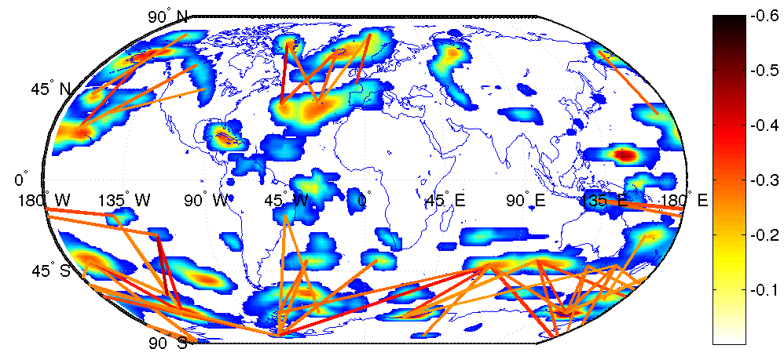
Detection of Global Dipole Structure
NCEP (National Centers for Environmental Prediction) Reanalysis
NCEP (National Centers for Environmental Prediction) Reanalysis Data
PNA
WP
NAO
AO
SOI
AAO
ACC
Most known dipoles discovered
Location based definition possible for some known indices that are defined using EOF analysis.
New dipoles may represent previously unknown phenomenon.

Slide 13
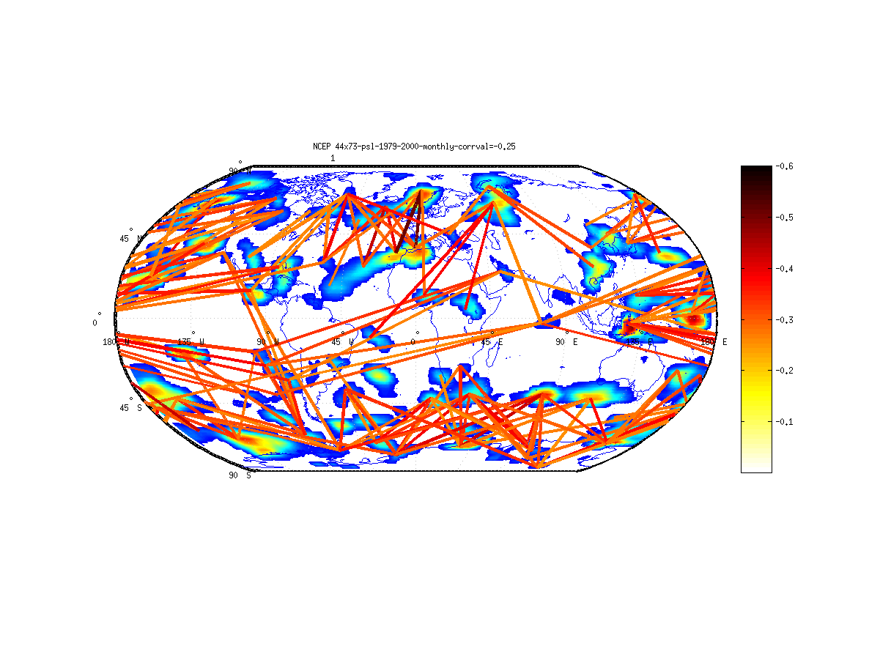
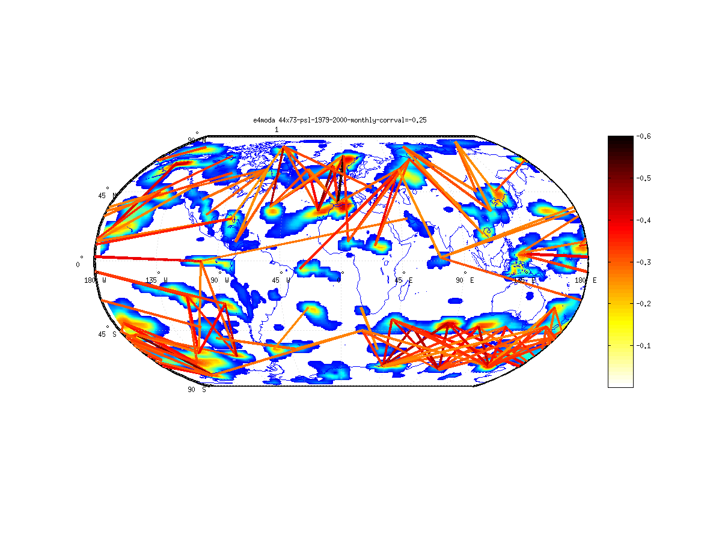
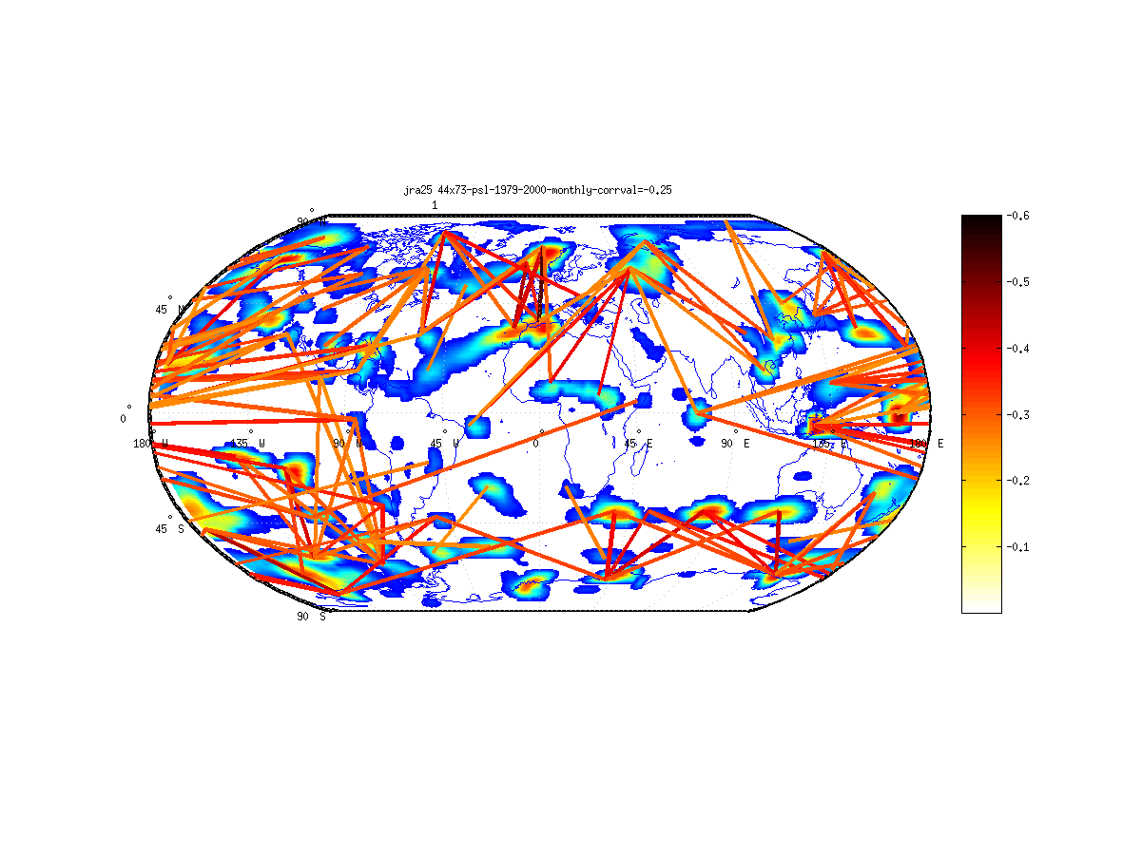
Comparing Dipole Structure in Historical (Reanalysis) Data
13
NCEP 1979-2000
ERA-40 1979-2000
JRA-25 1979-2000

Slide 14
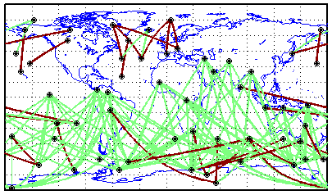
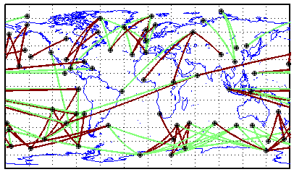
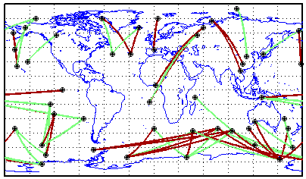
Statistical Significance of Dipoles
14
NCEP 1
JRA-25
ERA-40

Slide 15
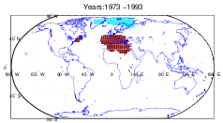
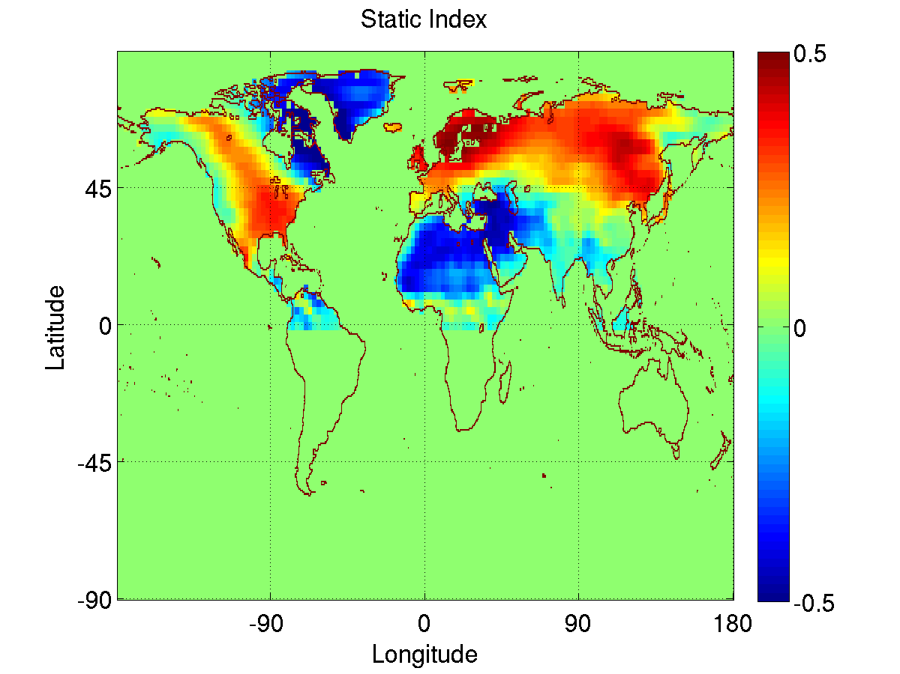
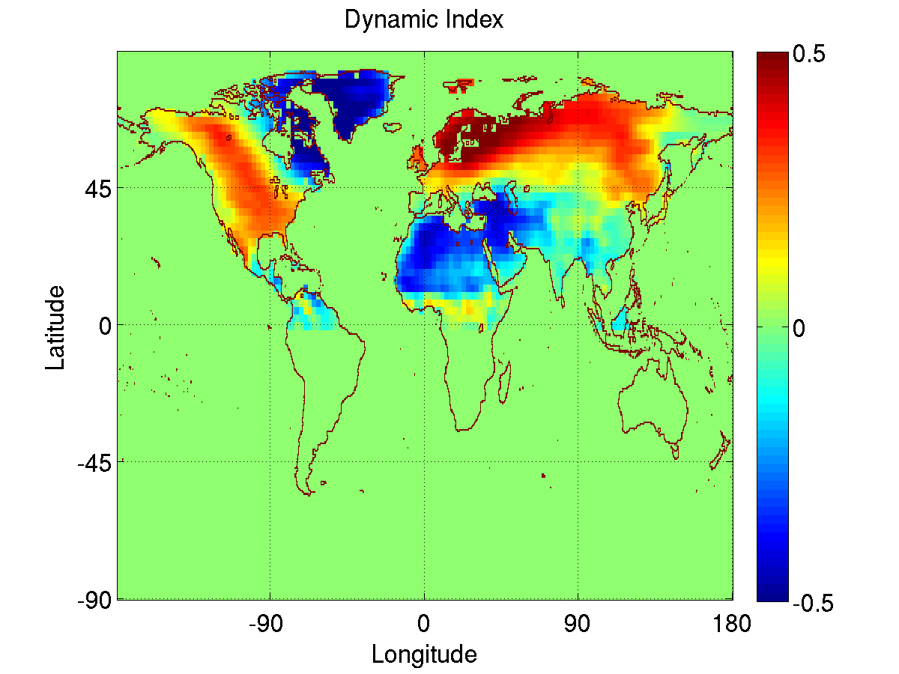
Results: Location Based definition AO
Static AO: EOF Analysis of 20N-90N Latitude
Impact on Land temperature Anomalies using Static and Dynamic AO
Mean Correlation between static and dynamic index: 0.84
Impact on land temperature anomalies comparatively same using static and dynamic index

Slide 16
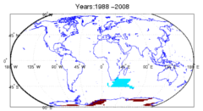
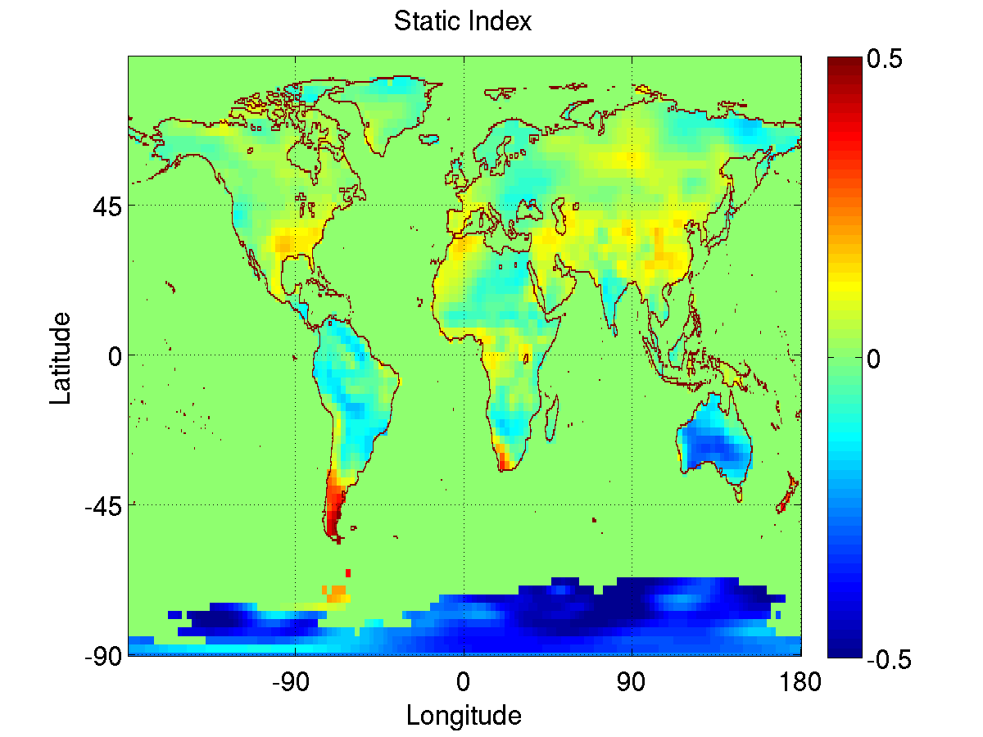
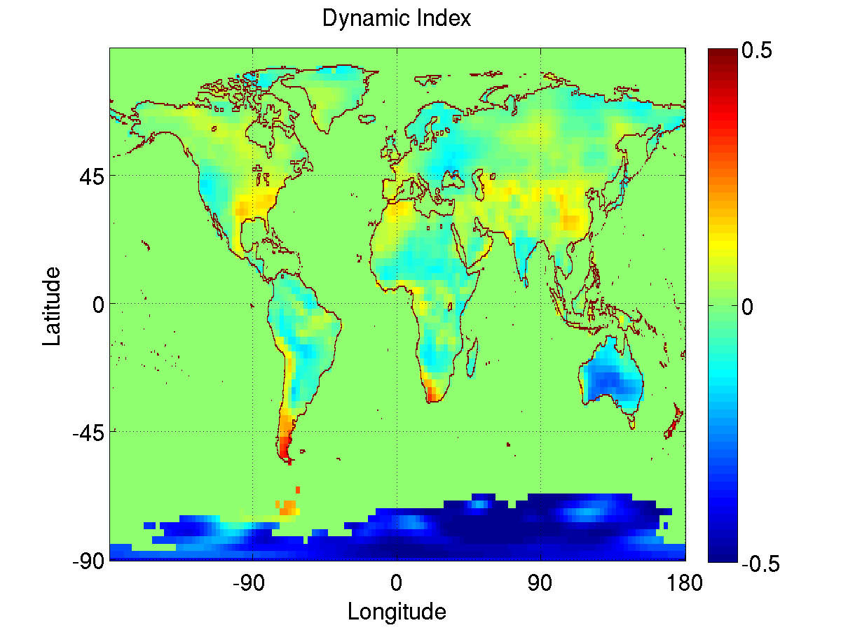
Results: Location Based definition AAO
Static AAO: EOF Analysis of 20S-90S Latitude
Impact on Land temperature Anomalies using Static and Dynamic AAO
Mean Correlation between Static and Dynamic index = 0.88
Impact on land temperature anomalies comparatively same using static and dynamic index

Slide 17
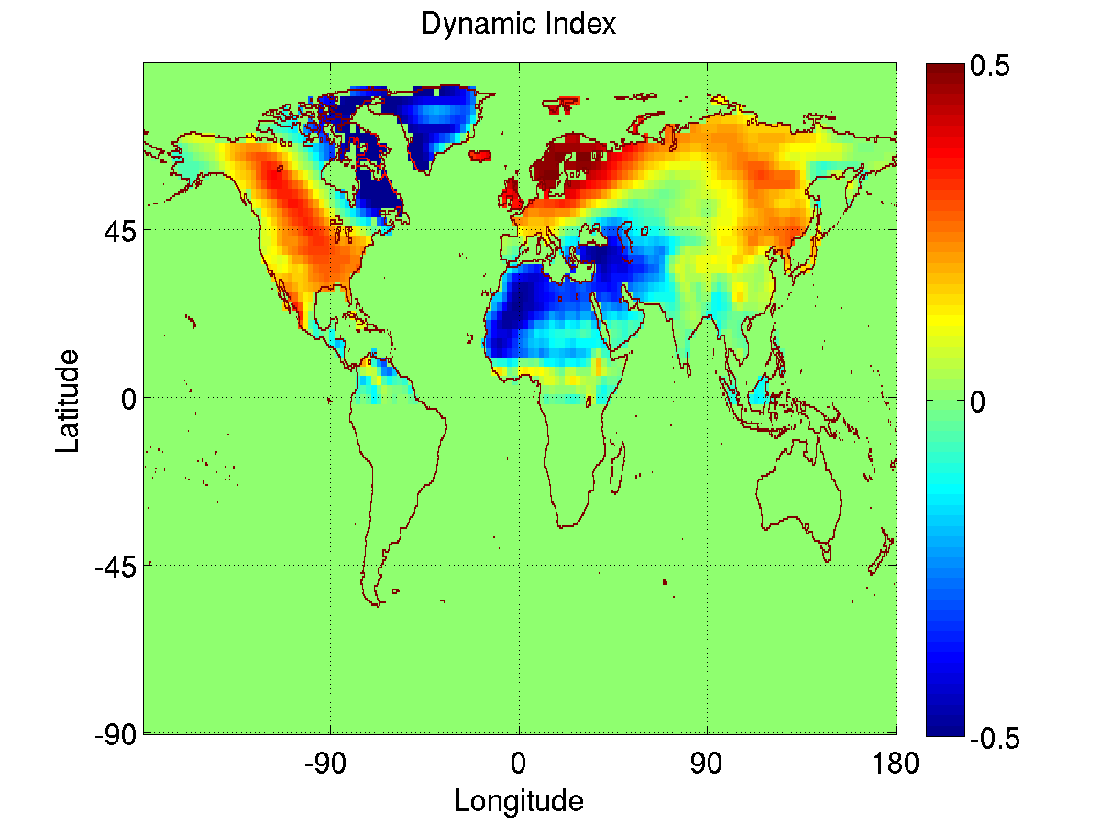
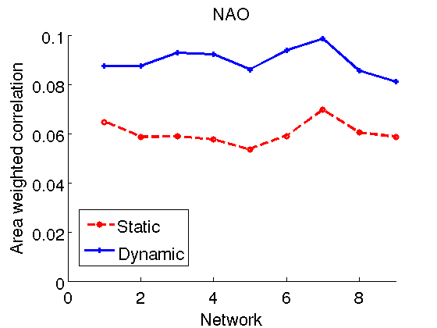
Static vs Dynamic NAO Index: Impact on land temperature
The dynamic index generates a stronger impact on land temperature anomalies as compared to the static index.
Figure to the right shows the aggregate area weighted correlation for networks computed for different 20 year periods during 1948-2008.

Slide 18
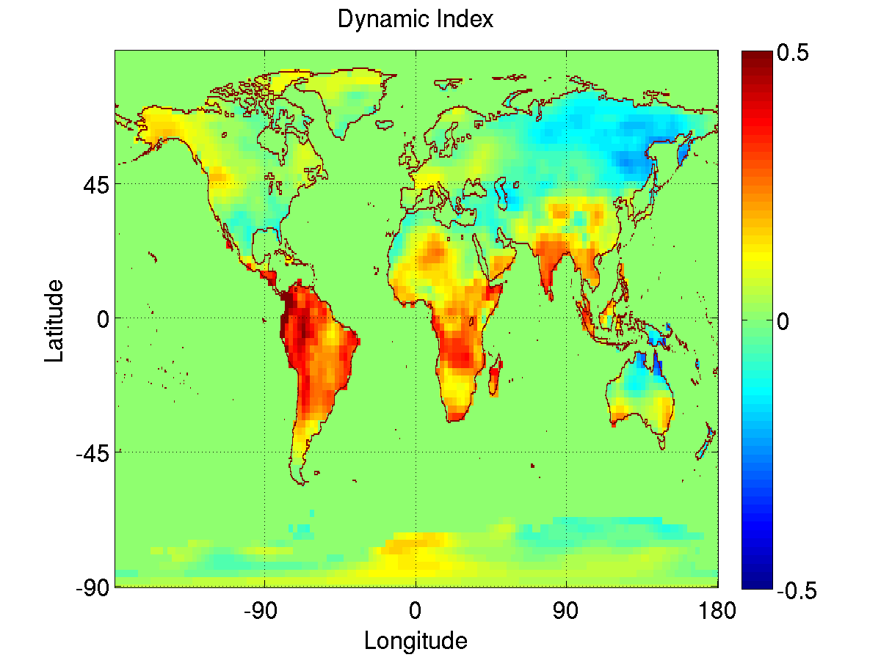
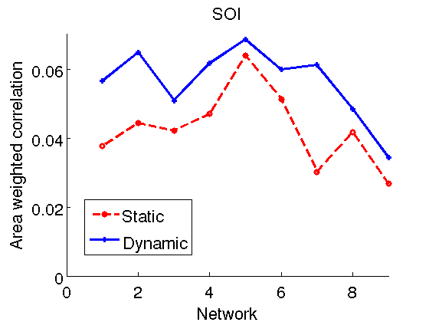
Static vs Dynamic SO Index: Impact on land temperature
The dynamic index generates a stronger impact on land temperature anomalies as compared to the static index.
Figure to the right shows the aggregate area weighted correlation for networks computed for different 20 year periods during 1948-2008.

Slide 19
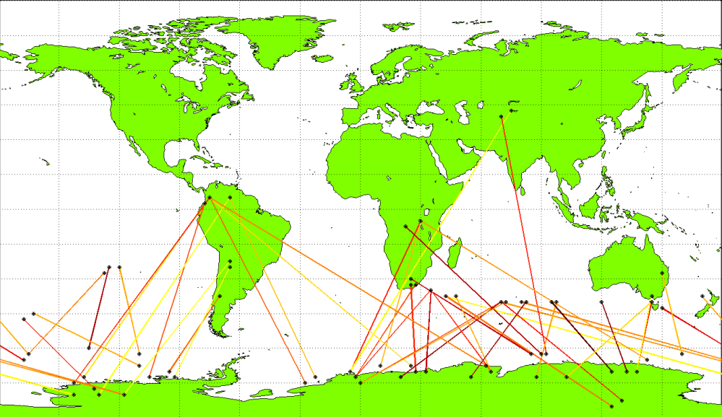
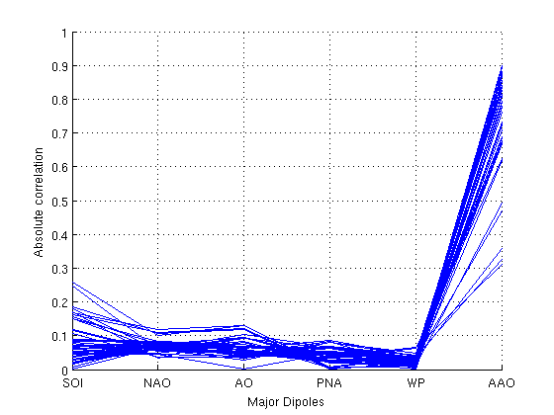
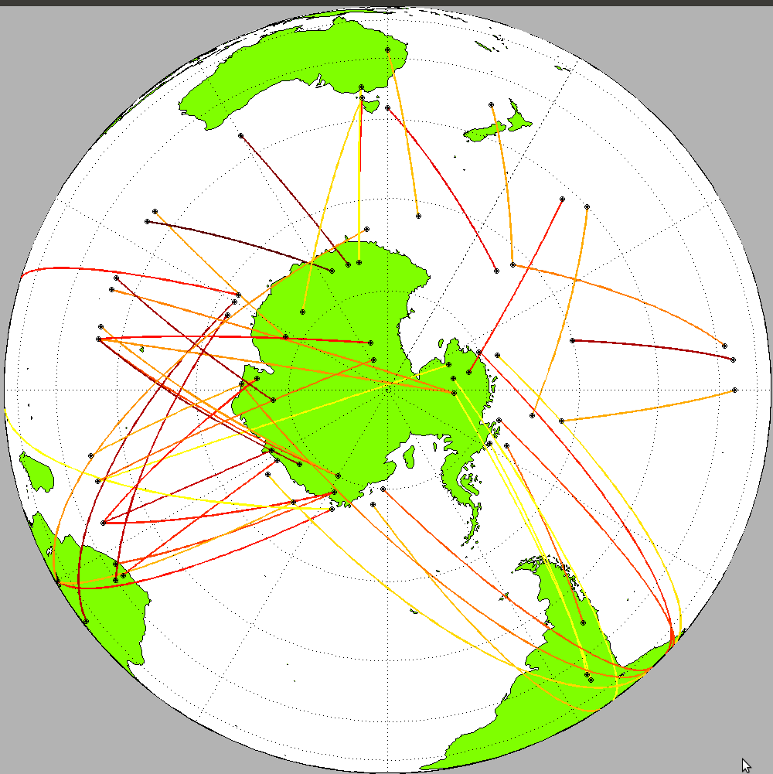
A New Dipole Around Antarctica?
3 major dipole structures can be seen.
The AAO and two others shown in figure
A newer phenomenon which is not captured by the EOF analysis?
Correlation plot with major dipoles

Slide 20
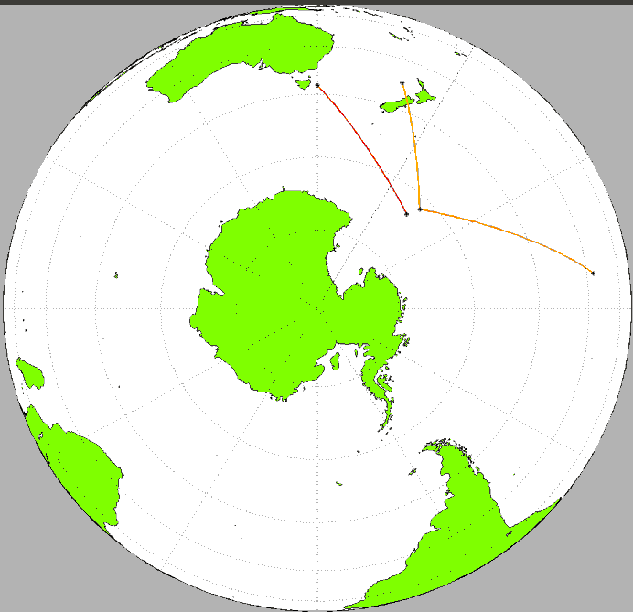
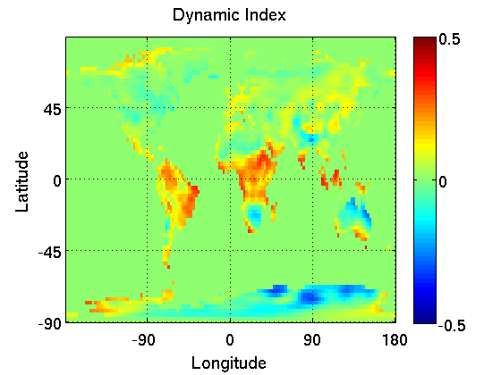
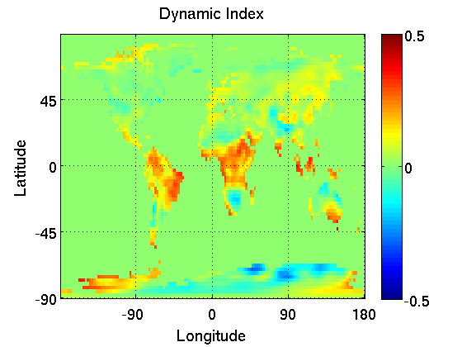
Correlation with land temperature
Comparison of dipoles by looking at land temperature impact.
Significant difference between the AAO impact and that due to dipoles 1,2,3 which are similar
It is possible that this may be a new phenomenon but this is still under speculation.
AAO
AAO
1
2
1
3
3

Slide 21
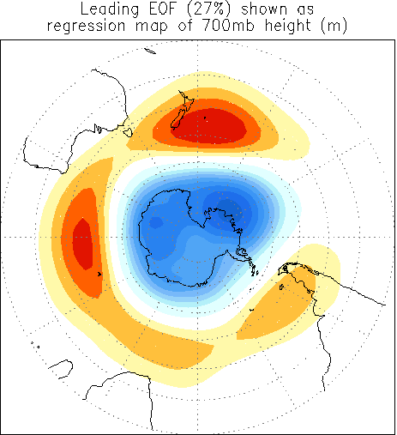
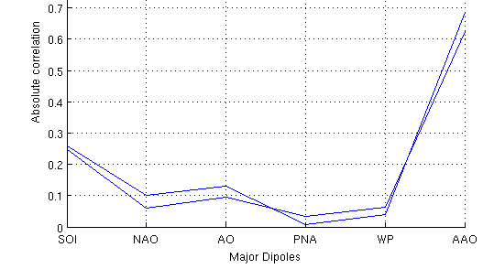
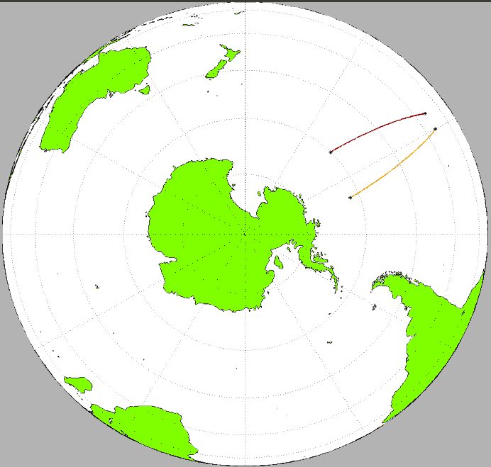
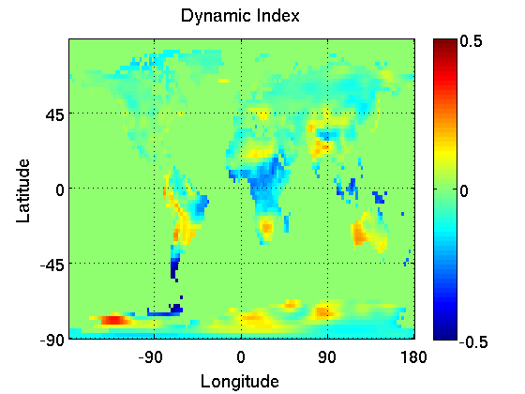
Dipoles not captured by EOF
EOF Analysis does not capture some dipoles
Mixture of SOI and AAO
The land area impact is also different
AAO
Courtesy of Climate Prediction Center
SOI
New Dipole

Slide 22
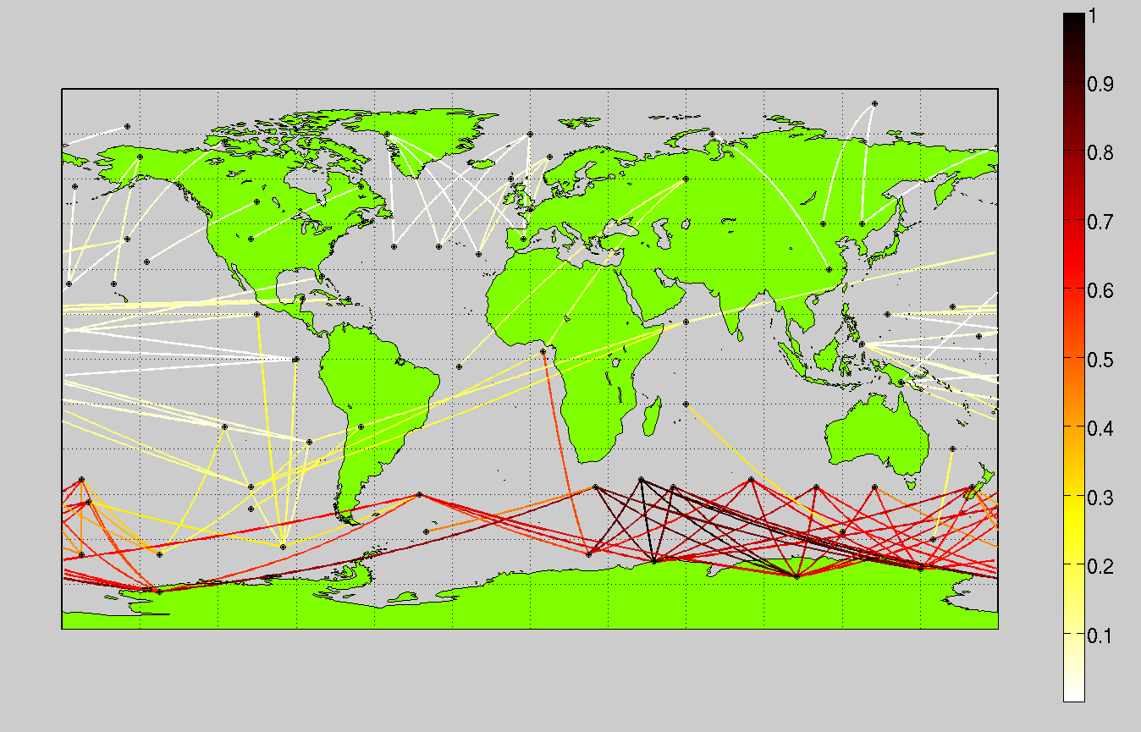
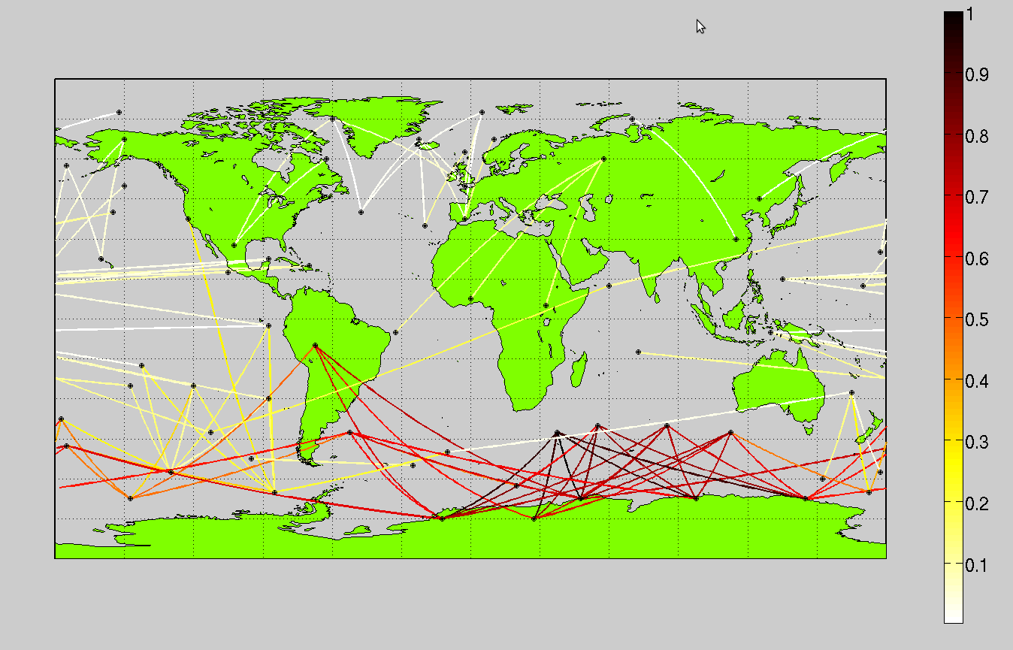
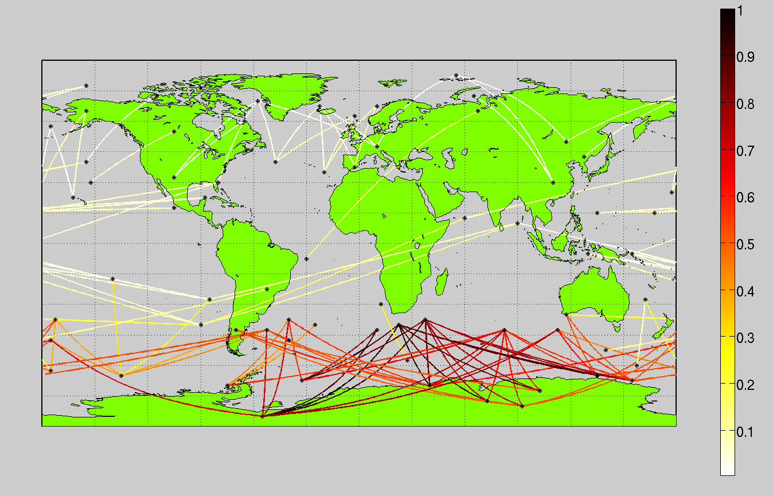
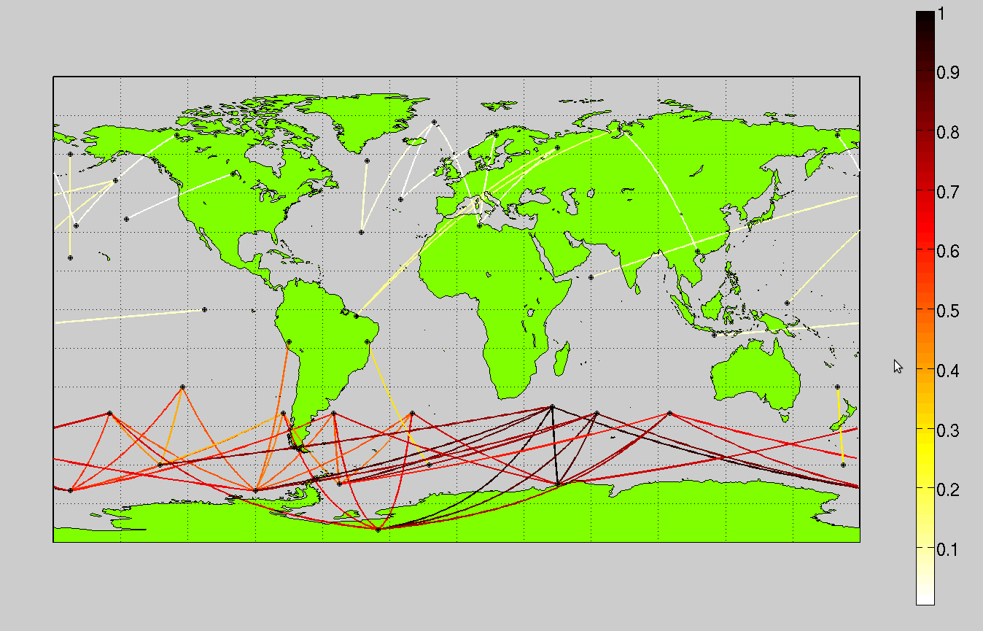
Correlation of AAO index with other dipoles (1979-2000)
ERA-40
JRA-25
NCEP
Mean Model

Slide 23
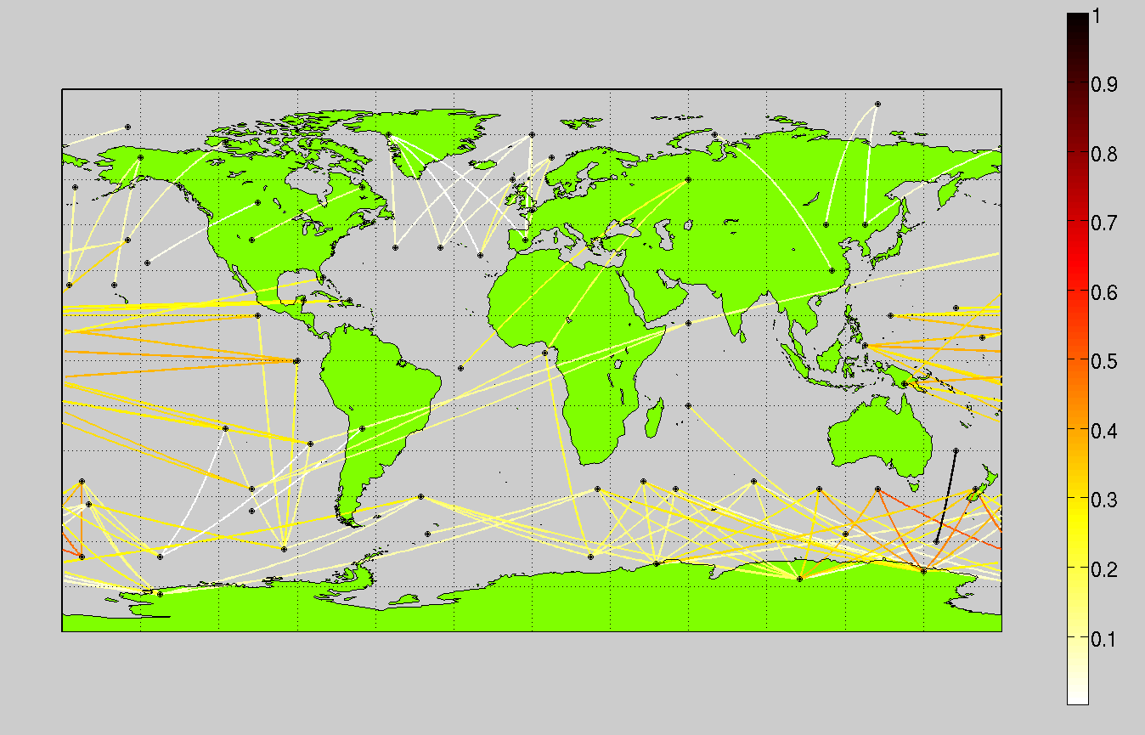
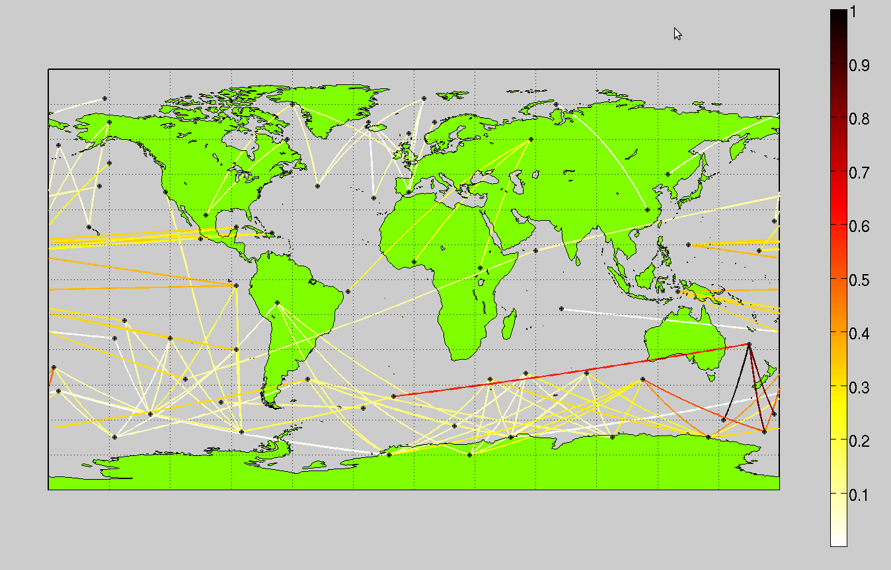
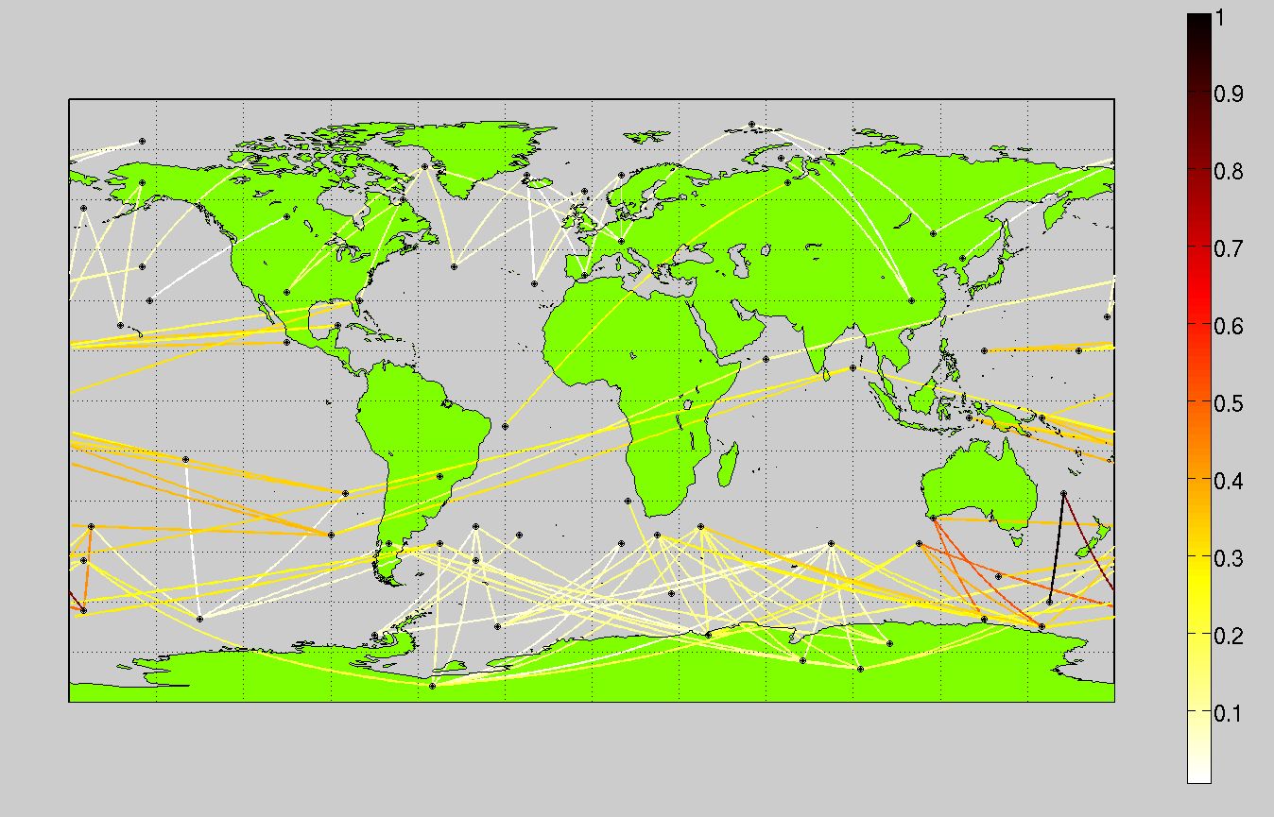
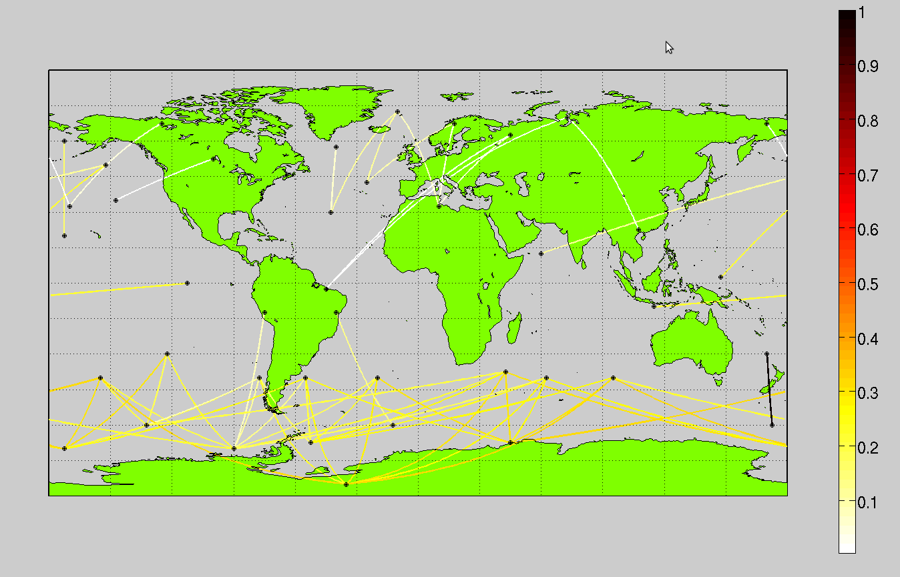
Correlation of the new dipole with other dipole indices.
ERA-40
JRA-25
NCEP
Mean Model

Slide 24
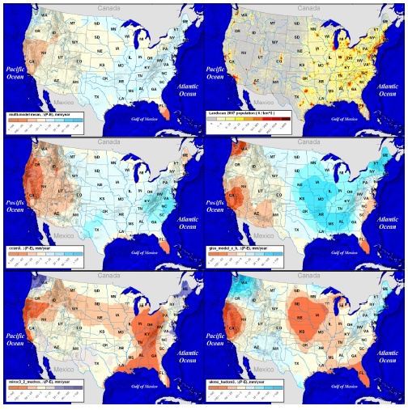




Relating Dipole Structure to Climate Models
Disagreement between IPCC models
The dipole structure of the top 2 models are different from the bottom two models
  NCAR-CCSM and NASA-GISS miss SOI and other dipoles near the Equator
NCAR-CCSM
NASA-GISS
MIROC_3_2
UKMO-HadCM3

Slide 25


COLA Athena: High vs Low Resolution

Slide 26


Slide 27


Slide 28
SOI representation in models
Models showing a good representation of SOI | Models that do not have a good representation of SOI
CNRM_CM3 CSIRO_MK3.0 CSIRO_MK3.5 GFDL_CM2.0 GFDL_CM2.1 IAP_FGOALS1 MIUB UKMO_HADCM3 INGV_ECHAM4 MIROC_3.2_MEDRES MPI_ECHAM5 | BCC_CM1 BCCR_BCM2 CCCMA_CGCM3 NCAR_CCSM NASA_GISS_E_H NASA_GISS_E_R MRI_CGCM2 INMCM3 IPSL MIROC_3.2_HIRES PCM UKMO_HADGEM1

Slide 29


Slide 30


Slide 31
Thanks!

Slide 32


Slide 33


Slide 34


Slide 35


Slide 36


Slide 37


Slide 38


Slide 39


Slide 40


Slide 41


Slide 42


Slide 43


Slide 44


Slide 45


Slide 46


Slide 47


Slide 48


Slide 49


Slide 50


Slide 51


Slide 52


Slide 53


Slide 54

http://lwf.ncdc.noaa.gov/oa/climate/igra
54

Slide 55

http://lwf.ncdc.noaa.gov/oa/climate/igra
55

Slide 56

http://lwf.ncdc.noaa.gov/oa/climate/igra
56

Slide 57


Slide 58


Slide 59


