Slide 1





Discovery of Patterns in Global Earth Science Data using Data Mining
Vipin Kumar
University of Minnesota
kumar@cs.umn.edu
www.cs.umn.edu/~kumar
Collaborators and Group Members:
Chris Potter Sudipto Banerjee, Shyam Boriah, Michael Steinbach
NASA Ames Ashish Garg, Joe Knight, Varun Mithal, Vikrant Krishna
Pang-Ning Tan Divya Alla, Ivan Brugere, Jaya Kawale, Marc Dunham
James Faghmous
Steve Klooster
California State University
Research funded by Planetary Skin Institute,ISET-NOAA, NSF, NASA, Cisco, MN Futures program

Slide 2
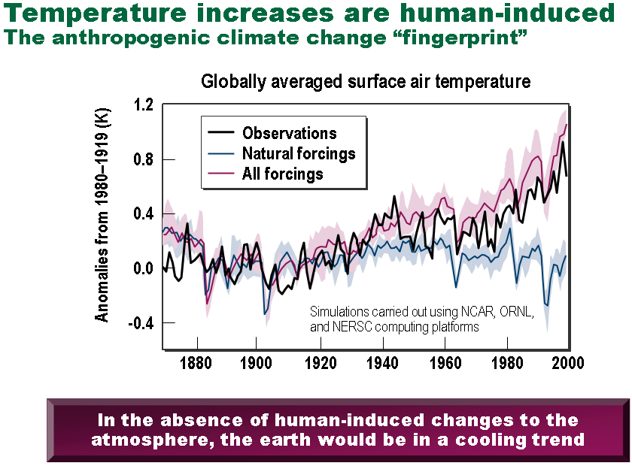
Climate Change: The defining issue of our era
The planet is warming
  Multiple lines of evidence
  Credible link to human GHG
  (green house gas) emissions
Consequences can be dire
  Extreme weather events
  Regional climate and ecosystem shifts
  Abrupt climate change
  Stress on key resources and critical infrastructures
There is an urgency to act
  Adaptation: “Manage the unavoidable”
  Mitigation: “Avoid the unmanageable”
The societal cost of both
action and inaction is large
Anomalies from 1880-1919 (K)
Figure Courtesy: ORNL
Key outstanding science challenge: Actionable predictive insights to credibly inform policy

Slide 3
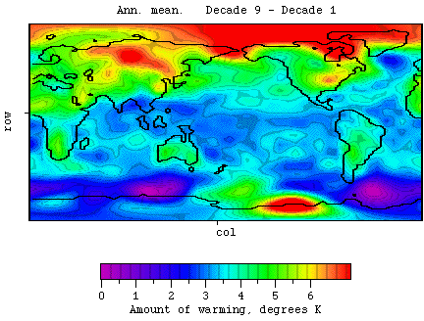
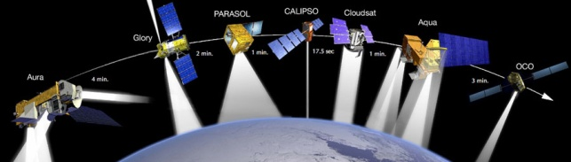

Data-Driven Knowledge Discovery in Climate Science
From data-poor to data-rich transformation
  Sensor Observations: Remote sensors like satellites and weather radars as well as in-situ sensors and sensor networks like weather station and radiation measurements
  Model Simulations: IPCC climate or earth system models as well as regional models of climate and hydrology, along with observed data based model reconstructions
Data guided processes can complement hypothesis guided data analysis to develop predictive insights for use by climate scientists, policy makers and community at large.
  "The world of science has changed ... data-intensive science [is] so different that it is worth distinguishing [it] … as a new, fourth paradigm for scientific exploration." - Jim Gray
Notes:
"The world of science has changed ... data-intensive science [is] so different that it is worth distinguishing … as a new, fourth paradigm for scientific exploration" - Jim Gray

Slide 4
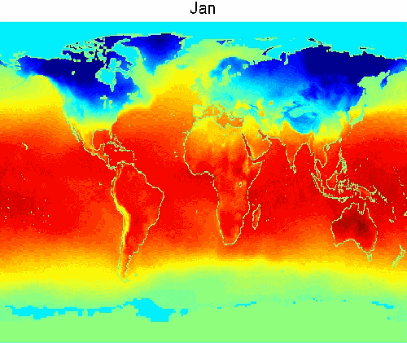
Data Mining Challenges
Spatio-temporal nature of data
  spatial and temporal autocorrelation.
  Multi-scale/Multi-resolution nature
Scalability
  Size of Earth Science data sets can be very large, For example, for each time instance,
    2.5°x 2.5°:10K locations for the globe
    250m x 250m: ~10 billion
    50m x 50m : ~250 billion
High-dimensionality
Noise and missing values
Long-range spatial dependence
Long memory temporal processes
Nonlinear processes, Non-Stationarity
Fusing multiple sources of data

Slide 5
Challenges in Analyzing Eco-Climate Data
Global Sea Surface Temperature

Slide 6

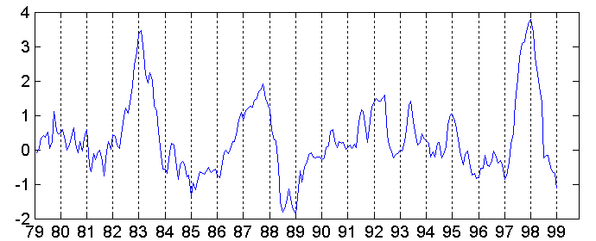
Challenges in Analyzing Eco-Climate Data
Global Sea Surface Temperature
Discovering teleconnections
El Nino Events
Nino 1+2 Index

Slide 7
Challenges in Analyzing Eco-Climate Data
Global Sea Surface Temperature
Discovering teleconnections
El Nino Events
Nino 1+2 Index

Slide 8
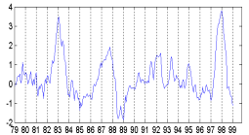
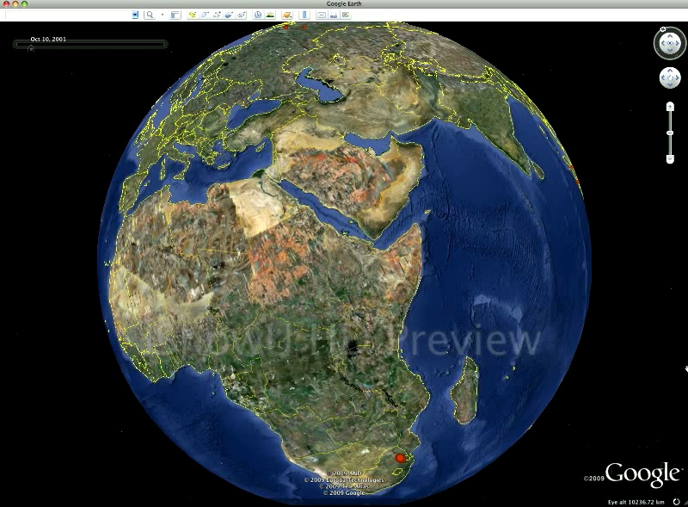
Challenges in Analyzing Eco-Climate Data
Global Sea Surface Temperature
Discovering teleconnections
El Nino Events
Nino 1+2 Index
Changes in Global Forest Cover

Slide 9
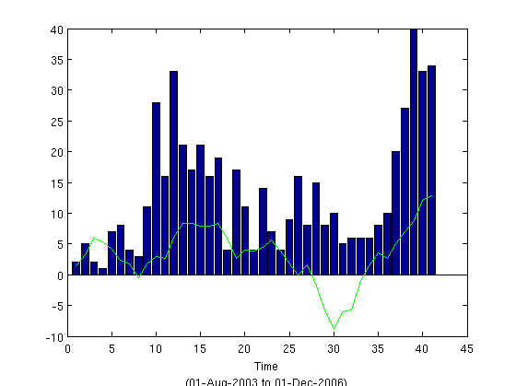

Challenges in Analyzing Eco-Climate Data
Global Sea Surface Temperature
Discovering teleconnections
El Nino Events
Nino 1+2 Index
Changes in Global Forest Cover
Relationship between El Nino
and Fires in Indonesia

Slide 10
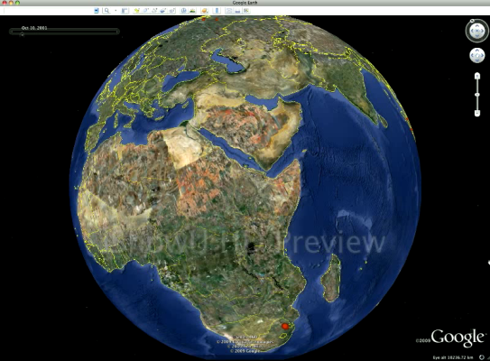
Challenges in Analyzing Eco-Climate Data
Global Sea Surface Temperature
Discovering teleconnections
El Nino Events
Nino 1+2 Index
Challenges due to data characteristics
Spatiotemporal, non-stationary, non-i.i.d.
Massive data sets
  2.5°x 2.5°:10K locations for the globe
  250m x 250m: ~10 billion
  50m x 50m : ~250 billion
Long range spatial dependencies
Long memory temporal dependencies
Nonlinear multiscale dependencies
Low frequency variability
…
Changes in Global Forest Cover
Relationship between El Nino
and Fires in Indonesia
Notes:
Challenges due to problem characteristics
Multiscale spatio-temporal processes
Importance of extreme events
Large changes in regional climate patterns
Regional and global scale abrupt changes
Projections over long lead times

Slide 11
Illustrative Applications of Data Mining
Monitoring of global forest cover
Understanding climate change and its impact

Slide 12
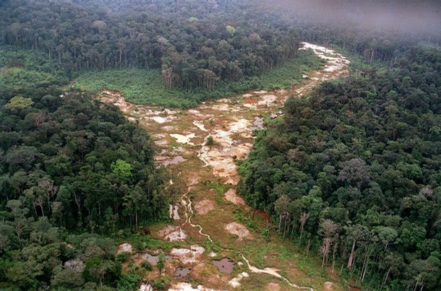


Monitoring Forest Cover Change: Motivation
Changes in forests account for over 20% of the greenhouse gas emissions
  2nd only to fossil fuel emissions
Terrestrial carbon can provide up to 25% of the climate change solution
Ability to monitor changes in global forest cover over space and time is critical for the United Nations REDD program and enabling inclusion of forests in carbon trading
The need for a scalable technological solution to assess the state of forest ecosystems and how they are changing has become increasingly urgent.
Deforestation moves large amounts of carbon into the atmosphere in the form of CO2.
Good to Go Green: SFO Unveils Carbon Offset Kiosks
'Carbon Offset' Business Takes Root
by Martin Kaste

Slide 13
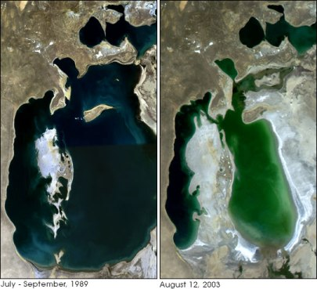
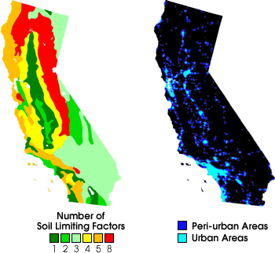
Land Cover Change Detection
Goal: Determine where, when and why land cover changes occur
  Examples: Deforestation, Urbanization, Agricultural intensification, crop rotation
Motivation: Land cover change can impact local climate, water and food supply, carbon cycle, and diversity/abundance of terrestrial species.
ARAL SEA:
Water from rivers feeding Aral Sea increasingly used to irrigate Cotton Fields
Population has increased 3 times since 1960’s.
Size of Aral Sea reduced to ¼ since 1960’s.
Surrounding Climate has changed to being more continental with shorter, hotter, rainless summers and longer, colder and snowless winters.
CALIFORNIA:
Increased urbanization
Housing development in prime agricultural land.
Pressure on water resources

Slide 14


Monitoring of Global Forest Cover
Planetary Information System for assessment of ecosystem disturbances
  Forest fires
  Droughts
  Floods
  Logging/deforestation
  Conversion to agriculture
This system will help
  quantify the carbon impact of these changes
  Understand the relationship to global climate variability and human activity
Provide ubiquitous web-based access to changes occurring across the globe, creating public awareness

Slide 15
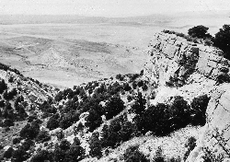
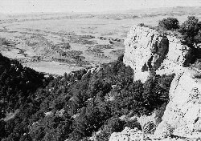
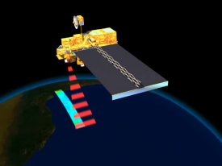
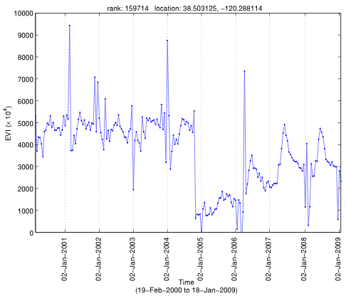
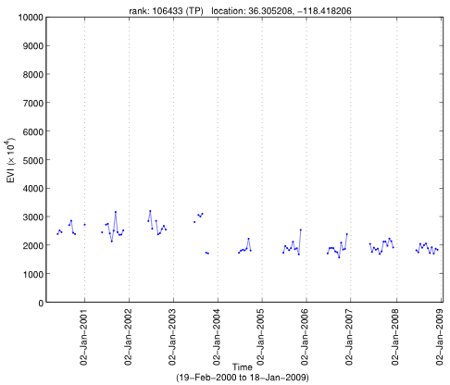
Novel Algorithms for Monitoring Global Eco-system
State of the art algorithm for land cover change detection do not scale
Remote Sensing data for global vegetation cover.
Existing time series change detection algorithms do not address unique characteristics of eco-system data like noise, missing values, outliers, high degree of variability (across regions, vegetation types, and time).
We have developed new algorithms that build non-parametric models of different segments of the time series and use them to capture the degree of change
Data sets used in our study :
  EVI: Enhanced Vegetation Index (250m x 250m)
  FPAR : Fraction of Photosynthetically Active Radiation (1km x1km and 4 km x 4km)
S. Boriah, V. Kumar, M. Steinbach, et al., Land cover change detection: a case study, KDD 2008.
V. Mithal, S. Boriah, A. Garg, M. Steinbach, V. Kumar et al., Monitoring global forest cover using data mining. Technical Report Department of Computer Science, University of Minnesota 2010.

Slide 16
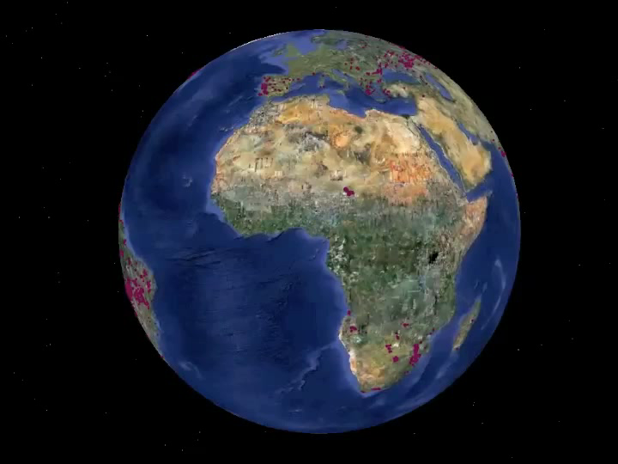
Monitoring Global Forest Cover

Slide 17
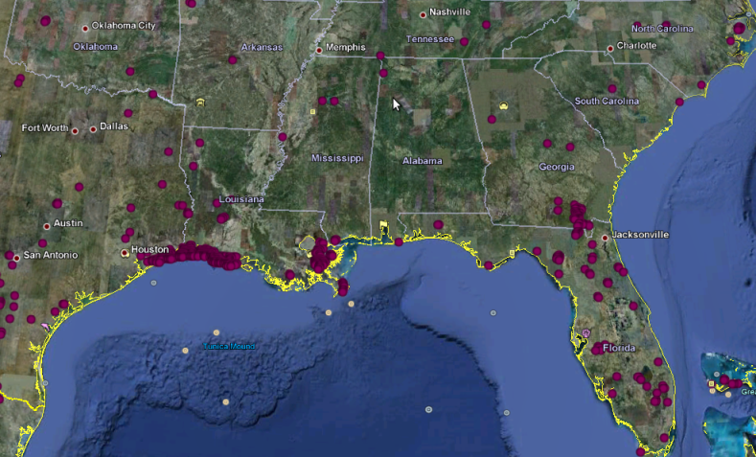
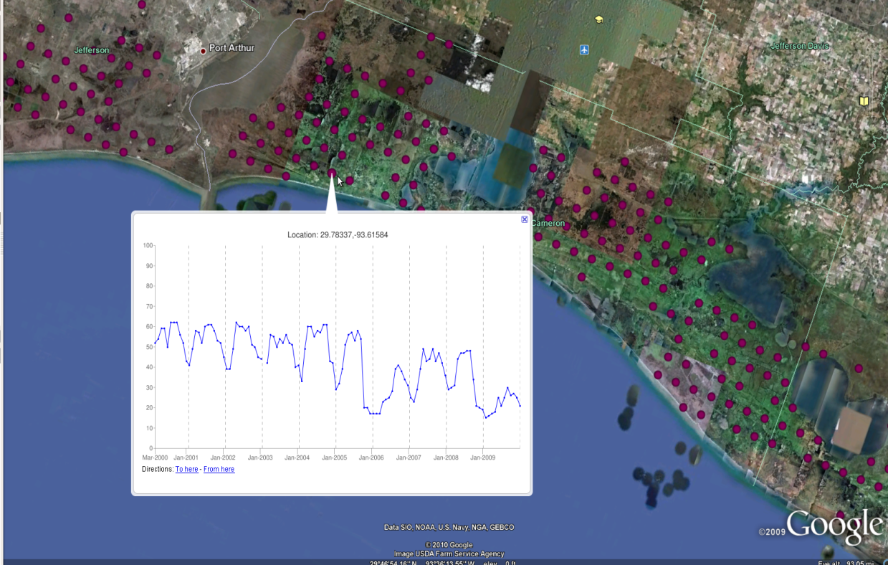
Hurricane Katrina
Hurricanes Katrina and Rita hit the Louisiana coast on August and September 2005.
The hurricanes transformed 217 square miles of Louisiana’s coastal land to water by storm surge.

Slide 18
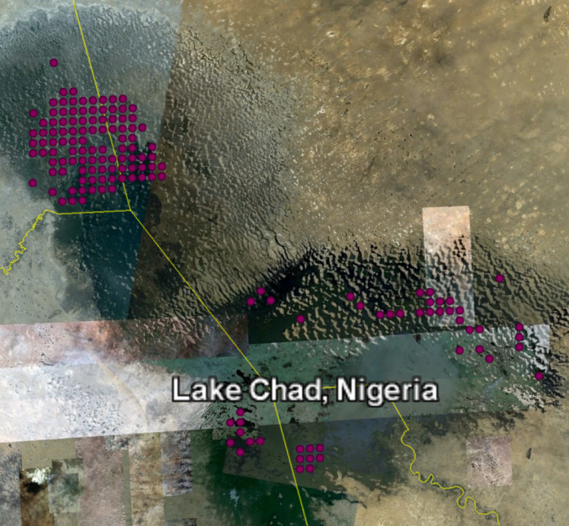
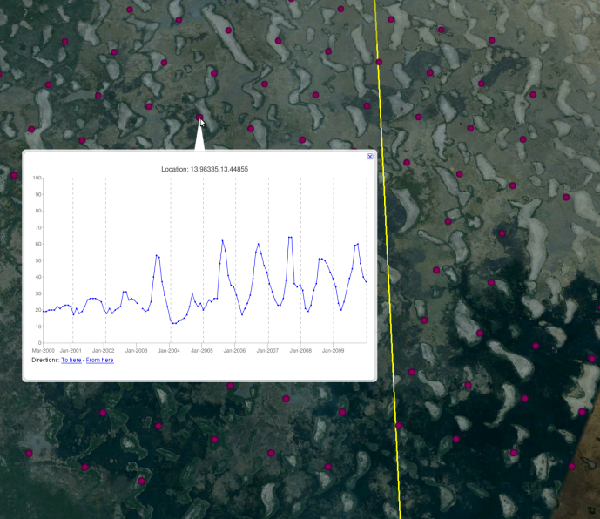
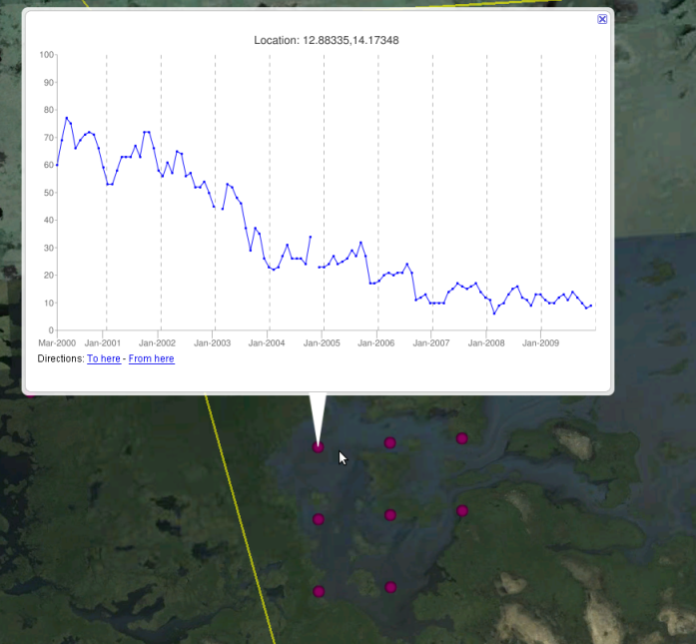
Shrinking of Lake Chad, Nigeria
Lake Chad is economically important, providing water to more than 20 million people living in the four countries that surround it.
The lake shrank as much as by 95 percent from about 1963 to 1998 and is continuing to shrink further.(Source: UN)
Efforts are in progress to divert Ubangi River into Lake Chad.

Slide 19
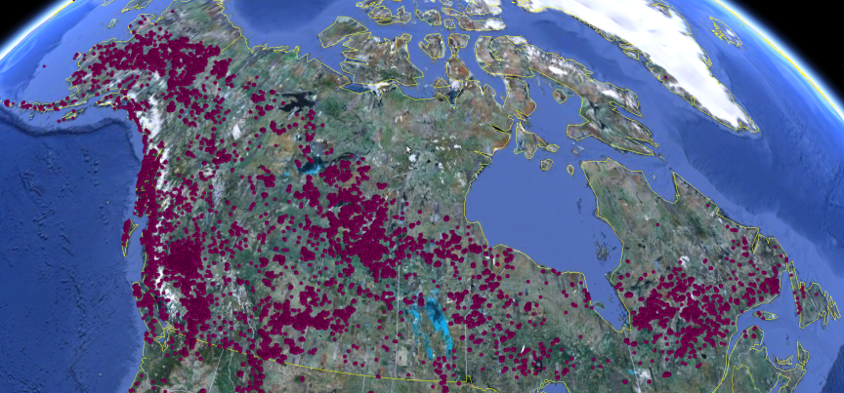
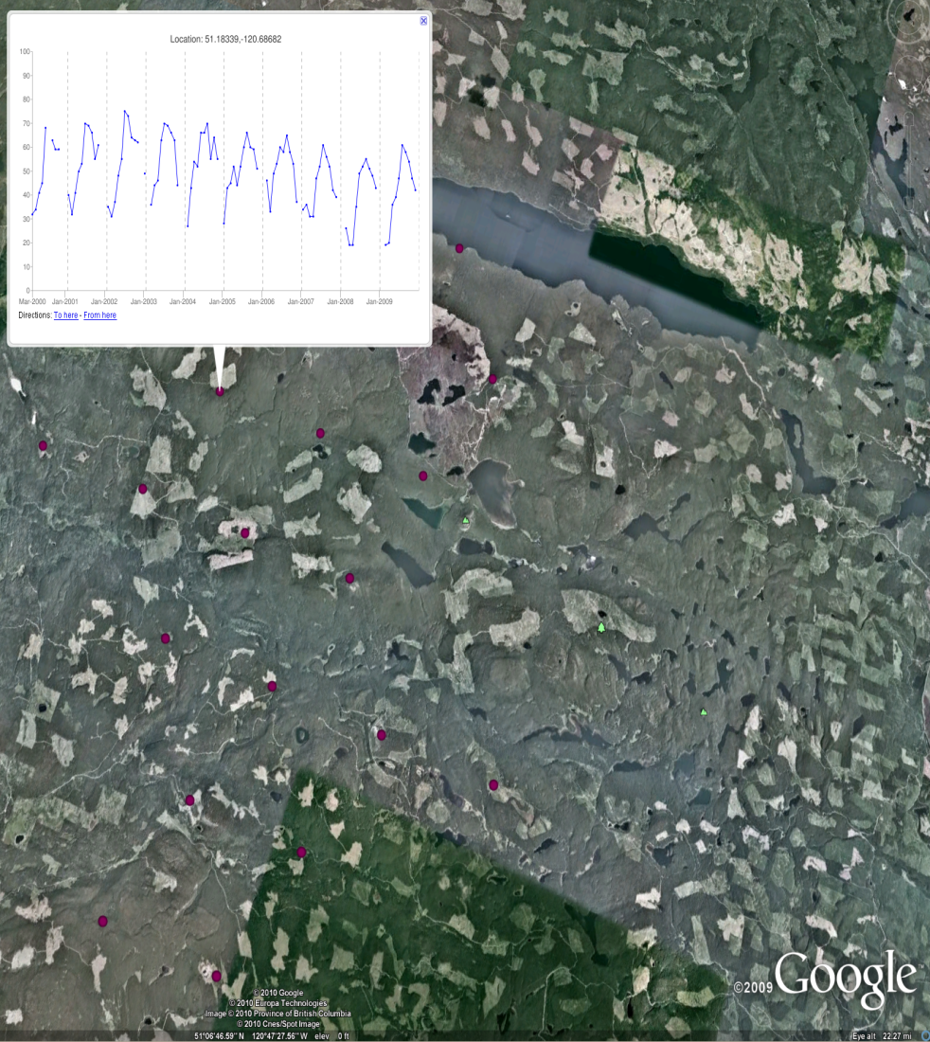
Logging in Canada
Logging has produced clear cut areas in British Columbia, which can be identified as regular, generally rectangular shapes.
The highly reflective clear cut areas stand out in marked contrast to the dark green forested areas.
(Source: NASA)

Slide 20
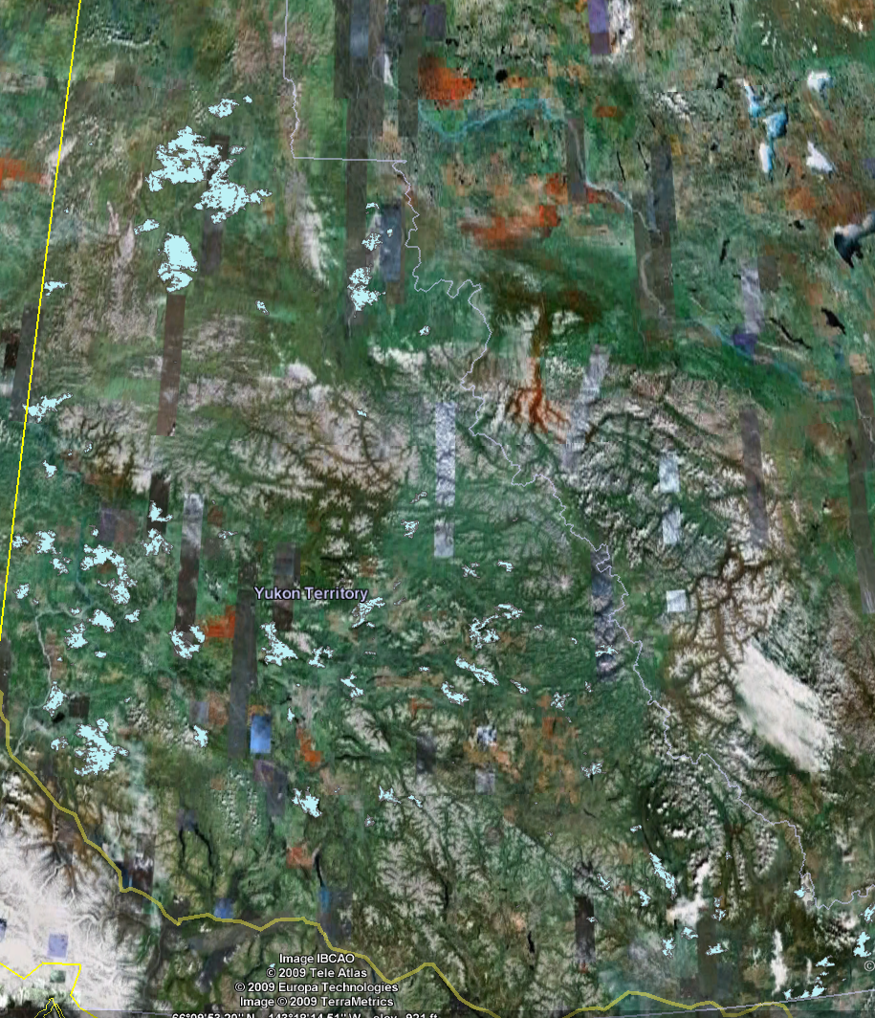
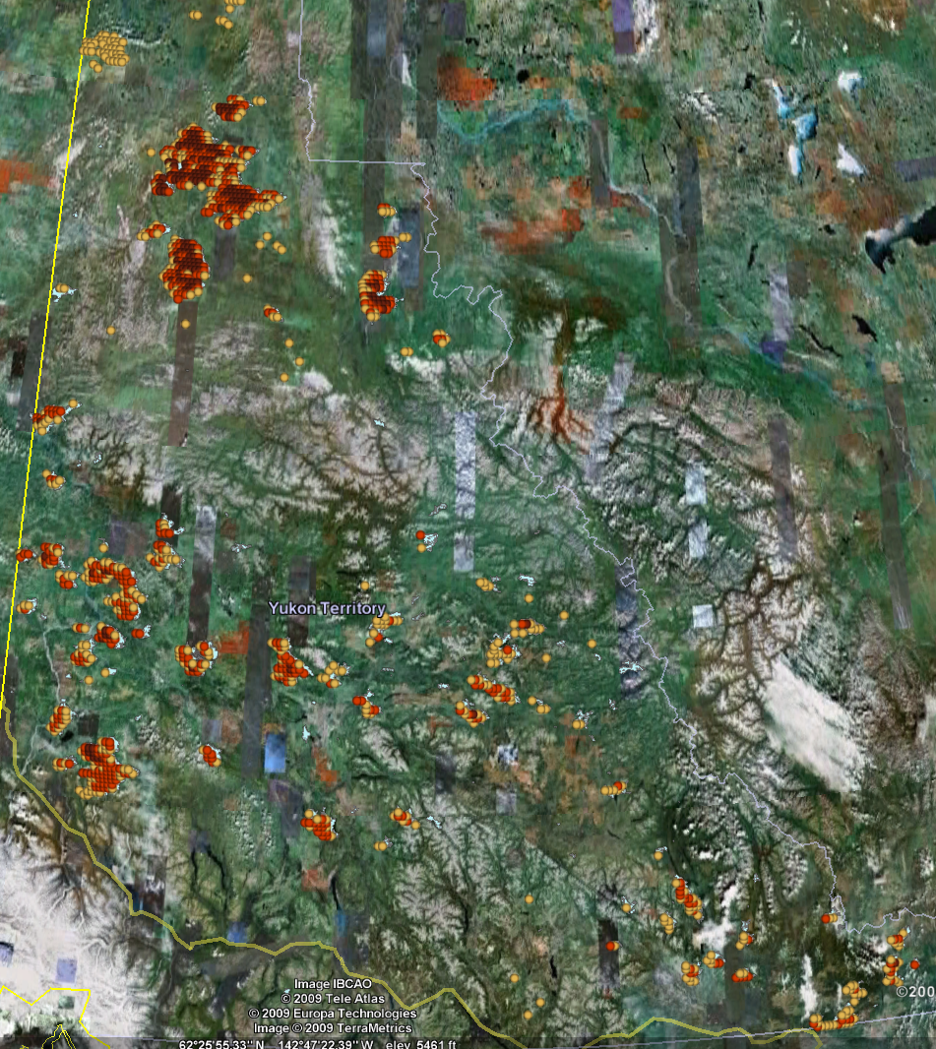
Canada: Fires in Yukon Province

Slide 21
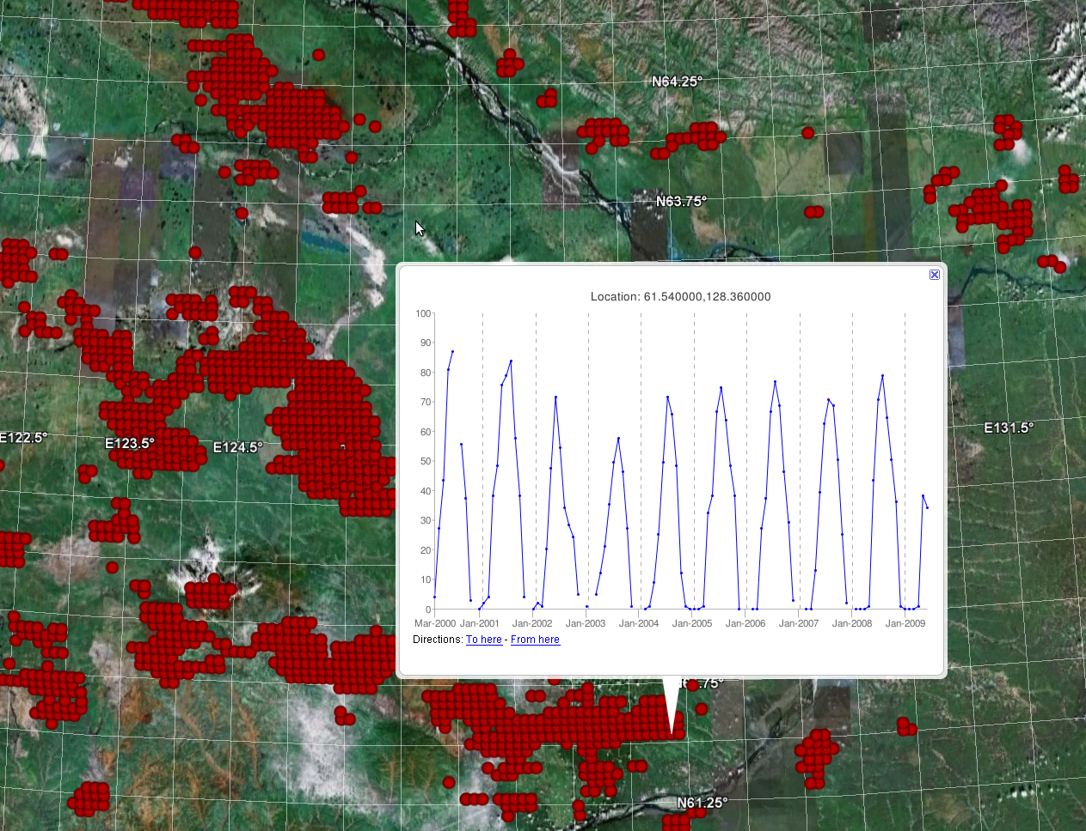
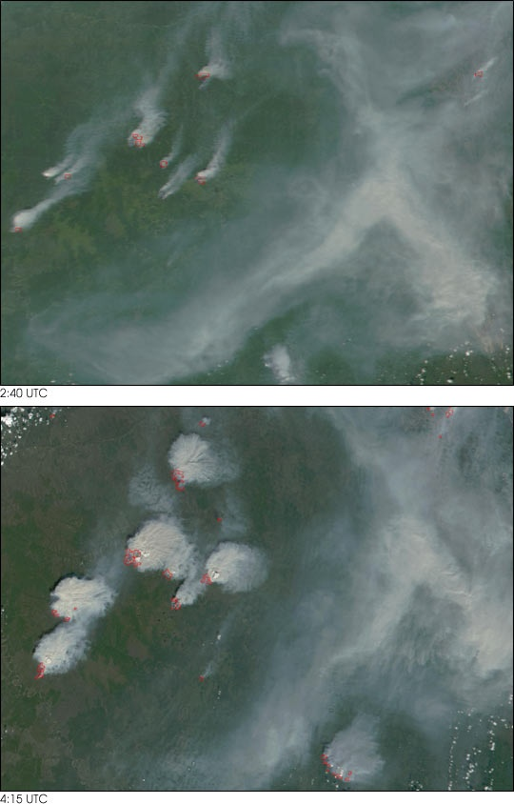
Large Outbreak of Fires near Yakutsk, Russia
During the summer months in the Northern Hemisphere, many fires are ignited in the boreal forests of Canada and Russia by lightning striking the surface
Image courtesy Jacques Descloitres, MODIS Land Rapid Response Team

Slide 22
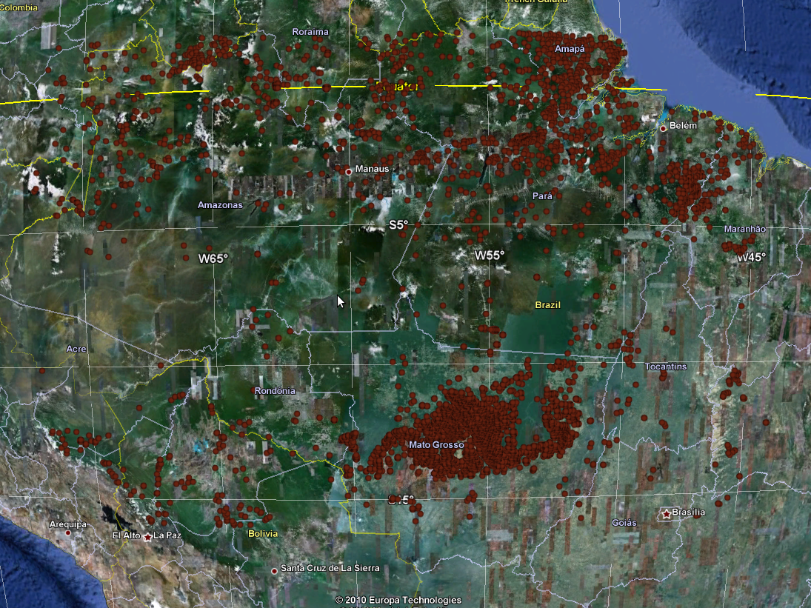
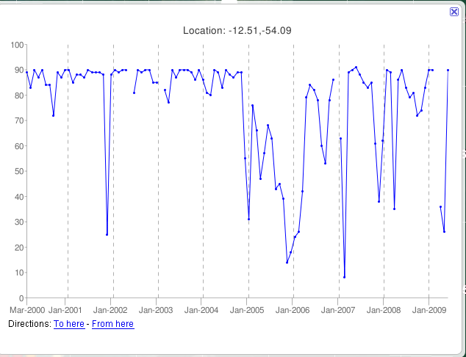
Amazon Rainforest
Brazil Accounts for almost 50% of all humid tropical forest clearing, nearly 4 times that of the next highest country, which accounts for 12.8% of the total.

Slide 23
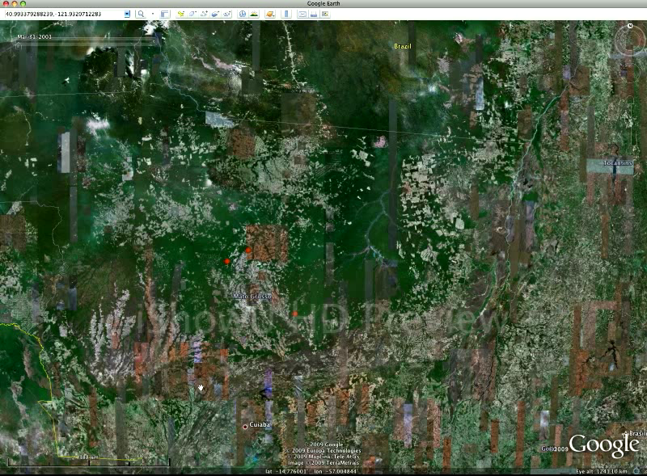
Amazon Animation

Slide 24
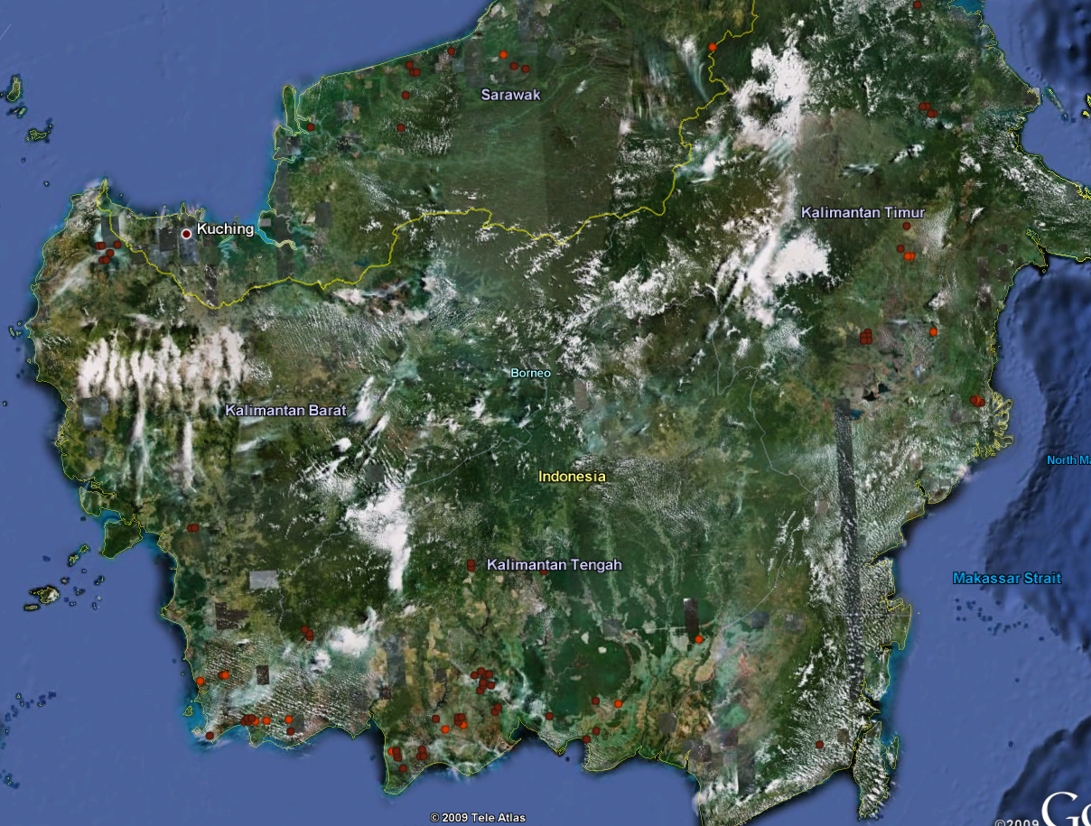
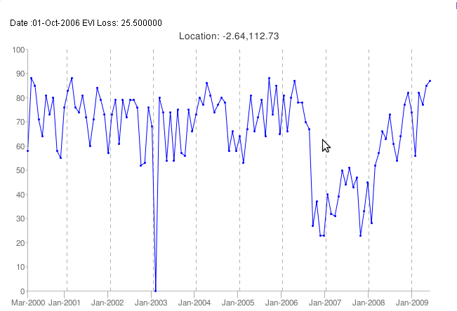

Indonesia
Forest Fires Sweep Indonesia Borneo and Sumatra.
Officials in Indonesia say illegal burning to clear land has caused rampant wildfires across Borneo and Sumatra ... eight million hectares have gone up in smoke over the last month, and fires are still burning out of control on the island of Borneo.
11 September 2006

Slide 25
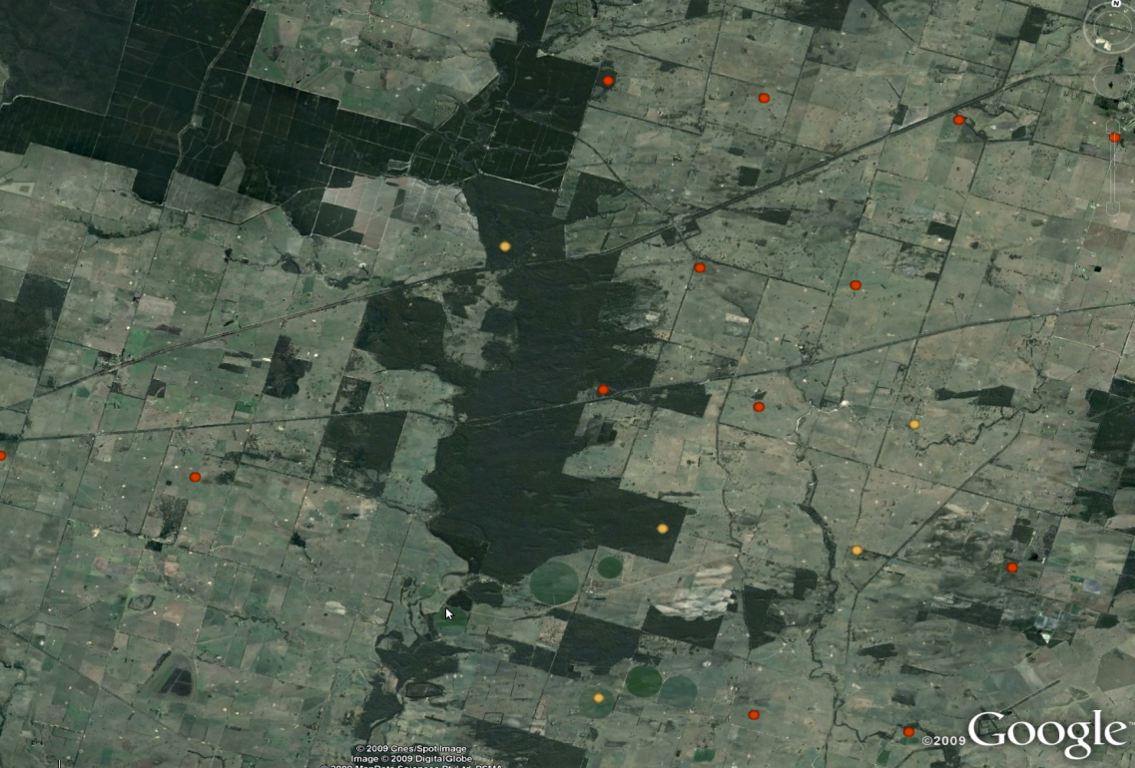
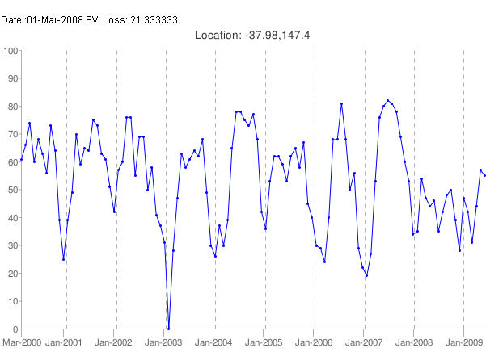
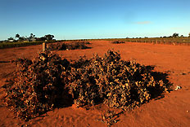
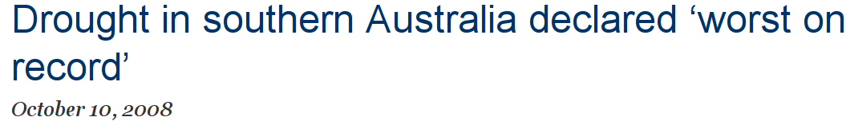
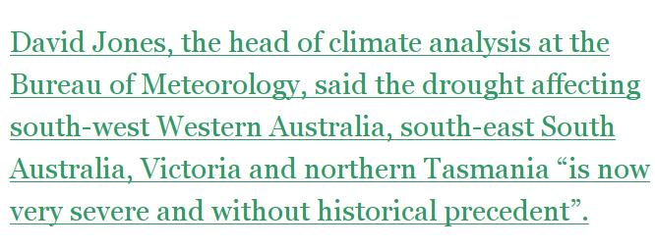
Victoria (Australia)
Source: climateprogress.org

Slide 26
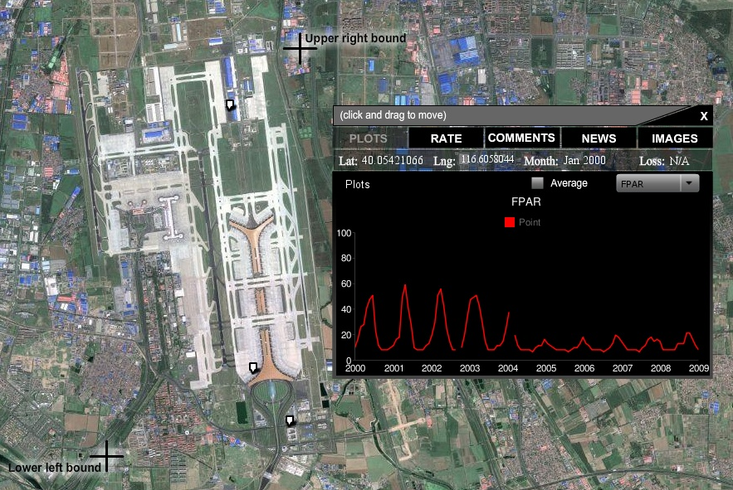

Beijing Capital International Airport Terminal 3
Construction of Terminal 3 started in March 2004
With an area of 986,000 square meters, Terminal 3 is Asia's largest free standing construction and the world's largest airport terminal complex.
http://news.163.com/special/00012J2S/beijingairport080226.html

Slide 27
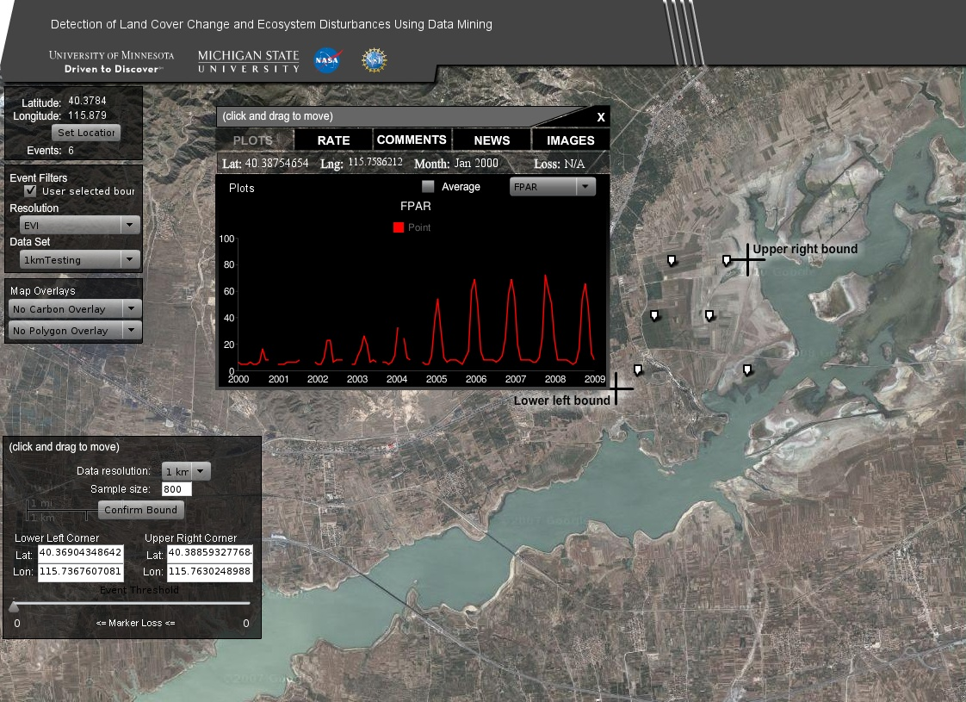
Reforestation near Guangting Reservoir, China
These reforestation events are around Guangting Reservoir, a reservoir around 100 miles away from Beijing.
Around 20 years ago, Guanting Reservoir used to play an important role of serving water for people in Beijing and Zhangjiakou.
The environment around the reservoir got polluted after years, due to lack of protection.
It is located very close to Beijing and plays an important role, therefore the government began to give a comprehensive treatment for this area.
Part of the treatment is planting trees around Guangting Reservoir which started in 2003 and is still going on.
News Articles:
http://www.yzhbw.net/news/shownews-22_510.aspx
http://news.china.com.cn/rollnews/2010-06/04/content_2514320.htm

Slide 28
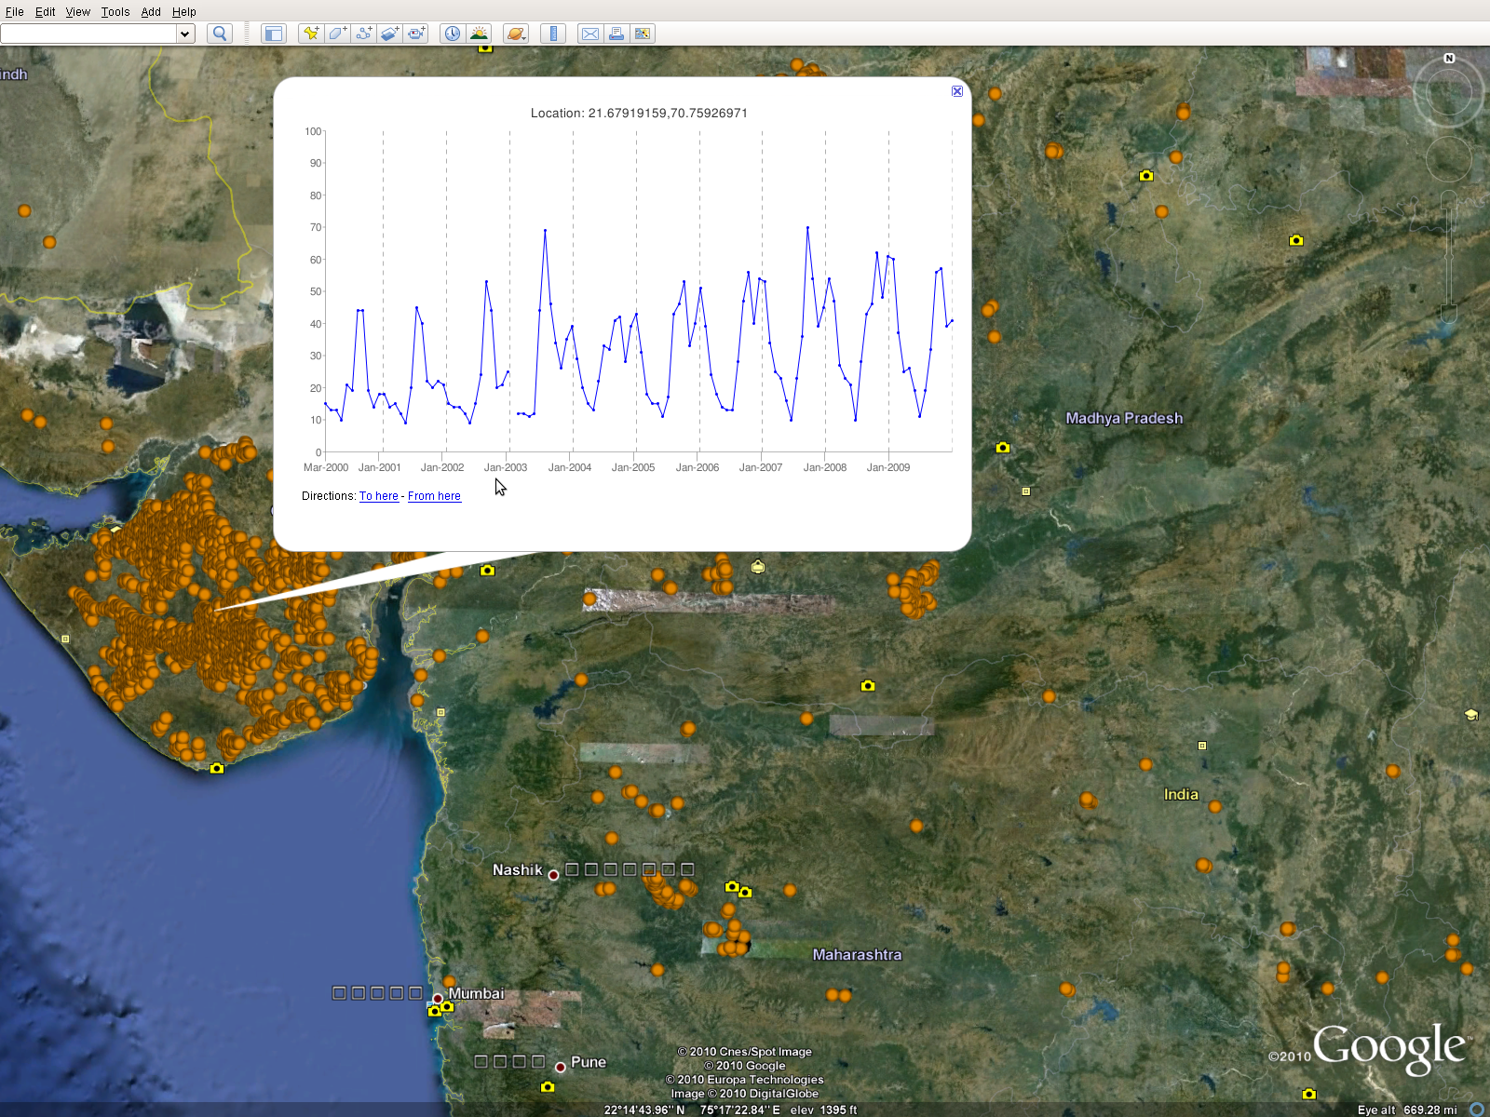
Change in Crop Patterns in Gujarat
A large scale change in the crop patterns was observed in Gujarat and nearby areas, where farmers switched from single crop to double crop.

Slide 29
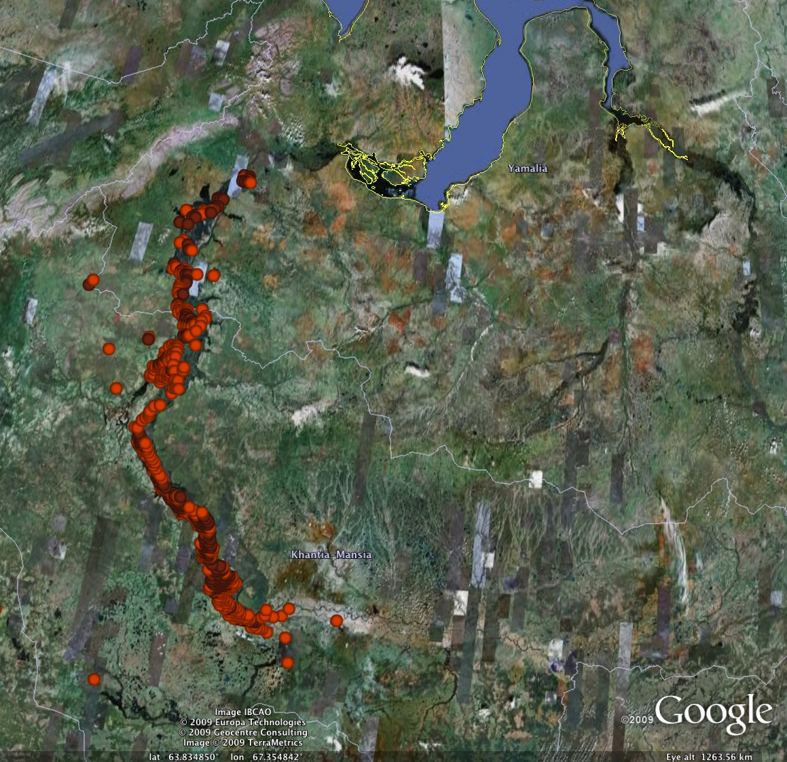
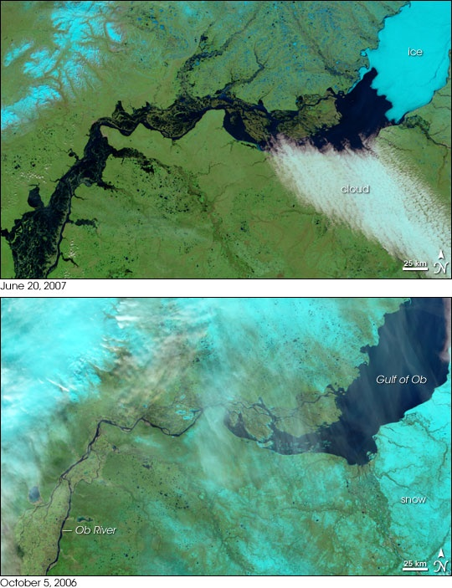
Flooding along Ob River, Russia
The river flows north and is blocked by ice (top right), which causes flooding. Under normal circumstances the river flows into the Gulf of Ob.
Source: NASA Earth Observatory

Slide 30
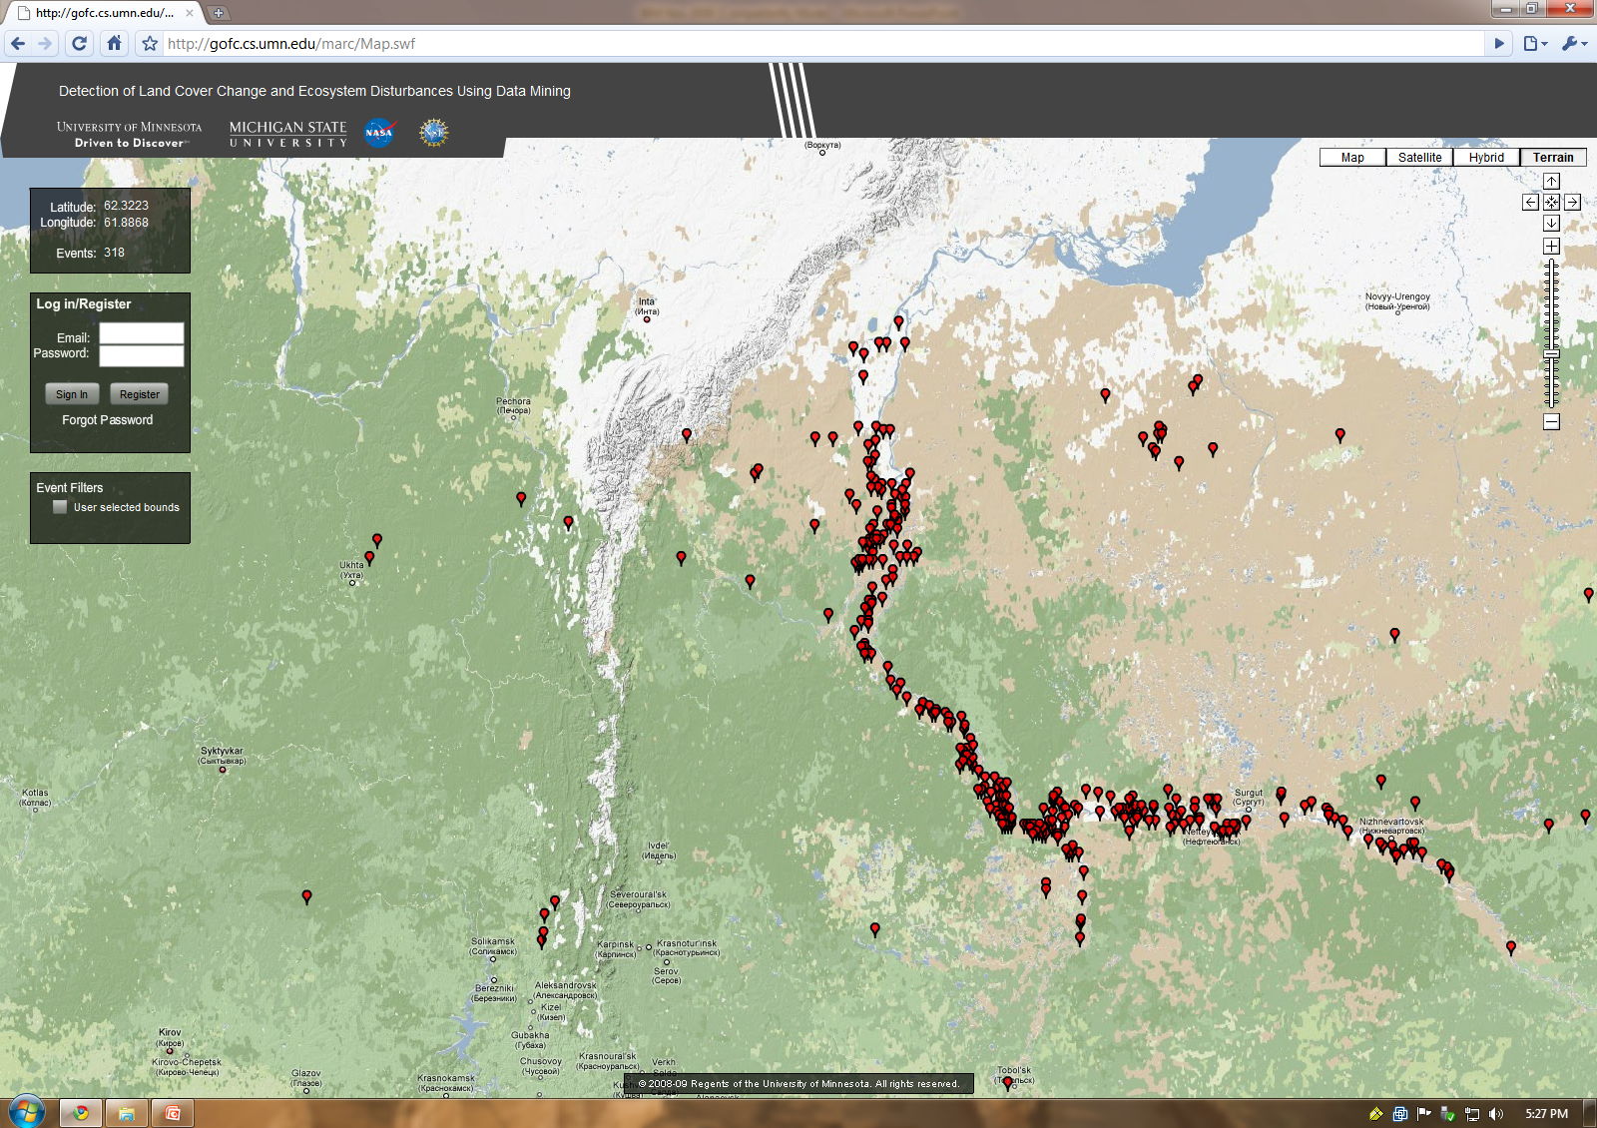
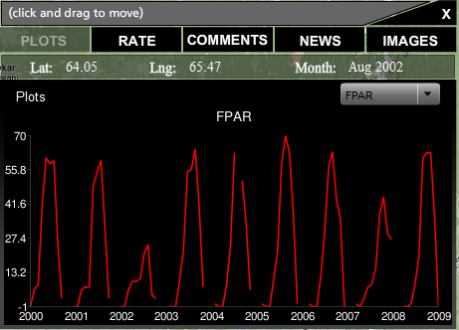
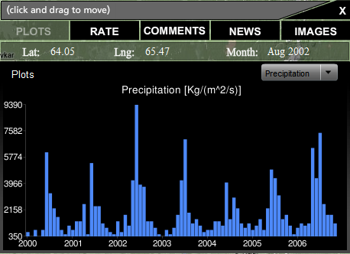
Web 2.0 interface for planetary information system

Slide 31
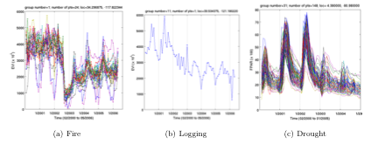
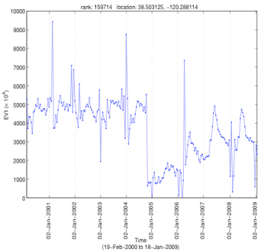
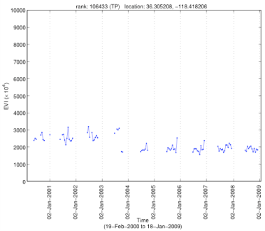



Monitoring Forest Cover Change: Challenges Ahead
Designing robust change detection algorithms
Characterization of land cover changes
Multi-resolution analysis (250m vs 1km vs 4km)
  Different kinds of changes are visible at different scales
Multivariate analysis
  Detecting some types of changes (e.g. crop rotations) will require additional variables.
Data quality improvement
  Preprocessing of data using spatio-temporal noise removal and smoothing techniques can increase performance of change detection.
Incremental update and Real-time detection
Spatial event identification
Applications in variety of domains:
  Climate, agriculture, energy
  Economics, health care, network traffic
Source: Merck, Google.

Slide 32













NSF Expedition Project: Understanding Climate Change: A Data Driven Approach
Vipin Kumar, UM Arindam Banerjee, UM Shashi Shekhar,UM Michael Steinbach, UM
Fred Semazzi, NCSU Joe Knight, UM Nagiza Samatova, NCSU Peter Snyder, UM Jon Foley, UM
Alok Choudhary, NW Abdollah Homiafar, NCA&T Auroop Ganguly, UTK/ORNL Singdhansu Chatterjee, UM

Slide 33

Physics-based Models are Essential but Not Adequate
Models make relatively reliable predictions at global scale for ancillary variables:
  Sea Surface Temperature (SST)
  Temperature/humidity profiles over land
  Wind spread at different heights
They provide least reliable predictions for variables that are crucial for impact assessment:
  Regional precipitation and extremes
  Hurricane intensity and frequency
  Droughts and floods
Disagreement between IPCC models
Regional hydrology (“P–E” changes in 2030s) exhibits large variations among major IPCC model projections
“The sad truth of climate science is that the most crucial information is the least reliable” (Nature, 2010)
Hypothesis-driven “manual” conceptual models try to address this gap:
Hurricane models (Emanuel et al, BAMS, 2008)
Regional-scale precipitation extremes (O’Gorman & Schneider, PNAS, 2008; Sugiyama et al, PNAS, 2010)
We need a systematic approach to semi-automatic data-driven model inference.

Slide 34
Transformative Computer Science Research
Enabling large-scale data-driven science for complex, multivariate, spatio-temporal, non-linear, and dynamic systems:
The Expedition is an end-to-end demonstration of this major paradigm for future knowledge discovery process.
Complex Networks
Enable studying of collective behavior of interacting eco-climate systems
Fusion plasma
Combustion
Astrophysics
….
Relationship Mining
Enable discovery of complex dependence structures such as non linear associations or long range spatial dependencies
Nonlinear, space-time lag, geographical, multi-scale
Predictive Modeling
Enable predictive modeling of typical and extreme behavior from multivariate spatio-temporal data
relationships
Community structure- function-dynamics
Nonlinear, spatio-temporal, multi-variate, persistence, long memory
kernels , features, dependencies
Nonlinear, spatio-temporal, multivariate
High Performance Computing
Enable efficient large-scale spatio-temporal analytics on
future generation exascale HPC platforms with complex memory hierarchies
Large scale, spatio-temporal, unstructured, dynamic
Notes:
Structure & dynamics of complex network representing climate system can provide predictive insights.

Slide 35

Relationship Mining
Objective
To develop methods for discovery of complex dependence structures (e.g., nonlinear associations, long-range spatial dependencies)
Dynamic behavior of the high and low pressure fields corresponding to NOA climate index (Portis et al, 2001)
Computer Science Innovations
Define a notion of “transactions” for association analysis in spatio-temporal data
Adapt association analysis to continuous data
Reduce the number of redundant patterns and assess statistical significance of the identified patterns
Define a new approach to association analysis that trades off completeness for a smaller, simpler set of patterns and far smaller computational requirements
Impact
Facilitate discovery of complex dependence structures in dynamic systems
Understand relationships between fire size and frequency to precipitation, land cover, ocean temperature, etc
  Characterize impacts of sea surface temperature on hurricane frequency and intensity
Understand feedback effects, the key uncertainty in climate science

Slide 36




What is the impact of climate change on ecosystems ?
Warmer Winters in Canada makes it a net emitter of Carbon
Insect Damage and Fires Are Causally Related
Fire in Yukon Province, Canada
Winters have not been cold enough
to kill off mountain beetles
2006 Fires in Indonesia were worsened by el Nino says NASA
Peaks of CO coincide with warm phases of El Nino
Source: CCIAP Project, NASA

Slide 37

Complex Networks
Objectives
To develop algorithms for characterization of network structure, function, and dynamics
To enable large-scale comparative analysis of climate networks to increase prediction confidence
Node degree in a correlation-based climate network
Computer Science Innovations
Construct multivariate networks to capture nonlinear spatio-temporal interactions
Characterize network dynamics at multiple spatial scales over different time periods
Scale graph mining algorithms to the required size and number for comparative analysis of multiple real-world networks
Impact
Apply network structure-function-dynamics methods to complex systems
Understand intricate interplay between topology and dynamics of the climate system over many spatial scales
Explain the 20th century great climate shifts from the collective behavior of interacting subsystems
Notes:
Characterize the relationship between various climate variables and understand

Slide 38

Discovery of Climate Indices Using Complex Networks
Clustering provides an alternative approach for finding candidate indices.
Clusters are found using the Shared Nearest Neighbor (SNN) method that eliminates “noise” points and tends to find homogeneous regions of “uniform density”.
Clusters are filtered to eliminate those with low impact on land points
NAO
AO
SOI
SOI
DMI
M. Steinbach, P. Tan, V. Kumar, C. Potter and S. Klooster. Discovery of Climate Indices Using Clustering, Proceedings of KDD 2003.
Notes:
This slide describes our work in using clustering to discover climate indices. This work involved the analysis of global climate data sets, both to find the indices, and to assess their impact.
The data mining technology demonstrated here is cluster analysis. The clustering technique used was developed in our group.
I have included the abstract of the paper that this work was taken from. The paper itself can be found at
http://www-users.cs.umn.edu/~kumar/papers/kdd03_nasa.pdf
To analyze the eect of the oceans and atmosphere on land
climate, Earth Scientists have developed climate indices,
which are time series that summarize the behavior of selected
regions of the Earth's oceans and atmosphere. In
the past, Earth scientists have used observation and, more
recently, eigenvalue analysis techniques, such as principal
components analysis (PCA) and singular value decomposition
(SVD), to discover climate indices. However, eigenvalue
techniques are only useful for nding a few of the strongest
signals. Furthermore, they impose a condition that all discovered
signals must be orthogonal to each other, making it
dicult to attach a physical interpretation to them. This
paper presents an alternative clustering-based methodology
for the discovery of climate indices that overcomes these limitations
and is based on clusters that represent regions with
relatively homogeneous behavior. The centroids of these
clusters are time series that summarize the behavior of the
ocean or atmosphere in those regions. Some of these centroids
correspond to known climate indices and provide a
validation of our methodology; other centroids are variants
of known indices that may provide better predictive power
for some land areas; and still other indices may represent
potentially new Earth science phenomena. Finally, we show
that cluster based indices generally outperform SVD derived
indices, both in terms of area weighted correlation and direct
correlation with the known indices.

Slide 39

Alok Choudhary, NWU
Nagiza Samatova, NCSU
Vipin Kumar, UMN
Predictive Modeling
Objectives
To advance nonparametric multivariate spatio-temporal probabilistic regression models to incorporate nonlinear dependencies
To develop latent variable models to characterize spatio-temporal climate states
To advance multivariate extreme value theory through geometric and probabilistic generalizations of quantiles
=
+
GP₁
GP₂
Correlated Gaussian Processes for multivariate spatiotemporal regression w/ nonlinear dependencies
Multivariate quantiles for extreme value analysis
Computer Science Innovations
Impact
Take into account nonlinear spatial, temporal, and multivariate dependencies
Minimize assumptions on temporal evolution, e.g., no`Markov’ assumptions
Deal with curse of dimensionality in nonlinear extreme value analysis (recency, frequency, duration) and quantiles
Scale algorithms yet ensure uncertainty quantification
Uncertainty quantified predictions of climate variables, e.g., precipitation, over space-time
Abrupt climate change detection, typical climate characterization
Modeling regional climate change and extreme climate events, e.g., hurricanes
Applications beyond climate data, e.g., finance, healthcare, bioinformatics, networks
Notes:
, e.g., variational inference/optimization vs MCMC/Gibbs/Boostrap
38

Slide 40
Predicting Tropical Storm Counts from Climate Model Projections for SST
Built a regression model that relates August SST values off the western coast with the August tropical storm counts.
Used predicted SST from climate scenarios produced by Global Climate Models (GCMs) to compute projected cyclones.
10 year moving average of predictions based on linear regression, and SST from four IPCC climate scenarios. Confidence intervals are based on estimate variability, not uncertainty. (Joint work with Ganguly and Semazzi).
Challenges
  How to model non-linear relationships?
  How to incorporate other climate parameters e.g. Wind speed, Vegetation over near by land?
  How to account for multiple hypothesis testing?

Slide 41

High Performance Computing
Objectives
To investigate a “co-design” approach to scalable analysis of complex dependence structures
To develop parallel and scalable statistical and data mining functions and kernels
To develop sophisticated parallel I/O techniques that fully exploit complex memory hierarchy (disks, SSDs, DRAMs, accelerators)
An architecture with accelerators such as GPUs. Some/all nodes have accelerators and many cores.
Computer Science Innovations
The first“co-design” approach that will take into account exploration of nonlinear associations, long-range spatial dependencies, I/O requirements and optimizations, presence of accelerators and multiple suitable programming models for HPC systems
Novel optimizations to deal with data-and-compute intensive computations on exascale platforms with complex memory hierarchies
Impact
Analytical kernels that will scale many data mining algorithms
Analytics algorithms designed for effective exploration of complex spatio-temporal dependence structures

Slide 42
Driving Use-Cases for the Expedition
CS Technologies
Co-design-based scalable analytics of complex dependence structures
Characterize feedbacks contributing to abrupt climate regime changes
Yr5+
Nonparametric multivariate spatio-temporal probabilistic regression models
Yr5
Identify drought and pluvial event triggers to improve prediction
Yr4
Understand and quantify the uncertainty of feedback effects in climate
Multivariate extreme value theory based on geom./prob. quantiles
Project climate extremes at regional and decadal scales
Yr3
Association analysis-based interplay between complex dependence structures
Yr2
Understand relationships between fire size and frequency to precipitation, land cover, ocean temperature, etc.
Yr1
Characterize impacts of sea surface temperature on hurricane frequency and intensity
Networks for multivariate nonlinear space-time interactions
Data Challenges
Multivariate
Non-linear
Non-stationary non-i.i.d
Long-memory, long-range, multiscale
Heterogeneous

Slide 43





Use Case: Hurricane Frequency
Steps for Discovery of Multivariate Non-linear Interactions
Yr1: UTK/ORNL, UMN, NWU
Yr1.5: NCSU, UMN, NWU
IPCC AR4 Models: CMIP3 datasets
Monthly mean sea surface temperature
Monthly mean atmospheric temperature
Daily horizontal wind at 250/850 hPa
1. Pre-process ancillary climate model outputs
2. Construct multivariate nonlinear climate network
3. Detect & track communities
Steps for Predictive Modeling of Hurricanes
Yr1.5: UMN, UTK/ORNL
Yr2: UMN, UTK/ORNL
Yr2.5: UMN, UTK/ORNL
SST impact on hurricane frequency & intensity
5. Determine non-stationary non-i.i.d. climates states & Build hurricane models
3. Find non-linear relationships
4. Validate w/ hindcasts
Notes:
Note: Emphasize the difference between the previous process:
Linear
Univariate
Stationary
Linear regression based

Slide 44

Use Case: Regional Precipitation
Step1: Conceptual physics models (O’Gorman and Schneider 2009) and relationship mining identify variables in 3D (space, time, vertical) neighborhoods with information relevant for predicting precipitation
Step 2: Precipitation mean and extremes are projected with ancillary variables in 3D neighborhoods with predictive modeling
Step 3: Complex networks are constructed over oceans using relationship mining
Step 4: Complex networks develop proxies for global and regional scale ocean dynamics leading to set of potential predictors
Step 6: The (Step 2) 3D neighborhood-based predictions are combined with teleconnction-based predictions with fusion of predictive modeling
Step 7: Regional precipitation prediction gains are run through cross-validation and interpreted with climate science
Step 5: Teleconnections are developed to predict regional precipitation change and their extremes based on both relationship mining and predictive modeling

Slide 45


Use Case: 1930s Dust Bowl
1930s Dust Bowl Drought
Affected almost two-thirds of the U.S. Centered over the agriculturally productive Great Plains Drought initiated by anomalous tropical SSTs (Teleconnections)
NASA NSIPP Model: 14 C20C datasets
Ensemble of 14 100-year simulations of the 20th Century
Forced with observed monthly SSTs
Allows for assessment of how much the SSTs control Great Plains climate variations
Information content in C20C model simulations along with ancillary observations can be used to identify and predict drought “triggers” and the contribution of complex feedbacks to abrupt precipitation regime changes and drought persistence
However, the abrupt change in the precipitation regime and decade-long persistence of drought thought to be related to strong land-atmosphere feedbacks (e.g., precipitation recycling)
Global SST anomalies averaged over 1932-1938. Boxes represent sub-regions used to identify the relative importance of SST anomalies in initiating the the Dust Bowl drought.
Time series of precipitation anomalies averaged over the Great Plains region for 14 ensemble members of C20C run. Anomalous Tropical SSTs explain most of the 20th Century drought events.
From Schubert et al. (2004)
Notes:
The key thing to note here is that the anomalous SSTs explain some of the precipitation variability, but there are some events for which the model predicts a drought and the obs don’t support it, or the reverse – the model doesn’t capture the severity of the drought. This brings into play the land-atmosphere feedbacks that can trigger changes and either amplify or offset the precipitation deficit. The abrupt changes and the persistence are related to things other than just the SSTs. Likely a lot of land-atmosphere variables (soil moisture, vegetation cover and growth, etc). The key is that these complex relationships can be explored with model and observational data to assess whether there is a predictive potential.

Slide 46

Use Case: Regime Shift in Sahara & Sahel
Regime Shift in Sahara
Sudden shift from `Green Sahara’ to `Desert Sahara’
Sahara consisted of extensive vegetation, lakes, wetlands according to Geologic data.
Sudden transition from vegetated to desert conditions around 5500 years ago
Complex system with more than one stable state.
Precipitation patterns are tightly correlated with vegetation cover patterns.
Northern Africa is dominated by the Sahara. The transition between the Sahara and the savanna/tropical forest to the south occurs in the Sahel.
Vegetation cover and precipitation patterns
Sahel zone
Key Questions stay unanswered:
- What were underlying conditions?
- What triggered the regime shift?
Regime Shift in Sahel
Sahel is the transition zone between the Sahara to the north and the tropical savanna and evergreen forests to the south
Onset of major 30-year drought over the Sahel region in 1969
Sahel drought led to widespread famine, ecosystem degradation, and dispersion of its inhabitants
Data analysis for hypothesis generation, testing:
Reduction in Precipitation
+
Such sudden, large change in environmental–or “regime shift”—often occurs without advance warning. Underlying conditions may predispose a system to a regime shift. A fairly small event, e.g., storm, drought, etc., may trigger the shift to a new stable state.
Reduction in Vegetation
Possible hypothesis: Land-atmosphere feedback process

Slide 47


Summary
Data driven discovery methods hold great promise for advancement in the mining of climate and eco-system data.
Challenges arise due to the complex nature of scientific data sets
        Multi-scale/Multi-resolution nature
        Spatio-temporal autocorrelation
        Long-range spatial dependence
        Long memory temporal processes
        Nonlinear processes, Non-Stationarity
        Variability, noise, and missing values
        Massive Size
        Fusing multiple sources of data
El Nino Events
Nino 1+2 Index

