Slide 1
OpenCDN: An ICN Based Open Content Distribution System Using Distributed Actor Model
Arvind Narayanan, Eman Ramadan, Zhi-Li Zhang
Department of Computer Science & Engineering
University of Minnesota, Minneapolis, USA
April 16, 2018
IECCO (co-located with IEEE INFOCOM) 2018, Honolulu, HI

Slide 2
Outline
Why OpenCDN?
Success of Internet: Cloud Content Distribution & CDN
(Content-Centric) Internet Architecture with Edge Computing?
CONIA: Content-provider Oriented Namespace Independent Architecture
OpenCDN: Design Goals
Modularity, Scalability, Velocity & Mobility
Ongoing & Future Work
Programming Model: Actor Model & Reactive Functional Programming
Runtime System (incorporated w/ DPDK)
(Declarative) Language

Slide 3
Success of Today’s Intenet
Today’s Internet can be primarily characterized by its success as a (human-centric, content-oriented) information delivery platform
Web access, search engine, e-commerce, social networking, multimedia (music/video) streaming, cloud storage, …
users search for and interact with websites (or “content”), or interact with other users;
users consume or generate information
static vs. dynamic content
Rise of web (and HTTP) – coupled with emergence of mobile technologies – led to cloud computing and CDNs
Huge data centers with massive compute and storage capacities to store information, process user requests and generate content they desire
CDNs with geographically distributed edge servers to “scale out” and facilitate “speedier” information delivery

Slide 4
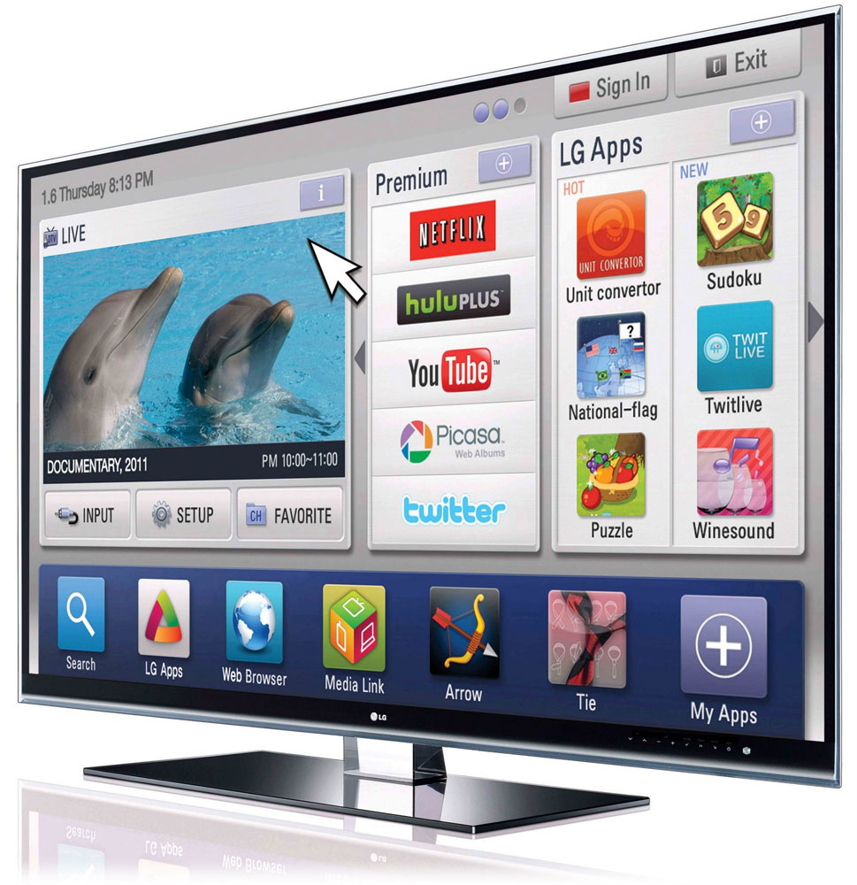
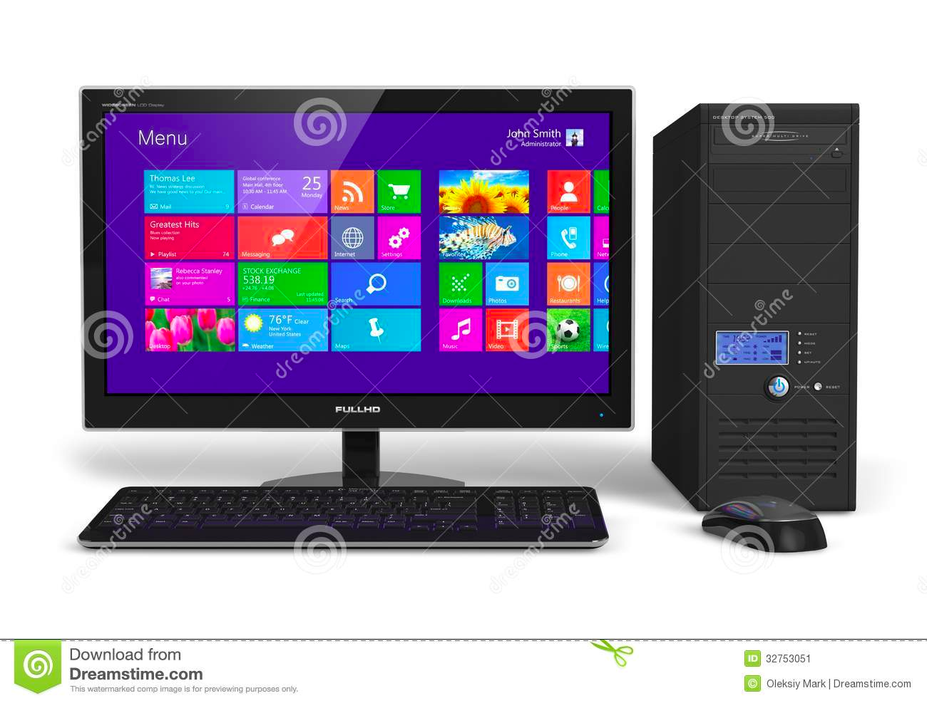
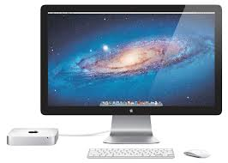
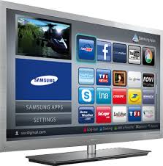
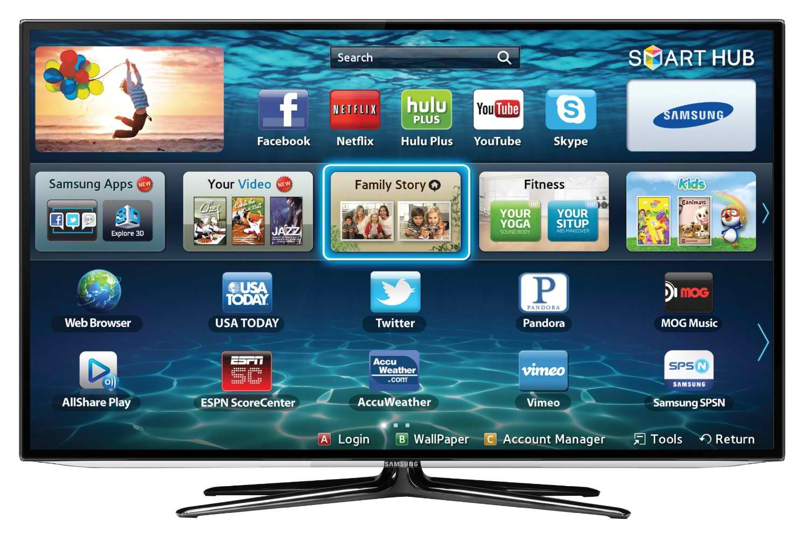
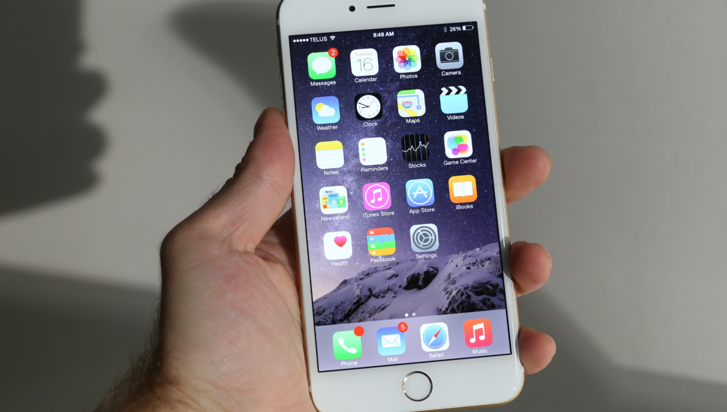
Content Distribution Ecosystem
Multiple major entities involved!
content providers (CPs), content distribution networks (CDNs), ISPs and of course, end systems & users
some entities may assume multiple roles
Complex business relationships: sometimes cooperative, but often competitive
CP2
CDN₂ & its servers
data centers
CDN₁ & its servers
CP1
ISP
data centers
media
players
ISP
ISP
users

Slide 5
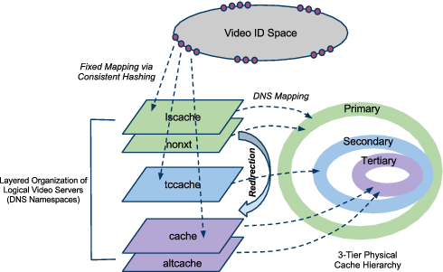
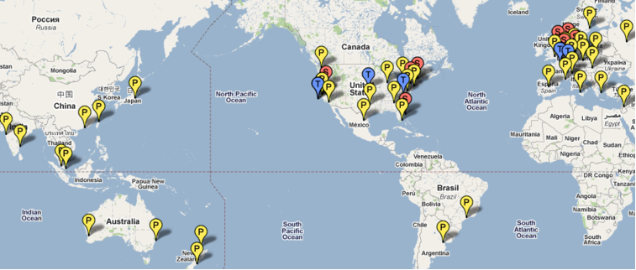
Static Content Distribution:
YouTube as a Case Study: world’s largest video sharing site
User interaction with content (e.g., search for a video) is separated from video delivery
Employs a combination of various “tricks” and mechanisms to scale with YouTube size & handle video delivery dynamics

Slide 6
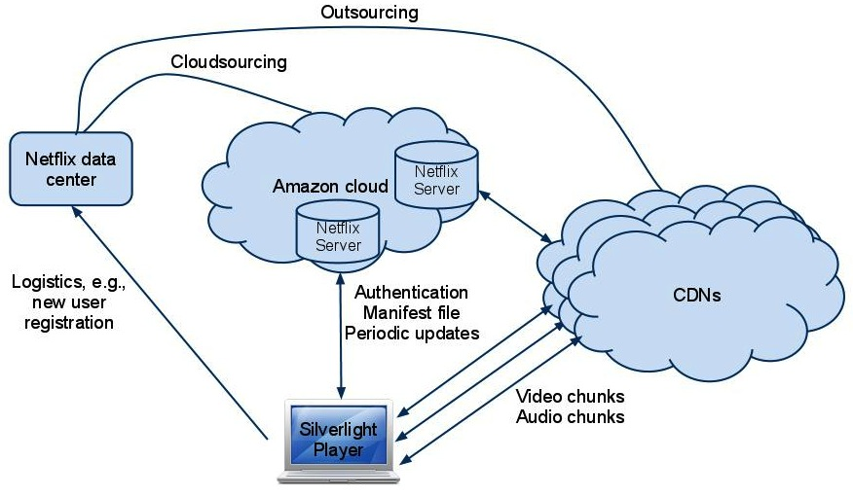
Static Content Distribution:
Netflix as a Case Study: “first” large-scale cloud-sourcing success
Has its own “data center” for certain crucial operations (e.g., user registration, …)
Most web-based user-video interaction, computation/storage operations are cloud-sourced to Amazon AWS
Users need to use MS Silverlight or other players for video streaming
Video delivery was/is partly out/cloud-sourced to 3 CDNs;
but now most utilizes its “own” OpenConnect boxes placed at participating ISPs, forming its own CDN
OpenConnect
CDN

Slide 7
Dynamic Content Distribution
Web search as (dynamic) content delivery – e-commerce, social networking services have similar architectures
response contains both static content (e.g., banner, css files) and dynamically generated search response (dynamic content)
User QoE metric: end-to-end search response time (SRT)
Generic Web Search System Architecture
backend data centers processing search
queries & generating responses
front-end edge servers (CDN)
handling search query delivery
Google: deploy its own CDN
Bing: utilized Akamai CDN
(it now also builds its own CDN)
Amazon and Facebook have also built its own CDNs
Back-end (BE)
Data Centers
Front-End (FE) Servers
(Edge Cloud/CDN)

Slide 8
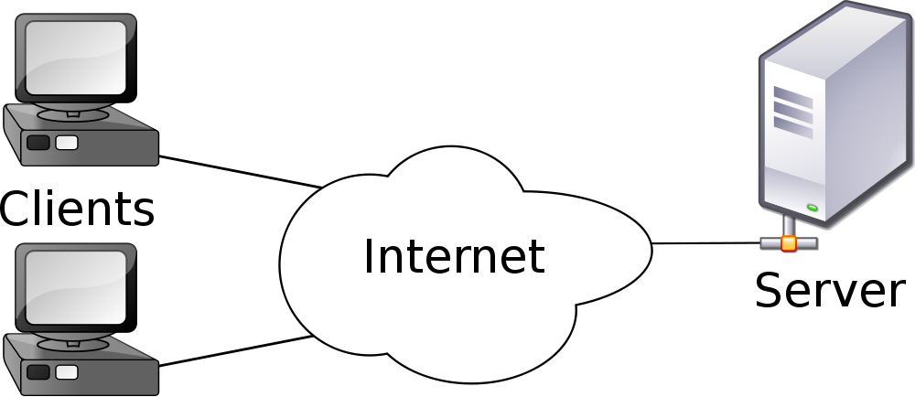
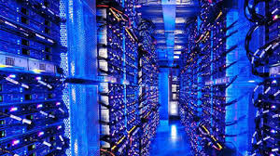
Cloud Content Distribution
request
Web: from simple client-server model for file downloads
➔ Cloud Computing + CDNs
reply
-- vast, complex networked systems spanning large geographically dispersed areas
-- scale out with user demands; meet user QoE
CDN₁ & its servers
CDN₂ & its servers
data centers
CP2
CP1
ISP
data centers
media
players
ISP
ISP
users

Slide 9
Network Architecture with Edge Computing?
-- Content-Centric Perspective
Making content “first-class” citizen on the Internet?
currently, specified by a URL, thus tied to “hostname”
DNS resolution is (generally) content (or server load) oblivious
e.g., Akamai employs sophisticated mechanisms for DNS resolution
cache miss may occur and re-direction may be needed
either done either internally or externally
Does any of the proposed NSF FIA architectures fit the bill?
e.g., NDN (named data network) architecture?
So far, both YouTube and Netflix scale well with the growth in videos and users
Scalability of either video delivery system is ultimately limited by the CDN infrastructure(s): whether Google’s own or big 3 CDNs
Must account for or accommodate “business interests”
Economic viability is critical to the success of any system architecture!
content providers (CPs) & end users are two most key players in the content distribution ecosystem!

Slide 10
Future EC Net Architecture Design Requirements
Better handling the diversity and complexity associated with multimedia (and other dynamic & composite) content
For example, video object is composite
no single namespace can fit it all
Need for Content providers (CPs) to have a larger say in provisioning and dynamically distributing content
e.g., deploy their own load balancing/cache management policies
Take into account the network economics of content delivery to make the ICN design economically viable

Slide 11
CONIA: A New ICN Architecture
Two basic tenets underlying all ICN designs:
Content is the first-class object
Content storage should be part of the network substrate
But, we put forth a third tenet:
One must not dictate how the namespace for content is designed for all content providers
so as to enable a scalable, robust, economically viable, and evolvable ICN architecture

Slide 12
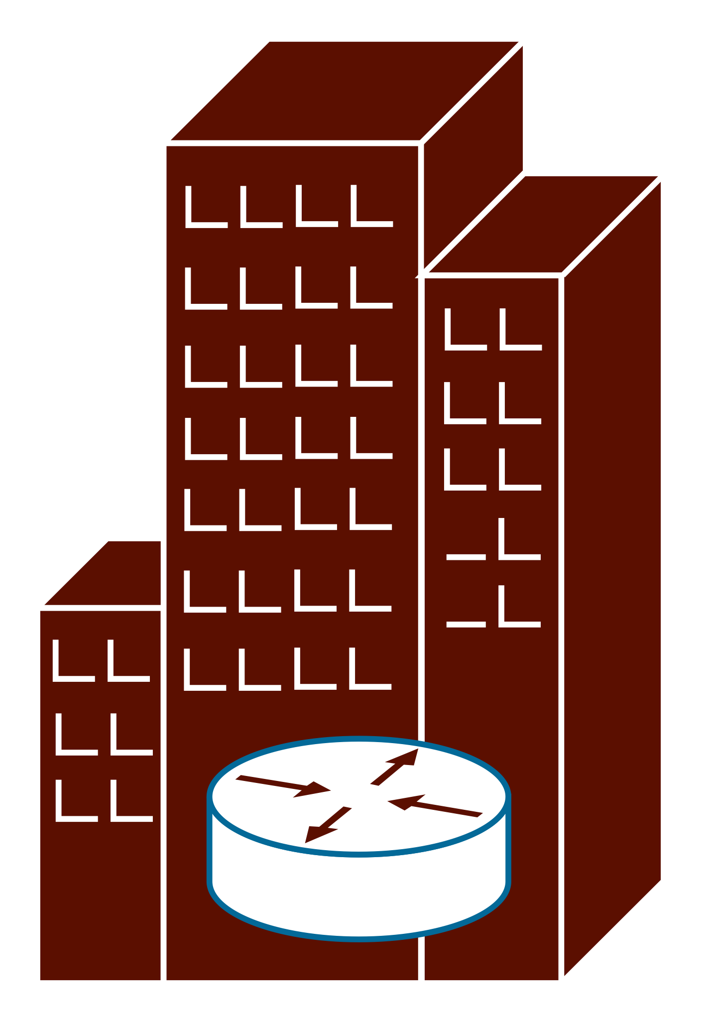
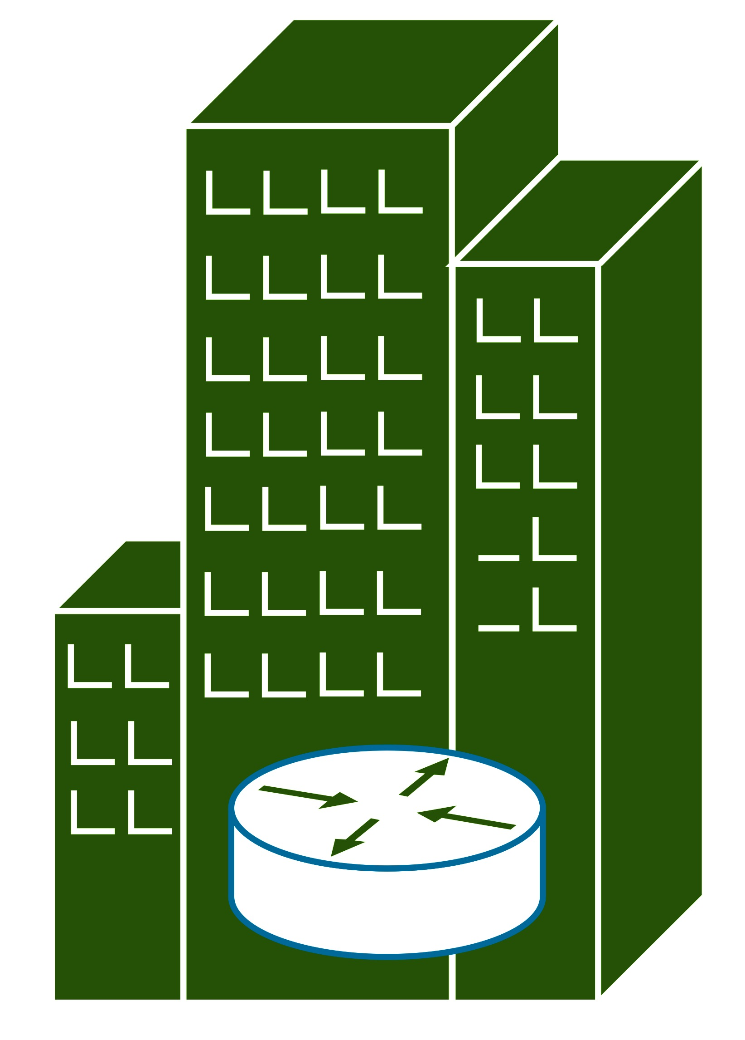
CONIA: Content Delivery Architecture
We focus on the design and implementation of CSR
Three key components
Content Store and Routing elements (CSR)
Generic, programmable, and shared resources
Offered/owned by third party entities (or CPs)
CP Controller
Content-provider (CP) specific
Provision & manage CSRs
Client Content Player
Generic or CP-specific software
Allows users to interact with CP Controller and CSRs
CSR
CSR
CP Controller B
CP Controller A
CP A’s CSR
CP B’s CSR
Unused CSR
Client Content Player
An open and standardized control framework APIs used for interaction between the components.

Slide 13
OpenCDN
An (architectural) framework for building and managing ICN-based “software-defined” content distribution (edge computing) networks
decompose CDN (“edge computing”) operations into “microservices” to realize several primitive functions (or basic building blocks) associated with CDN (edge computing) operations
Microservices can be composed to form (larger & new) services “dynamically” to realize CDN (edge computing) functions & policies
Design Goals
Modularity, Compositionality and Velocity
Enable basic building blocks to evolve to meet changing app. needs
Modularity does not imply compositionality: must ensure correctness under various operational contexts & environments

Slide 14
OpenCDN
An (architectural) framework for building and managing ICN-based “software-defined” content distribution networks.
decompose CDN operations into “microservices” to realize several primitive functions (or basic building blocks) associated with CDN operations
Microservices can be composed to form (larger & new) services “dynamically” to realize CDN functions & policies
Design Goals
Modularity, compositionality and velocity
Scalability and Availability
“Auto-scale” (via replication/parallelization) individual microservices
Minimize impact of failures of one microservice on another; re-run failed microservices

Slide 15
OpenCDN
An (architectural) framework for building and managing ICN-based “software-defined” content distribution networks.
decompose CDN operations into “microservices” to realize several primitive functions (or basic building blocks) associated with CDN operations
Microservices can be composed to form (larger & new) services “dynamically” to realize CDN functions & policies
Design Goals
Modularity, Compositionality and Velocity
Scalability, Availability and Performance
take advantage of multi-core servers, multi-server cluster/clouds & hardware supports (DPDK, RDMA, NetFPGA & other hardware accelerators)

Slide 16
OpenCDN
An (architectural) framework for building and managing ICN-based “software-defined” content distribution networks.
decompose CDN operations into “microservices” to realize several primitive functions (or basic building blocks) associated with CDN operations
Microservices can be composed to form (larger & new) services “dynamically” to realize CDN functions & policies
Design Goals
Modularity, Compositionality and Velocity
Scalability, Availability and Performance
Mobility (of end users/devices & service points)
Adapting to end device/user mobility; Moving microservices from one place to another; enable dynamic load balancing and fault tolerance

Slide 17
OpenCDN : Abstracting CSR Operations
Decompose CSR Operations into a set a building blocks or modules or primitive operations
Each building block has a well-defined behavior and I/O specs
Maybe stateless, but often stateful operations
This is where most design challenges lie

Slide 18
OpenCDN Building Blocks
Decomposing CDN Operations into its primitive operations a la building blocks of OpenCDN
Example 1: A PARSER module’s job is to parse the incoming raw byte stream and construct an intent-specific object
PARSER
raw byte stream
intent-specific object

Slide 19
OpenCDN Building Blocks
Decomposing CDN Operations into its primitive operations a la building blocks of OpenCDN
Example 1: A PARSER module’s job is to parse the incoming raw byte stream and construct an “intent-specific” object
ContentProvider
control message
Pattern
Matching
(filter function)
configures
PARSER
Parsing Logic
raw byte stream
extract content_id
intent-specific object
(end-user FETCH
requests)
CL_LOOKUP object

Slide 20
OpenCDN Building Blocks
Decomposing CDN Operations into its primitive operations a la building blocks of OpenCDN
Example 2: A ContentLookup module checks if a requested object is cached or not (requires to maintain state)
ContentStatistics
InMemoryRead
stats-update
ContentLookup
Content
Store
Table
mem-hit
disk-hit
Disk
Read
lookup requests
miss
CL_LOOKUP object
Remote
Fetch

Slide 21
OpenCDN Building Blocks
Decomposing CDN Operations into its primitive operations a la building blocks of OpenCDN
Parser
InMemory
Read
RemoteCSRFetch
Caching
DiskWrite
ContentLookup
DiskRead
PendingRequest
ForwardTo
Controller
ForwardTo
CSR
SwarmMonitor
ReturnObject
ContentStatistics
ContentCache
MissLookup
InMemoryEvict
Transcoding
LoadBalancer

Slide 22
Ongoing & Future Work
Ongoing Work
Programming Model: Actor Model & Reactive Functional Programming
Runtime System (incorporated w/ DPDK)

Slide 23
OpenCDN Programming Model
Programming Model:
functional reactive programming using distributed actor model
Basic Design Principle:
every OpenCDN’s primitive function implemented as an actor encapsulates its behavior and internal state information with pattern matching capabilities
Key Properties:
Strongly typed language
Asynchronous Message Passing between (distributed) actors
Actor Monitoring; Configure Actor Behavior at runtime; Concurrent Framework; Actors are Location-transparent; Fault tolerant programming w/ high-level abstractions

Slide 24
The Actor Model
Actors: universal primitive operations for concurrent computations
Maintains its own private state, send/receive messages, makes local decisions; can create other actors, supervise/monitor them;
Actor Model
state
mailbox

Slide 25
OpenCDN Runtime
We are building our own runtime system to provide the following services:
Efficient Transport Services Remote actor discovery services; using HW accelerators such as DPDK
can also be extended to incorporate NetFPGA, RDMA, NVM, etc.
Actor Lifecycle & Middleman Services spawning local/remote actors; actor initiations; actor placement services; actor migration;
Resource Management Actor monitoring services, Scheduler-related tasks, etc.
Application Logic Services Execution of control logic code
Fault Tolerance, Data Replication & Consistency Services

Slide 26
Ongoing & Future Work
Near-Future Work
Complete OpenCDN’s architecture design and API specs; as well as its runtime system
Implement key primitive operations such as FETCH and RemoteFETCH operations
Initial auto-scaling/auto-recovery experiments
Future Work
Develop a domain-specific language for CPs
CP Controller’s initial design and development

Slide 27
Thank you
Questions?

