Slide 1
Mobility & Social Networking:
A Data Management Perspective
Mohamed Mokbel Mohamed Sarwat
Data Management Lab
Department of Computer Science and Engineering
University of Minnesota

Slide 2
Seminar Outline
Motivation (10 minutes)
PART I: Systems (10 minutes)
PART II: Search (15 minutes)
PART III: Recommendation Services (15 minutes)
PART IV: Crowdsourcing (15 minutes)
PART V: Risks and Threats (15 minutes)
Wrap-Up (5 minutes)

Slide 3
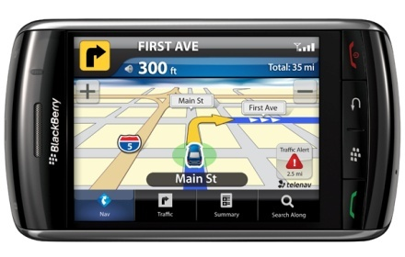
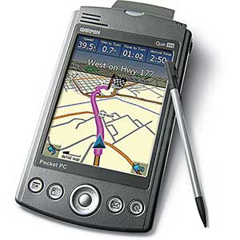
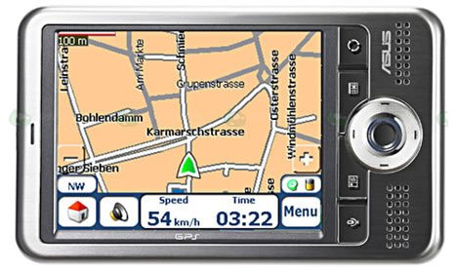
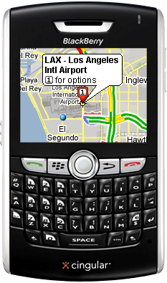
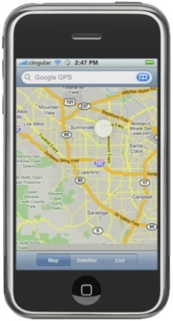
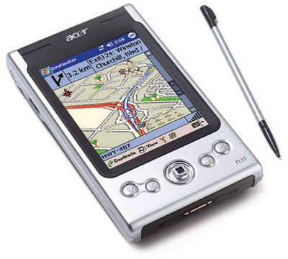
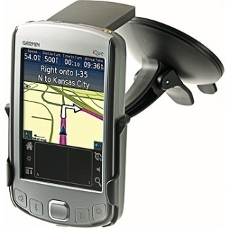
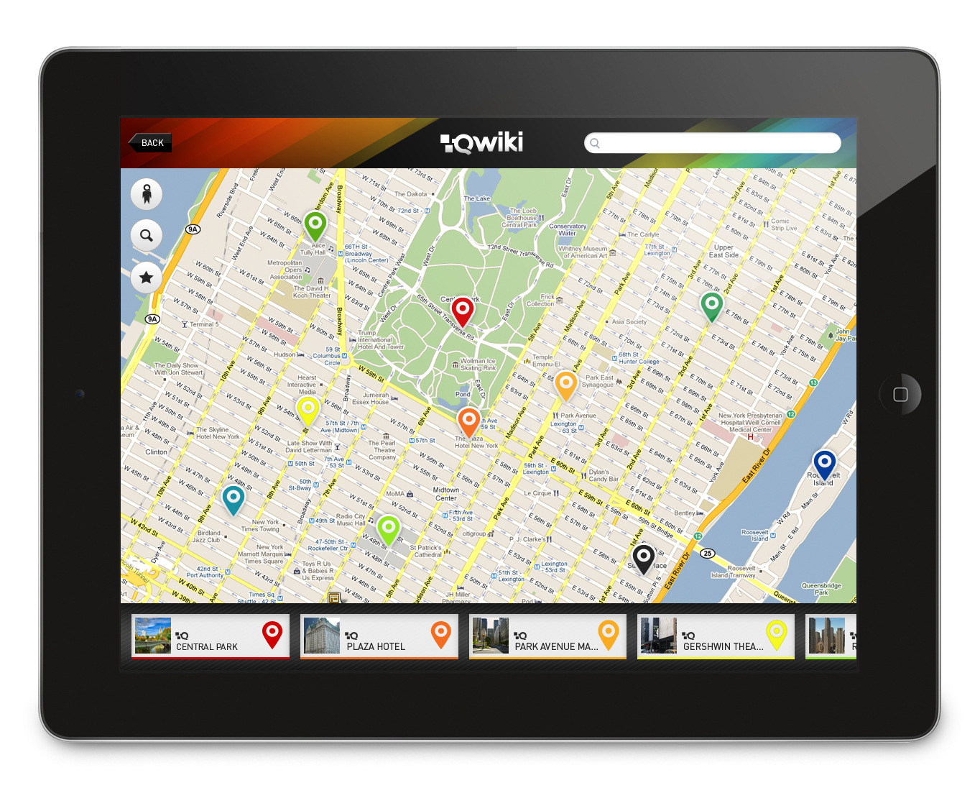
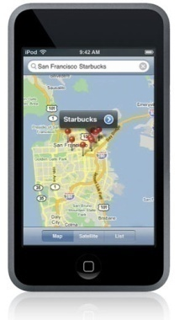
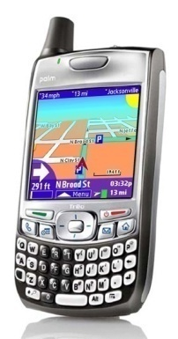
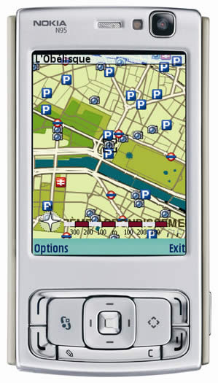
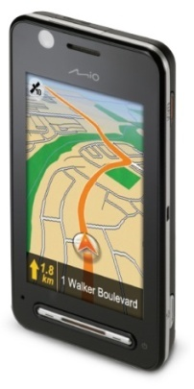
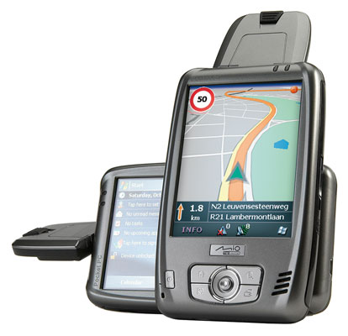
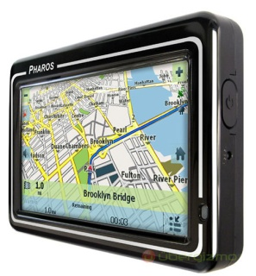
Mobile Devices are Ubiquitous
Many people Love to use these advanced technologies and devices

Slide 4
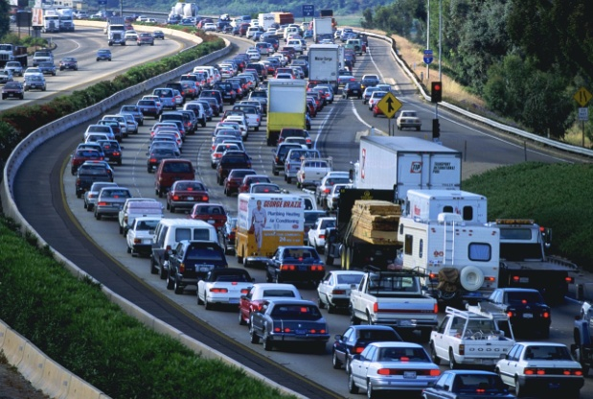
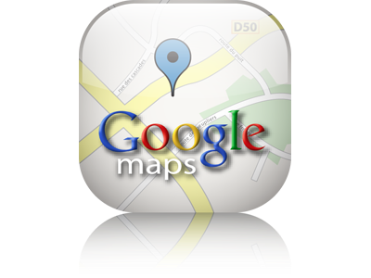

Location-based Services
Range Query: Give me all gas stations within one mile
K-Nearest-Neighbor Queries: Where is my nearest restaurant
Shortest Path Queries: What is the fastest/shortest route from here to the airport
RNN Queries, Group NN Queries, Trip Planning Queries, etc.
Aggregate Queries
Continuous Queries
Moving Queries

Slide 5





Social Networking Applications
Social Networking
Social Networking
Services
(e.g., Facebook, Twitter)
Have become very popular in the past few years

Slide 6
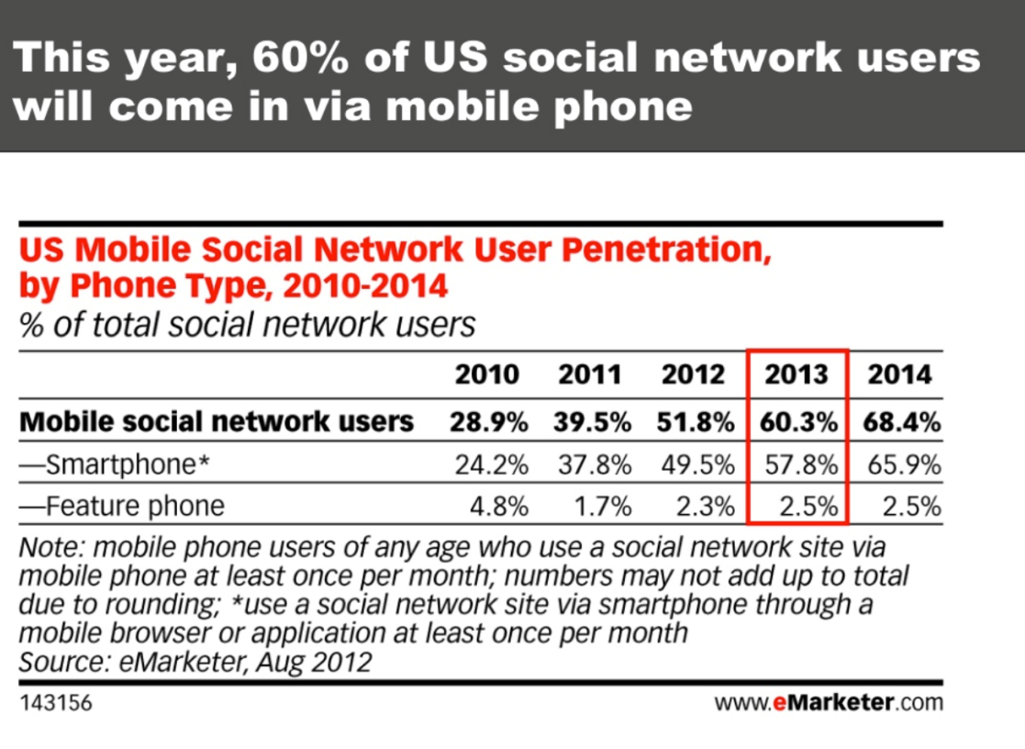
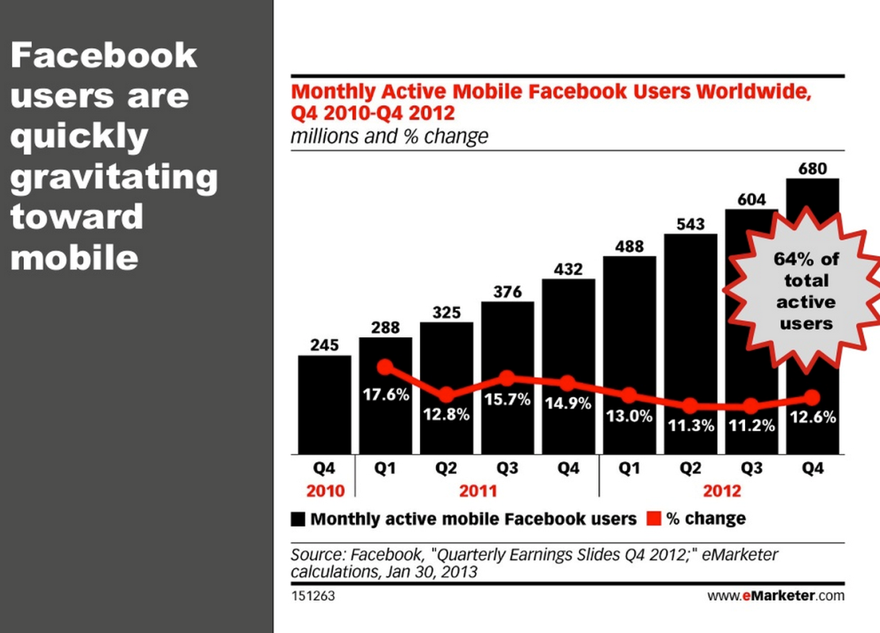
Mobile and Social: Market
The number of users accessing Facebook through their mobile devices is substantially increasing
The number of US mobile social network users is increasing on a yearly basis

Slide 7
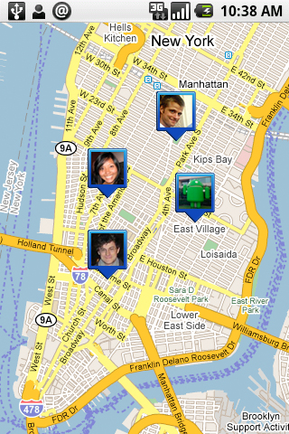
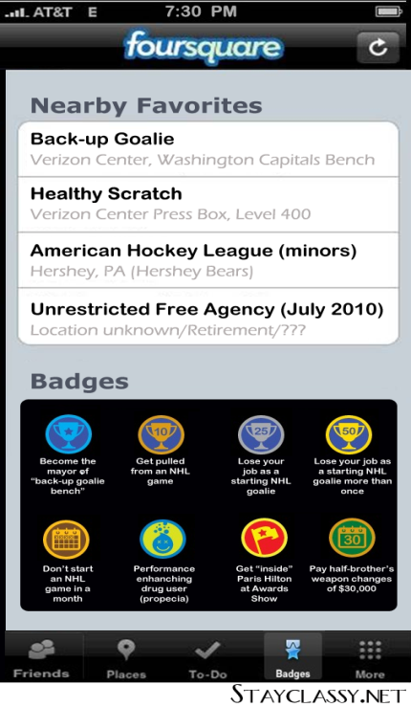
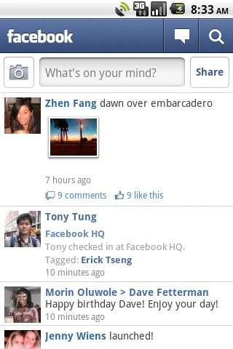
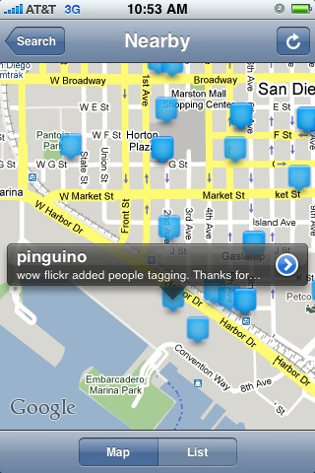
Mobile and Social: Apps
Google Latitude
Foursquare
Facebook Places
Twitter Nearby
Built for mobile devices / Make use of GPS and Maps technology
Show whereabouts of user friends (check-in functionality)
Track user visits (check-ins) and serve good local deals accordingly.

Slide 8

Mobile and Social: Why ?
Social Network
Maps & Spatial
Mobile Devices

Slide 9



LBS 2.0: Location-based Services go Social
Instead of issuing a trip planning query, post a message on Facebook to ask your friends on what to do in Riva del Garda or check tripadvisor
Instead of asking about nearest restaurant, ask a recommender system to suggest a restaurant that you would like based on your profile
Use the wisdom of the crowd to get to know the best route to a certain place

Slide 10



Social Applications go Location-Aware
Facebook and Twitter would show your news feed based on your location
Netflix or Amazon will recommend to you movies or books that people living in your neighborhood have liked
Crowd sourcing takes advantage of people’s locations for a better task assignment

Slide 11

When Social Network meets Mobility
Social Network
Mobility
Is it going to be a romantic meeting..!!
PART I: Systems
PART II:
Search
PART III:
Recommendation
Services
PART VI:
Crowdsourcing
PART V: Risks and Threats

Slide 12

PART I: Systems

Slide 13

Seminar Outline
Motivation
PART I: Systems
PART II: Search
PART III: Recommendation Services
PART IV: Crowdsourcing
PART V: Risks and Threats
Wrap-Up

Slide 14


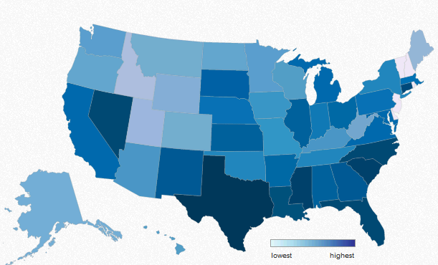
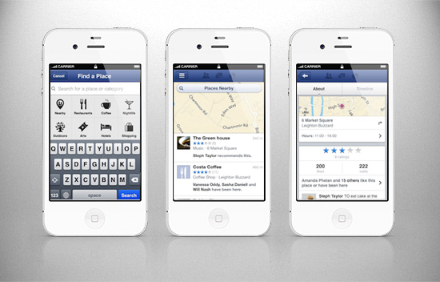


AsterixDB
[@ UC Irvine, UC Riverside, UC San Diego]
http://asterix.ics.uci.edu/
Semi-structured Data Management
- A Big Data Management System (BDMS)
- Spatial Attribute is a first class citizen
Parallel Database Systems
Data-Intensive Computing
  Query: “Spatial distribution of tweets mentioning iphone sales during the Christmas week.”
  Query: A user wants to find a good concerts that starts in the next two hours in a neighborhood, and find friends in the same area to go.
  Sattam Alsubaiee, Yasser Altowim, Hotham Altwaijry, Alexander Behm, Vinayak R. Borkar, Yingyi Bu, Michael J. Carey, Raman Grover, Zachary Heilbron,
  Young-Seok Kim, Chen Li, Nicola Onose, Pouria Pirzadeh, Rares Vernica, Jian Wen., “ASTERIX: An Open Source System for "Big Data" Management and Analysis”
  in VLDB, 2012.

Slide 15
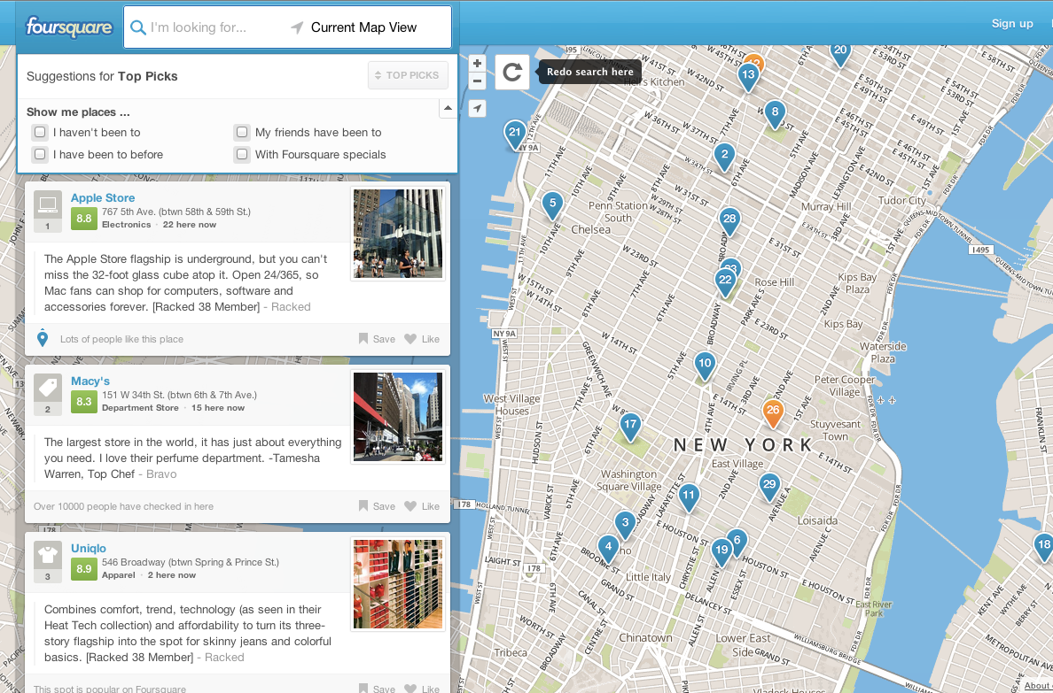
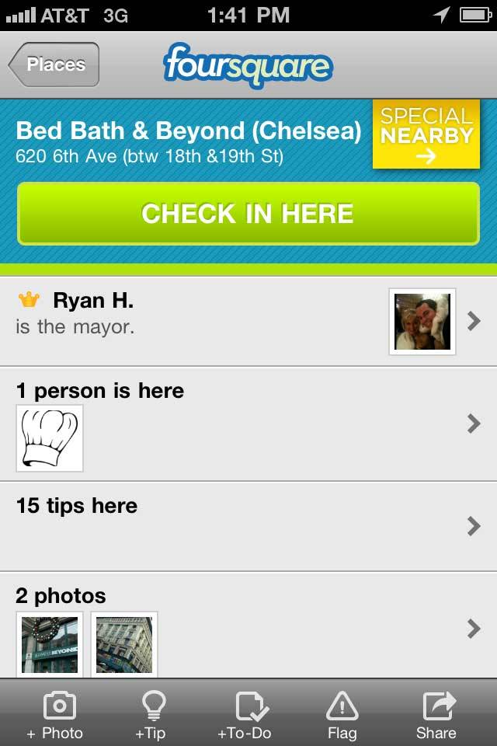
Foursquare
A mix of a Social Network and a City Guide

Slide 16
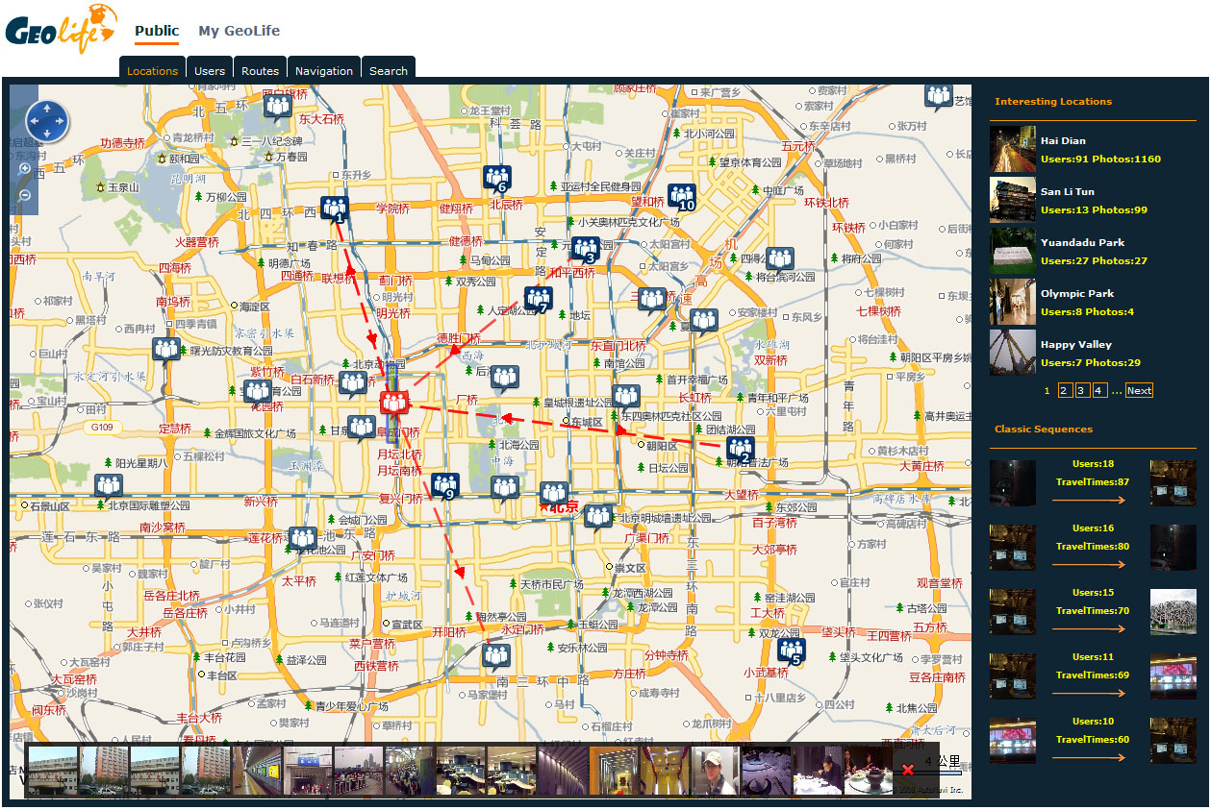
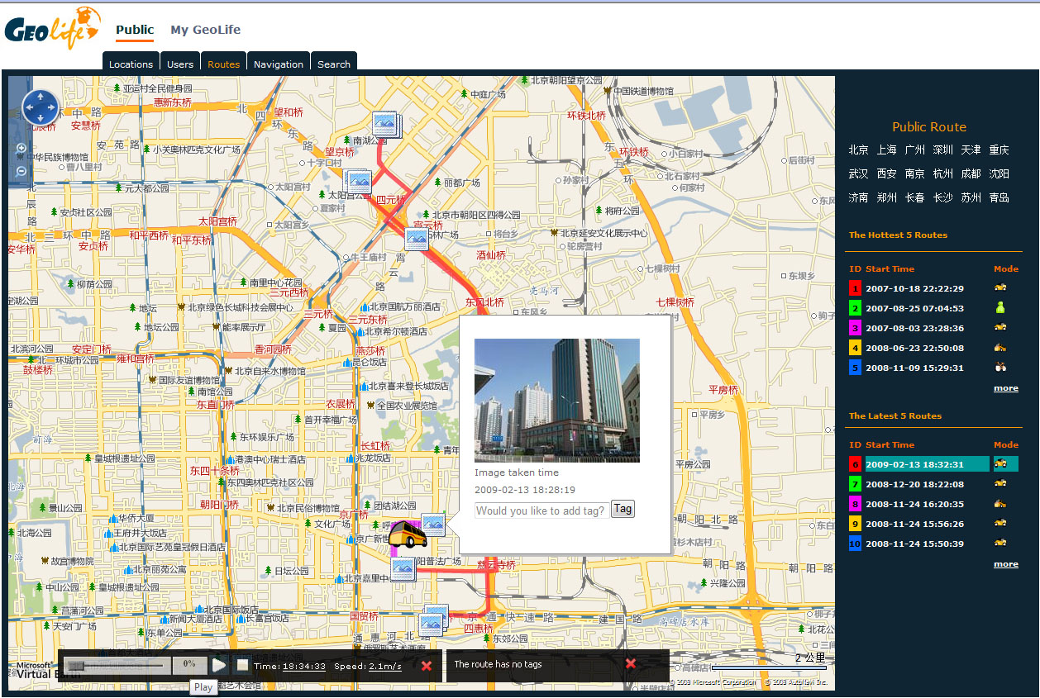
GeoLife
[@ MSR Asia]
http://research.microsoft.com/en-us/projects/geolife/
Location Recommendation
Share your Route on the Map
Share your content on the Map
Yu Zheng, Xing Xie, and Wei-Ying Ma, GeoLife2.0: A Location-Based Social Networking Service, in MDM 2009

Slide 17
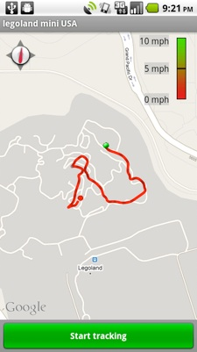
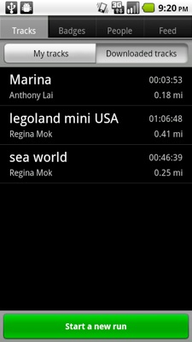
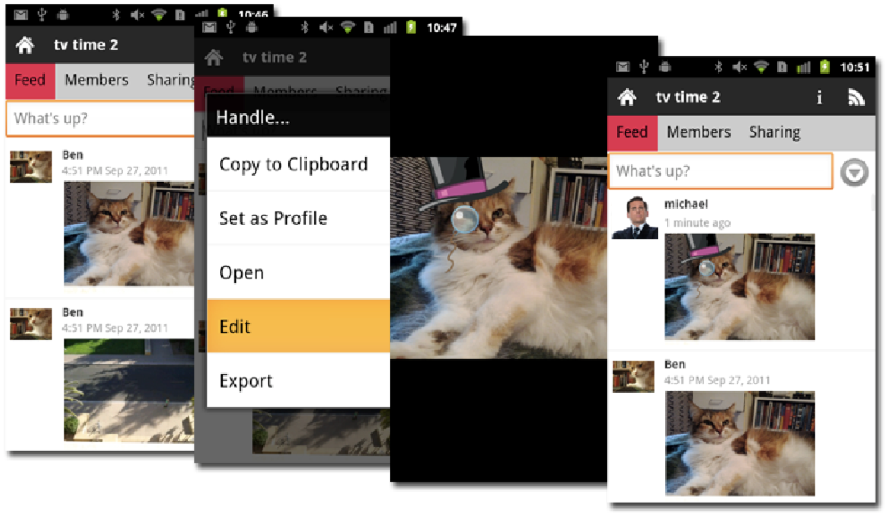
MobiSocial Project
[@ Stanford University]
http://mobisocial.stanford.edu/
A platform that attempts to create a social mobile INTERNET where users can have a rich and carefree social sharing experience with any group of friends, with the freedom to choose their own cloud storage provider and apps on their mobile devices. This open architecture can disrupt the lock-in seen in existing social INTRANETS which imposes rigid control over both the users and the developers.

Slide 18
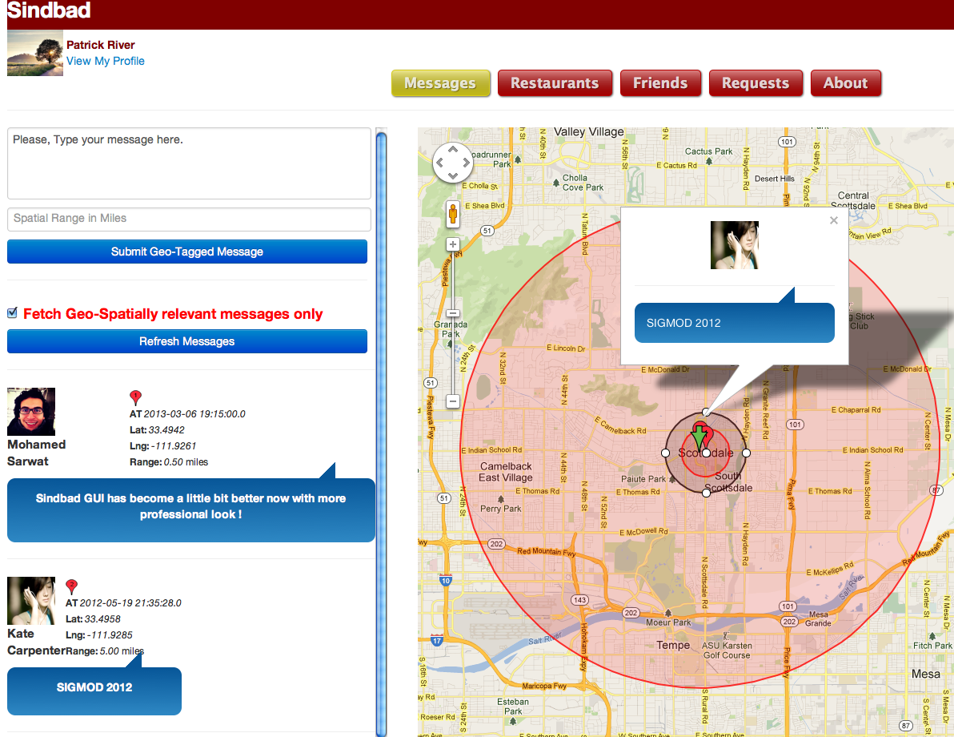
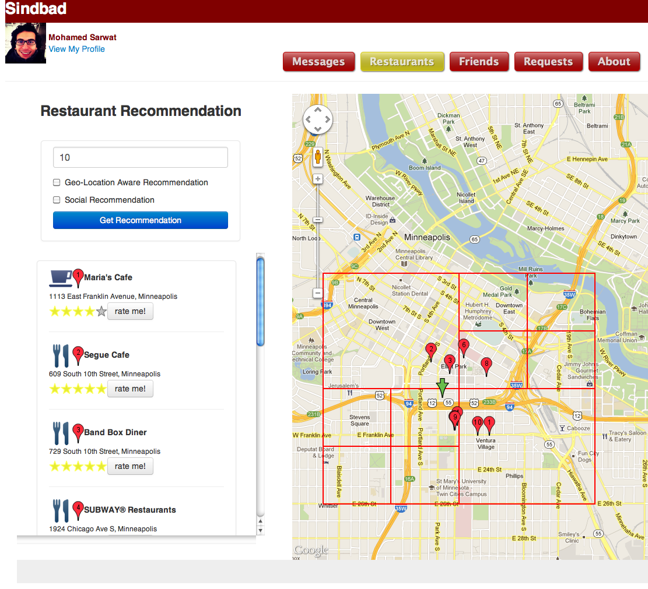
Sindbad
[@ University of Minnesota]
http://Sindbad.cs.umn.edu
Recommendation on the Map
Index
Spatial Message
GeoFeed
Recommendation
  M. Sarwat, J. Bao, A. Eldawy, J. J. Levandoski, A. Magdy, and M. F. Mokbel, “Sindbad: A Location-based Social Networking System,” in SIGMOD, 2012.

Slide 19
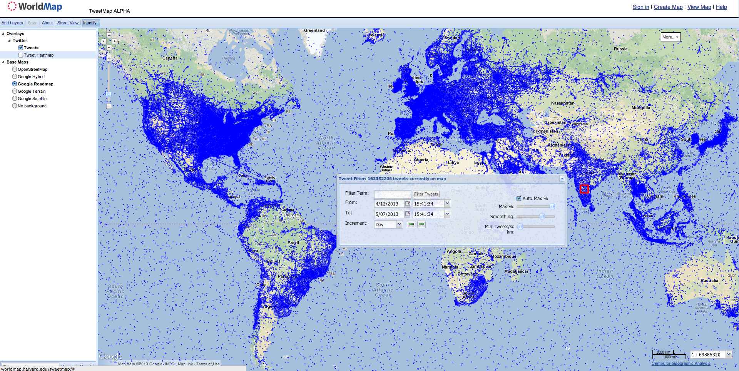
TweetMap
[@ Harvard University]
http://worldmap.harvard.edu/tweetmap/
Show Tweets or HeatMap / User Google or OSM
Filter tweets based on keyword, time
Tweets in North America
[@ Harvard University]

Slide 20

PART II: Search / Queries

Slide 21
Seminar Outline
Motivation
PART I: Systems
PART II: Search / Queries
  Microblogs Search
  News Feed Search
PART III: Recommendation Services
PART IV: Crowdsourcing
PART V: Risks and Threats
Wrap-Up

Slide 22
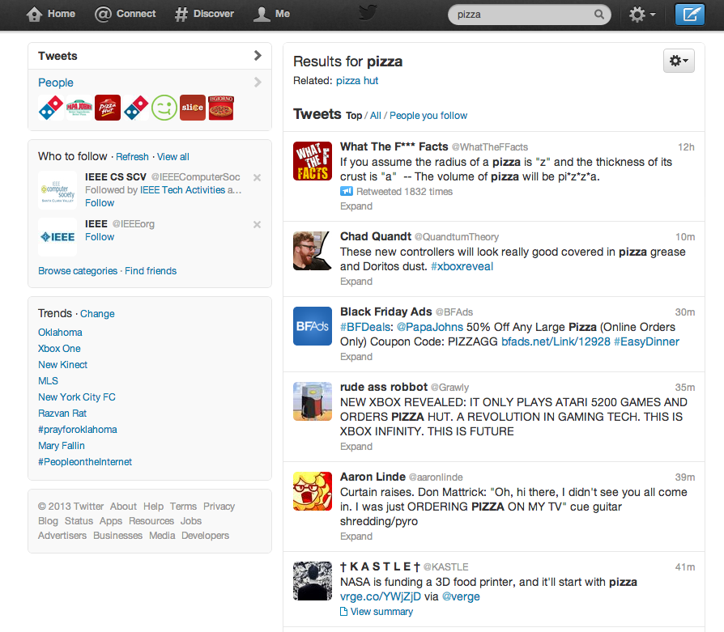
Searching Microblogs
Keyword Search Query
Keyword Search Results
Tweets can be ranked based on:
Keyword Relevance
Social Relevance
Temporal Relevance
Tweet Popularity
User Profile
Real-Time Search Requirements
Low Latency
High Throughput
Immediate Data Availability
Concurrent Reads/Writes

Slide 23
Non-spatial Search over Microblogs
In-memory Structures
Recent
Topic List
Popular
Queries
Popular
Topic List
Query Workload
Tweets Stream
Ranking Func
Timer
Query Processor
Tweet Index Processor
Perform Batch
Indexing
Tweet
Classification
Log Tweet
Database
Log
File
Inverted
Index
Tweet
Data
Update Index
Index Processor
Ranking Function:
User’s PageRank (social relevance)
Popularity of Topics (i.e., retweets)
Temporal Relevance (time-based ranking)
Distinguished Tweet
indexed immediately for real time search
Noisy Tweet
saved in a log file and periodically batch indexed
Chun Chen, Feng Li, Beng Chin Ooi, Sai Wu. “TI: an efficient indexing mechanism for real-time search on tweets” in SIGMOD 2011
Notes:
Keyword threshold records the statistics of recent popular queries.
The candidate topic list maintains the information about recent topics
popular topic list represents the hotly discussed topics

Slide 24

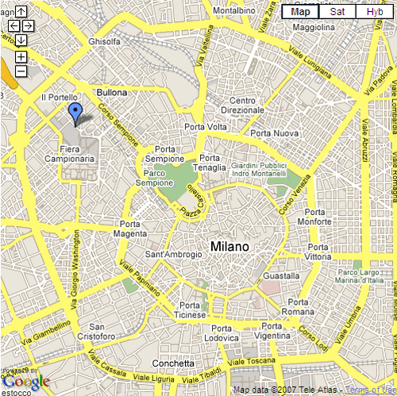
Offline Spatial Search over Microblogs
Searching for Tweets that contain Keywords: “Tasty”, “Pizza”
Querying User
Tweet that contains both “Tasty” and “Pizza”
✔
1
✔
5
✔
✔
✔
2
✔
✔
✔
4
✔
✔
3
6
7
8
  Boolean kNN Query
  Top-k kNN Query
  Boolean Range Query
Spatial Indexing Schemes
  Grid-based Index
  R-tree Index
  Space Filling Curves
Text Indexing Schemes
  Inverted File
  Bitmap Index
Lisi Chen, Gao Cong, Christian Jensen, and D. Wu. “Spatial Keyword Query Processing: An Experimental Evaluation”. VLDB 2013
Notes:
Boolean kNN Query: “Retrieve the k tweets nearest to the user’s current location such that each tweet’s text description contains the keywords Tasty, Pizza”
Top-k kNN Query: “Retrieve the k tweets with the highest ranking scores, measured as a combination of their distance to the query location and the relevance of their text description to the query keywords Tasty, Pizza”
Boolean Range Query: “Retrieve all objects whose text description contains the keywords Tasty and Pizza, and whose location is within 20 km of the query location”
each bit in a bitmap represents the presence or absence of a term in a document.

Slide 25
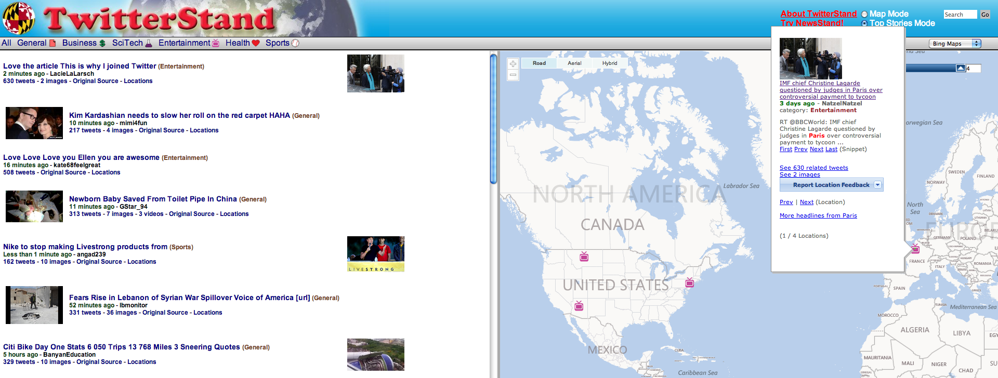
Online Spatial Search over Microblog: TwitterStand
Tweets List
Tweets GeoLocated
- Connects to Twitter through Twitter API to get recent tweets
- Classify and Cluster Tweets to extract news and place them on the map in an online manner
Jagan Sankaranarayanan, Hanan Samet, Benjamin E. Teitler, Michael D. Lieberman, Jon Sperling. “TwitterStand: News in Tweets” in ACM SIGSPATIAL GIS 2009

Slide 26
Online Spatial Search over Microblog: TweetQL
Query in English
SQL Query
Retrieve all tweets containing the word “Obama” that are tweeted from the New York City area.
SELECT text
FROM twitter
WHERE text contains ‘obama’
AND location in [bounding box for NYC]
The system Converts SQL queries to twitter text and spatial search APIs
A. Marcus, M. S. Bernstein, O. Badar, D. R. Karger, S. Madden, R. C. Miller. “Tweets as data: demonstration of TweeQL and Twitinfo”. SIGMOD 2011

Slide 27
Online Spatial Search over Microblog: AsterixDB
Tweets Type Creation
Load Tweets Data
CREATE TYPE TweetType AS OPEN {
id: string,
username: string,
location: point?
text: string,
hashtags: {{string}}?
}
CREATE DATASET Tweets (TweetType) partitioned by key id;
CREATE INDEX location_index on Tweets (location) type rtree;
LOAD DATA Tweets USING "edu.uci.ics.asterix.external.dataset.adapter.NCFileSystemAdapter"
(("path"=“…"),("format"=”…"));
Spatial Aggregation Queries (Count tweets that hashtag #obama in a region)
FOR $x IN dataset(`Tweets')
where isExistsHashtag($x.hashtags,‘#obama’)
let $poly := create-polygon(create-point(47.94900708555258,-74.49965312500001),create-point(38.63779231230829,-74.49965312500001),create-point(38.63779231230829,-111.41371562500001),create-point(47.94900708555258,-111.41371562500001))
where spatial-intersect($x.location, $poly)

Slide 28
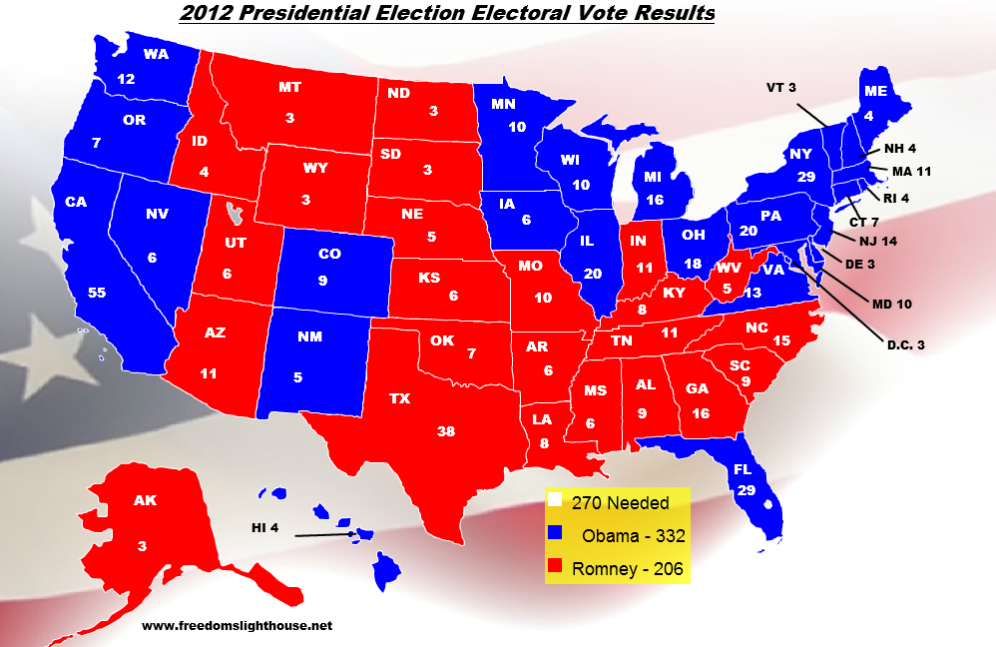
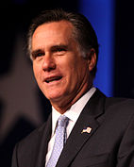

Spatial Aggregation over Microblog: AsterixDB
#romney
#obama
Spatial Aggregation Queries (Count tweets that hashtag #obama in a region)
FOR $x IN dataset(`Tweets')
where isExistsHashtag($x.hashtags,‘#obama’)
let $poly := create-polygon(create-point(lat1,long1),create-point(lat2,long2),create-point(lat3,long3),create-point(lat4,long4))
where spatial-intersect($x.location, $poly)
let $n := 1
group by $c := spatial-cell($x.location, create-point(0.000,0.000), 0.093, 0.369) with $n
return {'cell': $c, 'count': count($n)}

Slide 29
Seminar Outline
Motivation
PART I: Systems
PART II: Search / Queries
  Microblogs Search
  News Feed Search
PART III: Recommendation Services
PART IV: Crowdsourcing
PART V: Risks and Threats
Wrap-Up

Slide 30
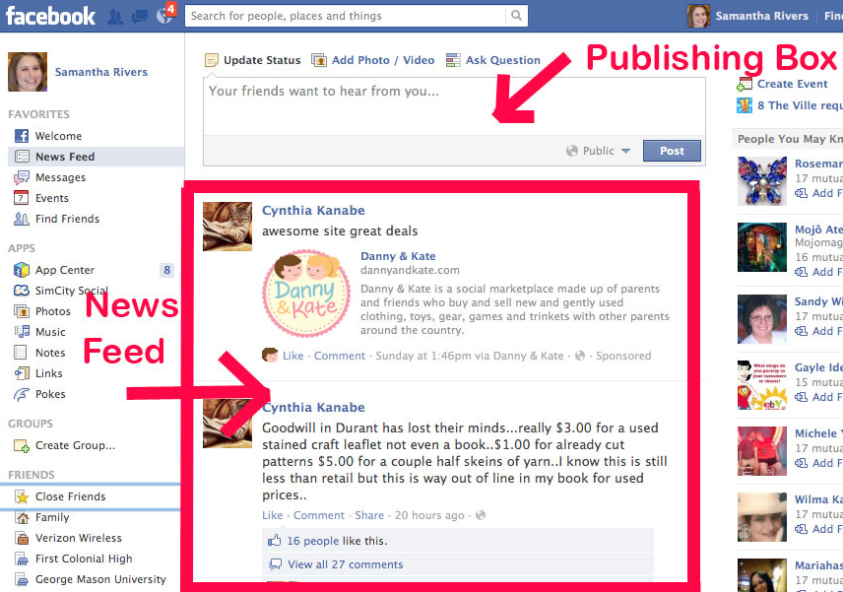
News Feed Queries

Slide 31
Non-Spatial News Feed Search: Feeding Frenzy
A
D
A user wants to see the most k recent news across all her friends or the ones that she follows
The news feed functionality is abstracted into a set of top-k queries as one query per friend.
The challenge is to decide whether to push or pull the answer of each single top-k query.
The objective is:
  Minimize the total system overhead
  Meet some query latency requirements.
B
E
C
F
Consumers
Producers
Producer | Consumer
D | A | PUSH
D | C | PULL
… | … | …
A. Silberstein, J. Terrace, B. F. Cooper, and R. Ramakrishnan, “Feeding frenzy: Selectively materializing user’s events feed” in SIGMOD 2011
Notes:
Push and Pull events: Decide whether to push events to consumer’s feed or pull them at query time.
Minimize Overall System Cost:
Includes both processing news (e.g., tweet) at generation time and generating news at query time.
Meet the following constraints:
Provide time-ordered, gapless, and no-duplicates Feeds.
Reduce user latency requirements.

Slide 32
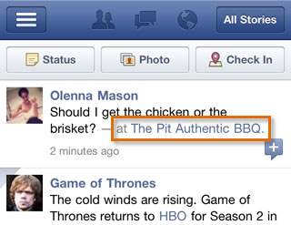
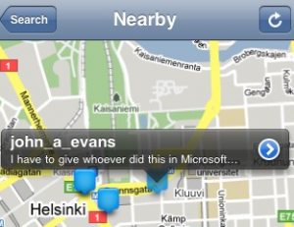
Geo-Tagged Social Messages
Friends Messages are Geo-Tagged
  Users assign geo-tags to posted messages, photos, or videos.
  Users can see geo-tagged messages posted by their friends
  Geo-location is at the longitude/latitude granularity
Geo-Location is dealt with as yet another attribute
  Social applications show friends whereabouts
  Social applications do not leverage geo-tagged messages.

Slide 33
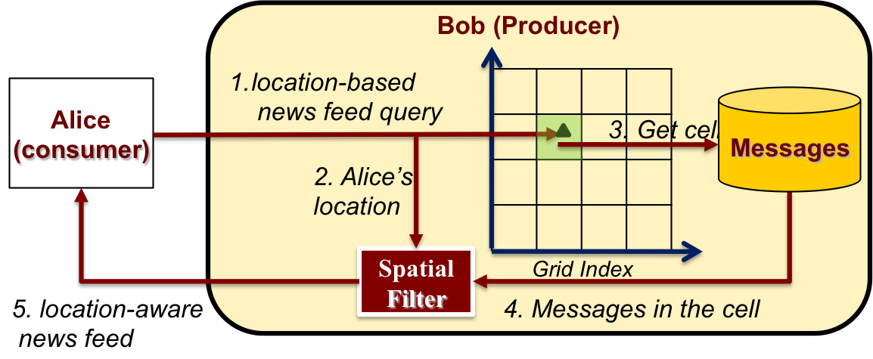
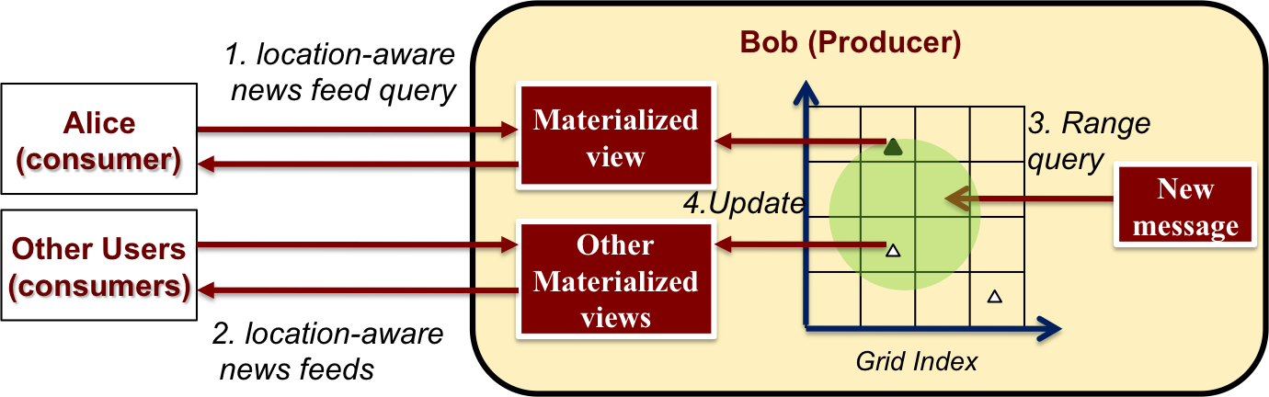
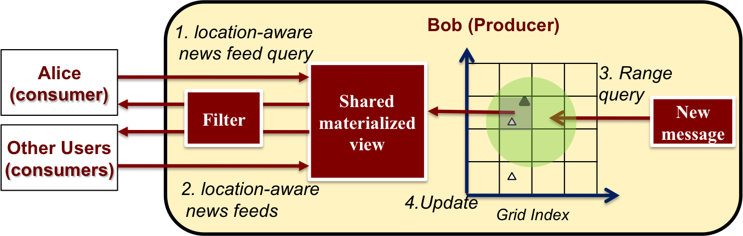
Location-Aware News Feed Queries: GeoFeed
M₄
M₂
M₆
Spatial Pull
M₅
Carol
M₃
M₁
Spatial Push
(a) Alice’s Messages
Message | Content | Location | Timestamp
M₅ | Back to hotel | S₅ | 14:30
M₃ | A nice bar | S₃ | 14:10
M₂ | Eating at bar | S₂ | 14:04
Shared Push
(b) Bob’s Messages
Message | Content | Location | Timestamp
M₆ | Having coffee | S₆ | 15:30
M₄ | An accident | S₄ | 14:21
M₁ | Work finished | S₁ | 11:40
J. Bao, M. F. Mokbel, and C.-Y. Chow, “GeoFeed: A Location-Aware News Feed System,” in ICDE 2012.

Slide 34
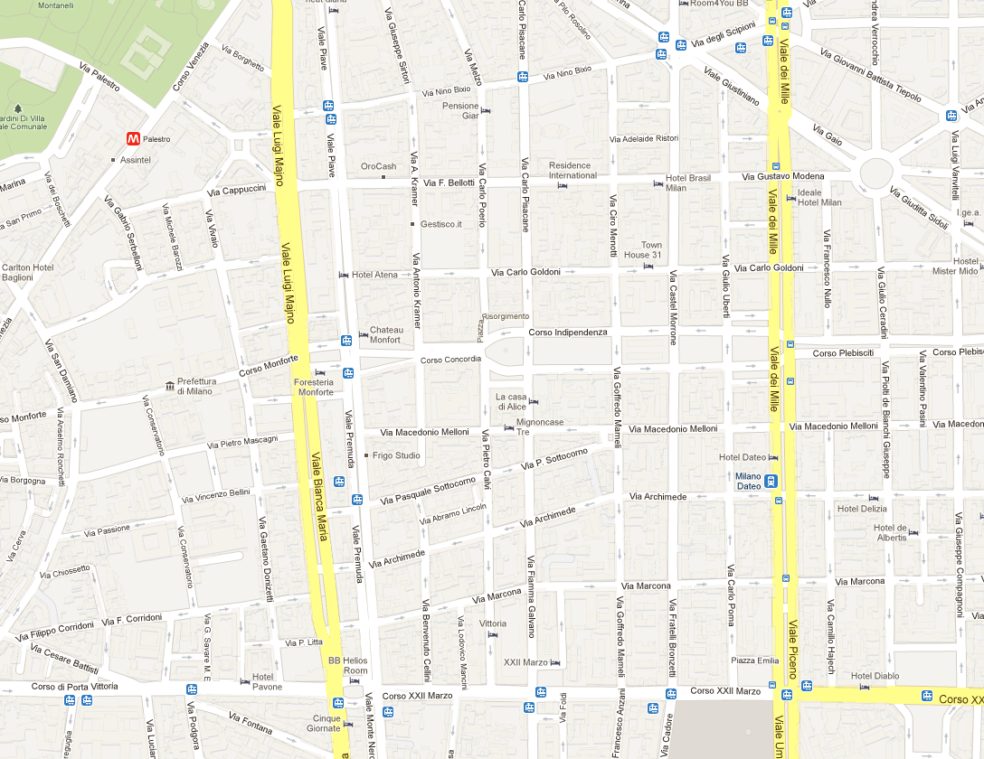
News Feed for Mobile Users: MobiFeed
Mobile User Queries
Milan is Awesome
Query
Answer
Social Networking and
Mobility Seminar
Geo-Tagged
Messages
MDM 2013 held at
University of Milan
Pizza @ Berk is
quite tasty
Location-Aware News Feed Scheduler
10 Euros coupon
@ Pasta Eat
Location
Predication
Message
Relevance
Wenjian Xu, Chi-Yin Chow, Man Lung Yiu, Qing Li, Chung Keung Poon “MobiFeed: A Location-Aware News Feed System for Mobile Users” in GIS 2012

Slide 35
PART III:
Recommendation Services

Slide 36
Seminar Outline
Motivation
PART I: Systems
PART II: Search / Queries
PART III: Recommendation Services
  Locations and Recommendations
  Location-Aware Recommendation
PART IV: Crowdsourcing
PART V: Risks and Threats
Wrap-Up

Slide 37
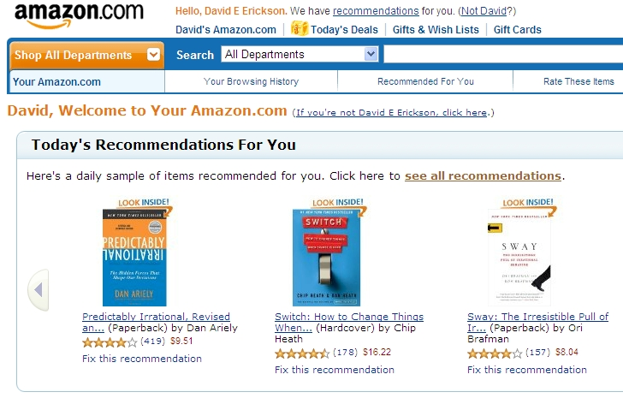
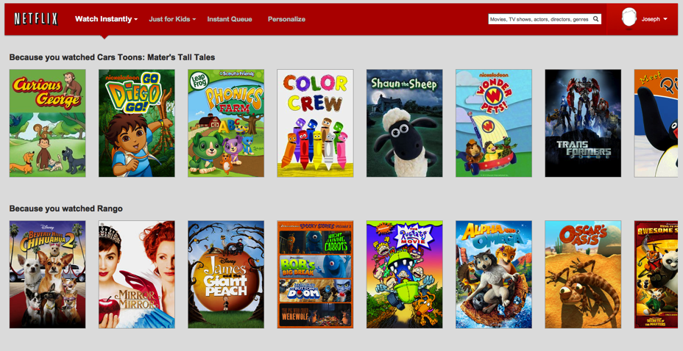
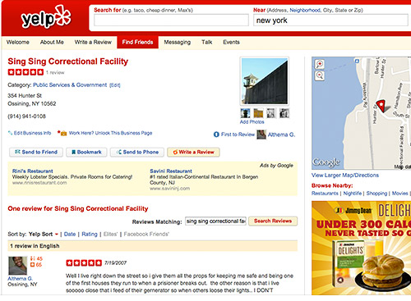
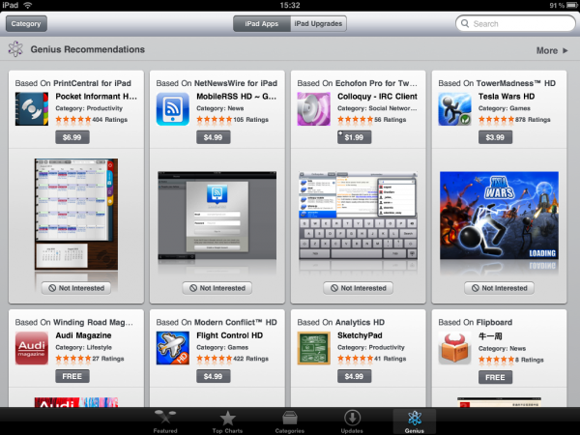
Recommender System
Notes:
1 min: The basic idea of a recommender systems is to gather user opinions/behavior and analyze this information to provide personalized suggestions (recommendations) to individual users
Examples:
Most prominent example is Netflix (users watch movies, provide ratings, netflix provides movie recommendations)
Amazon for books and other products (mix of purchase history and ratings)
Apple iTunes store: apps, TV shows, music

Slide 38



Recommender Systems Functionality
Analyze user behavior to recommend personalized and interesting things to do/read/see
Similar
Users
Movie
Ratings
rate movies
build recommendation
model
Similar Items
recommendation
query
Offline
Online
“Recommend user A five movies”
(1)
Leverage the history of users opinions over items to build a recommendation model
(2)
Predict User’s rating to items she did not see before
(3)
Recommend the items with high predicted rating
Notes:
First, we should ask the question what do Recommender systems do ?
Let’s take the Netflix example (which is a company for online video rental).
In Netflix, users watch movies and then give a rating to this movies.
All users ratings to different items are then used to build the recommendation model Offline.
We can then issue a recommendation query to the model to recommend user A five movies.
So, as we notice we have two phases: Offline model building phase, and Online recommendation generation phase.
Other examples of recommender system include amazon, and others…

Slide 39






Location Matters:
Netflix Rental Patterns
Movie preferences differ based on the user location (zip code)
Notes:
1 min

Slide 40


Location Matters:
Foursquare Check-in Patterns
Destination preferences differ based on the user location (zip code) and the destination location
Foursquare users
from Falcon Heights tend to visit venues in …
Fousquare users from Robbinsdale tend to visit venues in …
City | % of check-ins
Brooklyn Park | 32%
Robbinsdale | 20%
Minneapolis | 15%
City | % of check-ins
St. Paul | 17%
Minneapolis | 13 %
Roseville | 10%
~ 75 % of users travels less than 50 mi
Fousquare users
from Edina tend to visit venues in …
City | % of check-ins
Edina | 59%
Minneapolis | 37%
Edin Prarie | 5%
Notes:
1 min
Foursquare Data
visits data for 1M users to 643K venues across the United States

Slide 41



Location Matters:
Co-located Friends
Observations
  Social Friends share more common locations than non-friends.
  Nearby social friends share more commonly visited locations.
M. Ye, P. Yin, and W.-C. Lee, “Location recommendation for location-based social networks,” in ACM SIGSPATIAL GIS, 2010.
Notes:
1 min

Slide 42
Seminar Outline
Motivation
PART I: Systems
PART II: Search / Queries
PART III: Recommendation Services
  Locations and Recommendations
  Location-Aware Recommendation
PART IV: Crowdsourcing
PART V: Risks and Threats
Wrap-Up

Slide 43
Location-Aware Recommendation: Location/Activity
Restaurant
Bank
…
Tourism
Food
…
Tourism
Food
…
Location 1
0.32 | 0.13
Location 1
+1
Activity 1
0.1
Location 2
Location 2
Activity 2
…
…
…
Location-Feature Matrix
Location-Activity Matrix
Activity-Activity Matrix
V. Zheng, Y. Zheng, X. Xie, and Q. Yang “Collaborative location and activity recommendations with GPS history data” in WWW 2010

Slide 44









Location-Aware Recommendation:
Geo-Influence
Social Graph
Places Map
Assign Higher Weight to Geo-close Friends
Geographical Influence: Users Visited Places are Geographically Clustered
Mix User Preferences with Geographical Influence and Social Influence
M. Ye, P. Yin, and W.-C. Lee, “Location recommendation for location-based social networks,” in ACM SIGSPATIAL GIS, 2010.
M. Ye, P. Yin, W. Lee, and D. Lee, “Exploiting geographical influence for collaborative point-of-interest recommendation” SIGIR 2011

Slide 45














Location-Aware Recommendation: Preference-Aware
Movie
Food
Shopping
User Personal Interests/Preferences
User position & locations around
Social/Community Opinions
Identify user preference using semantic information from the location history
Use local experts & user preferences for recommendation
Discover local experts for different categories in a specific area
Offline Modeling
    Preference Discovery
    Social Knowledge Learning
Online Recommendation
    Candidate Selection
    Location Rating Inference
J. Bao, Y. Zheng, M. Mokbel: Location-based and preference-aware recommendation using sparse geo-social networking data. In ACM SIGSPATIAL GIS 2012

Slide 46






Location-Aware Recommendation: Collaborative Filtering
1. Partition ratings by user location
Cell 1
Cell 2
Cell 3
(x₇, y₇)
Influence Levels
C
C
B
(x₂, y₂)
(x₆, y₆)
3
3
4
2
4
5
4
B
B
No need to maintain all cells
If four cells will end up giving the same recommendations, merge them.
If ratings inside a cell are diverse, split it
Merging and splitting balance between localization and storage/maintenance
A
C
(x₃, y₃)
(x₄, y₄)
(x₁, y₁)
(x₅, y₅)
2. Build collaborative filtering model for each cell using only ratings contained within the cell
3. Generate recommendations using the model of the cell containing querying user
Cell 1
Cell 2
Cell 3
Build Collaborative
Filtering Model using:
Build Collaborative
Filtering Model using:
Build Collaborative
Filtering Model using:
Cell 1
Cell 2
Cell 3
User | Item | Rating
A |  | 4
C |  | 5
User | Item | Rating
B |  | 3
B |  | 3
C |  | 4
User | Item | Rating
B |  | 4
C |  | 5
Querying user
Recommendation List
M. Sarwat, J. Levandoski, A. Eldawy, M. Mokbel, “LARS*: A Scalable and Efficient Location-Aware Recommender System,” TKDE 2013
Notes:
1 min
Example

Slide 47

Location-Aware Recommendation: Continuous Recommendation
The system continuously update the recommendation list for a mobile user.
Moving within a cell changes the travel distance score and does not change the recommendation score.
  Incremental KNN to update the recommendation list
Crossing a cell boundary changes the collaborative filtering model and may also change the distance score.
Recommend me 2 Restaurants
M. Sarwat, J. Levandoski, A. Eldawy, M. Mokbel, “LARS*: A Scalable and Efficient Location-Aware Recommender System,” TKDE 2013

Slide 48
PART IV:
Crowdsourcing

Slide 49
Seminar Outline
Motivation
PART I: Systems
PART II: Search / Queries
PART III: Recommendation Services
PART IV: Crowdsourcing
  Crowdsourcing for Data Collection
  Crowdsourcing for Query Processing
PART V: Risks and Threats
Wrap-Up

Slide 50


Crowdsourcing Overview
A. Kittur, E. H. Chi, and B. Suh, “Crowdsourcing User Studies with Mechanical Turk,” in CHI, 2008.

Slide 51


Crowdsourcing for Data Collection
Building an Encyclopedia
Wikipedia reached about 2 Billion edits since its debut. It is among the top 10 highly visited sites on the web
Image Tagging
ESP game was bought by Google in 2006 to empower its image search engine

Slide 52


Spatial Crowdsourcing for Data Collection: Participatory Sensing
GPS-enabled mobile phones to collect traﬃc information and upload it to a server in real time.
The server processes the collected information, and distribute it back to the mobile phones in real time.

Slide 53




Spatial Crowdsourcing for Data Collection:
Volunteered Geographic Information
OSM
Contributors Collect Geographical Data using GPS devices and Other sources
The GeoWiki for Twin Cities Bicyclists

Slide 54



Spatial Crowdsourcing for Data Collection:
GeoTagging

Slide 55
Seminar Outline
Motivation
PART I: Systems
PART II: Search / Queries
PART III: Recommendation Services
PART IV: Crowdsourcing
  Crowdsourcing for Data Collection
  Crowdsourcing for Queries
PART V: Risks and Threats
Wrap-Up

Slide 56





Which one is the Stone Arch Bridge in Minneapolis ?
Need for Spatial Crowdsourcing
1
2
3
4
5
6
Someone living in Minneapolis will probably answer that better than anybody else

Slide 57
Spatial Crowdsourcing for Queries:
GeoCrowd
Server
Spatial Constraint
(W1)
T1
Spatial Task (T2)
T4
W1
Worker 1
Spatial Task (T4)
User 1
W2
T2
T3
Spatial Task (T1)
Spatial Constraint
(W2)
Receive Workers Inquiry
Receive Users Tasks
Spatial Task (T3)
User 2
Worker 2
Assign Tasks to Works
The main challenge is to assign tasks to workers in real time while spatial tasks and workers’ spatial constraints are streamed into the system
L. Kazemi and C. Shahabi, “Geocrowd: Enabling Query Answering with spatial crowdsourcing,” in ACM SIGSPATIAL GIS 2012.

Slide 58

Spatial Crowdsourcing for Queries:
Shortest-Path Computation
Centralized Server (Graph Separator Approach)
Client 1
SP Query
Answer
Client 2
Querying
User
…
Road Network
Updates
Client n
Clients runs JavaScript
Clients Calculate local Cliques
Clients Send Cliques back to server
Communication via AJAX
Batch Cells and results
Compression: Send only NodeIDs
Server is an Orchestrator
Receives SP Queries
Send Cells to clients
Return final SP answer
A. Efentakis, D. Theodorakis, and D. Pfoser, “Crowdsourcing Computing Resources for Shortest-Path Computation,” in GIS 2012

Slide 59

Part V:
Risks and Threats

Slide 60
Seminar Outline
Motivation
PART I: Systems
PART II: Search / Queries
PART III: Recommendation Services
PART IV: Crowdsourcing
PART V: Risks and Threats
Wrap-Up

Slide 61

Location Privacy
Service-Privacy Trade-off
Example:: What is my nearest gas station
100%
Service
0%
100%
Privacy
0%
Notes:
Entertain location-based services
Without revealing their private location information
First extreme:
A user reports her exact location ➔ 100% service
Second extreme:
A user does NOT report her location ➔ 0% service
Location cloaking, location blurring, location obfuscation
An adversary does know that the user is located in the cloaked region, but has no clue where the user is exactly located

Slide 62
Social Network Privacy
Privacy Breaches:
Occurs when a piece of sensitive information about an individual is disclosed to an adversary
  Identity Disclosure:
    When an adversary is able to determine the mapping from a profile in the social network to the specific real-world person
  Attribute disclosure:
    When an adversary is able to determine the value of a sensitive user attribute, one that the user intended to stay private
  Social Link disclosure:
    When an adversary is able to find out about the existence of a sensitive relationship between two users, a relationship that these users would like to remain hidden from the public

Slide 63

Sharing Location is a benefit for Burglars
Collected locational data from social media applications in real time and then posted the addresses of users who were away from home.

Slide 64


Location Privacy in Social Networks: Location Vs. Absence Privacy
Having Dinner with
Bob
at 7:00 pm
in Milan
Just Met Bob
at 7:10 pm
At Ristorante Al Mercante
in Milan
Bob
Alice
Charlie
Location Privacy
Carol
Absence Privacy
Even though Carol is neither a friend of Alice nor Charlie, She can infer that Alice and Charlie were at the same place (Ristorante Al Mercante) at 7:10 pm Even though Alice used a coarser region
The Adversary can infer that Alice is not home at 7:10 pm, and takes it a sign to robb her house
D. Freni, C. R. Vicente, S. Mascetti, C. Bettini, and C. Jensen, “Preserving location and absence privacy in geo-social networks,” in CIKM, 2010

Slide 65


Location Privacy in Social Networks: Networking Perspective
Social Network Server
  Manages users’ identity related information (e.g., profile)
Location Server
  Untrusted third party
  Stores blurred Locations updates of users
Cellular Towers
  User communicate to servers via cellular Towers (3G)
Users
  Share Location updates
  Watch friends Locations Updates
Alice
Social Network Server
Cellular Network
Bob
Location Server
W. Wei, F. Xu, and Q. Li, “MobiShare: Flexible privacy-preserving location sharing in mobile online social networks,” INFOCOM 2012

Slide 66
Seminar Outline
Motivation
PART I: Systems
PART II: Search / Queries
PART III: Recommendation Services
PART IV: Crowdsourcing
PART V: Risks and Threats
Wrap-Up

Slide 67


PART I: Systems

Slide 68




PART II: Search / Queries
TweetMap
TwitterStand

Slide 69






PART III: Recommendation Services

Slide 70


PART IV: Crowdsourcing
OSM

Slide 71


Part V: Risks and Threats
Bob
Alice
Carol
Untrusted server
Charlie
Charlie
Bob
Alice

Slide 72
Wrap-Up
Part I: Systems
Part II: Search / Queries
Part III: Recommendation Services
Part IV: Crowdsourcing
Part V: Risks and Threats

Slide 73

Conclusion
Privacy
Social Networks
Mobility
… And, they lived happily ever after

Slide 74

Thank You

