Slide 1
Location Privacy in Casper:
A Tale of two Systems
Mohamed Mokbel
University of Minnesota

Slide 2
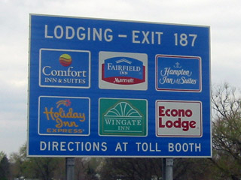
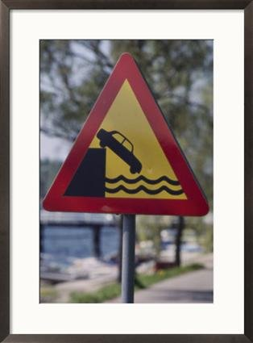
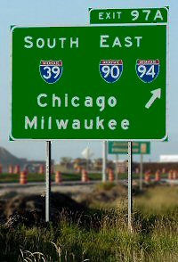
Location-based Services: Then

Slide 3
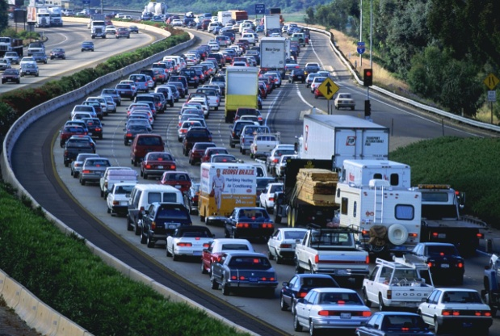
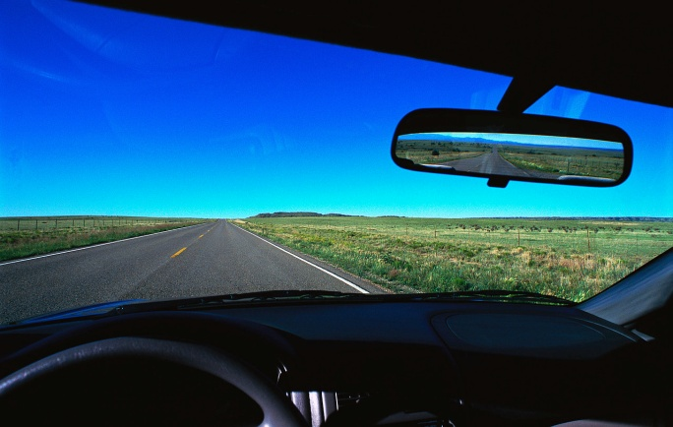
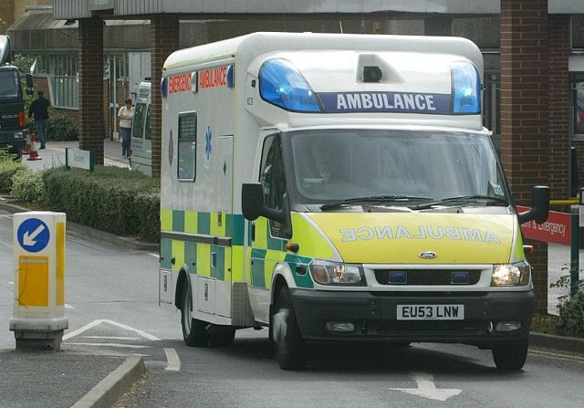
Location-based Services: Now
Location-based traffic reports
  Range query: How many cars in the free way
  Shortest path query: What is the shortest path (travel time) to reach my destination
Location-based store finder
  Range query: What are the restaurants within two miles of my location
  Nearest neighbor query: Where is my nearest fast food restaurant
Location-based emergency control
  Range query: How many police cars in the downtown area
  Nearest neighbor query: Dispatch the nearest ambulance to a patient

Slide 4
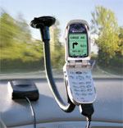
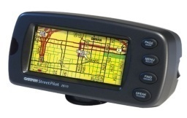
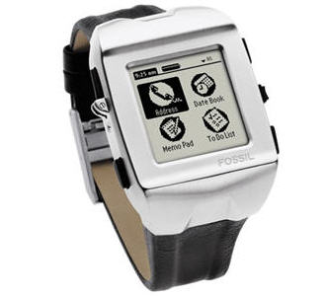
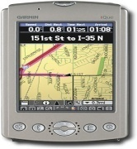

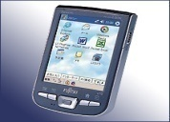

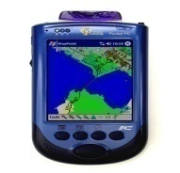
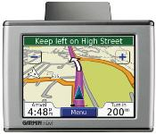
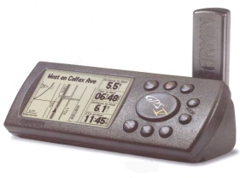
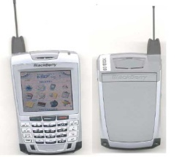
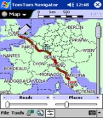
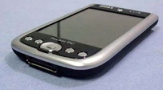

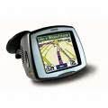
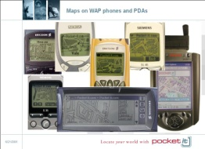
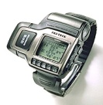

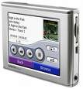
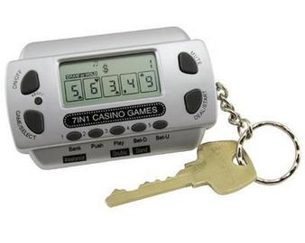

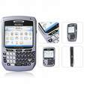

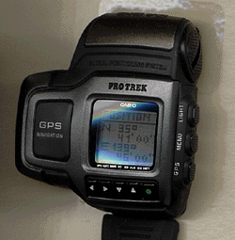
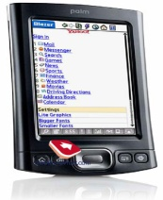

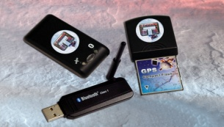
Location-based Services: Why Now ?

Slide 5
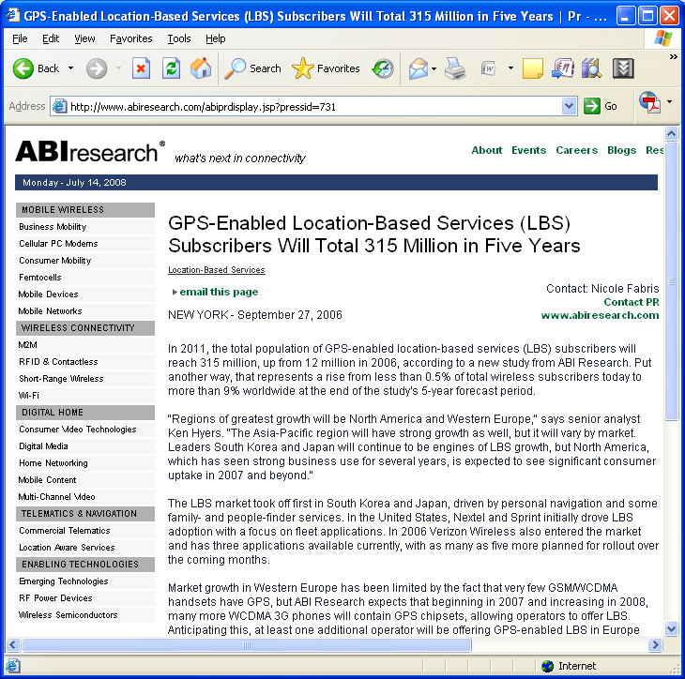
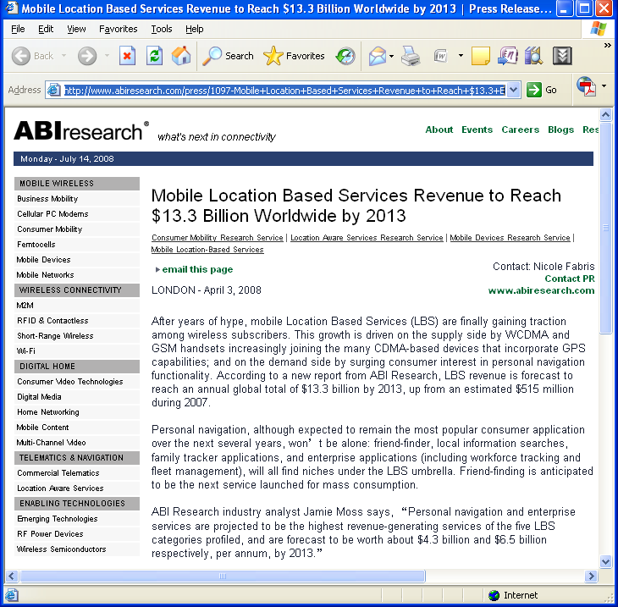
Location-based Services: Future Prospects

Slide 6

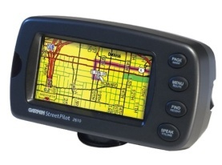

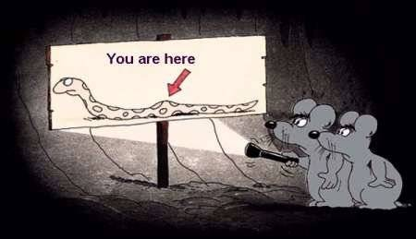
Privacy Threats in Location-based Services
YOU ARE TRACKED!!!
“New technologies can pinpoint your location at any time and place. They promise safety and convenience but threaten privacy and security”
Cover story, IEEE Spectrum, July 2003

Slide 7
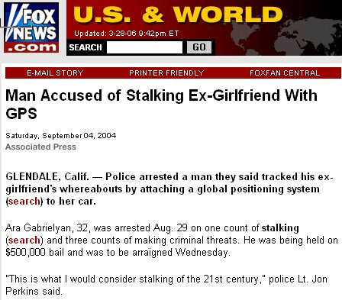
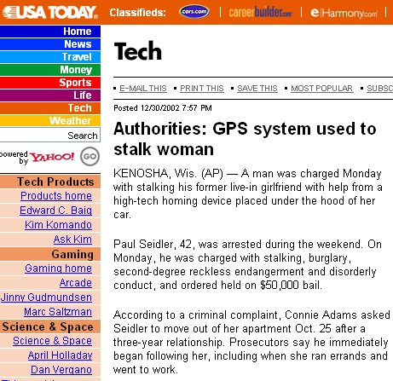
Privacy Threats in Location-based Services
http://www.foxnews.com/story/0,2933,131487,00.html
http://www.usatoday.com/tech/news/2002-12-30-gps-stalker_x.htm

Slide 8
Casper: Project Overview
2006
2007
2008
2009
Aggregate Query Processing (MDM)
TinyCasper Demo
(SIGMOD)
Private Continuous Queries (SSTD)
Location Anonymization
(Under Submission)
Casper
(VLDB)
Casper*
(ACM TODS)
Casper Demo
(ICDE)
Approximate Range NN Queries
(SSTD)
Road Networks
(Under Submission)
P2P Spatial Cloaking
(ACM GIS)
P2P Spatial Cloaking (GeoInformatica)

Slide 9
Casper: Project Overview
2006
2007
2008
2009
Aggregate Query Processing (MDM)
TinyCasper Demo
(SIGMOD)
Private Continuous Queries (SSTD)
Location Anonymization
(Under Submission)
Casper
(VLDB)
Casper*
(ACM TODS)
Casper Demo
(ICDE)
Approximate Range NN Queries
(SSTD)
Road Networks
(Under Submission)
P2P Spatial Cloaking
(ACM GIS)
P2P Spatial Cloaking (GeoInformatica)

Slide 10

Casper Architecture
Privacy-aware Query
Processor
3: Candidate Answer
Location-based Database Server
2: Query +
Cloaked Spatial Area
Third trusted party that is responsible on blurring the exact location information
Location Anonymizer
4: Answer
1: Query +
Location Information

Slide 11
Location Anonymizer: Basic Pyramid Structure
The entire system area is represented as a complete pyramid structure divided into grids at different levels of various resolution
Each grid cell maintains the number of users in that cell
To anonymize a user request, we traverse the pyramid structure from the bottom level to the top level until a cell satisfying the user privacy profile is found.
Scalable. Simple to implement. Overhead in maintaining all grid cells

Slide 12
Location Anonymizer: Adaptive Pyramid Structure
Instead of maintaining all pyramid cells, we maintain only those cells that are potential cloaked areas
Similar to the case of the basic pyramid structure, traverse the pyramid structure from the bottom level to the top level, until a cell satisfying the user privacy profile is found.
Most likely we will find the cloaked area in only one hit
Scalable. Less overhead in maintaining grid cells. Need maintenance algorithms

Slide 13
Privacy-Aware Query Classification
Two types of data:
  Public data. Gas stations, restaurants, police cars
  Private data. Personal data records
Three types of queries:
  Private queries over public data
    What is my nearest gas station
  Public queries over private data
    How many cars in the downtown area
  Private queries over private data
    Where is my nearest friend

Slide 14
Private Nearest-Neighbor Queries over Public Data
Step 1: Locate the NN target object for each vertex as a filter
Step 2: Find the middle points.
Step 3: Extend the query range
Step 4: Candidate answer
Similar algorithm for Private NN Queries over Private Data
v
m₃₄
v
3
4
T
m₂₄
m₁₃
3
T
4
T
T
1
2
v
m₁₂
v
1
2

Slide 15
Casper: Project Overview
2006
2007
2008
2009
Aggregate Query Processing (MDM)
TinyCasper Demo
(SIGMOD)
Private Continuous Queries (SSTD)
Location Anonymization
(Under Submission)
Casper
(VLDB)
Casper*
(ACM TODS)
Casper Demo
(ICDE)
Approximate Range NN Queries
(SSTD)
Road Networks
(Under Submission)
P2P Spatial Cloaking
(ACM GIS)
P2P Spatial Cloaking (GeoInformatica)

Slide 16



Continuous Private Queries
k-Sharing and
Memorization Properties
time
Continuous Query
+
Location
Continuous Query +
Cloaked Location
y
Answer
Candidate Answer Set
Location Anonymizer
Database Server
x

Slide 17
Privacy Attacks to Continuous Movements
I know you are here!
R_{i+1}
F
G
H
D
E
A
C
I
B
R_{i}
J
K
Maximum Movement Boundary Attack
Query Tracking Attack

Slide 18
Solution to Maximum Movement Boundary Attack
Two consecutive cloaked regions R_{i} and R_{i+1} from the same users are free from the maximum movement boundary attack if one of these three conditions hold:
  The overlapping area satisfies user requirements
  R_{i} totally covers R_{i+1}
  The MBB of R_{i} totally covers R_{i+1}
R_{i+1}
R_{i+1}
R_{i+1}
R_{i}
R_{i}
R_{i}
  The MMB of R_{i} totally covers R_{i+1}

Slide 19
Solution to Maximum Movement Boundary Attack
Patching: Combine the current cloaked spatial region with the previous one
Delaying: Postpone the update until the MMB covers the current cloaked spatial region
R_{i+1}
R_{i+1}
R_{i}
R_{i}

Slide 20
Solution to Query Tracking Attack:
Remember a set of users S that is contained in the cloaked spatial region when the query is initially registered with the database server
Adjust the subsequent cloaked spatial regions to contain at least k of these users.
F
G
H
D
E
A
C
I
B
J
K

Slide 21
Casper: Project Overview
2006
2007
2008
2009
Aggregate Query Processing (MDM)
TinyCasper Demo
(SIGMOD)
Private Continuous Queries (SSTD)
Location Anonymization
(Under Submission)
Casper
(VLDB)
Casper*
(ACM TODS)
Casper Demo
(ICDE)
Approximate Range NN Queries
(SSTD)
Road Networks
(Under Submission)
P2P Spatial Cloaking
(ACM GIS)
P2P Spatial Cloaking (GeoInformatica)

Slide 22
Casper*
v
v
3
4
m₃₄
T
4
m₁₃
T
m₂₄
3
T
T
1
2
v
m₁₂
v
1
2
Private NN over Public Data
with Constrained Refinement
Shared Execution for Continuous Privacy-aware Queries

Slide 23
Casper: Project Overview
2006
2007
2008
2009
Aggregate Query Processing (MDM)
TinyCasper Demo
(SIGMOD)
Private Continuous Queries (SSTD)
Location Anonymization
(Under Submission)
Casper
(VLDB)
Casper*
(ACM TODS)
Casper Demo
(ICDE)
Approximate Range NN Queries
(SSTD)
Road Networks
(Under Submission)
P2P Spatial Cloaking
(ACM GIS)
P2P Spatial Cloaking (GeoInformatica)

Slide 24
Approximate Range NN Queries
Range NN Queries
Exact Answers
Database Server
Object | Region within Query
…. | ….
…. | ….
…. | ….
Database Server
K-order Voronoi Diagram
Range NN Queries + Tolerance Level K
Approximate Answers

Slide 25
Casper: Project Overview
2006
2007
2008
2009
Aggregate Query Processing (MDM)
TinyCasper Demo
(SIGMOD)
Private Continuous Queries (SSTD)
Location Anonymization
(Under Submission)
Casper
(VLDB)
Casper*
(ACM TODS)
Casper Demo
(ICDE)
Approximate Range NN Queries
(SSTD)
Road Networks
(Under Submission)
P2P Spatial Cloaking
(ACM GIS)
P2P Spatial Cloaking (GeoInformatica)

Slide 26

Quality-aware Location Anonymization for Road Networks
Minimize Query Execution Cost
Minimize Candidate List Size
Satisfy the User Specified Privacy Requirements
Range/K-NN Query with Location
Range/K-NN Query with Cloaked Segment Set
Q
Exact Answers
Candidate Answers
Location Anonymizer
Database Server

Slide 27
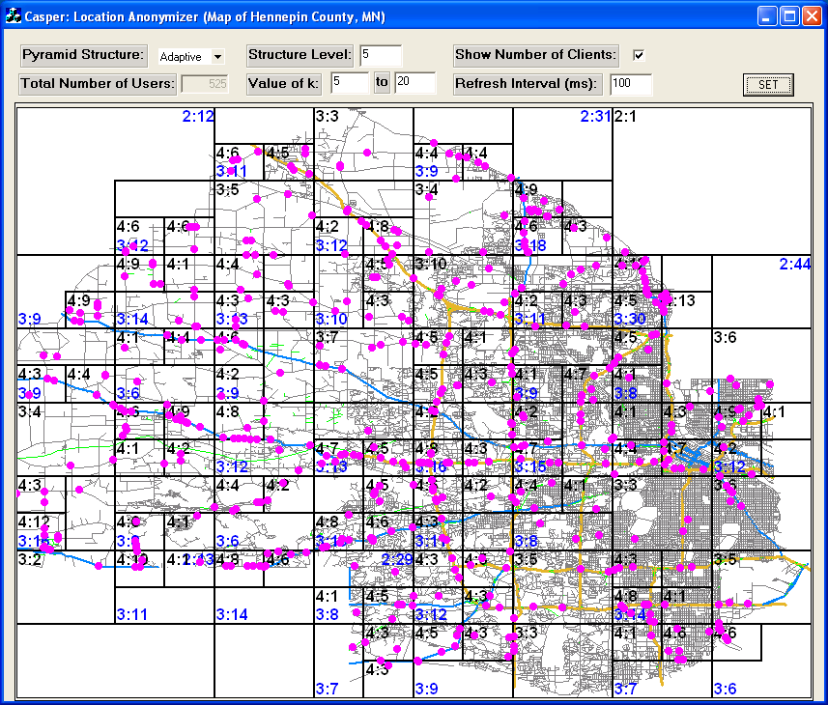
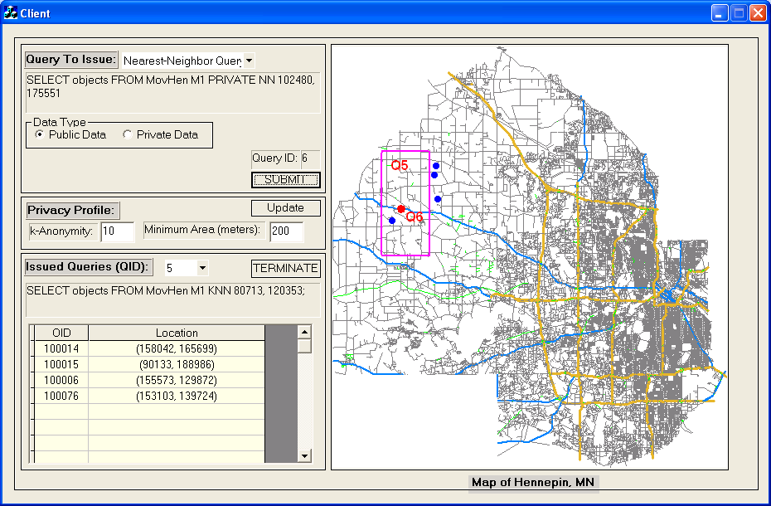
Casper Prototype (ICDE 2007 DEMO)
10-minute video clip for demonstrating Casper prototype is available online:
http://www.cs.umn.edu/~mokbel/demos.htm
http://www.youtube.com/watch?v=LoI-gitLdws
Location Anonymizer

Slide 28
Casper: Project Overview
2006
2007
2008
2009
Aggregate Query Processing (MDM)
TinyCasper Demo
(SIGMOD)
Private Continuous Queries (SSTD)
Location Anonymization
(Under Submission)
Casper
(VLDB)
Casper*
(ACM TODS)
Casper Demo
(ICDE)
Approximate Range NN Queries
(SSTD)
Road Networks
(Under Submission)
P2P Spatial Cloaking
(ACM GIS)
P2P Spatial Cloaking (GeoInformatica)

Slide 29
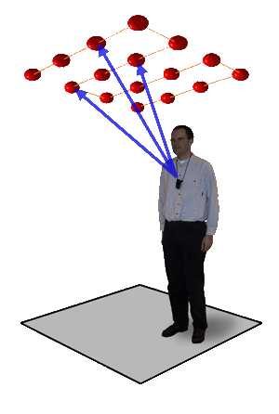
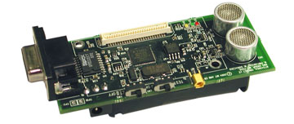
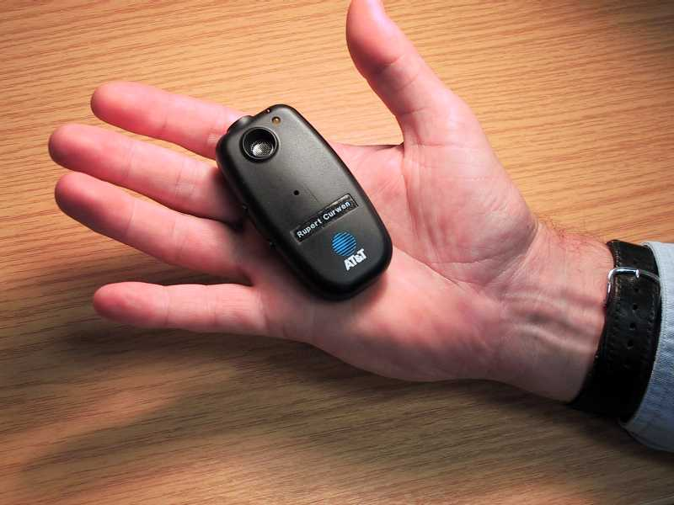
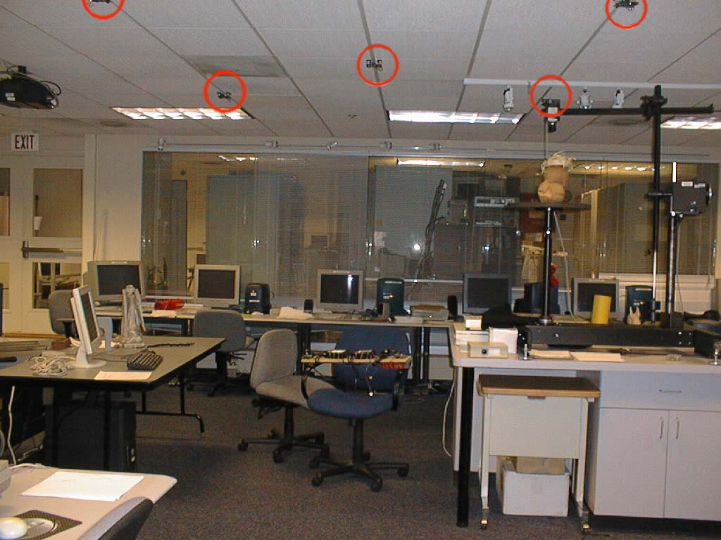
Location Systems in Wireless Sensor Network
Centralized Approach
  E.g., BAT and Active Badge
Distributed Approach
  E.g., Cricket
MICA2 Cricket Mote
The accuracy of these systems is within a few centimeters
BAT – ultrasonic transmitter
Bat - Deployment
Deployment
http://www.cl.cam.ac.uk/research/dtg/attarchive/bat/
http://cricket.csail.mit.edu/

Slide 30
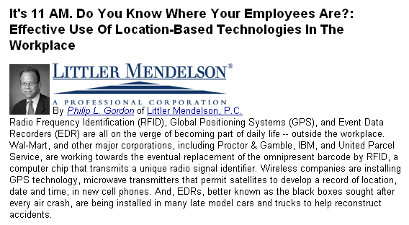
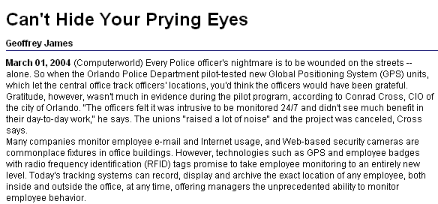
Privacy Threats in Location Systems
Employers who consider implementing location-based technology must balance the technology’s potential benefits against employees’ visceral sense that their privacy is being invaded
http://library.findlaw.com/2005/Mar/10/163970.html
New technologies can monitor employee whereabouts 24/7, but CIOs must measure expected benefits against potential privacy problems
http://www.computerworld.com/securitytopics/security/privacy/story/0,10801,90518,00.html

Slide 31
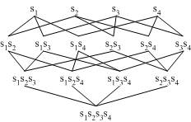
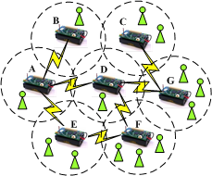
TinyCasper
Users
Quality-Aware Aggregate Locations
(Area, N)
Quality-Aware Module
Approximate Answers
Range Queries
Resource-Aware Aggregate Locations (Area, N)
Anonymity Level
Spatio-temporal Histogram
Sensornet

Slide 32
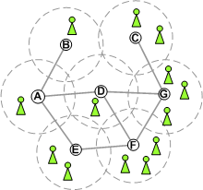
In-Network Anonymization Algorithm
Min-Resource Anonymization Algorithm
  Aim to minimize communication and query processing cost
STEP 1: Broadcasting
  Each sensor broadcasts its info
  Store the received info in a tuple list
  Forward the received info until all its neighbors have found k objects
STEP 2: Spatial Cloaking
  Select the peers with the highest score, i.e., distance/count, until at least k objects are found
Min-Area Anonymization Algorithm
  Aim to minimize the cloaked area to improve accuracy
The cloaked area of sensor node A
TupleList
B(1)
D(1)
E(2)

Slide 33
Aggregate Query Processing:
A Histogram Approach
R2=(R2.Area, R2.N=18)
Build a spatio-temporal histogram to estimate the distribution of moving objects based on the aggregate locations reported from sensor nodes
Use the spatial and temporal features in aggregate locations to update the histogram
The maintained histogram is used to answer aggregate monitoring queries
2.3 | 8.06 | 8.06 | 2.3 | 2.3
2.3 | 8.06 | 16.05 | 4.59 | 2.3
2.3 | 2.3 | 4.59 | 4.59 | 2.3
2.3 | 2.3 | 4.59 | 4.59 | 2.3
2.3 | 2.3 | 2.3 | 2.3 | 2.3
R1=(R1.Area, R1.N=3)
2.25 | 7.88 | 7.88 | 2.33 | 2.3
2.33 | 8.16 | 16.25 | 4.65 | 2.3
2.3 | 2.3 | 4.59 | 4.59 | 2.3
2.3 | 2.3 | 5.13 | 5.13 | 2.57
2.3 | 2.3 | 2.57 | 1.5 | 1.5

Slide 34
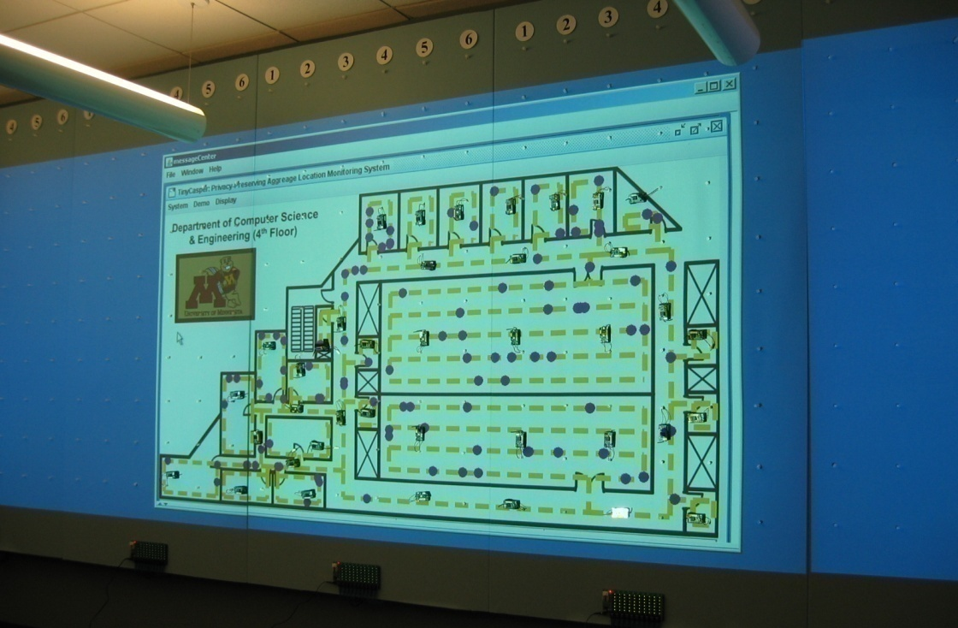
TinyCasper Prototype (SIGMOD 2008 DEMO)
Aggregate locations from sensornet
6-minute video clip for demonstrating TinyCasper prototype is available online:
http://www.cs.umn.edu/~cchow/publications.htm
http://www.youtube.com/watch?v=S-VUnTXCn-o
On the TinyOS/Mote platform in nesC with 39 MICAz
Floor plan projected on three 4-foot by 8-foot boards using 2 projectors
Spatio-temporal Histogram and Queries

Slide 35
Thank You …

